Slide 1
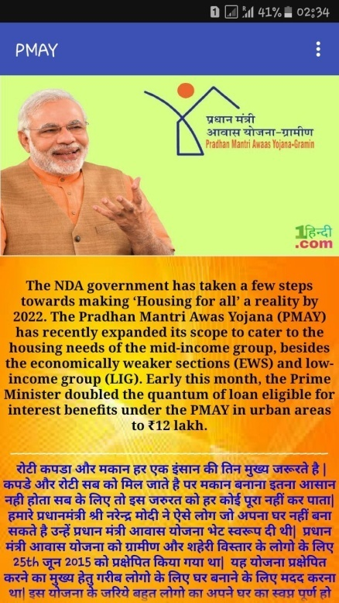
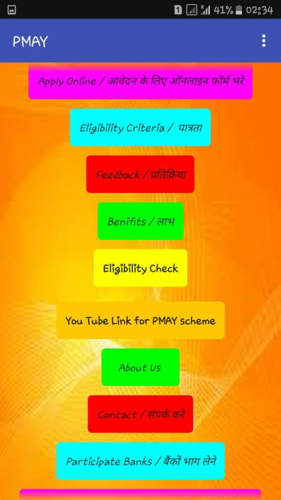
About Our App .
Our App is named PMAY.
It is an Android Application.
This is an App aimed to aware needy citizens about the PMAY scheme .
← Homescreen →

Slide 2
Basic Idea
Idea behind the App is simple and clear that is an individual who is alien to the scheme can easily understand the benefits of the scheme.
We have tried to reduce the time consumed in conventional process of Application of the scheme through our App .
We have designed it such that it is easily accessible to the citizens .

Slide 3
Features of the App
Our App has tab named Apply Online which directly connects to the official online Application Form. It reduces the time of the user.
It also have tab called Track Application which helps the user to check their Application status.

Slide 4
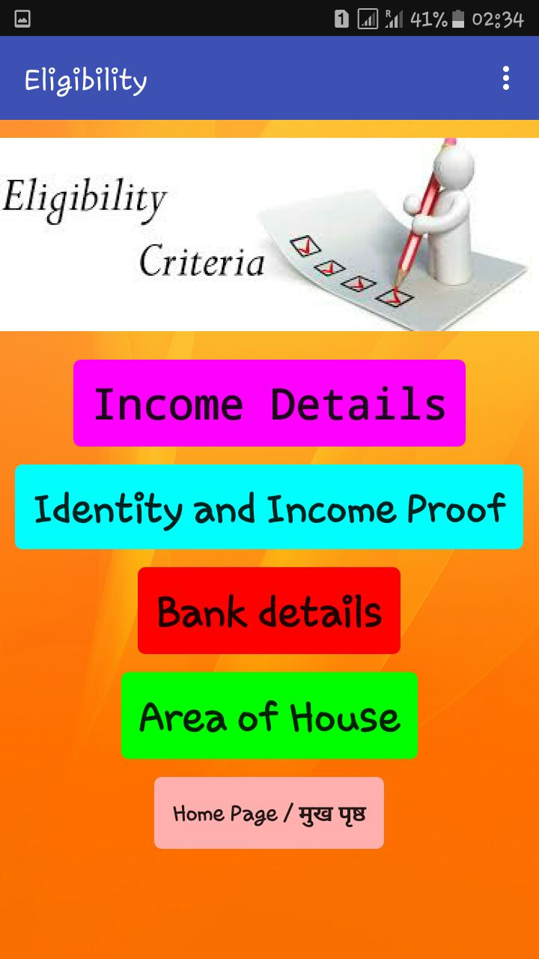
Features of the App
Icon Eligibility Criteria is to check whether the user is applicable for the scheme .

Slide 5
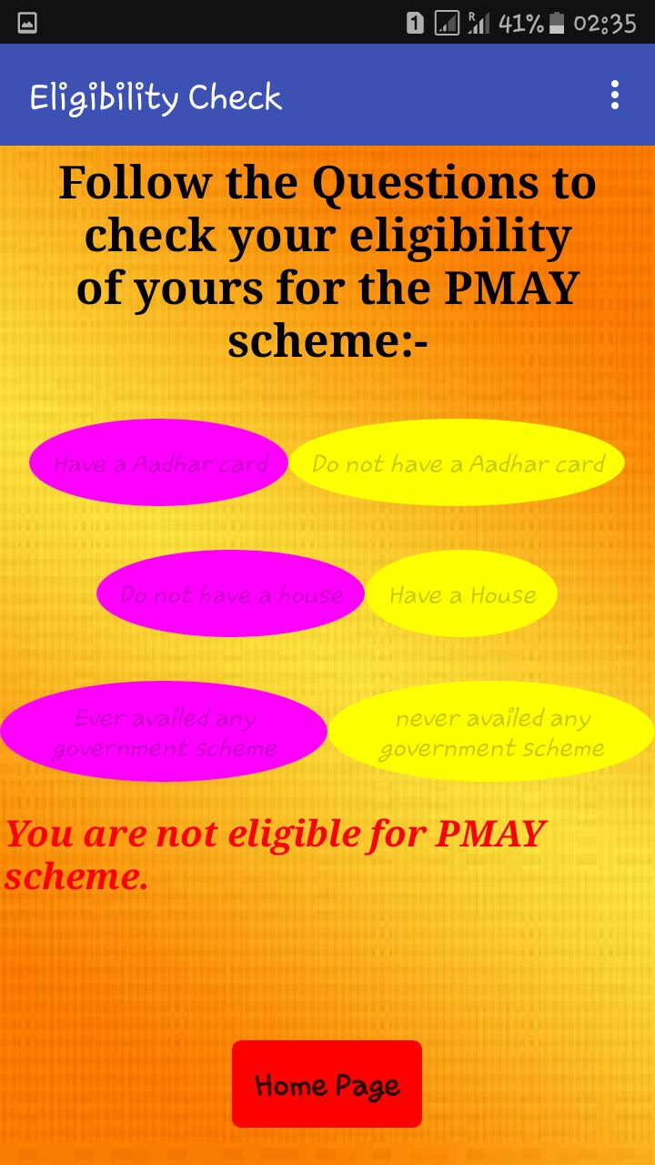
Features of the App
Eligibility Check asks some simple questions to the user regarding personal details and tells whether he is applicable for the scheme or not which makes the App user friendly.

Slide 6
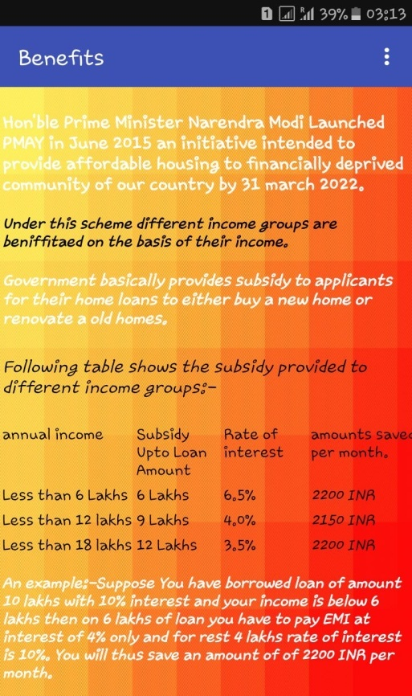
Features of the App
In Benefits tab we have put the data that is by how much amount user is going to be benefitted under the scheme.

Slide 7
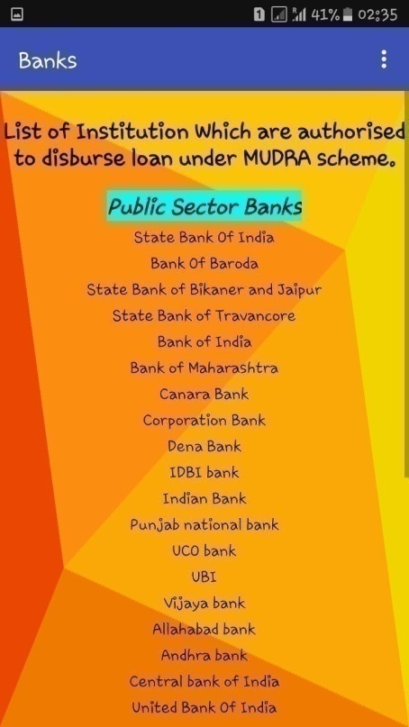
Features of the App
In Banks tab we have put the list of Banks which are legally authorized by Government to sanction the loan to the beneficiary under this scheme .

Slide 8
Features of the App
On long press of tab the App chants the name of the tab which is an additional features we have added to our App.

Slide 9
Resources
The data used in the App has been extracted from the official site of PMAY
so that the App don’t mislead the user.
http://www.pmaymis.gov.in.

Slide 10
Experience regarding Hackathon
It was our first Hackathon and we enjoyed it thoroughly .
We had a complete night out but we hope it will worth us.
We went through Youtube tutorial videos of App making and learnt how to make a simple App.

Slide 11

We are thankful to Capgemini team for providing us an opportunity to Apply our Academic Knowledge to solve a real life Problem.
Thank You .

