Slide 1
CGB1201 – JAVA PROGRAMMING
Department of Artificial Intelligence & Data science
Academic Year: 2024 – 2025 (Odd Semester)
Register Number : 2303811724321095
Name : SAKTHI VISHAL C
Year : II
Semester : III
Section : B
Date : 3/12/24

Slide 2
Title of the Project
FITNESS TRACKER APPLICATION

Slide 3
Abstract
This program designed to help users monitor their physical activity through simple data entry and retrieval processes. The application allows users to input their name, track the number of steps taken, and log calories burned during various activities.

Slide 4
Introduction
The Fitness Tracker application is designed to empower users by providing them with a simple yet effective platform to log their physical activities. This application caters to users of all fitness levels, allowing them to easily input data related to their daily steps and calories burned, thereby promoting awareness and accountability in their fitness routines.

Slide 5
Java Programming - Concepts Used
Classes and Objects
Constructors
Encapsulation
Input Handling
Conditional Statements

Slide 6
Proposed Architecture
Fitness Tracker Application
User Input
Add activities
Total steps taken
Total calories burned

Slide 7
List of Modules
Module 1 - User Input
Module 2 - Activities
Module 3 - Total Steps Taken
Module 4 – Total Calories Burned

Slide 8
Module Description
User Input - This module would contain user name.
Activities - This module check gives activity status (yes/no).

Slide 9

Module Description (Cont..)
Total Steps Taken - This module used to count the number of Steps taken.
Total Calories Burned – This module gives output for total calories burned.

Slide 10
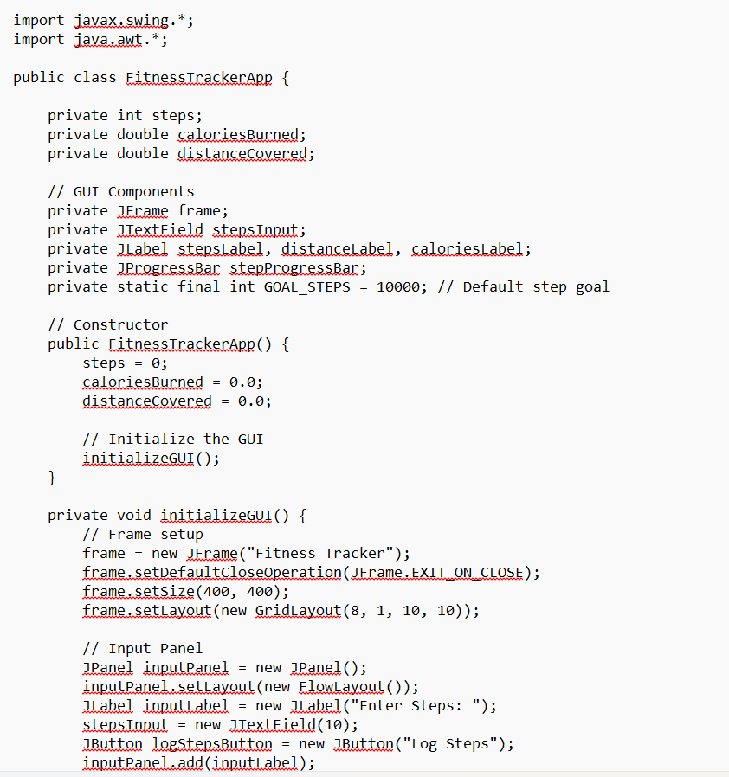
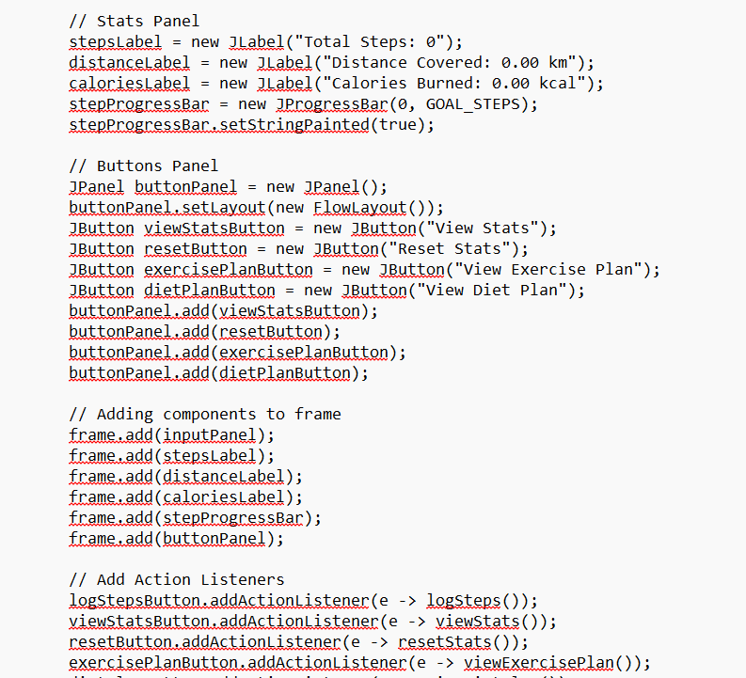
SOURCE CODE

Slide 11
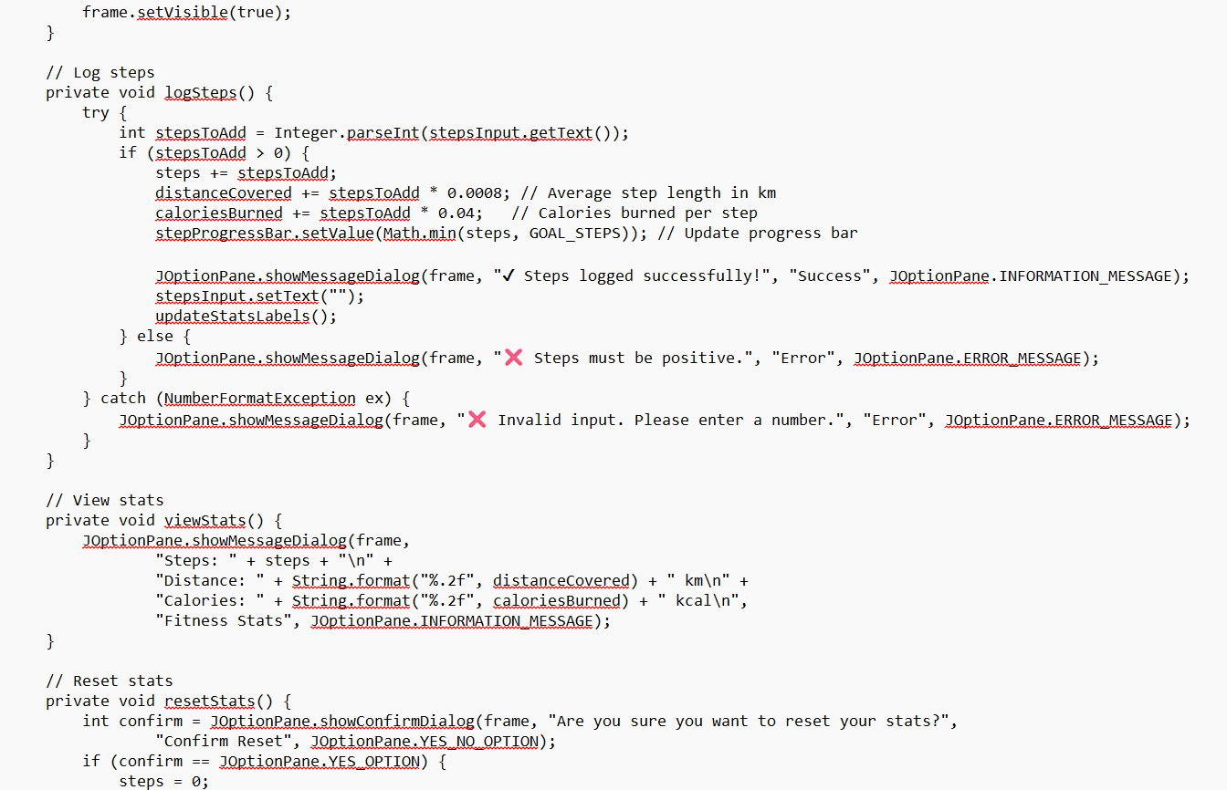
SOURCE CODE

Slide 12
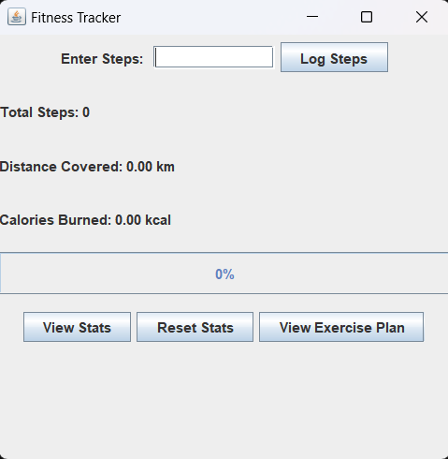
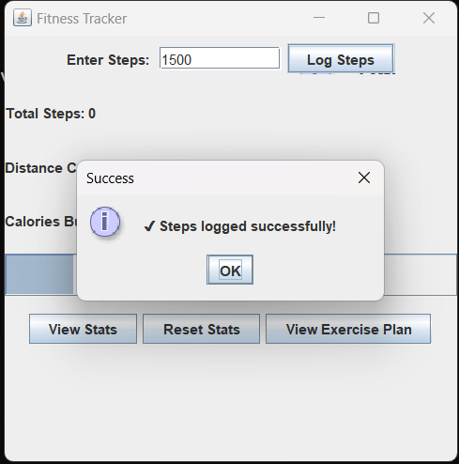
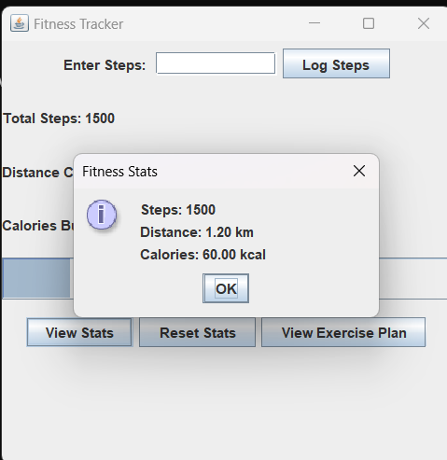
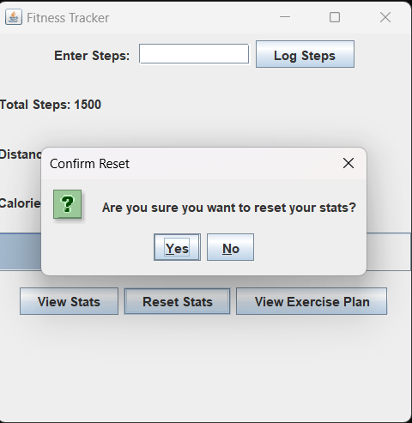
Results and Discussion

Slide 13
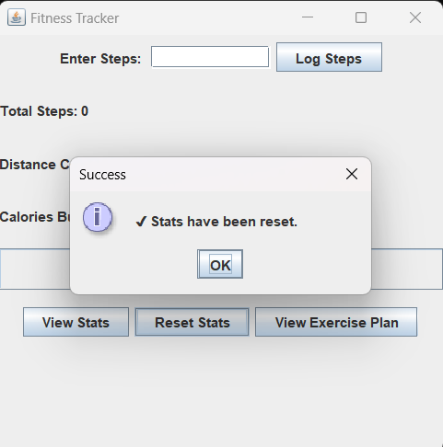
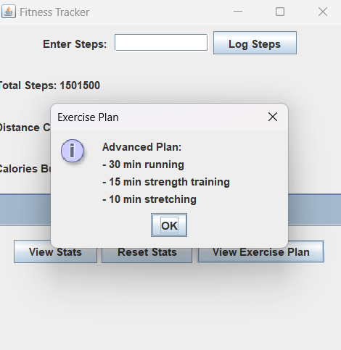
Results and Discussion (Cont..)

Slide 14
Conclusion
This project aimed to develop a comprehensive fitness tracker application designed to help users monitor and improve their overall health and fitness. The application incorporated features such as activity tracking, calorie counting, sleep monitoring, and personalized fitness plans.

Slide 15
Thank You
ANY QUERIES???

