Slide 1
HR Employee Attrition Analysis
Tableau Public Dashboard Project
Name:- Vishal M Patel
Course :- Data Analytics
Institute Name :- AENEXZ (DATA SCIENCE & DATA ANALYTICS)

Slide 2
Project Overview :-
Objective
Analyze employee attrition data to identify the key factors influencing employee turnover.
Perform data cleaning and exploratory data analysis (EDA) using Tableau.
Develop an interactive dashboard to visualize HR metrics and attrition trends.
Generate actionable insights and recommendations to support better employee retention strategies.
Business Problem
Employee attrition is a major challenge for organizations as it leads to:
Increased recruitment and training costs.
Loss of experienced and skilled employees.
Reduced productivity and team performance.
Lower employee morale and operational efficiency.

Slide 3
Problem Statement :-
Employee attrition is one of the most significant challenges faced by organizations. High employee turnover increases recruitment and training costs, reduces productivity, disrupts team performance, and results in the loss of experienced talent. Understanding the factors that influence employees to leave is essential for improving workforce stability and organizational performance.

Slide 4
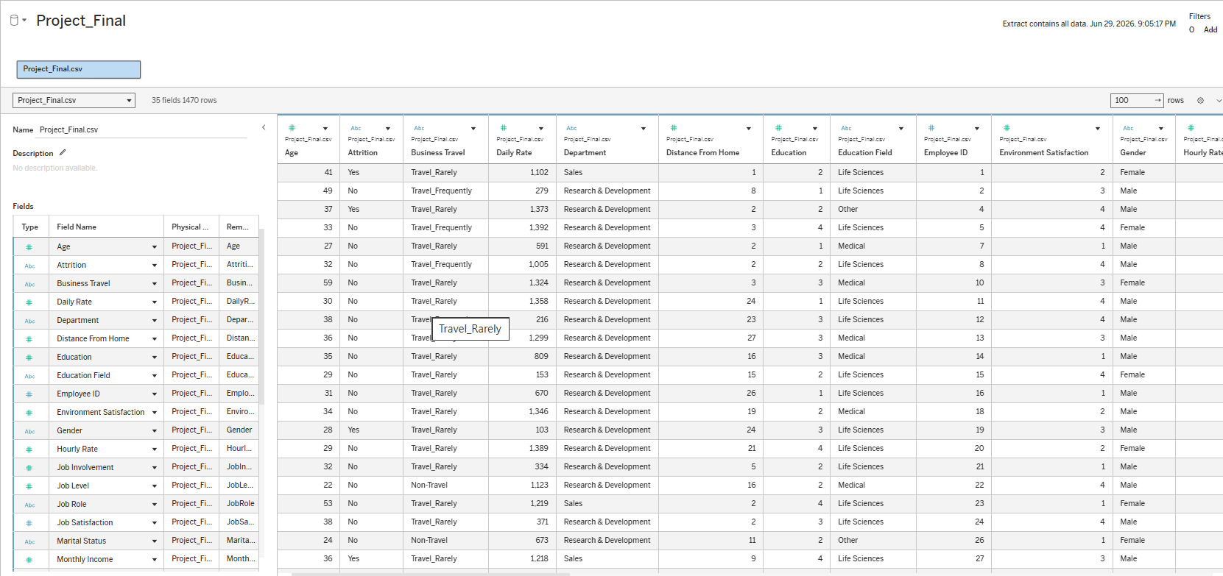
Dataset Overview
Dataset Information
• Records: 1470 • Columns: 35 • Target: Attrition

Slide 5
Data Preparation :-
Data Import
Imported the Employee Attrition CSV dataset into Tableau.
Verified the dataset structure and field names.
Data Cleaning
Checked for missing or null values.
Verified and corrected data types (Dimensions and Measures).
Removed duplicate records (if any).
Renamed fields for better readability and consistency.
Data Organization
Created a Data Dictionary to document all dataset fields.
Prepared Metadata describing each variable.
Classified fields into Dimensions and Measures.
Organized the Tableau workbook for efficient analysis.
Data Validation
Verified the total number of employees (1470).
Confirmed that key HR fields were accurate.

Slide 6
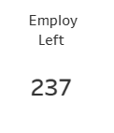
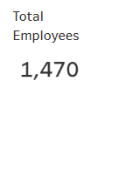
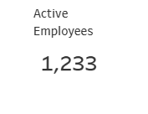
KPI Dashboard

Slide 7
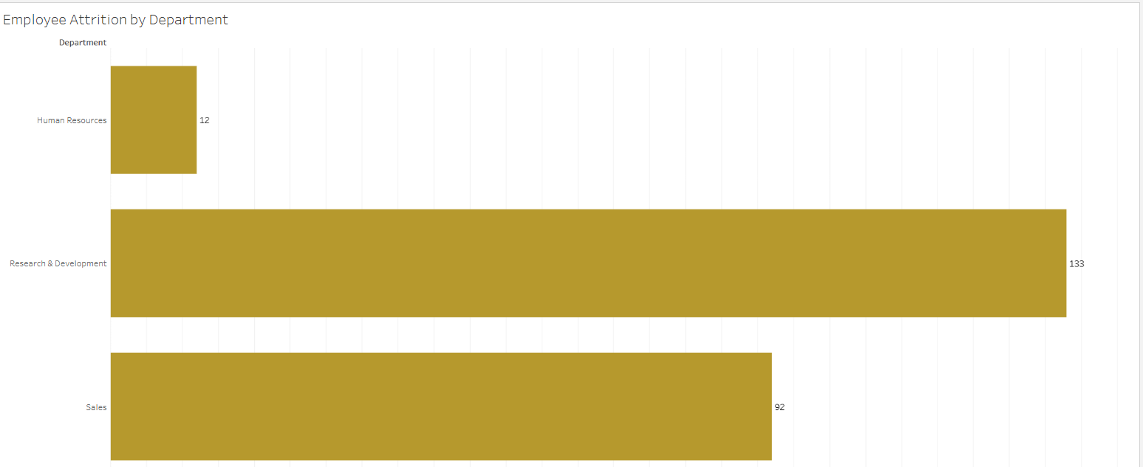
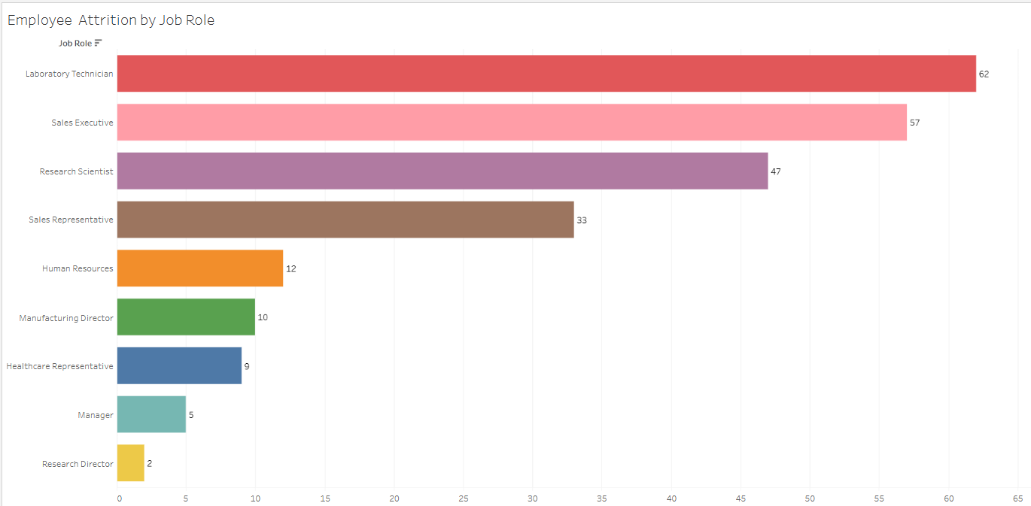
Department & Job Role :-
Department Analysis :-
Key Insights :-
The Research & Development department has the highest number of employees leaving the organization.
Sales also experiences a considerable level of attrition.
The Human Resources department records the lowest employee attrition.
Job Role Analysis:-
Key Insights :-
Certain job roles contribute more significantly to employee attrition than others.
Job roles with higher workloads or limited career growth opportunities tend to have higher attrition.

Slide 8
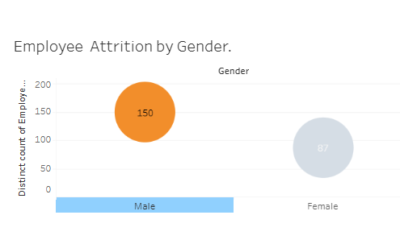
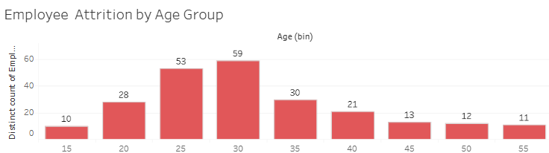
Demographic Analysis :-
Attrition by Gender
Key Insights
The chart compares employee attrition between Male and Female employees.
It helps identify whether one gender experiences higher attrition.
HR can use this information to evaluate workforce diversity and employee retention.
Attrition by Age Group
Key Insights
The chart shows attrition across different age groups.
It helps identify the age category with the highest employee turnover.
Understanding age-related attrition supports better workforce planning and targeted retention initiatives.

Slide 9
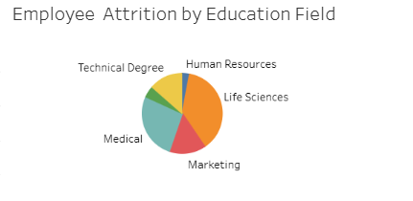
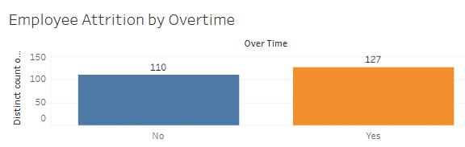
Employee Profile :-
Purpose :-
Analyze how Education Field, Overtime, and Business Travel influence employee attrition.
Education Field :-
Key Insights
Compares attrition across different education fields.
Identifies which educational background has the highest employee turnover.
Overtime :-
Key Insights
Compares attrition between employees who work overtime and those who do not.
Highlights the impact of overtime on employee retention.

Slide 10
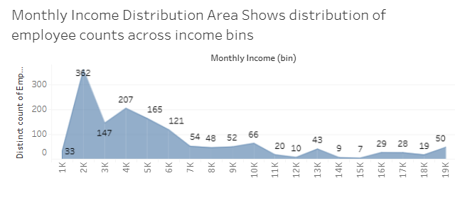
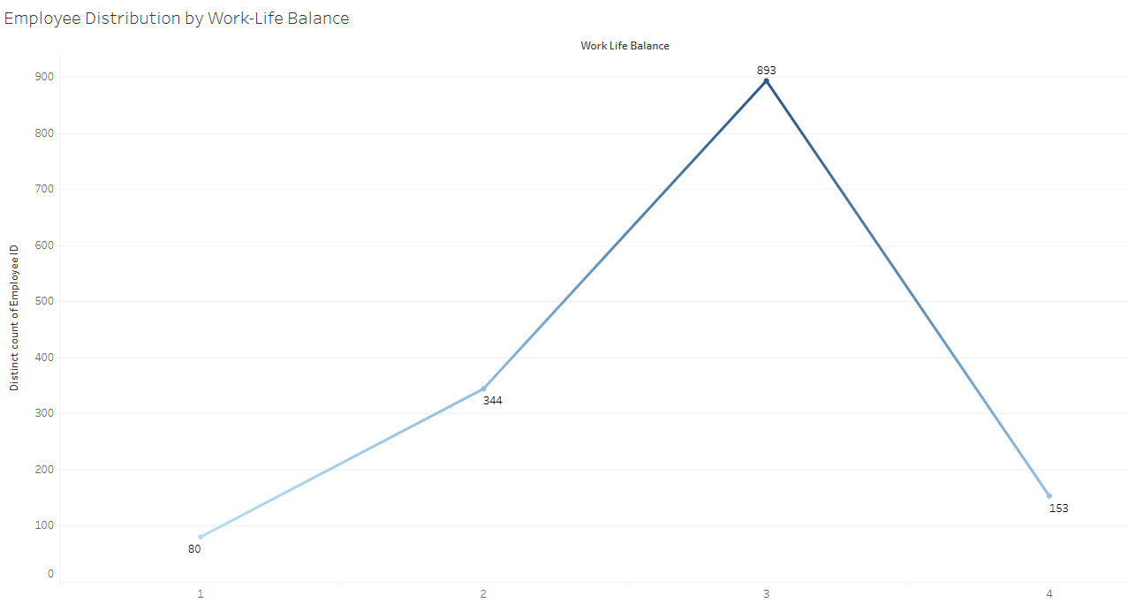
Employee Satisfaction
Monthly Income Distribution
Key Insights
Displays the distribution of employees across different salary ranges.
Helps identify the most common income levels within the organization.
Useful for analyzing whether compensation influences employee retention.
Job Satisfaction
Key Insights
Shows employee distribution across different job satisfaction levels.
Higher satisfaction generally indicates a more engaged workforce.
Helps HR identify areas where employee engagement can be improved.
Work-Life Balance
Key Insights
Displays employees across different work-life balance ratings.
Helps determine whether work-life balance may influence employee attrition.

Slide 11
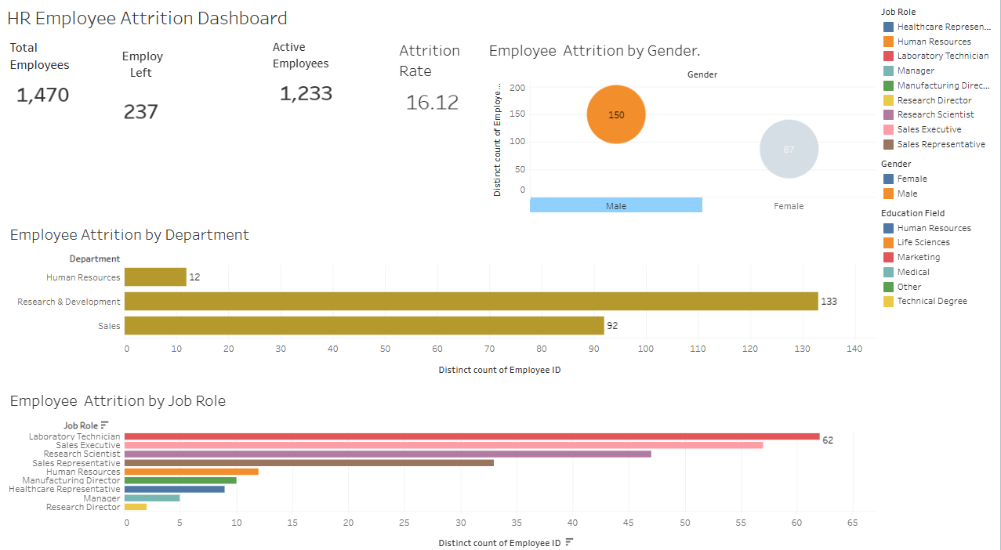
Final Dashboard :-

Slide 12
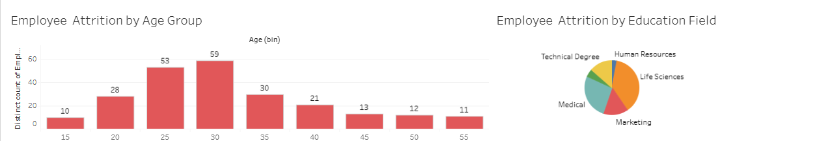
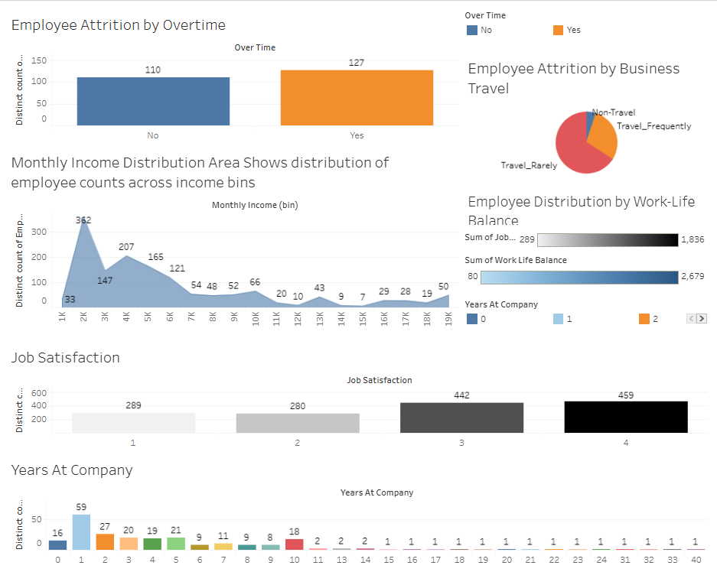
Final Dashboard :-

Slide 13
Recommendations :-
Actionable HR recommendations :-
1. Reduce Employee Overtime
Monitor overtime hours regularly.
Balance workloads across teams.
Encourage flexible work schedules to reduce burnout.
2. Improve Employee Engagement
Conduct regular feedback and engagement surveys.
Recognize and reward employee performance.
Promote open communication between employees and managers.
3. Enhance Career Development
Provide clear career growth opportunities.
Offer training, upskilling, and certification programs.
Implement mentorship and leadership development initiatives.

Slide 14
Recommendations :-
4. Strengthen Work-Life Balance
Introduce flexible working arrangements where possible.
Promote employee wellness and mental health programs.
Encourage employees to maintain a healthy work-life balance.
5. Review Compensation and Benefits
Benchmark salaries against industry standards.
Provide competitive incentives and performance-based rewards.
Regularly review employee benefits to improve satisfaction.
6. Focus on High-Risk Employee Groups
Identify departments, job roles, or employee groups with higher attrition.
Conduct stay interviews to understand employee concerns.
Develop targeted retention strategies for these groups.

Slide 15
Expected Business Benefits :-
Reduced employee attrition
Higher employee satisfaction
Improved productivity
Lower recruitment and training costs
Better workforce planning
Stronger organizational performance

Slide 16
Thank You
Made By :- Vishal M Patel

