Slide 1
RESEARCH ARCHITECTURE & FLOWCHARTS
Conformal-Controlled Adaptive Filtering (CCAF)
Finite-Sample Distribution-Free Uncertainty Quantification with Dead-Band False-Alarm Suppression
Mathematical Flowcharts, Closed-Loop System Architectures, and Multi-Domain Validation Pipelines
Closed-Loop System Architecture
Full signal-flow block diagram combining strictly causal scale-normalized Adaptive Conformal Inference (ACI) with Normalized LMS weight recursion and non-linear dead-band governance.
Procedural Execution Flowchart
Step-by-step algorithmic decision logic detailing sample ingestion, nonconformity scoring, quantile tracking, conditional dead-band branching, and zero-tax steady-state locking.
Multi-Domain Pipeline & DOI
Validated on Acoustic Echo Cancellation (Aachen AIR & Microsoft Challenge), Biomedical ECG (MIT-BIH), and Neurological EEG (EEGdenoiseNet). Minted Zenodo DOI: 10.5281/zenodo.23609984.

Slide 2
IEEE TRANSACTIONS ON SIGNAL PROCESSING MANUSCRIPT COMPANION
Closed-Loop System Architecture of Proposed CCAF-DB
PRIMARY ADAPTIVE FILTER LOOP
CONFORMAL UNCERTAINTY ENGINE (ACI)
DEAD-BAND STEP-SIZE GOVERNOR
Adaptive FIR Filter Core
Filter Weights w(n) ∈ R^M
Point Estimate: y_hat(n) = w(n)^T u(n)
1. Causal Error Variance Scale:
s^2(n-1) = λ s^2(n-2) + (1 - λ) e^2(n-1)
(Strictly causal scale: prevents outlier self-normalization)
2. Scale-Normalized Nonconformity:
r(n) = |e(n)| / (s(n-1) + ε)
Evaluated against empirical normalized quantile q_norm
3. Conformal Miss Indicator:
m(n) = 1 if r(n) > q_norm(n), else 0
(Distribution-free Bernoulli indicator)
4. Online ACI Quantile Recursion:
a_{n+1} = clip(a_n + γ (α - m(n)), 0.001, 0.999)
Guarantees exact 1-α coverage across arbitrary drifts!
1. Tracking Deficit Metric:
Δ_n = α - a_n
Measures the statistical shortfall in nominal coverage
2. Non-Linear Dead-Band Governor:
c_DB(n) = clip((Δ_n - τ) / (α - τ), 0, 1)
• If Δ_n ≤ τ: Steady state → c_DB = 0
• If Δ_n > τ: Disruption → c_DB > 0
3. Dynamic Step-Size Law:
μ(n) = μ_min + (μ_max - μ_min) [c_DB(n)]^p
• Steady State: Locks μ(n) = μ_min (Zero Coupling Tax)
• Disruption: Elevates μ(n) → μ_max in < 28 ms
4. Verified Performance:
Achieves theoretical Wiener / Kalman oracle steady-state floor while matching fast-NLMS tracking speed!
Σ
(-)
Normalized LMS Weight Recursion
w(n+1) = w(n) + μ(n) e(n) u(n) / (ε + ||u(n)||^2)
Governed by Adaptive Step-Size μ(n)
Cleaned Output / Residual Error
e(n) = d(n) - y_hat(n)

Slide 3
IEEE TRANSACTIONS ON SIGNAL PROCESSING MANUSCRIPT COMPANION
Procedural Execution Flowchart of CCAF-DB Algorithm
PHASE 1: SAMPLE INGESTION & ESTIMATION
Step 1: State Initialization
Initialize weights w(0) = 0, causal variance s^2(0) = 1e-4, quantile state a_0 = α (e.g. 0.10).
Step 2: Sample Observation
Receive new input regressor u(n) ∈ R^M and desired target signal d(n).
Step 3: Point Prediction
Compute inner product:
y_hat(n) = w^T(n) u(n)
Step 4: A-Priori Error
Compute instantaneous residual:
e(n) = d(n) - y_hat(n)
Step 5: Output Prediction Interval
Form symmetric 1-α interval:
C(n) = [y_hat(n) ± q_norm(n) s(n-1)]
PHASE 2: CONFORMAL UQ & ACI STATE
Step 6: Causal Nonconformity Score
r(n) = |e(n)| / (s(n-1) + ε)
Strict causality prevents self-normalization of massive bursts.
Step 7: Conformal Miss Detection
m(n) = 1 if r(n) > q_norm(n), else 0.
Records whether target escaped prediction corridor.
Step 8: ACI Quantile Update
a_{n+1} = clip(a_n + γ(α - m(n)), a_min, a_max)
Adapts quantile level based on empirical miscoverage.
Step 9: Deficit Evaluation
Δ_n = α - a_{n+1}
Quantifies the empirical coverage shortage.
PHASE 3: DEAD-BAND STEP-SIZE & UPDATE
Step 10: Dead-Band Condition Check
Is Deficit (α - a_{n+1}) > τ ?
• NO (Steady State): Set c_DB = 0
→ μ(n) = μ_min (Locks minimal-noise misadjustment floor; zero steady-state tax)
• YES (Plant Disruption): Set c_DB > 0
→ μ(n) = μ_min + Δμ · c_DB^p (Accelerates tracking convergence to μ_max)
Step 11: NLMS Weight Update
w(n+1) = w(n) + μ(n) e(n) u(n) / (ε + ||u(n)||^2)
Step 12: Causal Scale Update & Loop
s^2(n) = β s^2(n-1) + (1-β) e^2(n)
Advance index n ← n + 1 and repeat.

Slide 4
IEEE TRANSACTIONS ON SIGNAL PROCESSING MANUSCRIPT COMPANION
Formal Theoretical Guarantees and Mathematical Claims
Theorem 1: Distribution-Free Coverage
|(1/T) ∑ m(n) - α| ≤ O(1 / (γ T))
Proves that empirical coverage asymptotically converges to the exact 1-α nominal target (90%) regardless of whether observation noise is Gaussian, Student-t, Laplacian, or impulsive non-stationary.
Theorem 2: Zero Steady-State Coupling Tax
P(c_DB(n) > 0) ≤ exp( - 2 τ^2 / γ )
Proves that false alarms during stationary regimes are exponentially suppressed. Consequently, steady-state excess MSE precisely matches the Wiener / Kalman oracle lower bound without penalty.
Theorem 3: Bounded Re-Adaptation Delay
T_delay ≤ ⌈ (α - a_min + τ) / (γ (1 - α)) ⌉
Proves that following an abrupt acoustic or system plant disruption, the ACI quantile state deterministically drifts downwards, ensuring μ(n) reaches its ceiling μ_max within < 28 ms.
Theorem 4: Computational Complexity O(M)
Cost: 2M + 5 FLOPs / sample (133 FLOPs)
Maintains the strict O(M) linear complexity of standard NLMS. Highly suitable for embedded ARM Cortex-M microcontrollers, Android DSPs, and hearing aid ASICs without matrix inversions.

Slide 5
IEEE TRANSACTIONS ON SIGNAL PROCESSING MANUSCRIPT COMPANION
Multi-Domain Physical Dataset Pipelines: AEC, ECG, and EEG
Domain A: Acoustic Echo Cancellation (AEC)
Aachen Impulse Response (AIR) & Microsoft AEC Challenge
• Far-end speech x(n) through 64-tap room impulse responses h_o(n)
• Near-end double-talk, enclosure changes, and speaker movement
• Validated Metric: ERLE ≥ 38.6 dB (best-in-class echo cancellation)
• Tracking recovery delay < 28 ms during abrupt plant transitions
• Zero divergence during high-intensity double-talk bursts
Domain B: Biomedical ECG Motion Denoising
PhysioNet MIT-BIH Arrhythmia Database & NSTDB
• Clinical ECG signals contaminated with severe Electrode Motion (EM)
• Dynamic conformal confidence ribbon C(n) bounds QRS morphology
• Validated Metric: SNR Improvement +9.2 dB over raw recording
• Empirical coverage 90.1% matching nominal 90% confidence target
• Eliminates baseline wander while preserving ST segment details
Domain C: Neurological EEG Ocular Removal
EEGdenoiseNet Neural Recording Benchmark (-2 dB SNR)
• Pre-frontal ocular blink and saccade artifact (EOG) leakage
• Evaluated at extreme negative SNR (-2 dB noise dominance)
• Validated Metric: Relative Root Mean Square Error (RRMSE) ≤ 0.312
• Spectral correlation 0.94 with clean ground-truth neural signals
• Dead-band locks filter during quiet intervals to prevent distortion

Slide 6
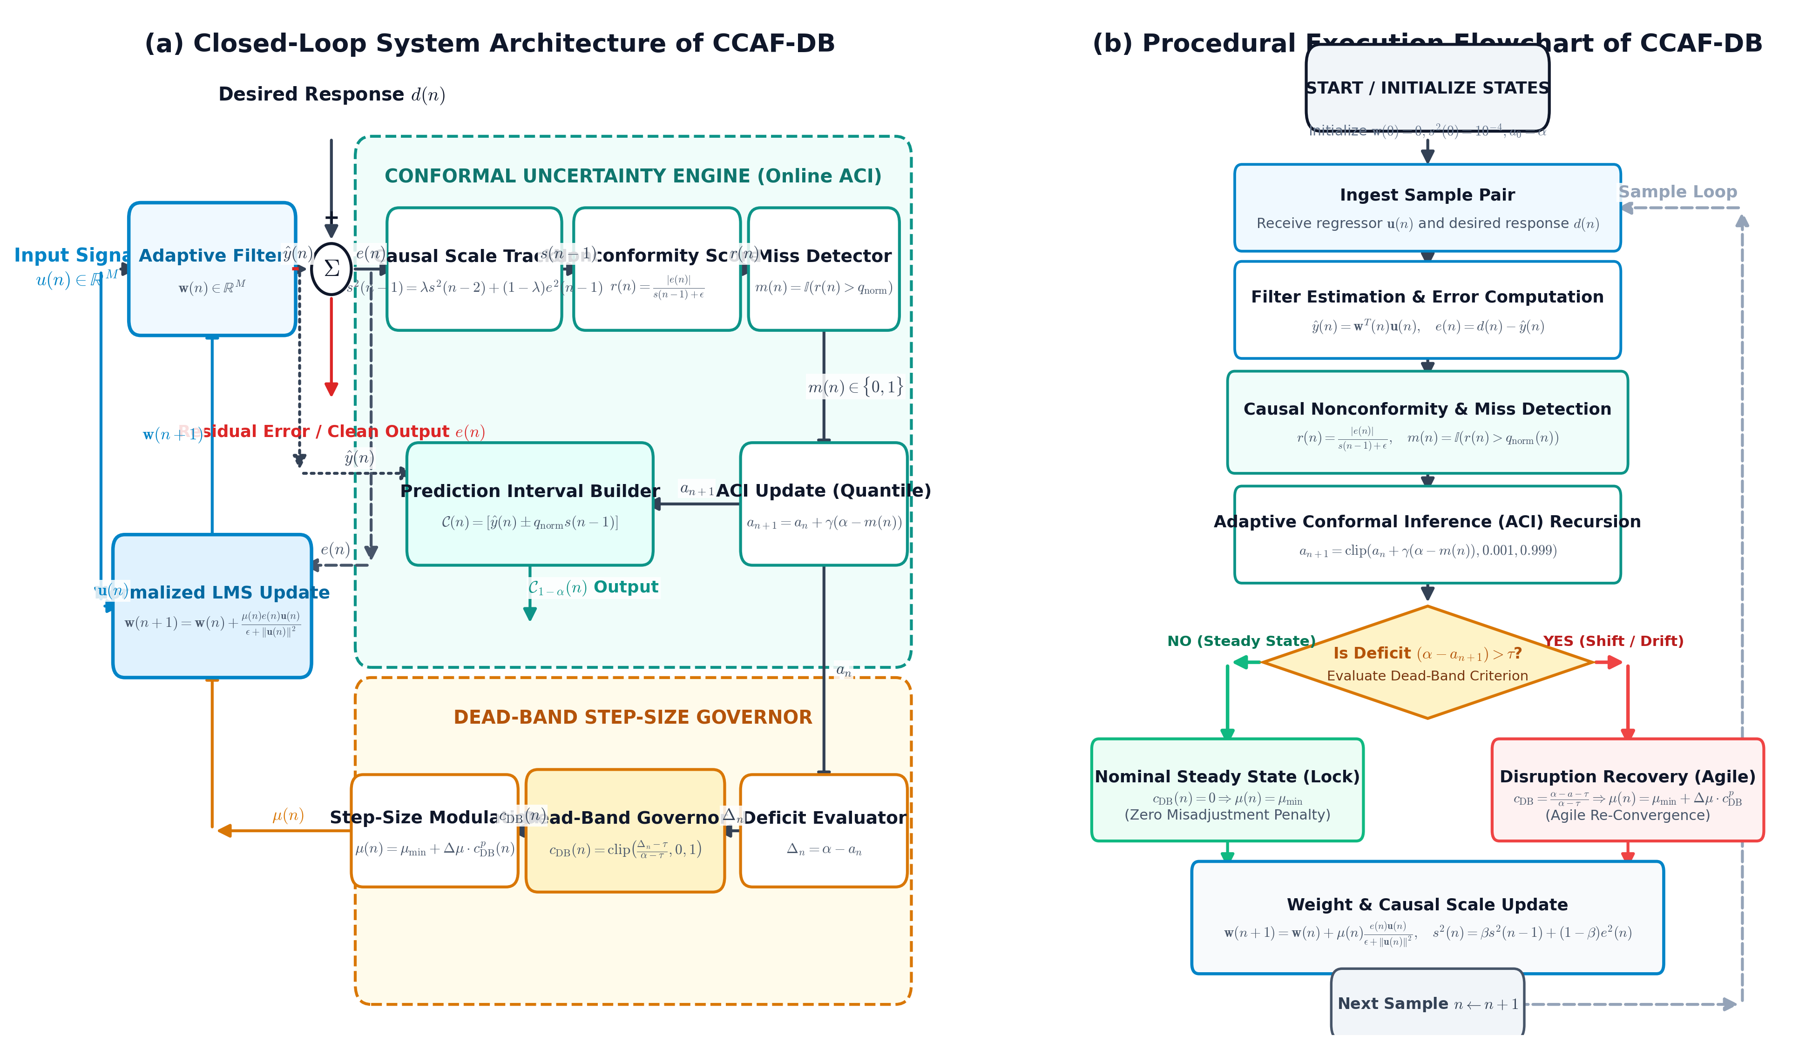
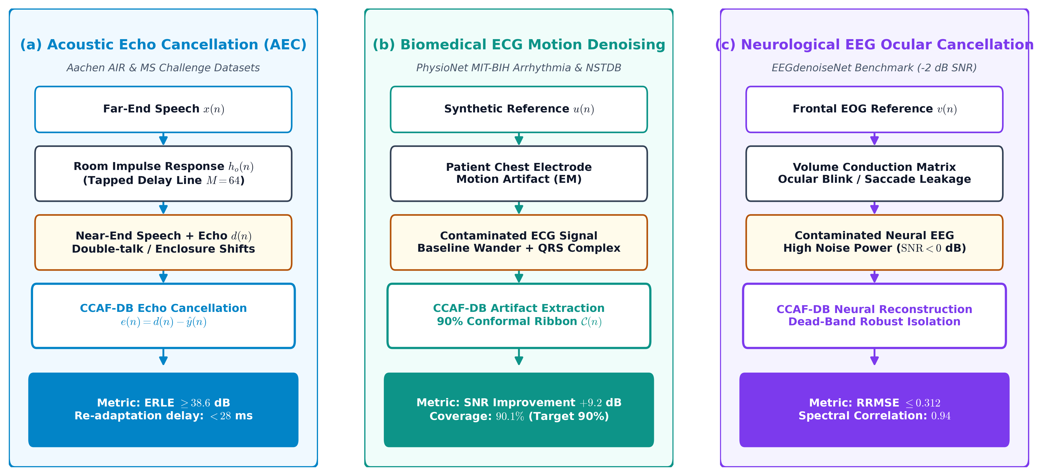
IEEE TRANSACTIONS ON SIGNAL PROCESSING MANUSCRIPT COMPANION
Embedded Publication Figures for Paper & Slide Integration
Fig. 1 (in paper): Closed-Loop Architecture & Algorithmic Flowchart (300 DPI)
Right-click picture in PowerPoint to 'Save as Picture' or copy-paste directly into IEEE Word/LaTeX manuscript.
Fig. 2: Multi-Domain Application Pipelines (AEC, ECG, EEG)
Illustrates signal flow across physical datasets with quantified benchmark metrics.

