Slide 1
CAPSTONE PROJECT
AI Statistician
Design-aware method selection for LLM statistical analysis
Does an explicit decision protocol make an LLM agent choose valid statistical methods more reliably than tool access alone?
A
B
C
Vishal Dhinesh Kumar
SP Jain School of Global Management
1
Notes:
Introduce yourself and the one-line question. Keep this short — the problem statement on the next slide does the real work.

Slide 2
WHY THIS PROJECT EXISTS
Problem statement
Large language models produce statistical analyses that are fluent, arithmetically correct, and frequently invalid — because validity depends on facts about how the data was collected, which the data itself does not contain.
Invalid method, correct arithmetic
Fabricated numerical detail
No mechanism to decline
Independence, pairing, temporal order and clustering are properties of the study design. A method that assumes them can be applied to data that violates them, and every number will still add up.
A model can write a plausible statistic that no calculation produced. The prose reads as a result; checking it means redoing the analysis.
Tool use gives the model the ability to compute. Nothing obliges it to establish that computing is appropriate before it answers.
2
Notes:
This is the most important slide. State the problem in one breath: fluent, correct arithmetic, often invalid. Then the three consequences. The key phrase is 'the data itself does not contain' — design facts live outside the spreadsheet.

Slide 3
THE FAILURE, CONCRETELY
A motivating case from the benchmark
Seoul Bike Sharing · UCI 560
Why a data-only system cannot see it
8,760 rows — one per hour for a year
Nothing in the matrix marks the rows as serially dependent. The dependence is a fact about the collection process — known to whoever gathered the data, invisible to anyone reading only the file.
Question: does temperature relate to rental demand?
The table is a textbook fit for correlation or Poisson regression.
Both assume observations are independent.
This project supplies that fact through a design card, and scores the system on whether it acts on it.
They are not.
Adjacent hours share weather, commuter cycles and daylight — each row carries information about its neighbours.
Correct answer: decline to model.
3
Notes:
Walk through it as a story. The table looks perfect. Two standard methods fit. Both are invalid because of how the data was collected. The design card is how the system learns the fact the file cannot tell it.

Slide 4
WHAT IS BEING TESTED
Research question and hypotheses
Does an explicit statistical decision protocol improve an LLM agent's selection of valid methods, compared with direct LLM advice and with tool access that has no protocol governing its use?
H1
Selection
The protocol arm selects an admissible method more often than the tool-enabled baseline.
H2
Abstention
The protocol arm declines more reliably on designs that no supported method fits — the safety-critical case.
H3
Provenance
Schema-level provenance prevents fabricated numbers from reaching a finished report.
4
Notes:
Point out that H1 compares C against B, not against A. B has the same tools and the same output format as C, so B is the honest control — if C wins against B, it is the procedure that won.

Slide 5
WHAT WAS BUILT, AND WHAT WAS RULED OUT
Scope and design decisions
A closed library of 14 methods
Closed, so it is scorable
An open library turns method choice into an essay-grading problem.
Two groups
Student t · Welch t · Mann–Whitney
Three or more groups
One-way ANOVA · Welch ANOVA · Kruskal–Wallis
No general code execution
Categorical
Chi-square · Fisher exact
It would let the model bypass the policy and make traces incomparable.
Association
Pearson · Spearman
Regression
OLS · Logistic · Poisson · Negative binomial
Out of scope, measured anyway
+ abstain — a decision, not a method
Paired, repeated-measures, mixed, time-series and survival designs enter the benchmark as abstention cases.
5
Notes:
The no-code-execution decision is the one a professor may probe. The answer: a general tool would let the model skip the method policy, and then the three arms would not be doing comparable work.

Slide 6
ARCHITECTURE
Three systems over one shared core
A
Direct
B
Tool loop
C
Protocol
No tools. Receives the same step-one diagnostics C receives.
Identical tools and report schema. No ordering imposed.
A state machine that must validate the design first.
SHARED CORE
Tool registry
Result store
Report schema
Trace log
Only control flow differs. Baseline fairness is therefore provable from the repository layout rather than asserted: there is no code path on which A or B could have been disadvantaged.
6
Notes:
This slide answers 'how do you know the comparison is fair?' before it is asked. All three import the same four components.

Slide 7
SYSTEM C
The structured agent's decision protocol
1
2
3
4
5
6
7
Parse
Validate design
Enumerate
Diagnose
Select or abstain
Execute
Verify
Question, variables and outcome type
Independence, pairing, time order, clustering
Candidate methods the design admits
Only the checks that could change the choice
Choose, or decline with a stated reason
Run through a validated statistical library
Check the report against every recorded result
Steps 2 and 5 carry the result.
Design validation gates everything downstream: a hazard found at step 2 removes methods before any diagnostic runs, so a clean-looking normality test can never talk the system into a method the design rules out.
7
Notes:
Emphasise ordering. B can run all the same checks as C — nothing stops it. What it lacks is the requirement to validate the design first and the permission to stop.

Slide 8
THE MODEL CANNOT WRITE A NUMBER
The provenance contract
Rather than inspecting a finished report for fabrication, fabrication is made structurally impossible.
1
2
3
4
Registered
Rejected
Referenced
Resolved
Every tool result is stored under a stable key in a run-scoped store.
The report schema refuses raw numeric literals in prose.
The model writes a reference such as {{r7.welch_t.p_value}}.
References are substituted at render; an unknown one fails the run.
Stated honestly
For System C this makes numerical fidelity an architectural guarantee, not an empirical finding. Its measurable counterpart is how often the model reached for a reference that did not exist.
8
Notes:
Pre-empt the obvious objection: 'if fabrication is impossible, then 100% fidelity is not a result.' Agree — say it is a design property, and that the rejection rate is the empirical measure.

Slide 9
METHOD · DATA
The benchmark: 64 cases, none hand-authored
64
52
12
48
Public sources
cases
supported
abstention
held out
Bank Marketing
45,211 rows
UCI 222
Online Shoppers
12,330 rows
UCI 468
Gold labels from the realised sample
Design facts come from the generator's parameters, because independence and pairing are properties of the design. Distributional facts come from the data actually drawn, because that is what a correct choice must respond to.
Seoul Bike Sharing
8,760 rows
UCI 560
Student Performance
649 rows
UCI 320
48 synthetic cases carry labels known by construction; 16 from public data were validated against their realised values, which caught one mislabel.
A generator asked for a normal sample that drew a skewed one is labelled for the sample it drew.
9
Notes:
If asked how the answer key avoids being opinion: 48 of 64 labels are derived from the generator and the realised sample, not judged by a person. The public-data audit found and fixed one mislabel.

Slide 10
METHOD · MEASUREMENT
Evaluation protocol
Frozen split
Metrics
48 held-out cases never examined during development.
Method-selection accuracy, Wilson 95% intervals
Abstention recall and unsafe-selection rate
Report validity under the provenance contract
Failure stage from an error taxonomy
Frozen prompts
Instructions fingerprinted by hash before the held-out run.
Repetitions
Two runs per system–case pair; 288 graded runs in total.
Inference
Paired at case level: repetitions collapse to a per-case majority, then McNemar's exact test with a case-level bootstrap interval.
Pinned model
Claude Haiku 4.5, fixed identifier and effort level.
10
Notes:
Why per-case majority: McNemar assumes independent pairs, and two runs of the same case are not two cases. Counting both would inflate n.

Slide 11
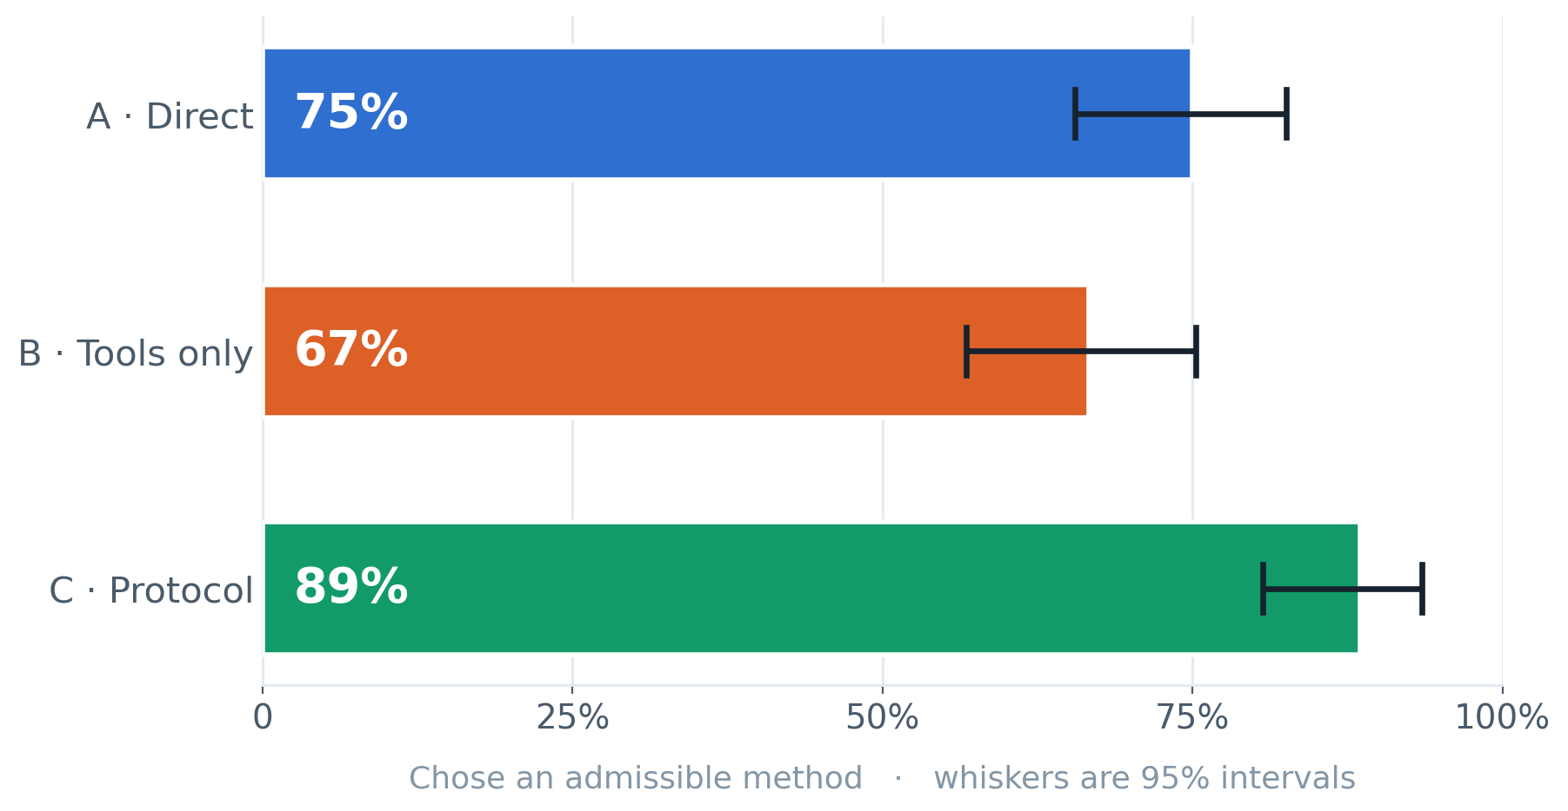
HELD-OUT EVALUATION · H1
Result: method-selection accuracy
C OVER B
+25 pts
The protocol arm beats tool access alone against a target of +10. Both arms hold identical tools and an identical report schema.
Tools without a protocol scored below no tools at all.
11
Notes:
Name the three numbers — 75, 67, 89 — then point at B. The version with tools and no procedure is the lowest of the three. That is the most surprising line in the results.

Slide 12
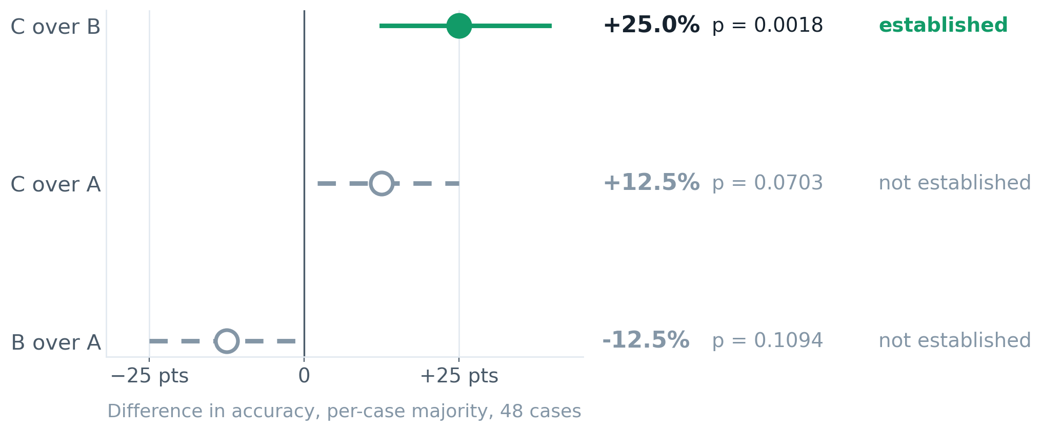
HELD-OUT EVALUATION · SIGNIFICANCE
Result: which differences are real
Established
Not established
C over B, p = 0.0018 — H1 is supported.
C over A points the right way but does not clear 0.05 on 48 cases.
12
Notes:
Solid and filled means significant; dashed and hollow means not. Read the second row aloud and say you report it as unresolved. Volunteering this is what makes the first row credible.

Slide 13
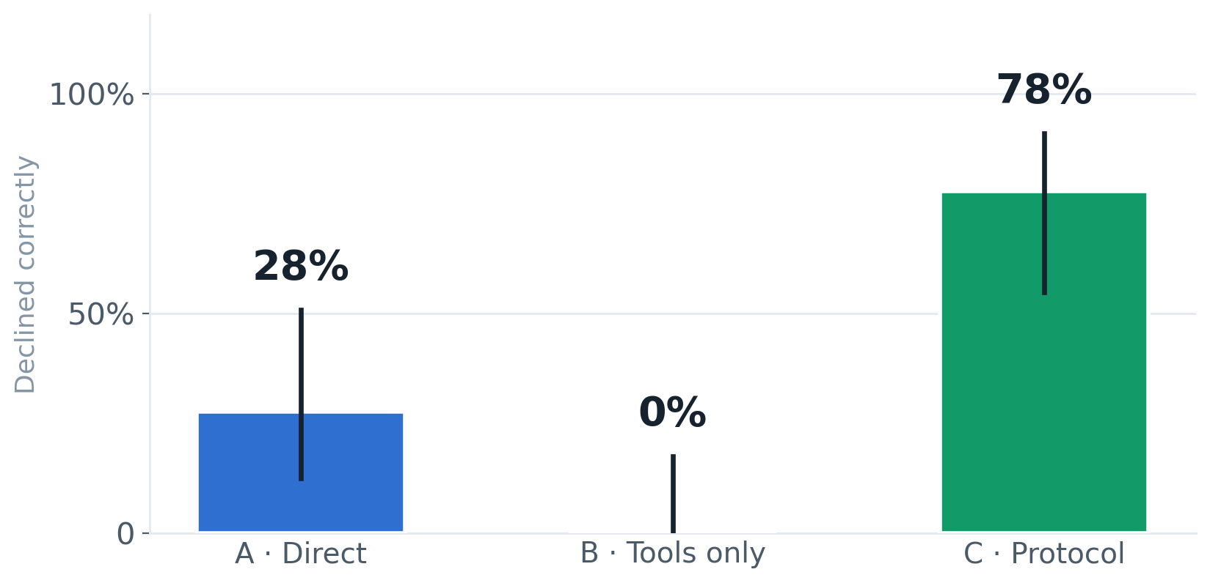
HELD-OUT EVALUATION · H2
Result: recognising an invalid design
ON 18 DESIGN-HAZARD RUNS
78%
The protocol arm declined correctly on the cases where every available method is invalid. The tool-enabled baseline never declined once.
The sharpest separation in the study — H2 is supported.
13
Notes:
This is the safety result. B answering every hazard case means B fitted a real method to data whose design rules it out, every time.

Slide 14
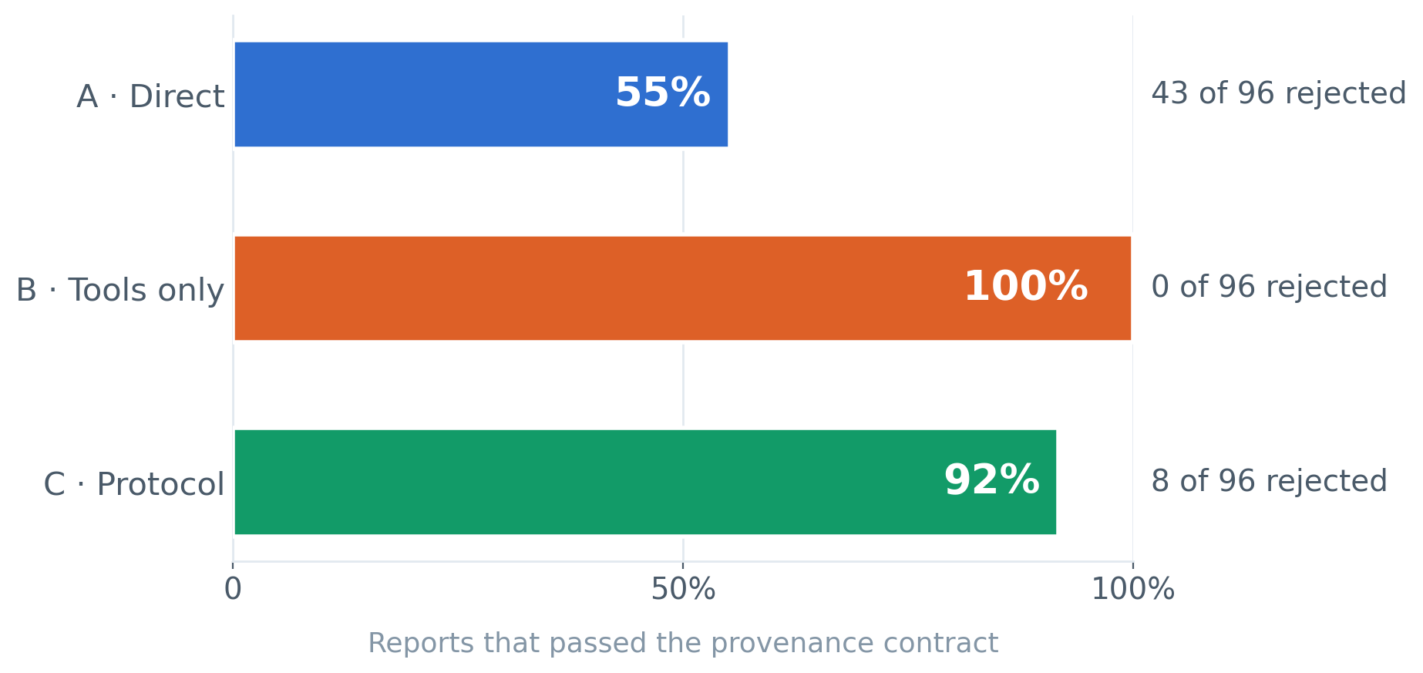
HELD-OUT EVALUATION · H3
Result: could the report be grounded?
DIRECT BASELINE
43 / 96
reports cited a number no tool produced, or a diagnostic never run. The contract rejected every one before it reached a reader.
No fabricated number shipped in any arm — H3 is supported.
14
Notes:
Explain why B scores 100% here: it has tools and uses them, so its numbers are real. Its failure is choosing the wrong method, not inventing figures. The two metrics measure different things.

Slide 15
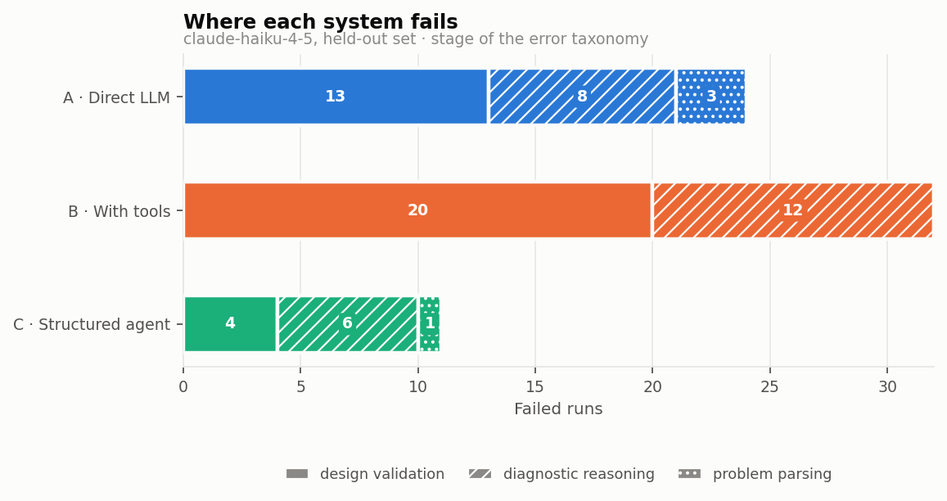
HELD-OUT EVALUATION · ERROR ANALYSIS
Result: where each system fails
DESIGN-VALIDATION FAILURES
20 → 4
Tool-only against protocol. The failures that remain in System C are mostly diagnostic reasoning, not design.
The protocol removed the failure it was built to remove.
15
Notes:
Total failures: A 24, B 32, C 11. The point is the design-validation segment — B has 20, C has 4. That is the mechanism behind every other result.

Slide 16
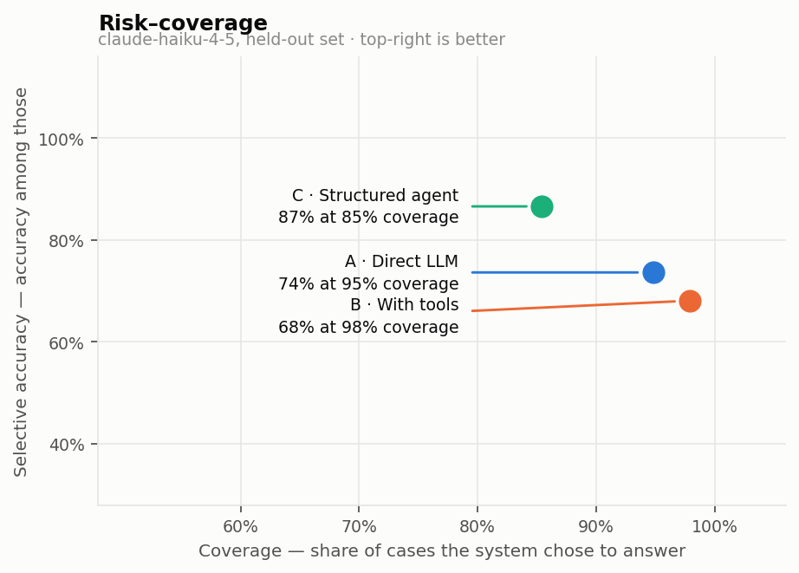
HELD-OUT EVALUATION · RISK–COVERAGE
Result: the coverage it gave up, and why
SELECTIVE ACCURACY
87%
System C answered 85% of cases and was right on 87% of those. A and B answered nearly everything — 95% and 98% — and were right less often.
Declining when it should is what lifts accuracy. It is not caution for its own sake.
16
Notes:
If asked whether C just refuses more: no. Lower coverage came with higher accuracy on what it did answer, which is the signature of declining the right cases rather than declining at random.

Slide 17
FINDINGS
Hypotheses revisited
H1
Selection
Supported
C over B: +25 points, McNemar p = 0.0018, 95% CI [+12.5, +39.6].
H2
Abstention
Supported
Declined correctly 78% of the time; the tool baseline 0%.
H3
Provenance
Supported
51 ungrounded reports rejected across all arms; none reached a reader.
—
C over A
Unresolved
+12.5 points, p = 0.0703. Direction favours C; the sample cannot settle it.
17
Notes:
Three supported, one unresolved. Keep the unresolved row on the slide — a findings table with no caveat reads as a sales pitch.

Slide 18
RIGOUR
Two defects found in the measurement itself
1
2
A rejected report is not a lost run
A verdict that changed between sessions
51 runs ended in an error. None were infrastructure: each had chosen a method before its report failed the contract, and 37 had chosen correctly. Discarding them — the obvious treatment — lifts the direct baseline from 75.0% to 81.1%.
With two repetitions a disagreement has no majority. The tie was broken by an ordering that varies per interpreter, so the C-over-A p-value moved between 0.016 and 0.125 on identical data — across 0.05.
Fix: score every run that reached a decision.
Fix: ties go to the earliest repetition, enforced by a test.
Neither raised an error. Both are recorded as formal deviations from the plan.
18
Notes:
If asked what was hardest, this is the answer. The system worked; the measurement had two silent defects that would each have produced a wrong headline.

Slide 19
WHAT THE EVIDENCE DOES NOT SUPPORT
Limitations and threats to validity
MODEL
Held-out claims are scoped to Claude Haiku 4.5. Generalising to frontier models requires re-running the evaluation.
POWER
Two repetitions and 48 cases. Enough to establish the primary comparison; not enough to resolve C over A.
INTERPRETATION
The blinded scoring round failed its reliability check (κ = −0.044). The metric is withheld rather than reported unreliably.
REVIEW
No independent second reviewer for the 16 public-data labels.
SCOPE
Paired, repeated-measures, mixed, time-series and survival designs are excluded from the library and tested only as abstention cases.
19
Notes:
Deliver this calmly and without apology. Each limit is known, bounded and disclosed in the report.

Slide 20
CONCLUSION
Contributions
1
Controlled evidence
A three-arm ablation over one shared core, showing that a decision protocol — not tool access — drives valid method selection.
2
A benchmark that scores declining
64 cases with construction-derived labels, twelve of which reward abstention, turning a scope limit into a measurable behaviour.
3
Provenance by construction
A report format in which a number without a recorded source cannot exist, rather than one checked for fabrication afterwards.
Structure, not tooling, is what makes an LLM a reliable statistician.
20
Notes:
End the findings on the one-line conclusion. Pause after it.

Slide 21
NEXT STEPS
Future work
Resolve C over A
Frontier models
Enlarge the held-out set and repetitions to give the comparison the power it currently lacks.
Re-run the frozen evaluation on larger models to test whether the protocol's gain persists as base capability rises.
Interpretation scoring
Wider method library
Run a second blinded round with the rebuilt rubric and two independent raters.
Extend to paired, mixed-effects and time-series designs now tested only as abstentions.
21
Notes:
Frame the first item as the natural next experiment, not as a weakness: the current design already tells you exactly how much larger the sample needs to be.

Slide 22
See it running
Every case, every answer each system gave, and every step it took — inspectable without installing anything.
LIVE EVALUATION
SOURCE, DATA AND LOGS
ai-statistician.netlify.app
github.com/Vishal4507/AI_statistician
Thank you — questions welcome.
22
Notes:
If time allows, open the live site and show the Seoul bike case: System C declines while A and B both fit a model.

