Slide 1


Slide 2

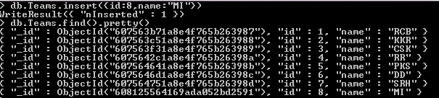
use DATABASE_NAME is used to create database. The command will create a new database if it doesn’t exist, otherwise it will return the existing database.
To check your currently selected database, use the command db.
To display database, you need to insert at least one document into it.(db.COLLECTION_NAME.insert())

Slide 3
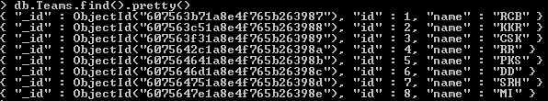
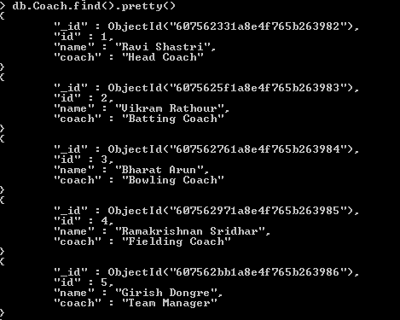
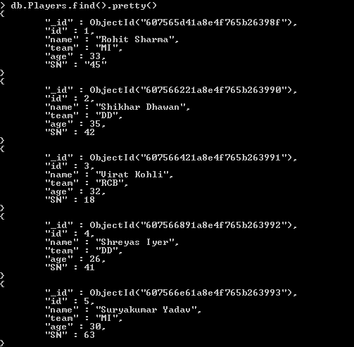
Teams
Coach
Players
COLLECTIONS

Slide 4
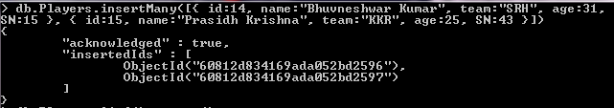
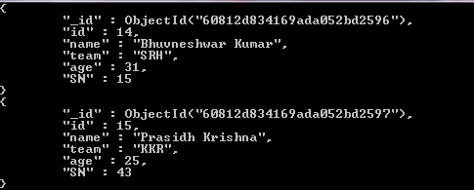


You can insert multiple documents using the insertMany() method. To this method you need to pass an array of documents.
If you need to insert only one document into a collection you can use this method.
(db.COLLECTION_NAME.insertOne(document))

Slide 5
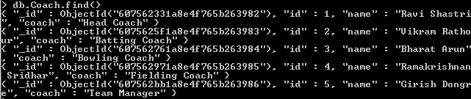
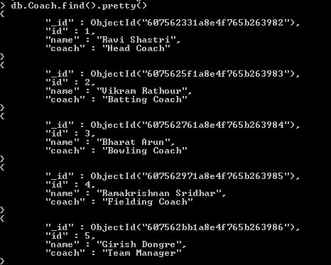
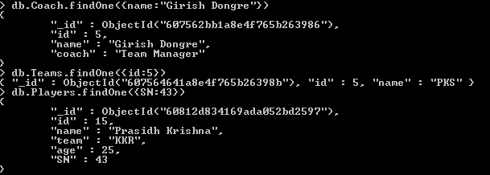
find() method will display all the documents in a non-structured way.
To display the results in a formatted way, you can use pretty() method.
Apart from the find() method, there is findOne() method, that returns only one document.

Slide 6
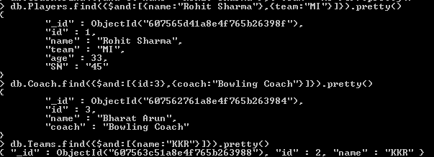

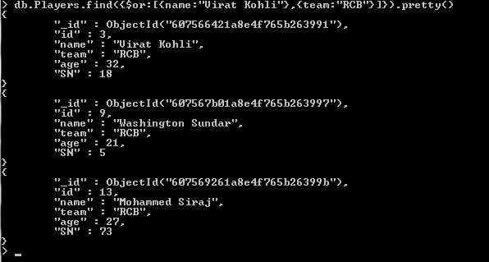
To query documents based on the AND condition, you need to use $and keyword.
To query documents based on the OR condition, you need to use $or keyword.
To query documents based on the NOT condition, you need to use $not keyword.

Slide 7
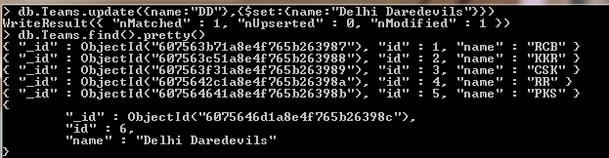
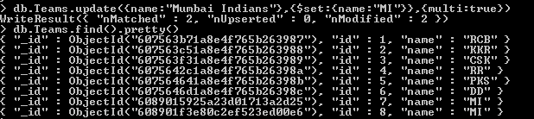
The update() method updates the values in the existing document. (db.COLLECTION_NAME.update(SELECTION_CRITERIA,UPDATED DATA))
To update multiple documents, you need to set a parameter 'multi' to true.

Slide 8
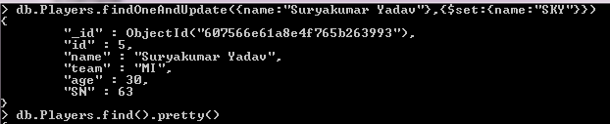
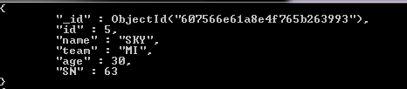
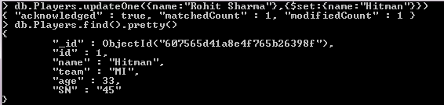

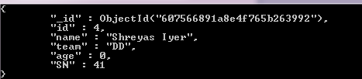
The findOneAndUpdate() method updates the values in the existing document.
updateOne() methods updates a single document which matches the given filter.
The updateMany() method updates all the documents that matches the given filter.

Slide 9
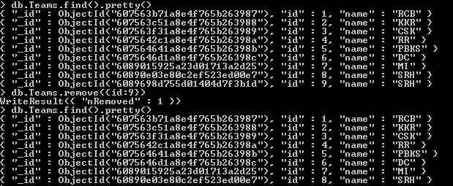
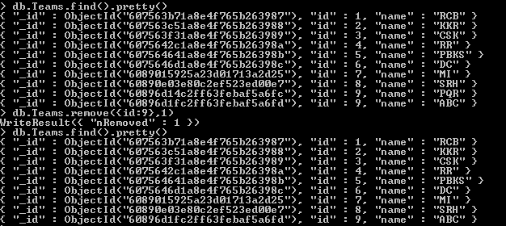
MongoDB's remove() method is used to remove a document from the collection. (db.COLLECTION_NAME.remove(DELETION_CRITERIA))
If there are multiple records and you want to delete only the first record, then set 1 parameter in remove() method.

Slide 10
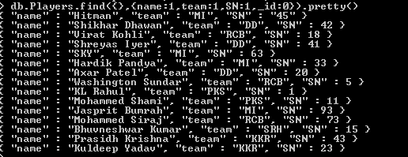
Projection means selecting only the necessary data rather than selecting whole of the data of a document. If a document has 5 fields and you need to show only 3, then select only 3 fields from them
(db.COLLECTION_NAME.find({},{KEY:1}))
2. _id field is always displayed while executing find() method, if you don't want this field, then you need to set it as 0.

Slide 11

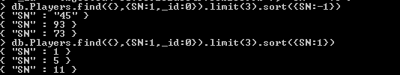
To limit the records in MongoDB, you need to use limit() method. The method accepts one number type argument, which is the number of documents that you want to be displayed.
(db.COLLECTION_NAME.find().limit(NUMBER))
2. Apart from limit() method, there is one more method skip() which also accepts number type argument and is used to skip the number of documents. (db.COLLECTION_NAME.find().limit(NUMBER).skip(NUMBER))
3. To sort documents in MongoDB, you need to use sort() method. To specify sorting order 1 and -1 are used. 1 is used for ascending order while -1 is used for descending order.
(db.COLLECTION_NAME.find().sort({KEY:1}))

