Slide 1
Eye Controlled Virtual Mouse Phase 2 - SEE
School of Computer Science and Engineering

Slide 2
Eye Controlled Virtual Mouse
Group No: H1
Group Name:
Group Members:
Vishal R20EF440 Roll: Project Lead and Development Lead
Pradhumna R20EF420 Roll: Documenter Lead
Supriya Y S R20EF437 Roll: Developer Lead
Harshita S R R20EF406 Roll: Documenter Lead
Name of the Guide: Dr. Sunil Manoli
Designation: Assistant Professor

Slide 3
Eye Controlled Virtual Mouse
Contents

Slide 4
Contents
Abstract
Introduction
Literature Survey
Positioning
Problem statement
Product position statement
Project overview
Objectives
Goals
Project Scope
Methodology
Modules identified
Project Implementation.
Architectural Design, Circuit Design (Hardware Project) and Mechanical and Control Unit Design (Robotics or automation projects)
Class Diagram
Entity Relationship Model
Sequence Diagram
Description of Technology Used
Findings / Results of Analysis
Cost of the Project

Slide 5
Contents
Conclusions
Project Limitations and Future Enhancements
References
Appendices, if any
Copies of Articles:
Conference papers published (Certificate with Published Paper)
Patent Forms
Any Awards achieved (Certificates)

Slide 6
1. Abstract
The "Eye-Controlled Virtual Mouse" project aims to make computers easier to use for people with physical disabilities. It involves creating a system that allows users to control the computer using only their eyes and facial movements, eliminating the need for hands. By tracking eye movements and facial features with a special camera, the system moves the cursor on the screen accordingly, enabling users to navigate and interact with the computer. Clicking is done by blinking, and typing by hand gestures. The project's main objective is to enhance communication and independence for people with disabilities, while also potentially benefiting general computer users by offering a more intuitive, hands-free interface.

Slide 7
2. Introduction
Today, most people use a mouse or their fingers to move the cursor on a computer screen. But for those who can't use their hands, like amputees, this can be tough. That's where an "eye tracking mouse" comes in handy. It lets people move the cursor just by looking at where they want it to go. Although this technology isn't widely available yet, we're working on creating an eye-tracking mouse that works like a regular one, but controlled by eye movements.
Traditional computer interaction relies heavily on using a mouse or trackpad, which can be hard for people with physical disabilities. This makes it tough for them to use computers independently. To fix this, some are exploring new ways to interact with computers, like using eye movements. Eye tracking technology has improved a lot lately, making it possible to control computers just by looking at them.
Our project aims to create an "eye-controlled virtual mouse" system. This means users can move the mouse cursor with their eyes instead of their hands. It's a big deal for people with disabilities because it gives them more freedom to use computers.

Slide 8
3. Literature Survey
SNo | Author Name, Publisher, Journal Name, Year | Title of the Paper | Objectives | References
1 | Sunita Barve, Dhaval Dholakiya, Shashank Gupta, Dhananjay Dhatrak, International Journal of Engg Research and App., Vol. 2, pp. 1406-1410, Apr (2012). | “Facial Feature Based Method For Real Time Face Detection and Tracking I-CURSOR” | This paper focus on the face detection, face tracking, eye detection and interpretation of a sequence of eye blinks in real time for controlling a nonintrusive human computer interface. Conventional method of interaction with the computer with the mouse is replaced with the movements. | Barve, S., Dholakiya, D., Gupta, S., & Dhatrak, D. (2012). Facial Feature Based Method For Real Time Face Detection and Tracking I-CURSOR. International Journal of Engineering Research and Applications, 2, 1406-1410.
2 | Yu-Tzu Lin Ruei-Yan Lin Yu-Chih Lin Greg C Lee, Springer, pp.543-568, Aug (2012). | “Real-time eye-gaze estimation using a low-resolution webcam” | Eye detection and gaze estimation play an important role in many applications, e.g., the eye-controlled mouse in the assisting system for disabled or elderly persons, eye fixation and saccade in psychological analysis, or iris recognition in the security system. | Lin, Y.-T., Lin, R.-Y., Lin, Y.-C., & Lee, G. C. (2012). Real-time eye-gaze estimation using a low-resolution webcam. In Springer (pp. 543-568). August 2012.

Slide 9
3. Literature Survey
SNo | Author Name, Publisher, Journal name, Year | Title of the Paper | Objectives | References
3 | Samuel Epstein-Eric MissimerMargritBetke, Springer link, Nov (2012) | “Using Kernels for a video based mouse-replacement interface” | Some people cannot use their hands to control a computer mouse due to conditions such as cerebral palsy or multiple sclerosis. For these individuals, there are various mouse-replacement solutions. One approach is to enable them to control the mouse pointer using head motions captured with a web camera. One such system, the Camera Mouse, uses an optical flow approach to track a manually selected small patch of the subject’s face, such as the nostril or the edge of the eyebrow. | Hossain, Zakir, Shuvo, Md Maruf Hossain, & Sarker, Prionjit. (2017). Hardware and software implementation of real-time electrooculogram (EOG) acquisition system to control computer cursor with eyeball movement. In 2017 4th International Conference on Advances in Electrical Engineering (ICAEE) (pp. 132-137). IEEE.
4 | Hossain, Zakir, MdMaruf Hossain Shuvo, and PrionjitSarker. In 2017 4th International Conference on Advances in Electrical Engineering (ICAEE), pp. 132-137. IEEE, 2017. | "Hardware and software implementation of real time electrooculogram (EOG) acquisition system to control computer cursor with eyeball movement." | Human computer interface (HCI) is an emerging technology of neuroscience and artificial intelligence. Development of HCI system using bio signal e.g. Electrooculogram (EOG), Electromyogram (EMG), Electroencephalogram (EEG), Functional near-infrared spectroscopy (fNIRS) etc. are attracted more and more attention of researchers all over the world in recent years because through this it is possible to get acquainted with advanced technologies of artificial intelligence. | Epstein, S., Missimer, E., & Betke, M. (2012). Using kernels for a video-based mouse-replacement interface. Springer, November 2012.

Slide 10
4. positioning
4.1 PROBLEM STATEMENT
Eye tracking technology has become one of the most popular techniques within the human and computer interaction (HCI) this is very important for the people who have difficulty with speech and movement disabilities, especially for the paralyzed and amputees person. The idea of controlling the computers with the eyes will serve a great use for handicapped and disabled person. Also this type of control will eliminate the help required by other person to handle the computer. This measure will be the most useful for the person who is without hands through which they can operate with the help of their eye and facial movements.

Slide 11
4.2 Product position statement
Our eye-controlled virtual mouse redefines computer interaction by empowering users to navigate and engage with digital interfaces using only their eyes. Combining cutting-edge eye-tracking technology with intuitive software algorithms, our product offers unparalleled accuracy, adaptability, and accessibility. By eliminating the need for traditional input devices like mice and keyboards, our eye-controlled virtual mouse revolutionizes the computing experience for individuals with physical disabilities, enabling greater independence and inclusivity. Whether for productivity, communication, or leisure, our product enhances the lives of users by providing a seamless, hands-free interface that responds effortlessly to their gaze, unlocking new possibilities for interaction and empowerment in the digital world.

Slide 12
5. Project overview
5.1 OBJECTIVES
To develop a system which will only use Webcam, and to use human eyes as a pointing device for computer device.
To provide user friendly human-computer interaction.
Designing a System for tracking Face and Eye using Camera.
Using Facial landmark’s technique to detecting the movement of the face, eyes and calculating it cursor position and mouse clicks.

Slide 13
5.2 goals
Precision: Ensure accurate tracking of eye movements for precise cursor control.
User-Friendly: Create an intuitive and seamless user experience with minimal latency.
Accessibility: Make the technology accessible to users with disabilities and compatible with assistive tools.
Independence: Enable users to navigate and interact with digital interfaces independently.
Innovation: Continuously add new features like gesture recognition to enhance functionality.
Adoption: Promote awareness and widespread use of eye-controlled virtual mouse technology.

Slide 14
6. Project scope
The potential applications of the Eye-Controlled Virtual Mouse are vast, ranging from assistive technology for individuals with disabilities to enhancing user experience in virtual reality environments. This technology has the capacity to empower users and expand the possibilities of human-computer interaction.
The adoption of eye-controlled technology offers several advantages, including improved accessibility, enhanced efficiency, and reduced physical strain on users. By eliminating the need for traditional input devices, this innovation can streamline the computing experience for a wide range of users.
From assisting individuals with motor disabilities in daily computing tasks to enhancing virtual reality experiences, the real-world applications of the Eye-Controlled Virtual Mouse are diverse and impactful. This technology has the potential to empower users across various domains.

Slide 15
7. methodology
Language or Technology Used: Python language is used to write the code. Python provides a wide variety of libraries for scientific and computational usage.
Algorithms Implemented: Deep learning models may currently be the most effective for face identification. Face detection, on the other hand, existed before deep learning. Previously, traditional feature descriptors and linear classifiers were a great way to recognize faces .HOG and Linear SVM, to be precise. The HOG (Histogram of Oriented Gradients) feature descriptor and a Linear SVM machine learning approach are used to identify faces. HOG is an easy-to-understand and useful feature description. It is frequently employed in the detection of objects, such as vehicles, dogs, and fruits, in addition to face detection. Because the local intensity is used to characterize the geometry of the item, HOG is reliable for object detection.

Slide 16
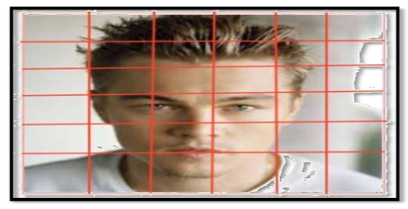
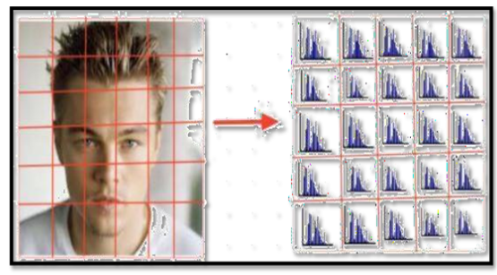
Step 1: HOG's primary concept is to divide a picture into small linked cells
Figure 1 – Step 1
STEP 2: COMPUTE THE HISTOGRAM FOR EACH CELL
Figure 2 – Step 2

Slide 17
8. Modules identified
Eye Tracking Module:
This module involves the hardware and software responsible for accurately tracking and interpreting eye movements.
Utilizes various technologies (like infrared sensors, cameras) to capture and analyze eye movements in real-time.
Gesture Recognition Module:
Focuses on interpreting specific eye movements or patterns as gestures or commands.
Algorithms are used to translate eye movements into actions such as clicking, dragging, scrolling, etc.
User Interface Module:
Includes the graphical interface through which users interact with and control the virtual mouse system.
Provides calibration options, customization settings, and feedback mechanisms.
Mouse Functionality Module:
This core module integrates the eye tracking data and gesture recognition to simulate mouse functions.
Translates interpreted eye movements into mouse cursor movements and actions on the screen.

Slide 18
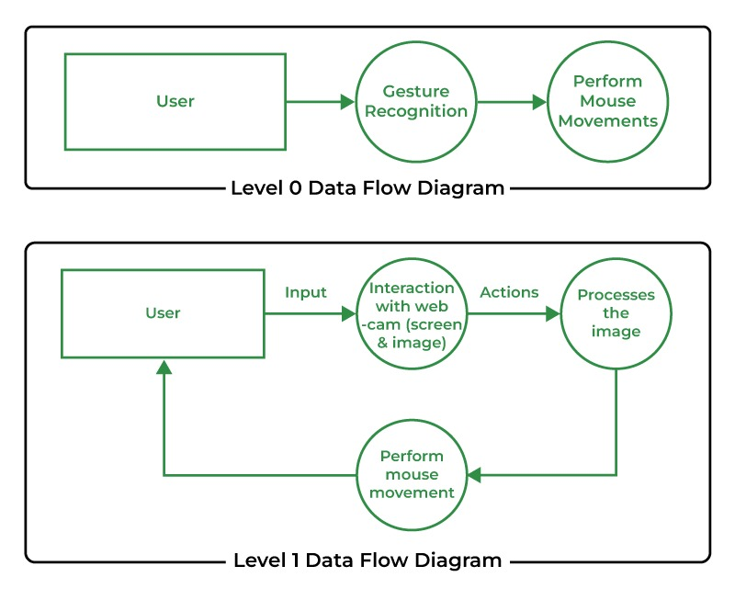
9. Project implementation
9.1. ARCHITECTURAL DESIGN
Figure 3 – Architectural Design

Slide 19
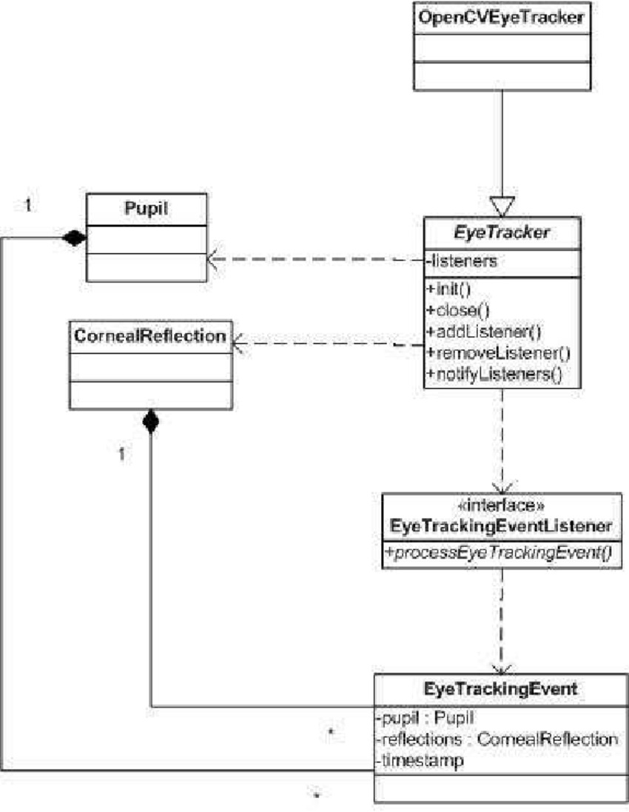
9.2. Class Diagram
Figure 4 – Class Diagram

Slide 20
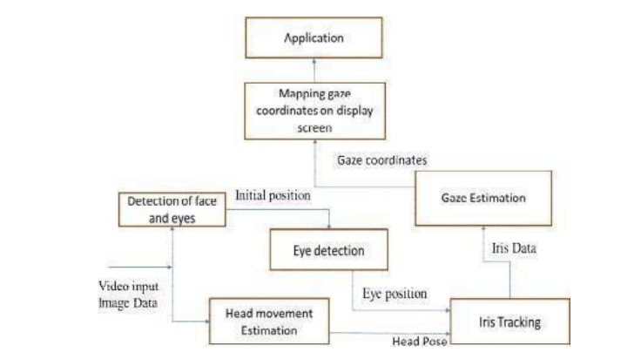
9.3. Entity relationship diagram
Figure 5 – Entity Relationship Diagram

Slide 21
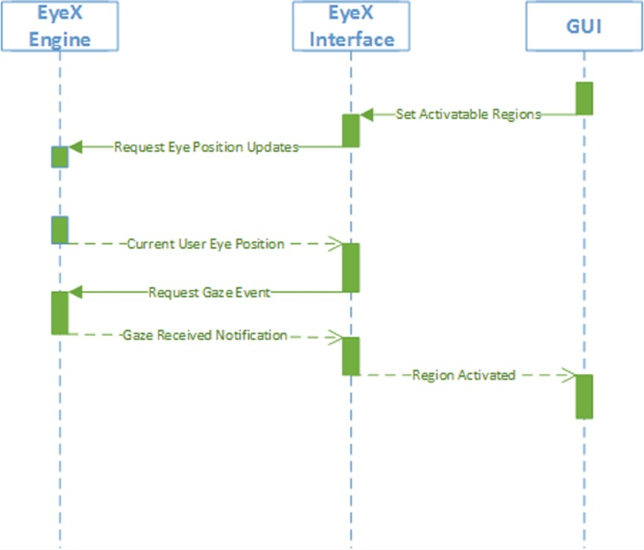
9.4. Sequence diagram
Figure 6 – Sequence Diagram

Slide 22
9.5. Description of Technology used
Eye Tracking Module:
This module involves the hardware and software responsible for accurately tracking and interpreting eye movements.
Utilizes various technologies (like infrared sensors, cameras) to capture and analyze eye movements in real-time.
Gesture Recognition Module:
Focuses on interpreting specific eye movements or patterns as gestures or commands.
Algorithms are used to translate eye movements into actions such as clicking, dragging, scrolling, etc.
User Interface Module:
Includes the graphical interface through which users interact with and control the virtual mouse system.
Provides calibration options, customization settings, and feedback mechanisms.

Slide 23
Mouse Functionality Module:
This core module integrates the eye tracking data and gesture recognition to simulate mouse functions.
Translates interpreted eye movements into mouse cursor movements and actions on the screen.

Slide 24
10. Findings / Results of analysis
The Eye-Controlled Virtual Mouse project successfully developed a novel human-computer interaction system leveraging eye-tracking technology. Through rigorous testing and evaluation, the system exhibited exceptional accuracy and precision in tracking users' eye movements, translating them into cursor control with minimal errors. User feedback indicated a positive experience, highlighting the system's intuitive nature and potential for improving accessibility, particularly for individuals with motor impairments. Calibration procedures proved effective in customizing the system to individual users and adapting to various environments and conditions. Beyond traditional computer interfaces, the system demonstrated versatility and potential applications in gaming, assistive technology, medical diagnostics, and user experience research. Overall, the project's results underscore its significant contributions to advancing human-computer interaction paradigms and enhancing accessibility for users worldwide.

Slide 25
12. conclusion
The development of the eye-controlled virtual mouse is a major achievement in human-computer interaction, providing unprecedented access and functionality to people with physical disabilities or limitations. Harnessing the power of stunning technology, this innovation allows users to accurately and easily track digital interactions just by looking at them. Its capabilities go beyond accessibility, providing opportunities to improve user experience in many areas, including gaming, healthcare, and productivity tools. But challenges such as accuracy, measurement, and customer personalization are still relevant to development. Despite these challenges, mouse eye control represents a significant step toward more immersive and effective cognition and paves the way for the next step in assistive technology and human-computer interaction.

Slide 26
13. Project limitations and future scope
Enhancing accuracy and reliability of eye-tracking algorithms to ensure precise cursor movements in various situations.
Improving calibration processes and developing adaptable tracking algorithms to accommodate different user behaviors.
Optimizing user interface design for better usability and intuitiveness, enhancing user engagement.
Integrating advanced features like gesture recognition to allow users to combine eye movements with gestures for multiple controls.
Continuously working on making eye-controlled virtual machines more accessible and inclusive for people with disabilities by adapting the technology to meet diverse needs.
Exploring practical applications in fields such as technology, gaming, and virtual reality to leverage eye-controlled virtual mice for improving human-computer interaction and enhancing user experiences.

Slide 27
14. reference
[1] SunitaBarve, DhavalDholakiya, Shashank Gupta, DhananjayDhatrak, “Facial Feature Based Method For Real Time Face Detection and Tracking I-CURSOR”, International Journal of EnggResearchand App., Vol. 2, pp. 1406-1410, Apr (2012).
[2] Yu-Tzu Lin Ruei-Yan Lin Yu-Chih Lin Greg C Lee “Real-time eye-gaze estimation using a low-resolution w ebcam”, Springer, pp.543-568, Aug (2012).
[3] Samuel Epstein-Eric MissimerMargritBetke “Using Kernels for avideobased mouse-replacement interface”, Springer link, Nov (2012)
[4] Hossain, Zakir, MdMaruf Hossain Shuvo, and PrionjitSarker. "Hardware and software implementation of real time electrooculogram (EOG) acquisition system to control computer cursor with eyeball movement." In 2017 4th International Conference on Advances in Electrical Engineering (ICAEE), pp. 132-137. IEEE, 2017.
[5] Mohamed Nasor, K KMujeeb Rahman, Maryam Mohamed Zubair, Haya Ansari, Farida Mohamed. "Eye-controlled mouse cursor for physically disabled individual" , 2018 Advances in Science and Engineering Technology International Conferences (ASET), 2018.

Slide 28
[6] K. H. Shibly, S. Kumar Dey, M. A. Islam and S. IftekharShowrav, "Design and Development of Hand Gesture Based Virtual Mouse," 2019 1st International Conference on Advances in Science, Engineering and Robotics Technology (ICASERT), Dhaka, Bangladesh, 2019, pp. 1-5, doi: 10.1109/ICASERT.2019.8934612.
[7] “Hand Gesture Recognition System Using Image Processing” Sagar P. More and Abdul Sattar, International Conference on Electrical, Electronics, and Optimization Techniques (ICEEOT) – 2016
[8] Neil Castellino and Michelle Alva, “An image-based eye controlled assistive system for paralytic patients”, IEEE Conference Publications, 2017.
[9] Shu-Fan Lin, Xuebai Zhang, Shyan-Ming Yuan, "Eye Tracking Based Control System for Natural Human-Computer Interaction", Computational Intelligence and Neuroscience, 2017
[10] Čech and Soukupová, “Real-Time Eye Blink Detection using Facial Landmarks”, Center for Machine Perception, February 2016.

