Slide 1
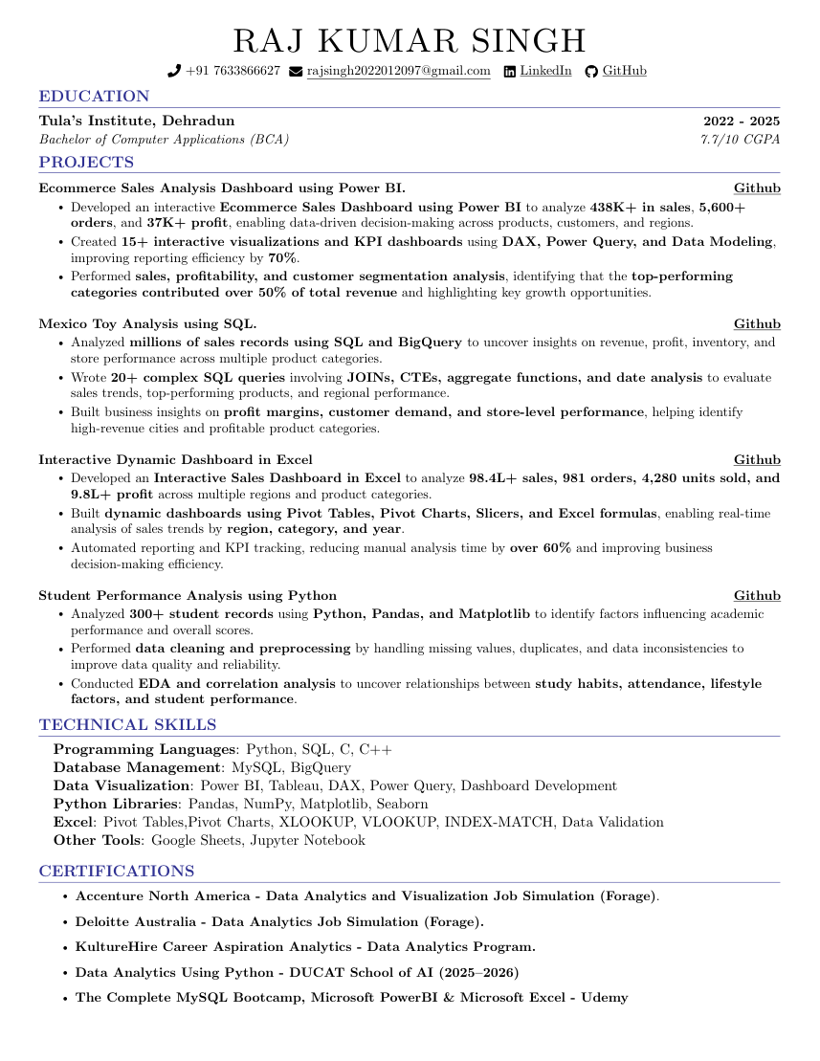
RAJ KUMAR SINGH
 +91 7633866627 # rajsingh2022012097@gmail.com ï LinkedIn § GitHub
Tula’s Institute, Dehradun 2022 - 2025 Bachelor of Computer Applications (BCA) 7.7/10 CGPA PROJECTS
Ecommerce Sales Analysis Dashboard using Power BI.
• Developed an interactive Ecommerce Sales Dashboard using Power BI to analyze 438K+ in sales, 5,600+ orders, and 37K+ profit, enabling data-driven decision-making across products, customers, and regions.
• Created 15+ interactive visualizations and KPI dashboards using DAX, Power Query, and Data Modeling, improving reporting efficiency by 70%.
• Performed sales, profitability, and customer segmentation analysis, identifying that the top-performing categories contributed over 50% of total revenue and highlighting key growth opportunities.
Mexico Toy Analysis using SQL.
• Analyzed millions of sales records using SQL and BigQuery to uncover insights on revenue, profit, inventory, and store performance across multiple product categories.
Source page 1

