Slide 1
Secure data hiding in images using steganography
CAPSTONE PROJECT
Presented By: VISHAL KUMAR TRIPATHI
Student Name : VISHAL KUMAR TRIPATHI
College Name & Department : ITM GIDA Gorakhpur & Computer Science Engineering

Slide 2
OUTLINE
Problem Statement
Technology used
Wow factor
End users
Result
Conclusion
Git-hub Link
Future scope

Slide 3
Problem Statement
With the increasing need for secure communication, traditional encryption methods are often susceptible to detection and attacks. Steganography provides a means to hide sensitive data within digital images, making it imperceptible to unauthorized users. This project aims to develop a secure and efficient method for embedding and retrieving hidden information within images while maintaining the visual integrity of the cover image.

Slide 4
Technology used
Programming Language: Python
Libraries: OpenCV2, NumPy, PIL (Pillow), Cryptography
Techniques: Least Significant Bit (LSB) Steganography, Encryption Algorithms (AES, RSA)
Frameworks: Flask (for web interface, if applicable)

Slide 5
Wow factors
High-level security integration with encryption before embedding data
Minimal distortion in the cover image, making the hidden data undetectable
User-friendly interface for encoding and decoding messages
Ability to hide multiple types of data (text, images, files)

Slide 6
End users
Government and defense agencies for confidential communication
Journalists and activists for secure information exchange
Businesses handling sensitive customer or financial data
General users seeking privacy in personal communication

Slide 7
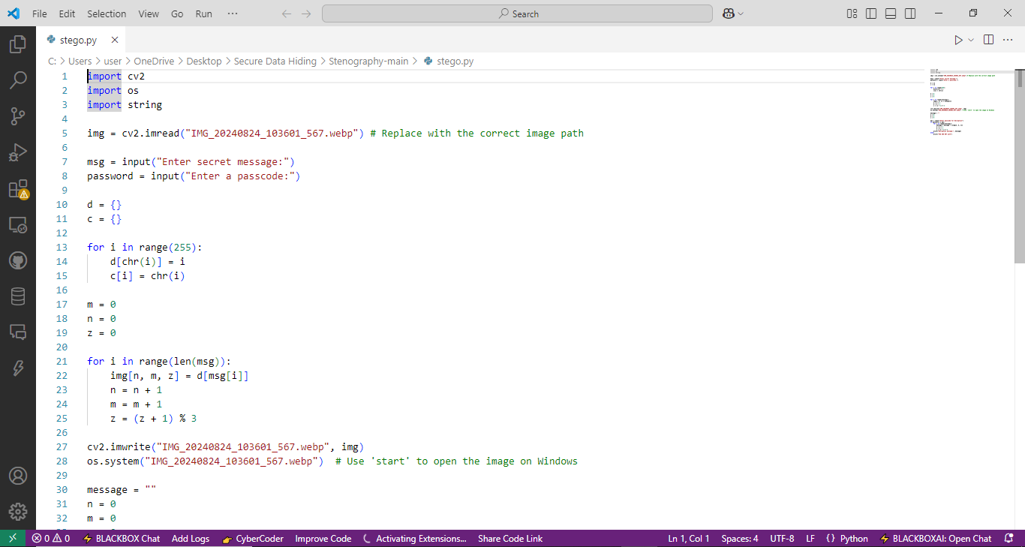
Results

Slide 8
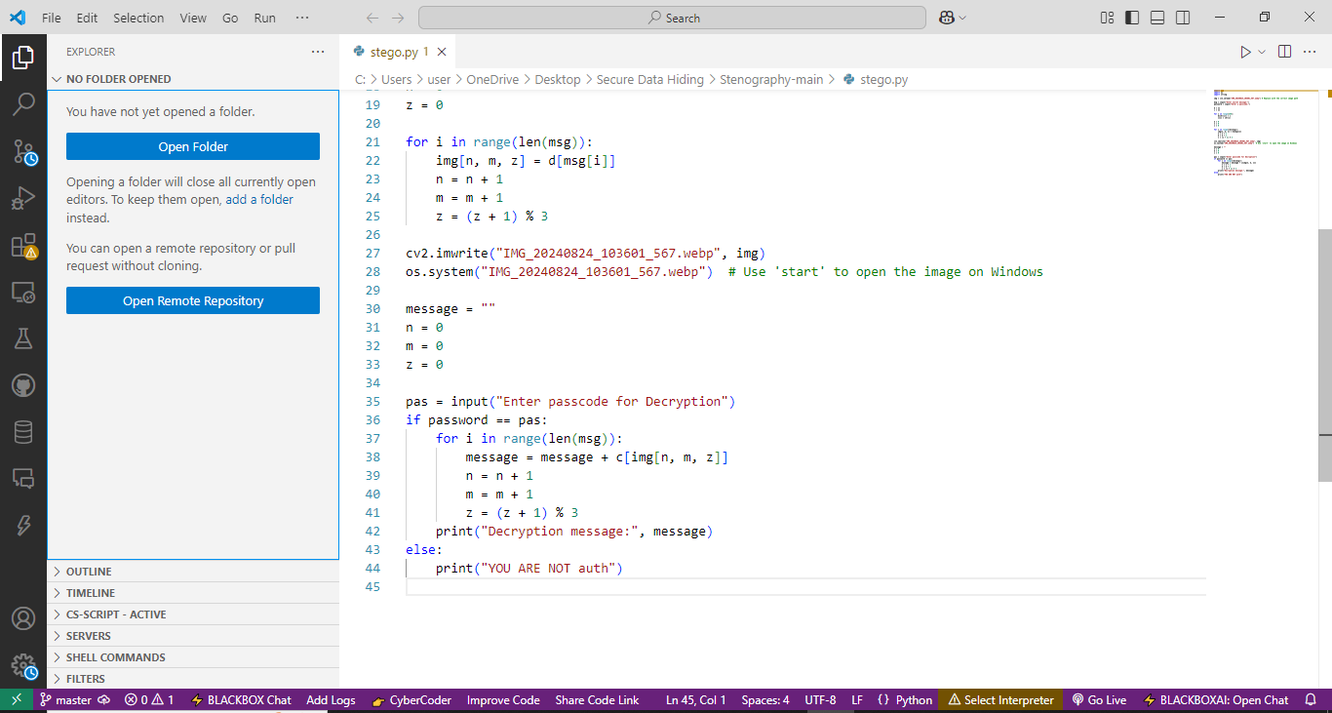
Results

Slide 9
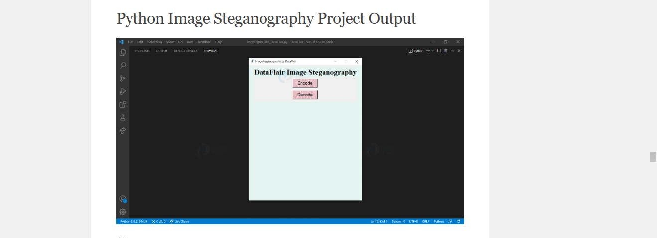
Results

Slide 10
Conclusion
This project demonstrates the effectiveness of steganography as a covert communication method. By combining it with encryption, we enhance the security of the hidden data, making unauthorized access extremely difficult. The implementation ensures usability while maintaining the integrity of the image.

Slide 11
GitHub Link
git@github.com:Vishal7310u6535om/myaicteProject.git

Slide 12
Future scope(optional)
Enhanced Security: As digital threats evolve, steganography will improve to offer advanced encryption and data concealment, ensuring better protection of sensitive information.
Integration with AI: Future advancements will leverage AI to detect and embed hidden messages more efficiently, making it harder for adversaries to break.
Applications in Digital Forensics: With its potential for covert communication, steganography will play a key role in cyber investigations, uncovering hidden digital evidence.
Mobile and IoT Security: As IoT devices proliferate, steganography will be crucial in securing communications and data transfer between devices with limited security features.

Slide 13
THANK YOU

