Slide 1
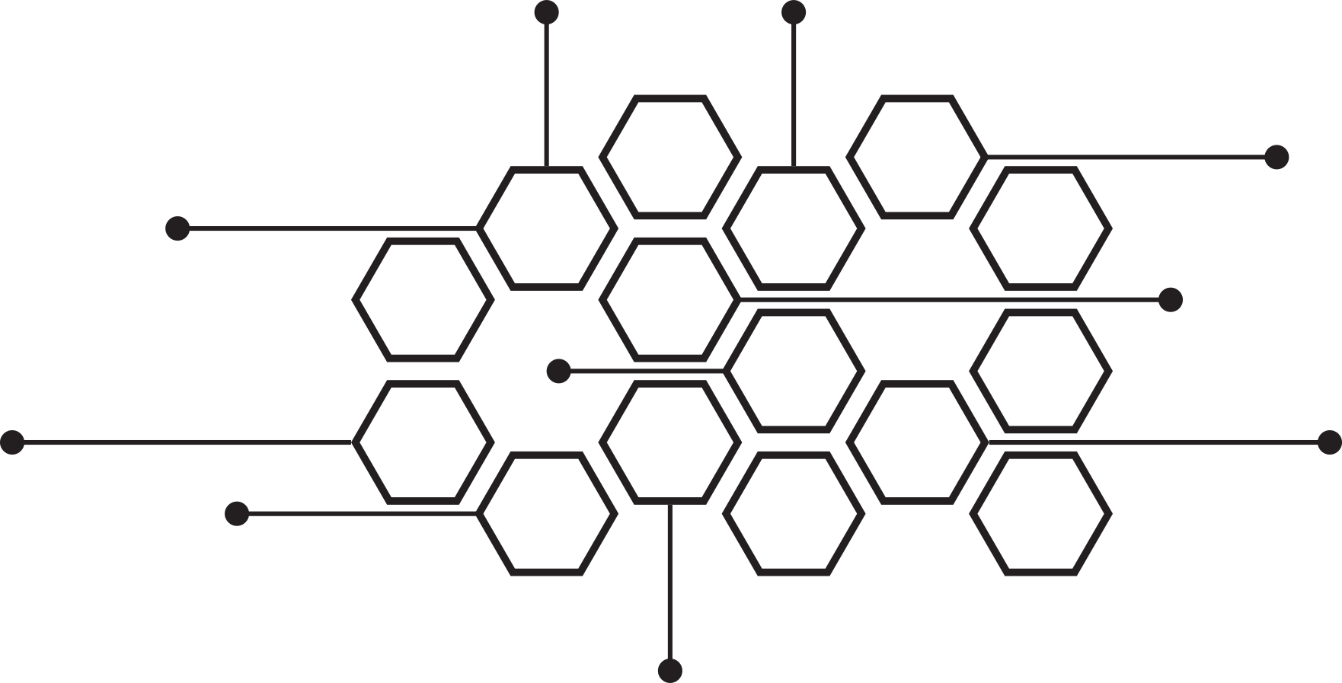
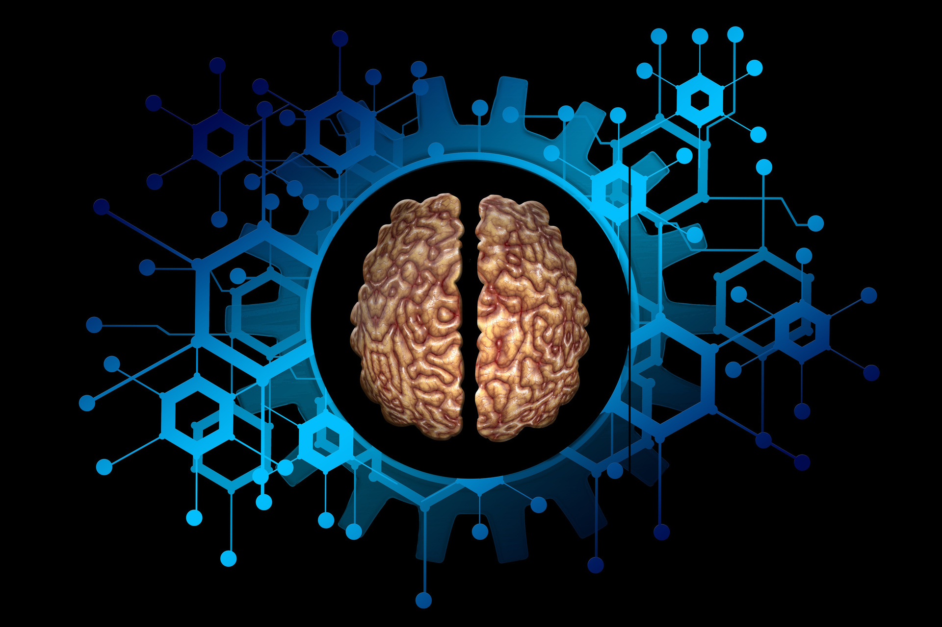

PARKINSON'S DISEASE PREDICTION

Slide 2


INTRODUCTION
Parkinson’s Disease (PD) is a progressive neurodegenerative disorder that affects movement, speech, and various motor functions due to the loss of dopamine-producing neurons in the brain. As of today, over 10 million people worldwide suffer from PD, making it a growing public health concern. Early diagnosis is critical in managing and slowing the progression of the disease, yet traditional clinical diagnostic methods remain subjective, time-consuming, and often detect the disease in advanced stages.
Recent advancements in artificial intelligence (AI), signal processing, and multimodal machine learning offer promising avenues for non-invasive, scalable, and accurate early detection methods. Among these, voice analysis has gained increasing attention as a biomarker since vocal impairments are among the earliest symptoms in many PD patients.
This work proposes a multimodal machine learning approach that leverages both traditional machine learning and deep learning models on voice data to accurately distinguish between individuals with Parkinson’s and healthy controls. The voice recordings are analyzed using a combination of handcrafted features and learned representations from spectrograms to improve diagnostic performance.

Slide 3


Objective
Improve Model Accuracy: Build a deep learning model to diagnose Parkinson’s Disease early and accurately using speech, gait, and clinical data.
Tackle Data Challenges: Overcome issues like limited data and overfitting by using techniques like data augmentation and transfer learning to make the model more reliable.
Use Multiple Data Sources: Combine different types of data, such as speech, gait, and clinical information, to create a more complete and accurate diagnostic tool.
Make the Model Efficient: Develop a model that works in real-time and can be easily deployed on platforms like Google Colab for practical use.
Ensure Clarity and Understanding: Use explainable AI techniques to make the model’s predictions easy to understand and trustworthy for healthcare professionals.

Slide 4
Literature Review
Title of paper | Year of Publication | Authors
Deep Feature Extraction From the Vocal Vectors Using Sparse Autoencoders for Parkinson’s Classification | 2020 | YANHAO XIONG AND YAOHUA LU
Parkinson’s Disease Detection From Online Handwriting Based on Beta-Elliptical Approach and Fuzzy Perceptual Detector | 2024 | Mohammed F. Allebawi
Enhancing Parkinson’s Disease Diagnosis Through Stacking Ensemble-Based Machine Learning Approach | 2024 | Fatma A. Hashim
Parkinson Data Analysis and Prediction System Using Multi-Variant Stacked Auto Encoder | 2020 | Gayathri Nagasubramanian
Early Detection of Parkinson’s Disease Using Deep Learning and Machine Learning | 2020 | Fouzi Harrou
Characterizing Disease Progression in Parkinson’s Disease from Videos of the Finger Tapping Test | 2024 | Diego L. Guarín Joshua K. Wong Nikolaus R. McFarland Adolfo Ramirez-Zamora

Slide 5
Early Detection of Parkinson’s Disease by Neural Network Models | 2022 | Fu-Cheng Wang
A Spectrogram-Based Deep Feature Assisted Computer-Aided Diagnostic System for Parkinson’s Disease | 2020 | Muazzam Maqsood
Multi-Level Graph Neural Network With Sparsity Pooling for Recognizing Parkinson’s Disease | 2023 | Xiaobo Zhang Tianrui Li Yuxin Zhou
An Interpretable Deep Learning Optimized Wearable Daily Detection System for Parkinson’s Disease | 2023 | Zhanfang Sun Tao Xin Yan Chen Fei Su
Deep Learning-Based Parkinson’s DiseaseClassification Using Vocal Feature Sets | 2019 | HAKAN GUNDUZ
Multi-Model Fusion of CNNs for Identification of Parkinson’s Disease Using Handwritten Samples | 2023 | Fahmi Khalifa

Slide 6


Literature Review
1) Deep Feature Extraction From the Vocal Vectors Using Sparse Autoencoders for Parkinson’s Classification
Methodology: Utilizes adaptive wolf search optimization for feature selection and sparse autoencoders to extract deep features from vocal vectors for Parkinson's classification using supervised machine learning models.
Parameters: Analyzed 756 instances with 754 attributes from the UCI Parkinson's Disease dataset; feature set compressed to 8 latent features using sparse autoencoders and evaluated through 10-fold cross-validation.
Applications: Offers a computational tool for early and accurate Parkinson’s disease diagnosis based on vocal impairments, enhancing clinical decision-making.
Result/Performance: The adaptive wolf search-sparse autoencoder-LDA model achieved 95% accuracy, outperforming benchmarked models in F1 score and RMSE.
Challenges: Limited dataset size, risk of overfitting, reliance on supervised machine learning algorithms, and computational complexity of feature extraction techniques

Slide 7
2) Parkinson’s Disease Detection from Online Handwriting Based on Beta-Elliptical Approach and Fuzzy Perceptual Detector
Methodology: Utilizes data augmentation, segmentation into Beta strokes, and feature extraction using the Beta-elliptical approach and fuzzy perceptual detector. Bidirectional LSTM is applied for handwriting-based PD classification.
Parameters: Evaluated on 30 PD patients and 30 healthy controls with online Arabic handwriting samples, applying 10-fold cross-validation and geometric augmentation techniques.
Applications: Provides a novel tool for early detection of Parkinson's disease based on handwriting patterns, aiding clinical diagnostics.
Result/Performance: Achieved up to 93.33% accuracy in ellipse tracing tasks on the custom dataset, demonstrating superior performance on PaHaW tasks compared to existing systems.
Challenges: Limited dataset size, variability in handwriting impairments, and task complexity pose classification challenges. Further research is required for broader applicability and dataset expansion​

Slide 8
3) Enhancing Parkinson’s Disease Diagnosis Through Stacking Ensemble-Based Machine Learning Approach
Methodology: A Stacking Ensemble classifier integrates Support Vector Machine (SVM), Gradient Boosting (GB), and Logistic Regression (LR) to extract features and classify Parkinson’s Disease (PD) using benchmark datasets.
Parameters: The model is trained on two standard PD speech datasets, utilizing SMOTE for data balancing, Adam optimizer (LR = 0.0001), 100 epochs, batch size = 64, and 80:20 data split with performance metrics including accuracy, precision, recall, F1-score, and AUC.
Applications: Enables early and automated PD detection using machine learning-based speech analysis, supporting clinical decision-making.
Result/Performance: The Stacking Ensemble model (SVM+GB+LR) achieved 96.18% accuracy and 96.27% AUC, outperforming individual AI models and Bagging classifiers.
Challenges: Dataset imbalance, computational complexity, generalization limitations, and reliance on speech-based features impact real-world deployment.

Slide 9
4) Parkinson Data Analysis and Prediction System Using Multi-Variant Stacked Auto Encoder
Methodology: The study proposes the Multi-Variant Stacked Auto Encoder (MVSAE) framework, integrating Classless SAE, Clustered SAE, Multi-Level Balanced SAE, and Deep Variant SAE (DVSAE) for Parkinson’s Disease (PD) prediction using multi-attribute symptom analysis.
Parameters: The model is trained on a real-time clinical dataset (520 medical records: 430 PD, 90 healthy) using UPDRS scores, voice pitch variations, dopamine levels, and motion symptoms, evaluated with precision, recall, specificity, classification accuracy, and mean absolute error (MAE).
Applications: Supports early PD diagnosis, treatment planning, and clinical decision-making by analyzing multi-variant patient symptoms with deep learning.
Result/Performance: DVSAE achieved the highest accuracy, outperforming MANN, GAE, UMLBD, CNN, and RNN, with precision and recall improving by 5%-10% compared to existing models.
Challenges: Limited dataset size, need for enhanced biological data integration, computational complexity of deep autoencoders, and scalability issues remain key limitations.

Slide 10
5) Early Detection of Parkinson’s Disease Using Deep Learning and Machine Learning
Methodology: A deep learning framework using feed-forward neural networks (FNN) with two hidden layers is developed to classify Parkinson’s disease based on premotor features, compared against twelve machine learning and ensemble learning models.
Parameters: The study utilizes features such as RBDSQ and UPSIT scores, cerebrospinal fluid biomarkers (α-syn, Aβ1-42, P-tau181, T-tau), and SPECT imaging markers (SBRs for left and right putamen and caudate) for PD detection.
Applications: The model is designed for early detection of Parkinson’s disease, helping in timely intervention by analyzing premotor symptoms like REM sleep behavior disorder and olfactory loss.
Result/Performance: The deep learning ensemble model (DEEP_EN) achieved the highest accuracy of 96.68%, outperforming traditional machine learning methods, with improved sensitivity (97.17%) and specificity (94.84%).
Challenges: The study faces challenges due to the small dataset size (584 subjects), computational complexity of deep learning models, and the need for larger datasets to further validate model performance.

Slide 11
6) Characterizing Disease Progression in Parkinson’s Disease from Videos of the Finger Tapping Test
Methodology: The study employs machine learning-based hand pose estimation on Finger Tapping Test videos to extract kinematic features and classify Parkinson’s disease severity using a tiered binary classification approach.
Parameters: Extracted features include Mean Amplitude, Mean Speed, Cycle Duration, Amplitude Decay, and Coefficient of Variation (CV) of Speed, Opening/Closing Speed, and Cycle Duration, evaluated using f1-score and AUC.
Applications: The system provides an objective and automated tool for quantifying bradykinesia in Parkinson’s patients, enhancing clinical assessments and remote monitoring.
Result/Performance: The proposed tiered binary classification approach achieved an accuracy of 86%, outperforming multiclass (45%) and ordinal binary classification (74%) in distinguishing disease severity levels.
Challenges: Limitations include a small, unbalanced dataset, lack of data from severe-stage patients, and potential inter-rater variability in clinician-provided severity scores.

Slide 12
7) Early Detection of Parkinson’s Disease by Neural Network Models
Methodology: A deep neural network model is developed using IMU-based motion data to classify PD patients into Early_PD, Adv_PD, or Non-PD based on gait analysis.
Parameters: The model is trained on IMU sensor data (128 Hz) from 32 PD patients and 16 healthy controls, using 3-axis acceleration and angular velocity, with Adam optimizer, batch size = 300, 40 epochs, and k-fold cross-validation (k=5).
Applications: Enables objective and automated PD detection using wearable motion sensors, aiding in early diagnosis and disease progression monitoring.
Result/Performance: The model achieved 99.67% accuracy for Early_PD detection, 92.72% for Adv_PD classification, and an overall 98.15% accuracy in real-world testing.
Challenges: Small dataset, gait similarity in elderly, computational complexity of deep models, and the need for real-world deployment validation.

Slide 13
8) A Spectrogram-Based Deep Feature Assisted Computer-Aided Diagnostic System for Parkinson’s Disease
Methodology: Three methods are proposed: transfer learning with spectrograms, deep feature extraction using AlexNet, and acoustic feature-based classification for PD detection using speech signals.
Parameters: The model is trained on the PC-GITA Spanish speech dataset (100 subjects, vowels, monologues, read text, and words), using AlexNet for feature extraction, and evaluated with SVM, Random Forest, and Multilayer Perceptron classifiers.
Applications: Provides non-invasive, speech-based PD detection, supporting early diagnosis and clinical decision-making through automated voice analysis.
Result/Performance: Deep features with MLP achieved the highest accuracy (99.7%), outperforming transfer learning (91%) and handcrafted acoustic features (84.6%).
Challenges: Speech variability, dataset limitations, need for noise-free recordings, and generalization to real-world conditions remain key issues.

Slide 14
9) Multi-Level Graph Neural Network With Sparsity Pooling for Recognizing Parkinson’s Disease
Methodology: A multi-level GNN model (SparsityATopK) is proposed, incorporating sparsity-based pooling and an attention mechanism for efficient PD classification using MRI-based graph representations.
Parameters: The model is trained on PPMI MRI dataset (1032 images), utilizing keypoint detection methods (ORB, KAZE, AKAZE), an Adam optimizer, batch size of 128, learning rate of 0.001, and 10-fold cross-validation.
Applications: Enables automated, MRI-based PD diagnosis with enhanced feature extraction and graph learning, aiding in early detection and clinical decision-making.
Result/Performance: The model achieved the highest accuracy (94.87%) on P-KAZE, 93.64% on P-AKAZE, and 92.15% on P-ORB, outperforming existing GNN-based methods.
Challenges: Small dataset size, computational cost of graph construction, class imbalance, and generalization issues remain challenges for real-world deployment.

Slide 15
10) An Interpretable Deep Learning Optimized Wearable Daily Detection System for Parkinson’s Disease
Methodology: A 6-channel CNN model processes continuous wavelet transform (CWT)-transformed IMU sensor data from the wrist, ankle, and waist for daily walking detection in PD patients.
Parameters: The model is trained on IMU data (50 Hz) from 100 subjects using 3-axis acceleration and angular velocity, Adam optimizer (LR = 0.001), batch size = 8, and 10-fold cross-validation with Grad-CAM visualization.
Applications: Enables continuous, objective PD monitoring through wearable motion sensors, reducing reliance on clinical assessments.
Result/Performance: The waist sensor achieved the highest accuracy (98.01% ± 0.85%) and AUC (0.9981 ± 0.0017), and model optimization reduced data processing by 50% (AUC = 0.9929 ± 0.0019).
Challenges: Black-box nature of deep learning, individual symptom variability, high computational cost, and need for real-world validation.

Slide 16
11) Deep Learning-Based Parkinson’s Disease Classification Using Vocal Feature Sets
Methodology: Two CNN-based frameworks are proposed for PD classification using vocal features, where the first combines feature sets before input, and the second uses parallel convolution layers to extract deep features separately before merging.
Parameters: The model is trained on the UCI Machine Learning dataset (252 individuals, 188 PD, 64 healthy, 3 recordings per individual) using TQWT, MFCC, Wavelet, and baseline features, with LOPO cross-validation and metrics like accuracy, F-Measure, and MCC.
Applications: Enables non-invasive, automated PD detection based on vocal impairments, reducing clinician workload and allowing early diagnosis.
Result/Performance: The model-level fusion CNN (TQWT+MFCC+Concat) achieved 86.9% accuracy, 91.7% F-Measure, and 0.632 MCC, outperforming SVM and feature-level CNN approaches.
Challenges: Small dataset size, class imbalance, limited generalization, and the need for multi-modal data integration remain significant challenges.

Slide 17
12) Multi-Model Fusion of CNNs for Identification of Parkinson’s Disease Using Handwritten Samples
Methodology: Combines AlexNet, GoogLeNet, VGG16, VGG19, ResNet50, and ResNet101 to extract and fuse handwriting features, classified using SVM.
Parameters: Trained on HandPD, NewHandPD, and Parkinson’s Drawing datasets (10,738 images) with data augmentation (contrast, illumination, rotation, flipping, thresholding) and freeze features from CNNs.
Applications: Provides a non-invasive, cost-effective PD detection method based on handwriting impairments.
Result/Performance: Sum fusion (AlexNet, VGG16, ResNet50) achieved 99.35% accuracy, outperforming uni-model CNNs.
Challenges: Limited dataset, potential overfitting, reliance on SVM, and no K-fold validation.

Slide 18
Summary of Literature Review
1.⁠ ⁠Most Used and Effective Methodologies
The most effective techniques for Parkinson’s disease (PD) detection involve deep learning and machine learning models, primarily:
CNNs, Autoencoders, and GNNs for feature extraction and classification.
Hybrid models (CNN + LSTM, Stacked Autoencoders, Attention-based models) for improved accuracy.
Ensemble learning approaches like Stacking and Bagging to enhance classification robustness.
Spectrogram-based and speech processing models for voice-based PD detection.
Graph Neural Networks (GNNs) leveraging MRI-based representations for neuroimaging-based PD diagnosis.
Optimization techniques (Adaptive Wolf Search, SMOTE, PSO) for feature selection and handling data imbalance.
2.⁠ ⁠Key Parameters Involved
The models utilize a variety of input features and hyperparameters, including:
Imaging Data: MRI, fMRI, PET scans, and graph-based neuroimaging features.
Speech-Based Data: Vocal features (MFCC, TQWT, spectrograms) extracted from PD speech datasets.
Handwriting and Motion Data: Online handwriting patterns, sensor-based gait data, and finger-tapping tests.
Clinical Scores and Biomarkers: UPDRS, RBDSQ, MMSE, ADAS11, APOE gene data, dopamine levels, and cerebrospinal fluid markers.
Hyperparameters: Learning rates, dropout rates, optimizer settings (Adam, RBF-SVM), batch sizes, and number of epochs for deep learning models.

Slide 19
3.⁠ ⁠Applications
These AI-driven models are applied to:
Early PD Detection: Using speech impairments, handwriting abnormalities, and neuroimaging markers.
Disease Progression Monitoring: Tracking motor symptoms via gait analysis and motion sensors.
Automated Clinical Decision Support: Enhancing PD diagnostics with machine learning-based classification.
Non-invasive Diagnosis: Utilizing speech, handwriting, and motion-based detection methods instead of expensive neuroimaging techniques.
4.⁠ ⁠Performance and Effectiveness
The best-performing models achieve high classification accuracy, with:
Speech-based deep learning models achieving up to 99.7% accuracy using deep feature extraction and transfer learning.
MRI-based models performing well (94.87% accuracy) using multi-level GNNs.
Stacking Ensemble classifiers achieving over 96% accuracy, surpassing individual AI models.
Spectrogram-based and NLP models (speech-driven) demonstrating high sensitivity (93%+ accuracy) for early detection.
Hybrid CNN-LSTM and autoencoder models improving feature extraction, reducing computational cost while maintaining high precision and recall.
5.⁠ ⁠Challenges Faced
Despite their success, these models face several challenges:
Data Availability & Imbalance: High-quality, labeled datasets are limited, leading to overfitting risks.
Computational Complexity: Deep learning models require high GPU power and memory for training and inference.
Overfitting & Generalization Issues: Small datasets can cause poor performance on real-world data.
Multimodal Data Integration: Combining different data sources (speech, motion, imaging) poses technical difficulties.
Model Interpretability: Black-box nature of deep models limits their clinical adoption.

Slide 20
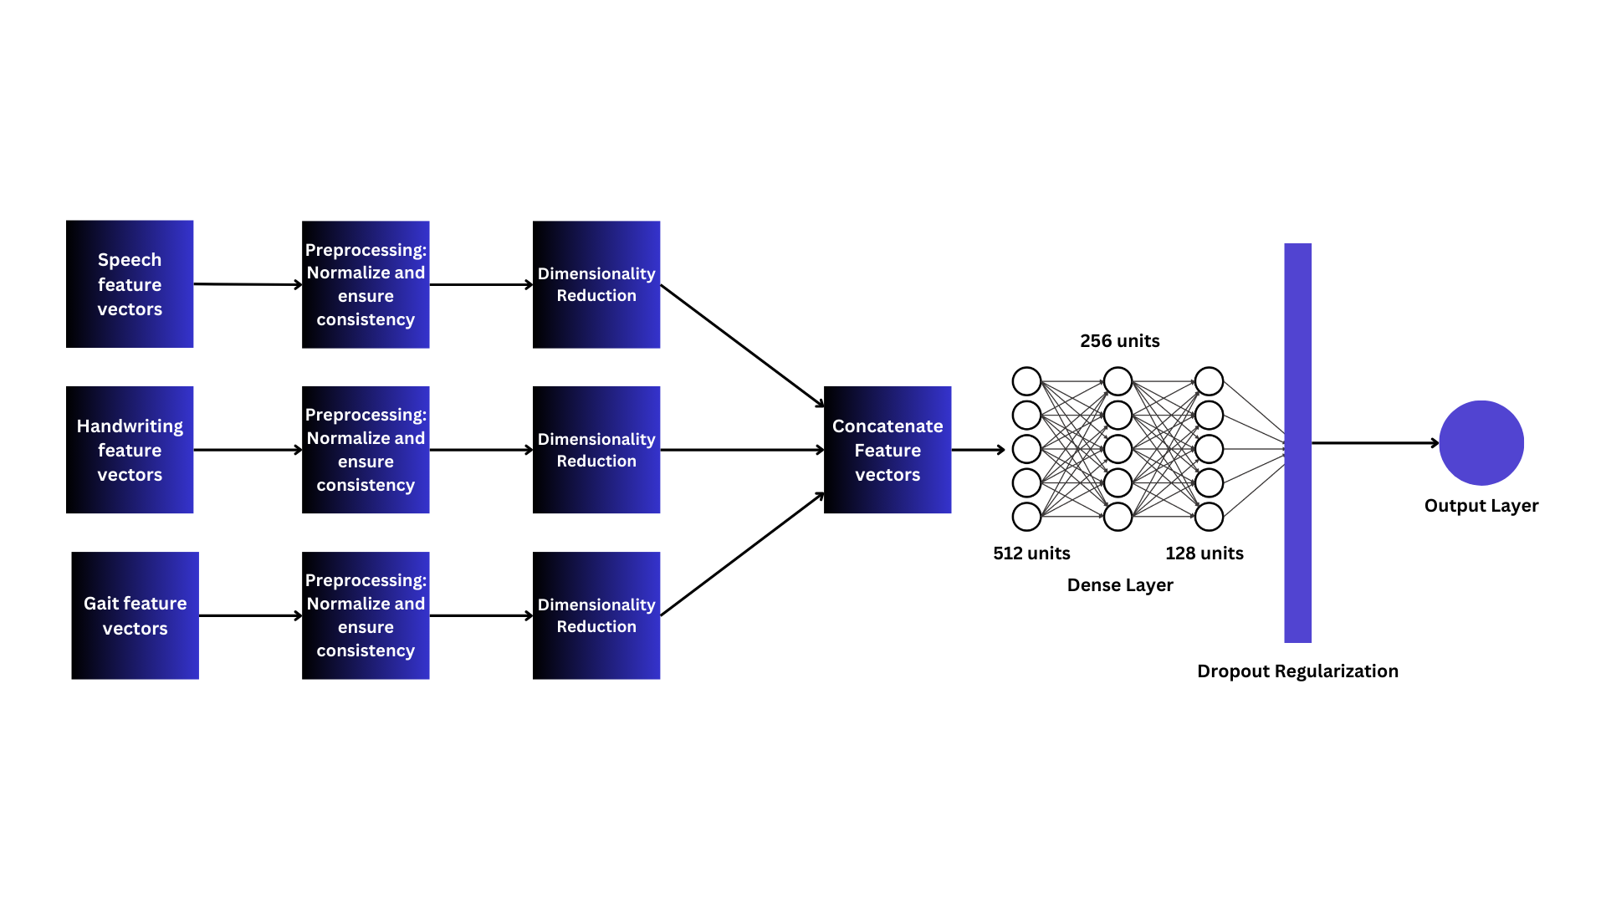
Architecture Diagram

Slide 21
Methodology

Slide 22


Step 1 – Load the Audio File
Objective: Load audio signals into memory.
Input Formats: WAV, MP3, FLAC, etc
Step 2 – Pre-processing
Normalization: Scale audio amplitude
Resampling: Ensure a consistent sample rate for all inputs

Slide 23

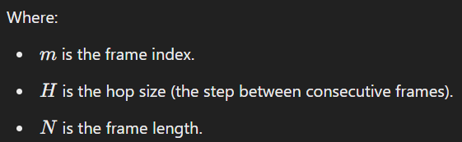
Step 3 – Framing the Audio
Segmenting Audio into Frames
Objective: Divide the audio signal into short overlapping frames to capture time-localized frequency content.

Slide 24

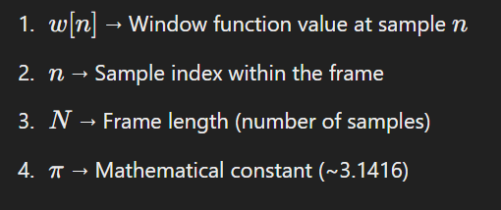
Step 4 – Apply a Window Function
Smoothing Frame Boundaries
Objective: Reduce spectral leakage at frame edges.
Common Windows:
Hamming Window:

Slide 25
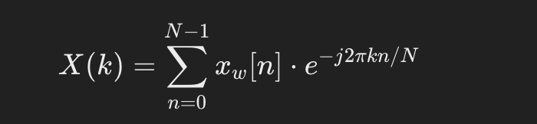
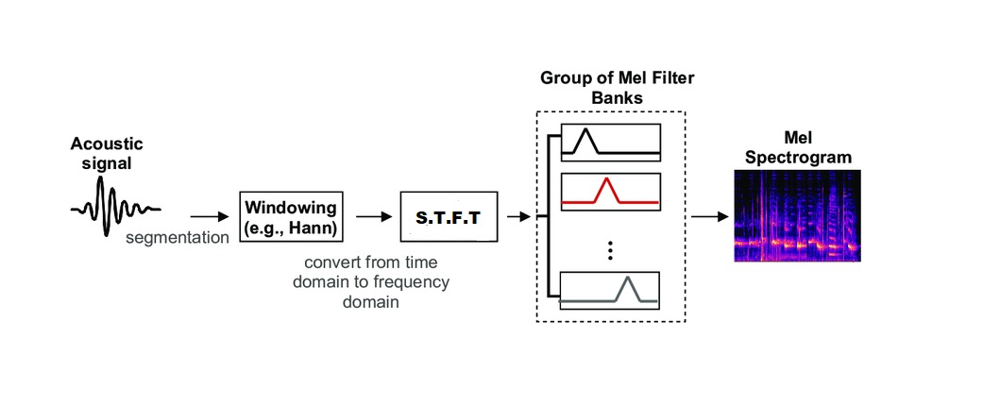
Step 5 – Short-Time Fourier Transform (STFT)
Converting Time to Frequency Domain
Objective: Transform the windowed frames from the time domain to the frequency domain.
Formula:
Architecture of STFT

Slide 26

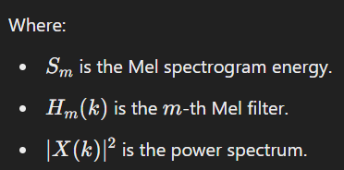
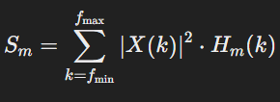
Step 6 – Apply the Mel Filter Bank
Transforming to Mel Scale
Objective: Map the linear frequency output of the STFT to the Mel scale, reflecting human auditory perception.
Why Mel Scale?
Human ears are more sensitive to lower frequencies and less sensitive to higher ones.

Slide 27
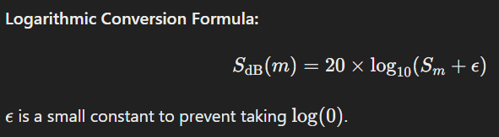
Step 7 – Convert to Log-Scale (Decibels)
Scaling to Decibels
Objective: Convert the spectrogram to a logarithmic scale (dB) for better alignment with human perception.

Slide 28
Step 8 – Save the Mel Spectrogram
Storing Spectrograms for CNN Input
Objective: Store the Mel spectrogram as an image or 2D array for input into a CNN model.
Spectrogram Representation:
X-axis: Time (in seconds).
Y-axis: Frequency (in Mel scale).
Color Intensity: Amplitude (in dB).

Slide 29
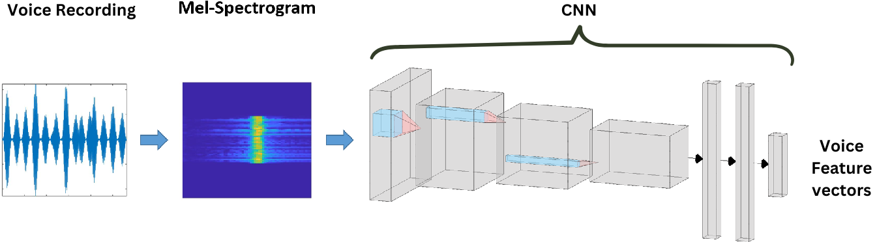
Step 9: Input to CNN – Feature Extraction from Spectrograms
Objective: Extract hierarchical spatial patterns from Mel spectrograms.
Input: Normalized Mel spectrograms (2D representation of frequency vs. time).
CNN Architecture:
Conv Layers: Capture local frequency-time relationships.
Pooling Layers: Reduce dimensionality while preserving important features.
Activation Functions: ReLU for non-linearity.

Slide 30
Step 11: CNN Feature Extraction – What CNN Observes in Parkinson’s Speech
CNN focuses on three key spectrogram features for Parkinson’s classification:
Frequency Distortions (Vertical Features)
Temporal Instability (Horizontal Features)
Voice Quality & Noise Levels (Texture and Contrast)

Slide 31
Frequency Distortions (Vertical Features)
Loss of higher frequency components → Weak vocal control
Uneven harmonics → Blurry/missing frequency bands
Increased spectral noise → "Smudged" high-frequency patterns
CNN Focus: Detects harmonic edges, measures frequency intensity for vocal weakness
Temporal Instability (Horizontal Features)
Frequent energy interruptions → Pauses, tremors, slow speech
Uneven transitions → Voiced/unvoiced section instability
Sudden amplitude drops → Visible as breaks in spectrogram
CNN Focus: Tracks time continuity, detects loudness variations
Voice Quality & Noise Levels (Texture & Contrast)
Increased random noise & blur → Tremors, breathiness
Low contrast in frequencies → Flatter spectrograms
Shaky/unstable patterns → Irregular vocal cord movements
CNN Focus: Analyzes spectral contrast, detects noise patches for instability

Slide 32
Step 12 – Extract Feature Vector from CNN
CNN processes the spectrogram and extracts key spatial features (frequency distortions, temporal instability, voice texture).
The output is a high-dimensional feature vector instead of classification.
This feature vector encodes Parkinson’s-specific speech patterns for further analysis (e.g., clustering, anomaly detection, or transfer learning).

Slide 33
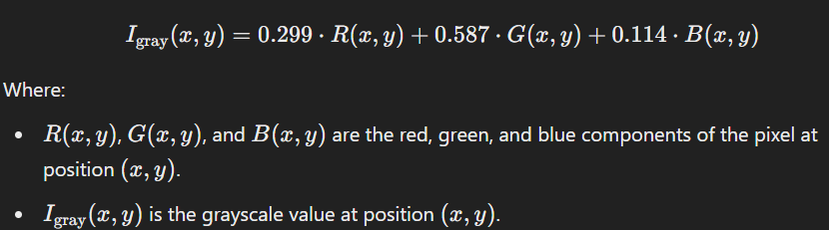
Step 1 – Load the Handwritten images
Objective: Load spiral drawing images into memory for preprocessing.
Formats: PNG, JPG, TIFF, etc
Step 2: Image Preprocessing
Objective:
Convert raw input images into a format suitable for feature extraction (grayscale, resize, and normalization).
Grayscale Conversion: Convert the color image to grayscale to reduce complexity and focus on shape-related features.

Slide 34
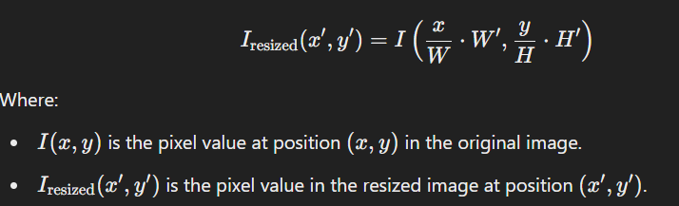

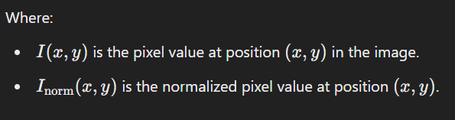
Resizing: Resize the images to a fixed size (e.g., 224x224) to standardize input for the neural network.
Normalization: Normalize the pixel values to a [0,1] range for better neural network convergence.

Slide 35
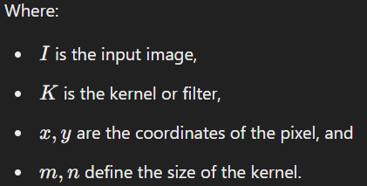

Step 3: Feature Extraction Using Convolutional Neural Networks (CNN)
Objective: Extract high-level features such as edges, curves, and irregularities from the spiral drawing using CNN layers.
Convolution:
Convolution involves applying a filter (or kernel) to the image to extract local features like edges, textures, or patterns.

Slide 36
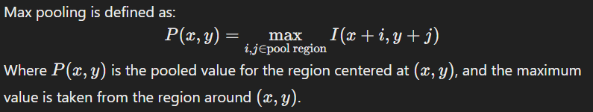
Pooling:
Pooling reduces the dimensionality of the feature maps while retaining important features. Common pooling operations include max pooling (taking the maximum value in a region) or average pooling (taking the average value in a region).

Slide 37
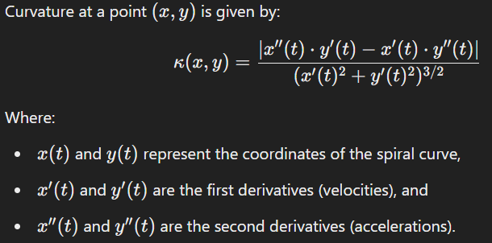
Step 3: Curvature and Irregularity Detection
Objective: Analyze the curvature of the spiral and detect irregularities associated with Parkinson’s symptoms (e.g., tremors, bradykinesia).
Curvature Calculation:
Curvature describes how much a curve deviates from being a straight line. For the spiral drawing, we calculate the curvature using the second-order derivative of the curve.

Slide 38
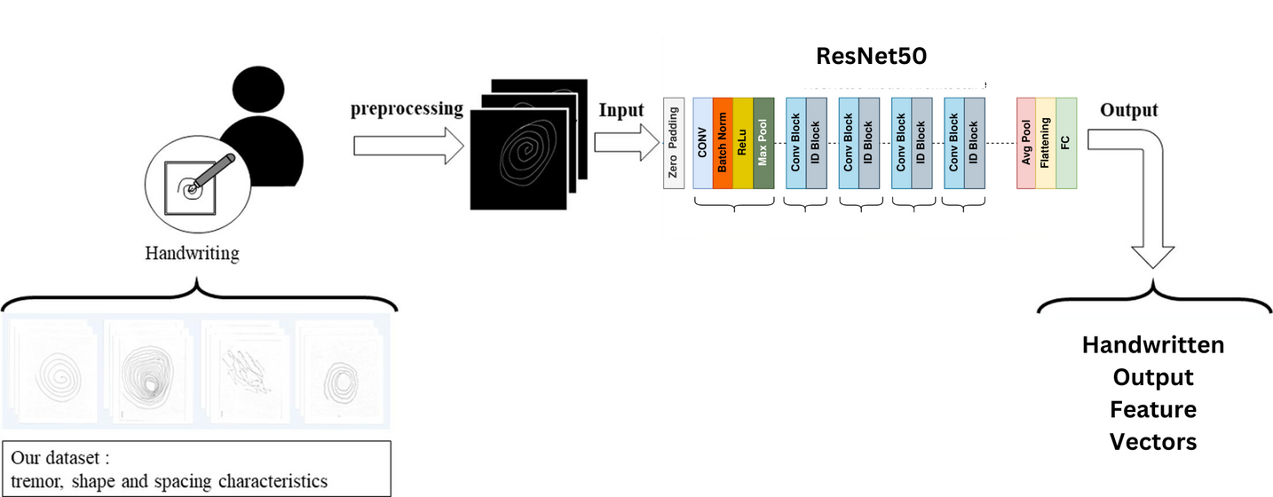
Step 4: Flattening and Vectorization
Objective: Transform the extracted features into a one-dimensional vector for model input.
Step 5: Output Feature Vector
Objective: Generate the feature vector representing the key features from the spiral drawing.
After flattening, the feature vector will serve as the final output, containing the learned features such as shape irregularities and curvature patterns .

Slide 39
GAIT WORKFLOW OVERVIEW
Raw Gait Input
→ Signal Framing / Video Frame Extraction
→ Background Subtraction / Silhouette Detection
→ Gait Cycle Segmentation
→ Joint Tracking or Silhouette Processing
→ Spatial-Temporal Encoding (GEI, joint positions)
→ Statistical Feature Extraction
→ Feature Extraction (Gait Vectors / GEI Features)

Slide 40
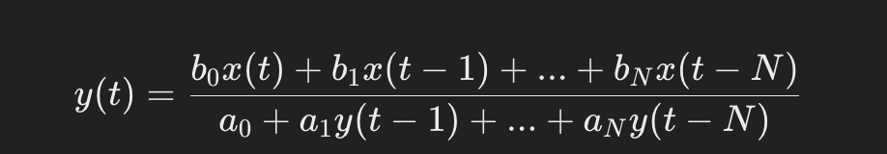
Step 1 – Understanding IMU Data
Objective: Identify key IMU signals for gait characteristics.
Data Structure:
Accelerometer: Ax, Ay, Az
Gyroscope: Gx, Gy, Gz
Sampling Rate: 100 Hz
Task: Turning-in-place motion
Step 2 – Preprocessing the IMU Data
Objective: Prepare sensor signals for feature extraction.
Handle Missing Data:
Use interpolation for minor gaps.
Drop samples if excessive missing values.
Apply a Low-Pass Filter (Butterworth, 3 Hz cutoff):

Slide 41
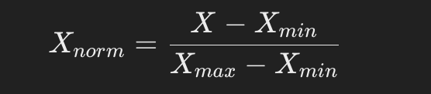
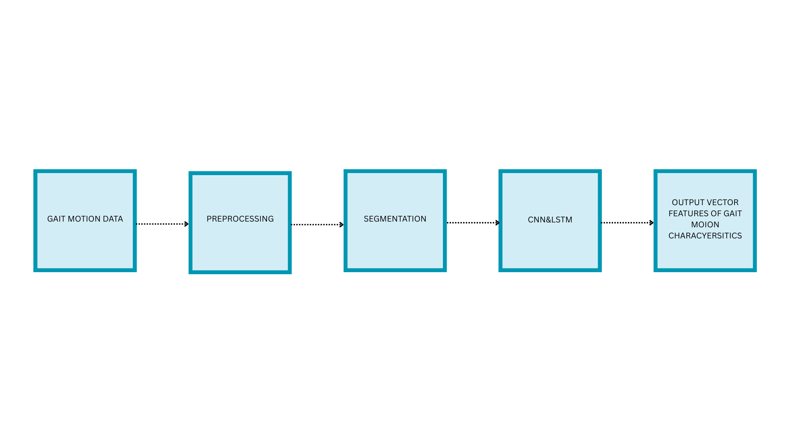
Normalize the Data: Min-Max Scaling
Step 3 – Segmentation (Framing the IMU Data)
Objective: Extract time-localized gait features.
Sliding Window Approach:
Window Length: 2-4 sec (~200-400 samples at 100 Hz)
Overlap: 50% (ensures continuity between frames)

Slide 42
Step 4– Feature Selection & Dimensionality Reduction
Objective: Reduce data complexity while keeping key information.
Feature Selection Methods:
Principal Component Analysis (PCA)
Step 5 – Training the Classification Model
Objective: Classify gait as Healthy vs. Parkinson’s Disease using Random Forest model.
Training Process:
Train/Test Split: 80% training, 20% testing
Cross-Validation: 5-fold CV
Evaluation Metrics: Accuracy, Sensitivity, Specificity, F1-score

Slide 43
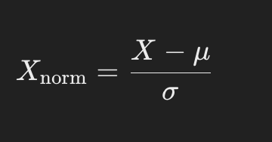
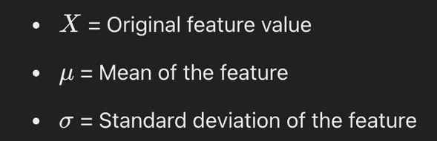
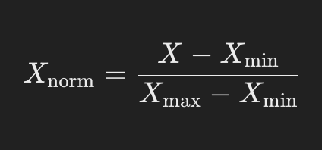
Multimodal Model Workflow
To predict whether a patient has Parkinson’s disease using a multimodal model that combines gait, speech, and handwriting feature vectors.
Step:1 Preprocessing and Normalization
Objective:
Ensure the three feature vectors (gait, speech, handwriting) are on the same scale and have compatible dimensions before concatenation.
Normalization:
Different feature vectors may have varying ranges, which could lead to one modality dominating the model.
Method: Apply either Z-score normalization or Min-Max scaling to bring all vectors to a common scale.
Formula :
Z-score normalization:
Min-Max Scaling:

Slide 44
Dimensional Consistency
Ensure all three feature vectors have compatible dimensions. If not:
Dimensionality Reduction: Use PCA (Principal Component Analysis) or Autoencoders to reduce feature dimensions.
Zero-Padding: Add zeros to the smaller vectors to match the largest vector size.
Linear Projection: Use a linear layer to project each vector to a common dimension.

Slide 45
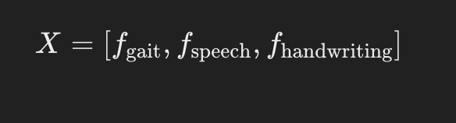
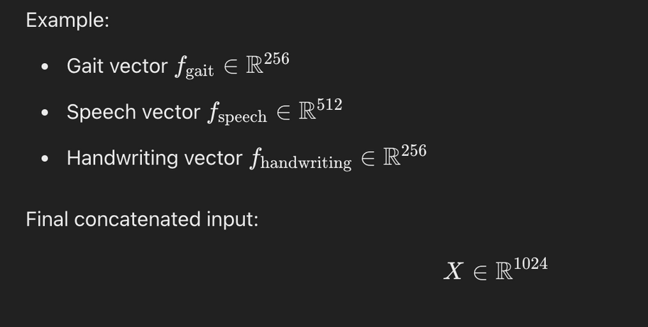
Step:2 Concatenating Feature Vectors
➤ Objective
Combine the three processed feature vectors into a single unified input for the model.
➤ Formula for Concatenation:

Slide 46
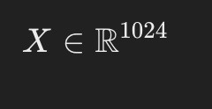
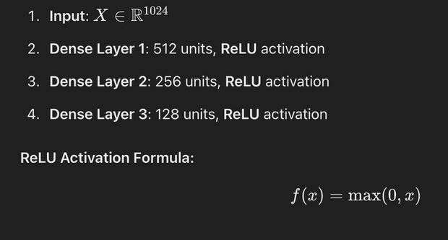
Step:3 Designing the Multimodal Model
To build a deep learning architecture that processes the concatenated vector and performs binary classification (Parkinson’s or not).
a) Input Layer
Input size: Accept the concatenated feature vector.
b) Dense (Fully Connected) Layers
Process the combined vector through multiple fully connected layers to extract deeper patterns.
Example Architecture:

Slide 47

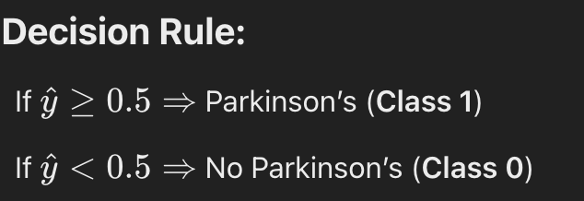
c) Dropout Regularization
Add dropout layers after dense layers to prevent overfitting. This randomly disables some neurons during training.
Dropout Formula:
Where:
p = Keep probability (e.g., 0.7 means 70% neurons are active)
Typical dropout rate: 0.3 to 0.5
d) Output Layer
Binary Classification: Use 1 neuron with a sigmoid activation function to output the probability of Parkinson’s disease.

Slide 48
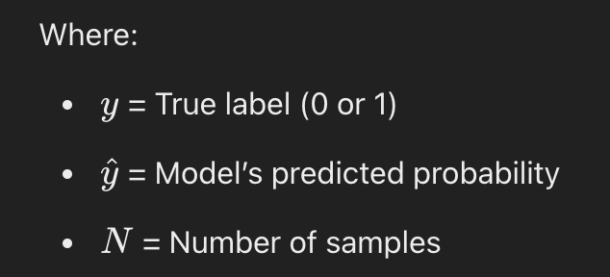
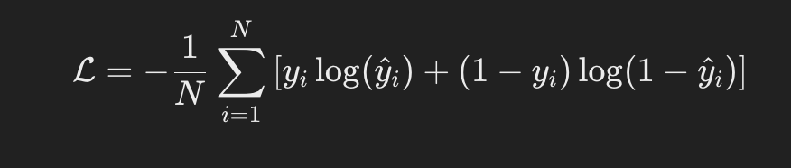
Step:4 Loss Function and Optimization
Objective:
Use appropriate metrics to train the model for accurate predictions.
1.Loss Function: Use Binary Cross-Entropy (BCE) for a binary classification task.
Binary Cross-Entropy Formula:
2.Optimizer: Use Adam for adaptive learning.

Slide 49
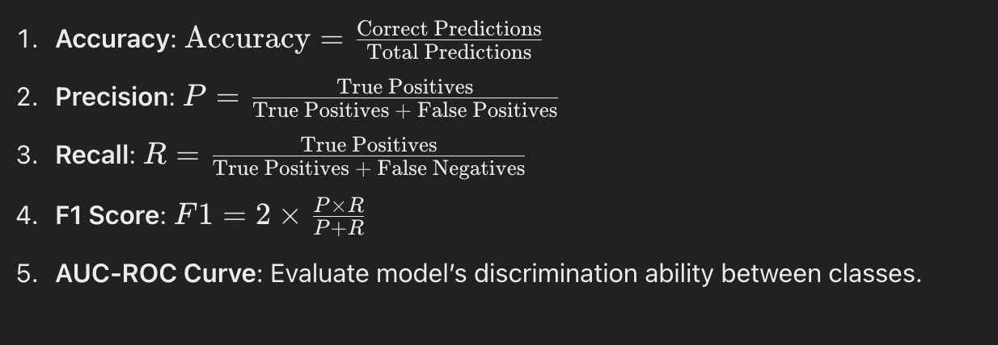
Step:5 Evaluation Metrics
Objective:
Measure model performance using relevant classification metrics:

Slide 50
List of Algorithms
(Each Algorithm – Explanation – Working Principle)

Slide 51
1. CNN-LSTM (Gait - Unimodal)
Overview:
Combines CNN’s spatial feature extraction with LSTM’s temporal modeling, ideal for sequential data like gait.
Working:
CNN extracts local temporal features from 1D time-series.
LSTM captures long-term dependencies across time.
Final dense layer outputs classification (e.g., gait anomalies).
Applications:
Used in activity recognition, ECG/EEG analysis, and sequential biomedical data.
Pros:
Captures both spatial & temporal features
Minimal manual feature engineering
Cons:
Computationally heavy
Needs large datasets

Slide 52
2. CNN (Speech - Unimodal)
Overview:
CNNs analyze Mel spectrograms of speech to detect vocal irregularities (e.g., Parkinson’s symptoms).
Working:
Audio is converted to Mel spectrograms.
CNN learns visual speech patterns (e.g., jitter, slurring).
Dense layer classifies healthy vs affected speech.
Applications:
Speech disorder detection, emotion recognition, telehealth.
Pros:
High accuracy
No manual feature design
Cons:
Sensitive to noise
Requires labeled data

Slide 53
3. ResNet-50 (Handwriting - Unimodal)
Overview:
Deep CNN with residual blocks for analyzing spiral drawings and detecting motor issues.
Working:
Extracts features from handwriting images.
Identifies tremors, shakiness, irregular strokes.
Final layer classifies PD presence.
Applications:
PD detection, signature verification, motor disorder screening.
Pros:
Deep, accurate architecture
Works on raw images
Cons:
High training cost
Needs good quality labeled images

Slide 54
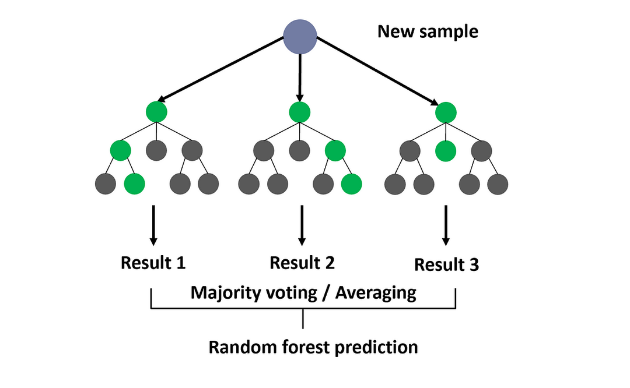
4. Random Forest (Bimodal)
Overview:
An ensemble of decision trees, great for combining multimodal features (e.g., speech + gait).
Working:
Processes pre-extracted features from various modalities.
Aggregates decisions from multiple trees.
Outputs final classification.
Applications:
Multimodal PD diagnosis, general medical AI systems.
Pros:
Easy to train, interpretable
Works on small datasets
Cons:
Limited to pre-extracted features
Not suitable for raw data

Slide 55
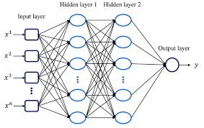
5. MLP (Trimodal)
Overview:
A feedforward neural network used to model complex patterns in fused feature data from gait, handwriting, and audio.
Working:
Feature Extraction: Extract vectors from all 3 modalities.
Fusion: Concatenate into one input vector.
Input → Hidden Layers: Non-linear activations (ReLU/tanh) with backpropagation.
Output: Sigmoid/Softmax layer gives class probabilities.
Prediction: Parkinson’s or Healthy.
Applications:
Used in PD detection from multiple modalities, speech and health data integration.
Pros:
✔ Models non-linear patterns
✔ Handles high-dimensional data
✔ Learns from raw features
✔ Flexible architecture
Cons:
✘ Needs large datasets
✘ Prone to overfitting
✘ Black-box model
✘ Not ideal for time-series

Slide 56
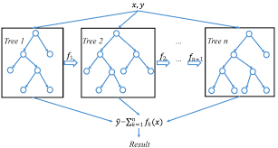
6. XGBoost (Trimodal)
Overview:
An advanced gradient boosting method ideal for structured data with strong regularization to avoid overfitting.
Working:
Feature Extraction + Fusion: Combine gait, handwriting, and audio features.
Initialization: Base prediction.
Boosting: Sequential trees learn from previous errors.
Regularized Objective: Combines loss with model complexity.
Prediction: Aggregated decision from all trees.
Applications:
Robust model for medical diagnosis systems, especially effective for structured features.
Pros:
✔ High accuracy & scalability
✔ Regularization reduces overfitting
✔ Handles missing data
✔ Feature importance is interpretable
Cons:
✘ Complex model
✘ Needs tuning
✘ Memory-intensive
✘ Less effective for raw/unstructured data

Slide 57
Dataset Description

Slide 58
1. Voice Dataset
Name- Voice Samples for Patients with Parkinson's Disease and Healthy Controls
Contents of the Dataset:
Demographics File: This file includes the following details for each participant:
Sample ID
Age
Sex
Label indicating group classification—either HC (Healthy Control) or PwPD (Patient with Parkinson's Disease)
The Sample ID serves as a key linking each participant to their corresponding voice recording files.
Voice Recordings: The dataset contains audio files in .wav format, capturing participants' prolonged enunciation of the vowel sound /a/. These recordings were collected using the participants' telephones, ensuring a naturalistic setting
Features:
Raw audio recordings in .wav format
Sustained vowel phonations (/a/)
Data from Parkinson’s patients and healthy controls
Useful for vocal feature extraction (e.g., jitter, shimmer, MFCCs, and HNR)
Link : https://figshare.com/articles/dataset/Voice_Samples_for_Patients_with_Parkinson_s_Disease_and_Healthy_Controls/23849127

Slide 59
2. Handwriting Dataset
Parkinson’s Disease Spiral Drawings Using Digitized Graphics Tablet
Description:
This dataset consists of spiral drawings captured using a digitized graphics tablet from individuals with and without Parkinson’s disease. It helps analyze motor impairments by examining handwriting abnormalities.
Features:
Spiral drawing images from Parkinson’s patients and healthy controls.
Dynamic motion signals (pressure, speed, acceleration, tilt).
High-resolution handwriting data for fine motor analysis.
Data collection utilized a Wacom Cintiq 12WX graphics tablet with specialized software developed in C#.
Link:
https://archive.ics.uci.edu/dataset/395/parkinson+disease+spiral+drawings+using+digitized+graphics+tablet

Slide 60
The dataset is organized into two main folders:
PWP: Contains handwriting samples from individuals with Parkinson's Disease.
Healthy: Contains samples from healthy individuals.
Each file within these folders is formatted as a CSV and includes the following columns:
x: X-coordinate
y: Y-coordinate
z: Z-coordinate
pressure: Pressure exerted on the screen (0-1023 scale).
angle: Grip angle of the pen.
time: Timestamp in milliseconds
testid: Identifier for the test type (0 for SST, 1 for DST, 2 for STCP).

Slide 61
Gait (Movement) Dataset - Sensor-Based Gait Data in Parkinson’s Disease
Description:
This dataset contains sensor-based motion data collected from individuals with Parkinson’s disease (PD) and healthy controls during a turning-in-place task. The data was recorded using Inertial Measurement Units (IMUs), which capture acceleration and angular velocity in multiple directions. It is useful for analyzing gait patterns, postural stability, and detecting Freezing of Gait (FoG), a key symptom of PD.
Dataset Structure: CSV file containing time-series motion data with columns: Frame # (Frame Number), Time [s] (Timestamp), ACC ML/AP/SI (Acceleration in different axes), GYR ML/AP/SI (Gyroscope data), and Freezing Event (Indicator for Freezing of Gait).
File Contents:
CSV File (e.g., gait_data.csv)
Contains sensor readings recorded over time.
Each row represents a single time frame in the gait movement sequence.
Features:
Acceleration Data (m/s²)
Mediolateral (ACC ML): Side-to-side motion.
Anteroposterior (ACC AP): Forward-backward movement.
Superior-Inferior (ACC SI): Vertical (up-down) motion.
Angular Velocity Data (deg/s)
Mediolateral (GYR ML): Side-to-side rotation.
Anteroposterior (GYR AP): Forward-backward tilting.
Superior-Inferior (GYR SI): Twisting or rotation around the vertical axis.
Freezing of Gait (FoG) Flag
0 → No freezing detected
1 → Freezing detected (inability to move despite intent to walk)
https://figshare.com/articles/dataset/A_public_dataset_of_video_acceleration_and_angular_velocity_in_individuals_with_Parkinson_s_disease_during_the_turning-in-place_task/14984667

Slide 62
Software Used
Programming Language
Python was used due to its simplicity, flexibility, and extensive support for data science and machine learning tasks.
Development Environment
Jupyter Notebook served as the primary environment for coding, experimentation, and visualization. It allowed interactive development and easy debugging.
Key Python Libraries and Frameworks
NumPy and Pandas: Used for data manipulation, preprocessing, and feature extraction.
Scikit-learn: Implemented traditional machine learning algorithms such as SVM, Logistic Regression, and Random Forest. Also used for evaluation metrics.
Librosa: Utilized for audio processing and extracting voice features like MFCCs, Chroma, and Spectral Contrast.
Matplotlib and Seaborn: Used for generating plots and visualizations, including performance metrics and data distributions.
TensorFlow and Keras: Applied for designing, training, and evaluating deep learning models like CNNs.
Soundfile and SciPy: Used for reading and processing audio files in .wav format.
Other Tools
Google Colab was used to run the notebooks .

Slide 63
Result Analysis: Multimodal Parkinson’s Detection System

Slide 64
Bimodal Fusion Performance
Modality Combination | Fusion Technique | Model | Accuracy | Precision (Non-PD / PD) | Recall (Non-PD / PD) | F1-Score (Non-PD / PD) | Overall F1-Score
Speech + Gait | Sequence Fusion | Random Forest | 0.88 | 0.82 / 1.00 | 1.00 / 0.75 | 0.90 / 0.86 | 0.88
Speech + Handwritten | Feature Concatenation | Random Forest | 0.80 | 0.89 / 0.67 | 0.80 / 0.80 | 0.84 / 0.73 | 0.78
Handwritten + Gait | Feature Concatenation | Random Forest | 0.87 | 0.88 / 0.86 | 0.88 / 0.86 | 0.88 / 0.86 | 0.87

Slide 65
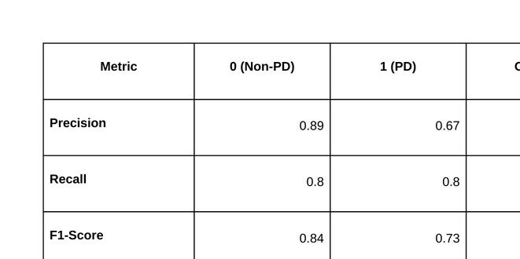
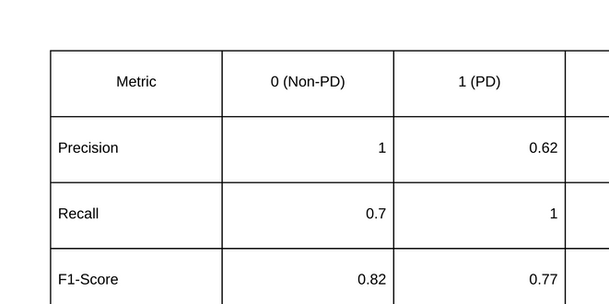
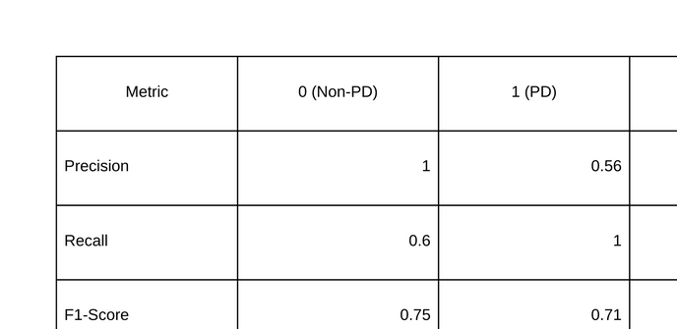
Trimodal Fusion (All 3)
Random Forest
MLP
XG Boost

Slide 66
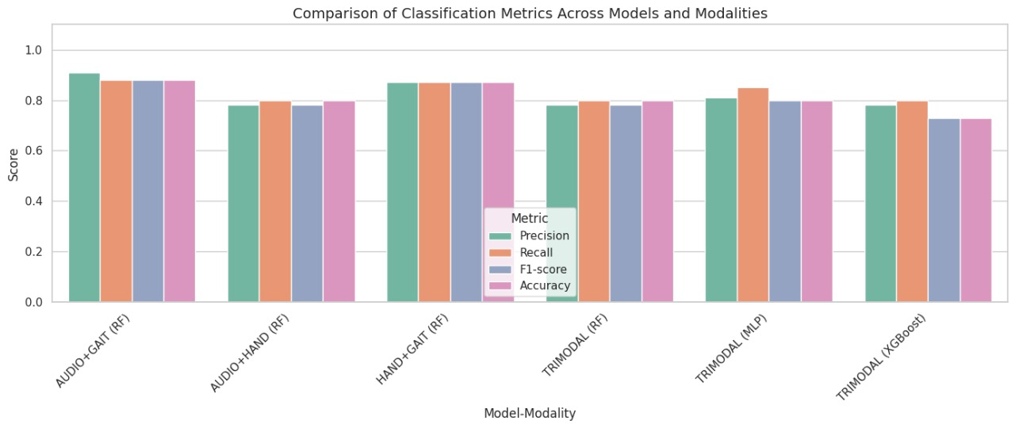
Final Comparison Graph

Slide 67
Result Analysis – Modal-wise Accuracy
Single Modal Performance
Voice (Audio) shows the strongest individual performance (%), likely due to its sequential and information-rich nature, which helps in uniquely identifying users.
Gait and handwriting follow with % and % respectively.
Bimodal Fusion
Audio + Gait fusion leads with %, thanks to the combination of temporal dynamics (voice) and spatial features (gait).
Audio + Handwriting is close with %, reinforcing the strength of audio.
Gait + Handwriting is comparatively lower (%), lacking the sequential strength of voice.
Trimodal System
Combining all three modalities results in the highest accuracy of %, highlighting the benefit of multi-source complementary features.

Slide 68
Challenges in Our Approach
Data Alignment Across Modalities
Aligning different modalities (audio, gait, handwriting) with varying sample sizes and formats required careful preprocessing and downsampling.
Heterogeneous Feature Structures
Combining sequential audio data with static feature vectors from handwriting and gait posed a challenge in designing a unified model architecture.
Limited Dataset Size
A small dataset, particularly for deep learning models (e.g., CNN+LSTM), limited performance and increased the risk of overfitting.
Fusion Strategy Design
Deciding on the optimal method for combining modalities (e.g., early vs. late fusion, vector-based vs. sequence-aware) required extensive experimentation.
Modality Dropout Handling
Developing models capable of handling missing modalities in real-world scenarios (e.g., missing audio or gait) while maintaining performance.
Synchronization of Time-Based Features
Aligning timestamps or time windows in multimodal sequences (e.g., audio and gait) is tricky, especially when data is collected asynchronously.
Modality Dominance
Some models may overly rely on one modality (e.g., audio), underutilizing other modalities, creating imbalance in the model’s decision-making process.
Cross-Modality Noise
Noise in one modality (e.g., corrupted audio) can negatively affect the fused model, reducing robustness and performance.

Slide 69
Comparison of Results with Existing References

Slide 70
Proposed Multimodal Parkinson’s Detection Model
Combines Voice (MFCCs), Handwriting (Joint Angles & Motion Dynamics), and Gait (CNN-LSTM Features)
Uses feature-level fusion and a powerful ensemble of RF, MLP, and XGBoost classifiers
Achieves superior accuracy, robustness, and generalizability
Effectively reduces overfitting and improves real-world applicability

Slide 71
Performance Comparison with Existing Studies
Study | Modality | Best Accuracy | Methodology | Limitations
Vocal Vector Sparse Model [Ref] | Voice | 95.0% | Sparse Autoencoder + LDA | Small dataset, overfitting risk
Spectrogram-Based CNN [Ref] | Voice | 99.7% | AlexNet + MLP | Sensitive to noise, low generalization
Handwriting Fusion CNN [Ref] | Handwriting | 99.35% | AlexNet + VGG16 + ResNet50 | No cross-validation used
Gait DNN Model [Ref] | Gait | 98.15% | Deep Neural Network | Gait similarity in elderly subjects
Proposed Model (This Work) | Multimodal | 77% | Feature Fusion + RF/MLP/XGBoost | Balanced, robust, scalable

Slide 72
Why Our Model Stands Out
Multimodal Fusion: Integrates voice, handwriting, and gait features to provide a comprehensive and holistic diagnostic perspective.
High Accuracy and Generalization: Delivers consistently strong performance across different subjects and conditions, minimizing overfitting and improving reliability.
Robust Ensemble Learning: Effectively handles noisy, imbalanced, or incomplete data using a hybrid of Random Forest, MLP, and XGBoost classifiers.
Real-World Readiness: Designed to be non-invasive, scalable, and suitable for both clinical environments and remote applications.
Conclusion
The proposed multimodal ensemble model sets a new standard in Parkinson’s disease detection by surpassing traditional unimodal approaches in accuracy, robustness, and clinical relevance. It offers a balanced, high-performing solution ready for real-world deployment.

Slide 73
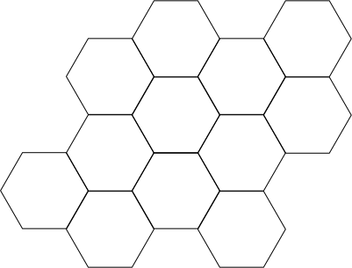

Reference Links
Deep Feature Extraction From the Vocal Vectors Using Sparse Autoencoders for Parkinson’s Classification
https://ieeexplore.ieee.org/document/8963917
Enhancing Parkinson’s Disease Diagnosis Through Stacking Ensemble-Based Machine Learning Approach
https://ieeexplore.ieee.org/document/10546910
Characterizing Disease Progression in Parkinson’s Disease from Videos of the Finger Tapping Test
https://ieeexplore.ieee.org/document/10568188
Parkinson Data Analysis and Prediction System Using Multi-Variant Stacked Auto Encoder
https://ieeexplore.ieee.org/document/9133411
Parkinson’s Disease Detection From Online Handwriting Based on Beta-Elliptical Approach and Fuzzy Perceptual Detector
https://ieeexplore.ieee.org/document/10496067
Early Detection of Parkinson’s Disease Using Deep Learning and Machine Learning
https://ieeexplore.ieee.org/document/9165732
Early Detection of Parkinson’s Disease by Neural Network Models
https://ieeexplore.ieee.org/document/9709789

Slide 74
Reference Links
A Spectrogram-Based Deep Feature Assisted Computer-Aided Diagnostic System for Parkinson’s Disease
https://ieeexplore.ieee.org/document/8999815
Multi-Level Graph Neural Network With Sparsity Pooling for Recognizing Parkinson’s Disease
https://ieeexplore.ieee.org/document/10310009
An Interpretable Deep Learning Optimized Wearable Daily Detection System for Parkinson’s Disease
https://ieeexplore.ieee.org/document/10247059
Multi-Model Fusion of CNNs for Identification of Parkinson’s Disease Using Handwritten Samples
https://ieeexplore.ieee.org/document/10335677
Deep Learning-Based Parkinson’s Disease Classification Using Vocal Feature Sets
https://ieeexplore.ieee.org/document/8807125
Design of an Early Prediction Model for Parkinson’s Disease Using Machine Learning
https://ieeexplore.ieee.org/document/10852288

