Slide 2
Image Steganography
Steganography is the study and practice of concealing information within objects in such a way that it deceives the viewer as if there is no information hidden within the object. Simply put, it is hiding information in plain sight, such that only the intended recipient would get to see it.

Slide 3
Methodology
Let’s consider a scenario where two employees are expected to exchange official messages via email. In this case, we know that they will exchange messages, and hence, there is no need for them to hide those messages. However, as those messages might contain sensitive information, they might want to encrypt-decrypt it using cryptography. On the contrary, consider information exchange between a spy, operating undercover in the opponents’ military regiment and his parent organization, with whom he wants to share important information.

Slide 4
In this case, the officers would be monitoring pretty much everything that goes in and out of his room. Hence, if he resorts to using cryptography to share encrypted information, officers might get suspicious. In such a situation, he might prefer image steganography, where he would deceptively hide a message within another object/message, without raising suspicions, and find a way to drop it off to his recipient. In summary, cryptography hides the meaning of the data, while steganography hides the existence of the data. Although they are different techniques, they might as well be used in combination, in the same instance, to get the best of both worlds.

Slide 5
How it’s been used from ancient days
Steganography has been with us for ages, be it the spies in the Revolutionary War writing in invisible ink or Da Vinci embedding a secret meaning in a painting. Steganography traces its roots back to 500 BC. The first physical case of steganography is found in Histories by Herodotus, where he talks about the Greek leader Histiaeus’ act. Histiaeus was stuck in an enemy camp and was in dire need of sending a message to his camp.

Slide 6
He then resorted to shaving a trusted slave’s head, tattooing a secret message on his scalp, letting his hair grow, and then sending him off to be shaved again by the message’s recipient.On the other end of the timeline, steganography is also being used recently. It is expected to be in use in the forthcoming years. For example, it was used very recently to drop malware into user’s computers, by sending them innocent-looking messages but hiding the malware within, using steganography techniques.

Slide 7
Applications of Steganography
Although the prime objective is to share messages or information discreetly, it has found varied fields of applications such as Hackers using steganography techniques for malware transmission Intelligence agencies use them for communication. Printers also use micro-dots as a steganography tool to embed timestamps and date information within the document. Also, the same technique is used in bank-note printing, to prevent colour copiers from reproducing images of currency as fake-notes.

Slide 8
Image Steganography
Before diving into steganography, it is important to understand pixels and colour models. A pixel is the smallest building of an image and the colours in any pixel are (assume RGB) a function of the combination of proportions of red, green, and blue. So a pixel with a value of 0, 0, and 1 would mean 0 parts of red, 0 parts of green and 1 part of blue; in essence, this would turn out to be a blue pixel. In the case of an 8-bit system, a pixel can accommodate up to 8 digits (zeros or ones), and the largest number that could be represented in 8 digits is 11111111 which would be 255, and the smallest number that could be represented in 8 digits, would be 00000000 which would be 0. So any pixel in an 8-bit scenario could accommodate anything between 0 to 255 as a value for each of the colours. Now let’s say a random 8-bit grid has 3 pixels and each pixel having the below values for R, G, and B.

Slide 9
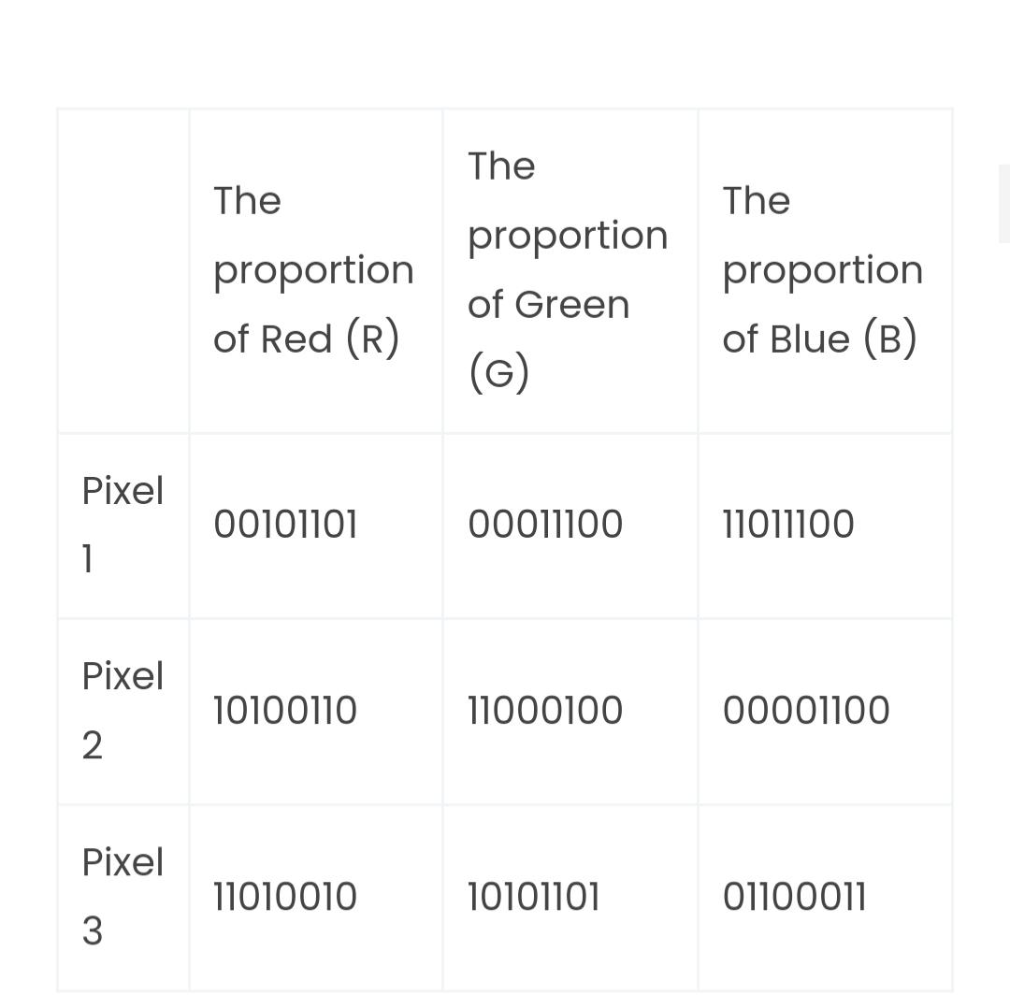
And if we want to house a secret number 200, we get the binary value of that number, i.e, 11001000. and use each digit of that number to replace the least significant digit (mostly the last digit) of our pixel grid, indicated in bold red font. The new colour scheme would be as below:

Slide 10
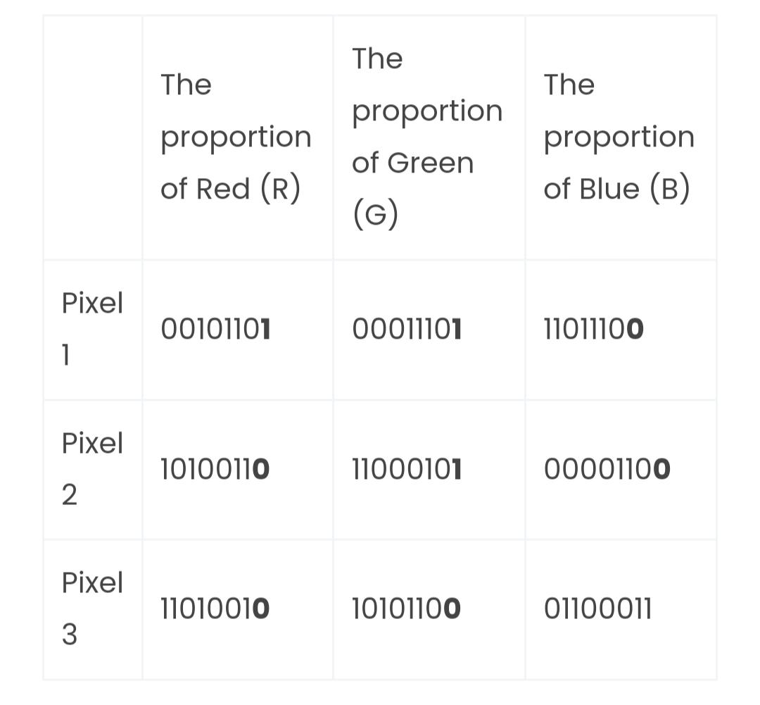
This would alter colours in the original image in the three channels for the 3 pixels by the smallest amount, thereby rendering the alerted image almost indistinguishable from the original image.

Slide 11
Detecting Steganography
Although it might be possible to detect physical steganography, it is extremely difficult to detect digital steganography. Even if some activity is suspected, say some messages are hidden within images, trying to monitor all images that are exchanged, and comparing them to source images would result in lots of false positives and false negatives. That said, experts still use a variety of techniques, including image histogram comparisons to detect hidden messages, ‘conditional’ to them suspecting some covert message exchange.

Slide 12
Is it a secure method of communication
When steganography is employed alone, it is security by obscurity, which might result in the secret message being disclosed. Combining steganography and cryptography is the greatest way to disguise a message from adversaries while still protecting it in case it is detected.

Slide 13
References
https://www.mygreatlearning.com/blog/image-steganography-explained/
https://www.google.com/amp/s/www.geeksforgeeks.org/image-steganography-in-cryptography/amp/

