Slide 1

UNIVERSITY INSTITUTE OF COMPUTING
UNIT-2
Master of Computer Applications
Front end Web UI Framework and tools
24CAT-604
INTRODUCTION TO BASICS OF HTML
DISCOVER . LEARN . EMPOWER

Slide 2

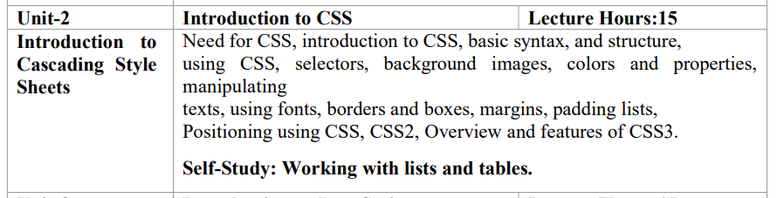
Syllabus
Unit-II
2
3

Slide 3

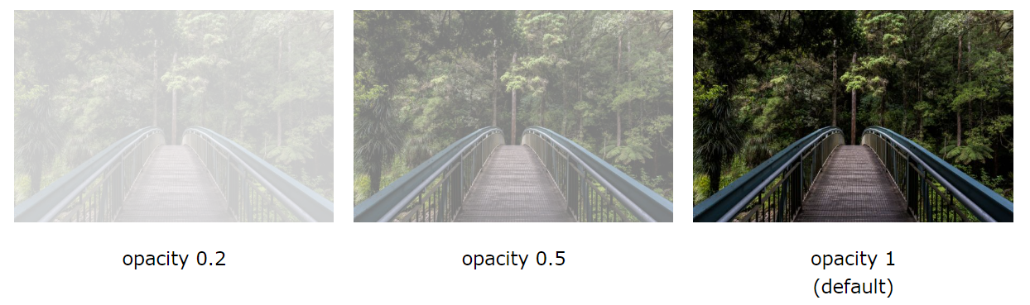
opacity property
Transparent Image
The opacity property can take a value from 0.0 - 1.0. The lower value, the more transparent:

Slide 4
opacity property
Transparent Image
The opacity property can take a value from 0.0 - 1.0. The lower value, the more transparent:

Slide 5
opacity property
Example
img { opacity: 0.5; }

Slide 6

:
Transparent Hover Effect
The opacity property is often used together with the :hover selector to change the opacity on mouse-over:
Example
img { opacity: 0.5; } img:hover { opacity: 1.0; }

Slide 7
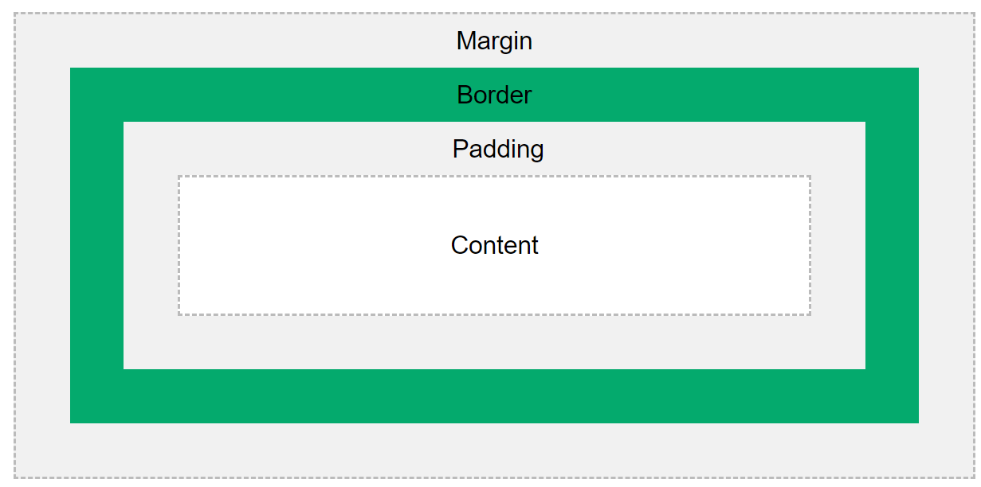
The CSS Box Model
In CSS, the term "box model" is used when talking about design and layout.
The CSS box model is essentially a box that wraps around every HTML element. It consists of: margins, borders, padding, and the actual content. The image below illustrates the box model:

Slide 8
The CSS Box Model
Explanation of the different parts:
Content - The content of the box, where text and images appear
Padding - Clears an area around the content. The padding is transparent
Border - A border that goes around the padding and content
Margin - Clears an area outside the border. The margin is transparent
The box model allows us to add a border around elements, and to define space between elements.
Example
div { width: 300px; border: 15px solid green; padding: 50px; margin: 20px; }

Slide 9
CSS Fonts
Font Selection is Important
Choosing the right font has a huge impact on how the readers experience a website.
The right font can create a strong identity for your brand.
Using a font that is easy to read is important. The font adds value to your text. It is also important to choose the correct color and text size for the font.

Slide 10
CSS Fonts
Font Selection is Important
Choosing the right font has a huge impact on how the readers experience a website.
The right font can create a strong identity for your brand.
Using a font that is easy to read is important. The font adds value to your text. It is also important to choose the correct color and text size for the font.

Slide 11
CSS Fonts
Generic Font Families
In CSS there are five generic font families:
Serif fonts have a small stroke at the edges of each letter. They create a sense of formality and elegance.
Sans-serif fonts have clean lines (no small strokes attached). They create a modern and minimalistic look.
Monospace fonts - here all the letters have the same fixed width. They create a mechanical look.
Cursive fonts imitate human handwriting.
Fantasy fonts are decorative/playful fonts.
All the different font names belong to one of the generic font families.

Slide 12
CSS Icons
Icons can easily be added to your HTML page, by using an icon library.
How To Add Icons
The simplest way to add an icon to your HTML page, is with an icon library, such as Font Awesome.
Add the name of the specified icon class to any inline HTML element (like <i> or <span>).
All the icons in the icon libraries below, are scalable vectors that can be customized with CSS (size, color, shadow, etc.)

Slide 13
CSS Icons
Font Awesome Icons
To use the Font Awesome icons, go to fontawesome.com, sign in, and get a code to add in the <head> section of your HTML page:
<script src="https://kit.fontawesome.com/yourcode.js" crossorigin="anonymous"></script>
Note: No downloading or installation is required!

Slide 14
CSS Links
With CSS, links can be styled in many different ways.
Styling Links
Links can be styled with any CSS property (e.g. color, font-family, background, etc.).
Example
a { color: hotpink; }
In addition, links can be styled differently depending on what state they are in.
The four links states are:
a:link - a normal, unvisited link
a:visited - a link the user has visited
a:hover - a link when the user mouses over it
a:active - a link the moment it is clicked

Slide 15
CSS Links
Example
/* unvisited link */ a:link { color: red; } /* visited link */ a:visited { color: green; } /* mouse over link */ a:hover { color: hotpink; } /* selected link */ a:active { color: blue; }

Slide 16
CSS Layout – Overflow
The CSS overflow property controls what happens to content that is too big to fit into an area.
The overflow property specifies whether to clip the content or to add scrollbars when the content of an element is too big to fit in the specified area.
The overflow property has the following values:
visible - Default. The overflow is not clipped. The content renders outside the element's box
hidden - The overflow is clipped, and the rest of the content will be invisible
scroll - The overflow is clipped, and a scrollbar is added to see the rest of the content
auto - Similar to scroll, but it adds scrollbars only when necessary
By default, the overflow is visible, meaning that it is not clipped and it renders outside the element's box

Slide 17
CSS Layout – Overflow
Example
div { width: 200px; height: 65px; background-color: coral; overflow: visible; }

Slide 18
REFERENCES
https://www.w3schools.com/css/css_syntax.asp
https://www.tutorialspoint.com/css/index.htm
https://www.codecademy.com/learn/learn-css

Slide 19
THANK YOU

