Slide 1

UNIVERSITY INSTITUTE OF COMPUTING
UNIT-2
Master of Computer Applications
Front end Web UI Framework and tools
24CAT-604
INTRODUCTION TO BASICS OF HTML
DISCOVER . LEARN . EMPOWER

Slide 2

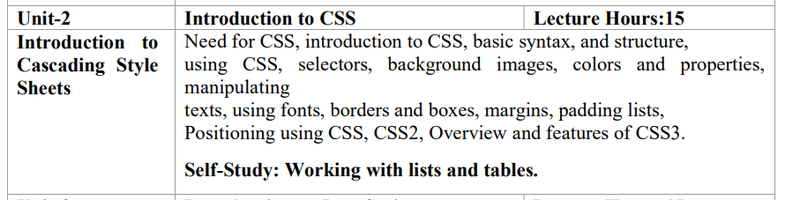
Syllabus
Unit-II
2
3

Slide 3
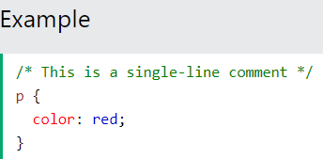

CSS Comments- Comments are used to explain the code, and may help when you edit the source code at a later date. Comments are ignored by browsers. A CSS comment is placed inside the <style> element, and starts with /* and ends with */:

Slide 4
CSS Colors-
CSS Color property is used to set the color of HTML elements. This property is used to set font color, background color, etc. The color of an element can be defined in the following ways:
Built-In Color
RGB Format
RGBA Format
Hexadecimal Notation
HSL
HSLA

Slide 5


Slide 6
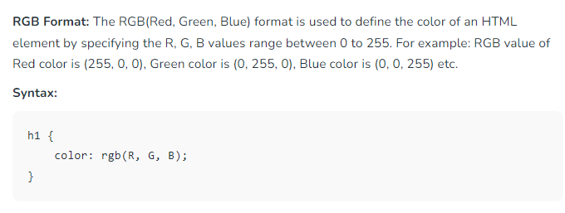
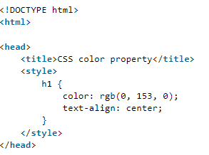

Slide 7

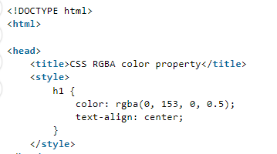

Slide 8



Slide 9
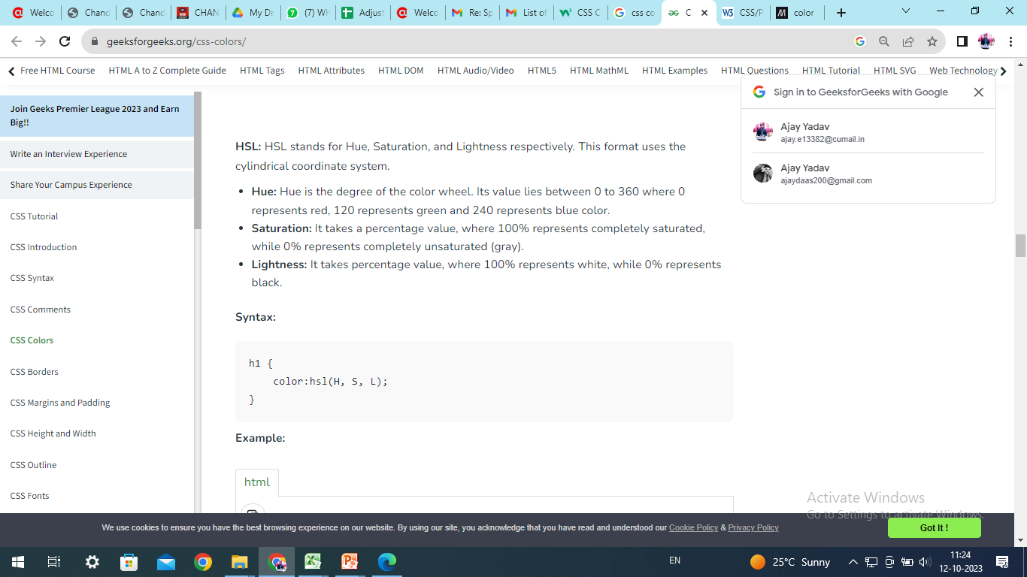

HSL: HSL stands for Hue, Saturation, and Lightness respectively. This format uses the cylindrical coordinate system.

Slide 10
CSS Background-The CSS background properties are used to define the background effects for elements. There are lots of properties to design the background.
CSS background properties are as follows:
CSS Background-color Property: The background-color property in CSS is used to specify the background color of an element.
CSS Background-image Property: The background-image property is used to set one or more background images to an element.
CSS Background-repeat Property: The background-repeat property in CSS is used to repeat the background image both horizontally and vertically.
CSS Background-attachment Property: The background-attachment property in CSS is used to specify the kind of attachment of the background image with respect to its container.
CSS Background-position Property: In CSS body-position property is mainly used to set an image at a certain position.
CSS Background-origin Property: The background-origin is a property defined in CSS which helps in adjusting the background image of the webpage.
CSS Background-clip Property: The background-clip property in CSS is used to define how to extend the background (color or image) within an element.

Slide 11
Background color Property: This property specifies the background color of an element. A color name can also be given as: “green”, a HEX value as “#5570f0”, an RGB value as “rgb(25, 255, 2)”. }
Syntax: body { background-color:color name }

Slide 12

Example: This example shows the use of the background-color property in CSS.

Slide 13
REFERENCES
https://www.w3schools.com/css/css_syntax.asp
https://www.tutorialspoint.com/css/index.htm
https://www.codecademy.com/learn/learn-css

Slide 14
THANK YOU

