Slide 1




Lending Club Case Study
#LifeKoKaroLift
Submitted by: Vishal Arora
1

Slide 2






Application of EDA approach
Problem Statement and business objectives
Data understanding
Agenda
Data cleaning and manipulation
Derive Columns for analysis
Univariate analysis
Bi-variate analysis
Mutivariate analysis and correlation matrix

Slide 3
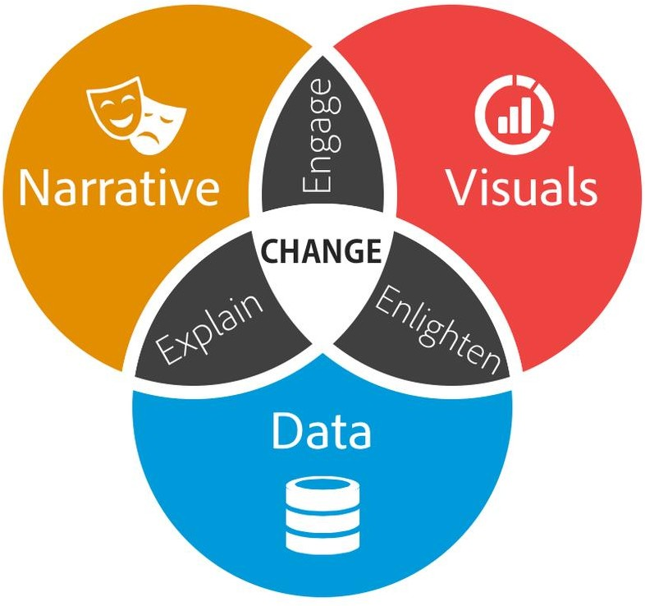
Problem Statement
The case study is based on a consumer finance company. The company specializes in lending different types of loans to urban customers. When the company receives a loan application, the company has to make a decision for loan approval based on the applicant’s profile. Two types of risks are associated with the bank’s decision:
If the applicant is likely to repay the loan, then not approving the loan results in a loss of business to the company
If the applicant is not likely to repay the loan, i.e. he/she is likely to default, then approving the loan may lead to a financial loss for the company
The data shared by UpGrad contains the information about past loan applicants and whether they ‘defaulted’ or not.
The aim is to identify patterns which indicate if a person is likely to default, which may be used for taking actions such as denying the loan, reducing the amount of loan, lending (to risky applicants) at a higher interest rate, etc.

Slide 4
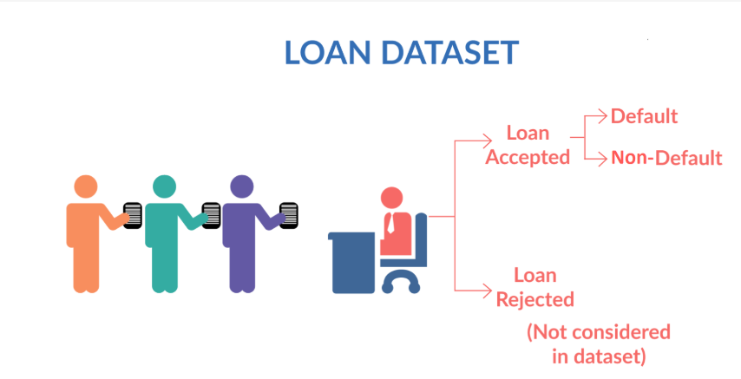
Problem Statement
When a person applies for a loan, there are two types of decisions that could be taken by the company:
(1) Loan accepted: If the company approves the loan, there are 3 possible scenarios described below:
1.1 Fully paid: Applicant has fully paid the loan (the principal and the interest rate)
1.2 Current: Applicant is in the process of paying the instalments, i.e. the tenure of the loan is not yet completed. These candidates are not labelled as 'defaulted'.
1.3 Charged-off: Applicant has not paid the instalments in due time for a long period of time, i.e. he/she has defaulted on the loan
(2) Loan rejected: The company had rejected the loan (because the candidate does not meet their requirements etc.). Since the loan was rejected, there is no transactional history of those applicants with the company and so this data is not available with the company (and thus in this dataset)

Slide 5

Business Objective
Lending loans to ‘risky’ applicants is the largest source of financial loss (called credit loss). Credit loss is the amount of money lost by the lender when the borrower refuses to pay or runs away with the money owed.
In other words, borrowers who default cause the largest amount of loss to the lenders. In this case, the customers labelled as 'charged-off' are the 'defaulters'.
The business objective is to identify risky loan applicants, then such loans can be reduced thereby cutting down the amount of credit loss.

Slide 6
Application of EDA approach
Business Understanding & Data Exploration
Data Overview
Data Cleaning & Manipulation
Derive Columns for analysis
Exploratory Data Analysis
Summary & Suggestions
Correlation Matrix
Perform Multivariate Analysis
Perform Bivariate Analysis
Perform Univariate Analysis

Slide 7
Data Overview
(39717, 111) <class 'pandas.core.frame.DataFrame'> RangeIndex: 39717 entries, 0 to 39716 Columns: 111 entries, id to total_il_high_credit_limit dtypes: float64(74), int64(13), object(24) memory usage: 33.6+ MB None id int64 member_id int64 loan_amnt int64 funded_amnt int64 funded_amnt_inv float64 ... tax_liens float64 tot_hi_cred_lim float64 total_bal_ex_mort float64 total_bc_limit float64 total_il_high_credit_limit float64 Length: 111, dtype: object

Slide 8

Data Cleaning
& Manipulation

Slide 9
Data Cleaning & Manipulation
There are no duplicate rows in loan dataset
Number of empty columns 54 (There are 54 columns have all missing values)
Dropping sequence all columns have null values (Column from 53 to 104)
Drop additional columns which do not make any sense in the entire analysis
Reasons for each fields
member_id: This is unique field and does not have any relevance to our analysis
emp_title: This does not have relevance as there is no standard and business sense (Such as : Rydeer, Veolia Transportaton)
pymnt_plan: This contains only "n" and does not make any sense in analysis
# url: This has no business relevance

Slide 10
Data Cleaning & Manipulation
desc: This is non standard remarks by data entry person which do not have any relevance in analysis
zip_code: This contains information where first 3 digits are available and last 2 digits are xx example 860xx. We have better field next to it addr_state which we can use for analysis.
next_pymnt_d: This fiels contains 1140 records out out of 39717 and do not add any value to our analysis
collections_12_mths_ex_med: This contains 0 or NA and do not add any value to analysis
mths_since_last_major_derog: This contains NA and do not add any value to analysis
tax_liens: This contains 0 or NA and do not add any value to analysis

Slide 11
Data Cleaning & Manipulation
There are no duplicate rows in loan dataset
Number of empty columns 54 (There are 54 columns have all missing values)
tot_hi_cred_lim : This contains NA and do not add any value to analysis
total_bal_ex_mort : This contains NA and do not add any value to analysis
total_bc_limit : This contains NA and do not add any value to analysis
total_il_high_credit_limit : This contains NA and do not add any value to analysis
Number of empty rows 0
Drop additional columns which are not needed further in analysis and reasons for it
application_type: This contains only value " INDIVIDUAL" which do not add any value to analysis
policy_code: This contains only value "1" which do not add any value to analysis
initial_list_status: This contains only value "f" which do not add any value to analysis

Slide 12
Data Cleaning & Manipulation
We have left finally with Rows: 39717 and Columns: 42
pub_rec_bankruptcies is cleaned for further analysis
There were 697 Null values(na) which are replaced with Not Known
Remove % symbol from interest rate column so that it can be used in calculations
Int_rate
revol_until
convert amount columns into numeric data to find correlation among important variables.['loan_amnt','funded_amnt','int_rate','funded_amnt_inv','installment','annual_inc','dti','emp_length','total_pymnt']
We are remaining with 39717 Rows and 42 Columns for conducting analysis

Slide 13
Derive Columns for Analysis
Two new columns month and year were derived from issue date
Categorize loan amounts into buckets which will help in analysis further in bivariate analysis
'0-7000', '7000-14000', '14000-21000', '21000-28000', '28000 +'
Categorize interest rates into buckets which will help in analysis further in bivariate analysis.
'0-10', '10-13', '12.5-16', '16 +‘
Categorize dti(Debt to interest ratio) into buckets for bivariate analysis.
'0-5', '05-10', '10-15', '15-20', '25+'
Finally we are remaining with 39717 Rows and 48 Columns for conducting analysis

Slide 14
Data Analysis

Slide 15
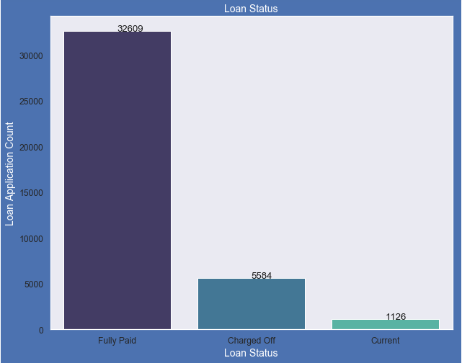
Univariate Analysis
14% loans were charged off out of total loan issued.
83% loans were fully paid out of total loan issued.
Fully Paid 82.96 %
Charged Off 14.17 %
Current 02.87 %

Slide 16
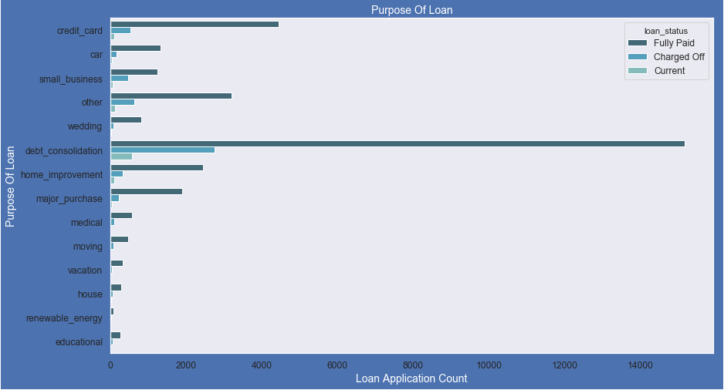
Univariate Analysis
Purpose of Loans
Larger portion of loans were taken for the purpose of debt consolidation & paying credit card bill.
Number of charged off counts also high for these loans.
Loan Purpose Percentage
debt_consolidation 46.93%
credit_card 12.92%
other 10.05%
home_improvement 7.49%
major_purchase 5.51%
small_business 4.60%

Slide 17
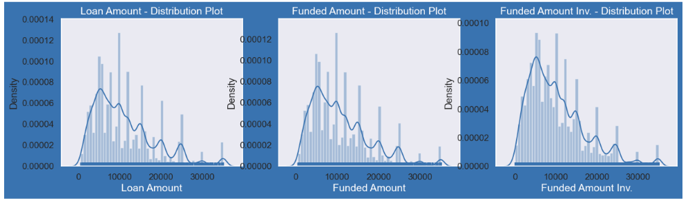
Univariate Analysis
Distribution of three loan amount fields using distribution plot.
Distribution of amounts for all three looks very much similar.
We will work with only loan amount column for rest of our analysis.

Slide 18
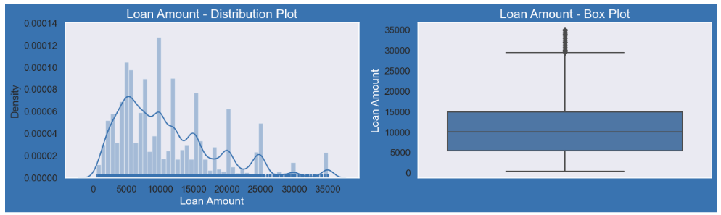
Univariate Analysis
Plots show that most of the Loan amounts are in range of 5000 - 15000

Slide 19
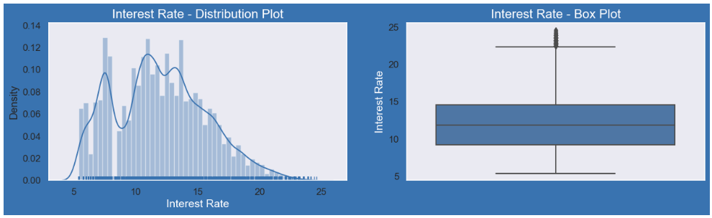
Univariate Analysis
Plot show that most of the Interest Rates on loans are in range of 10% - 15%

Slide 20
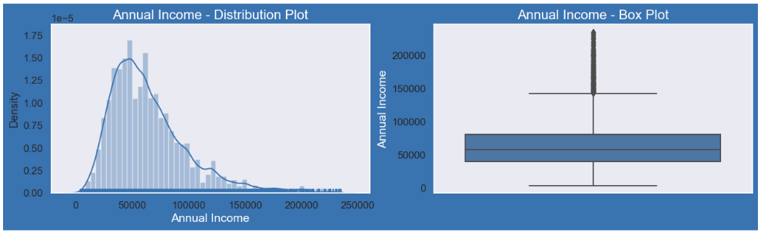
Univariate Analysis
Borrower's Annual incomes are in range of 40000- 80000

Slide 21
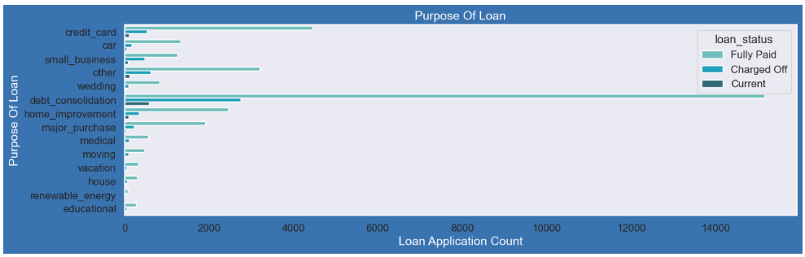
Univariate Analysis
Plot shows that most of the loans were taken for the purpose of debt consolidation & paying credit card bill.
Number of charged off count also high too for these loans.

Slide 22
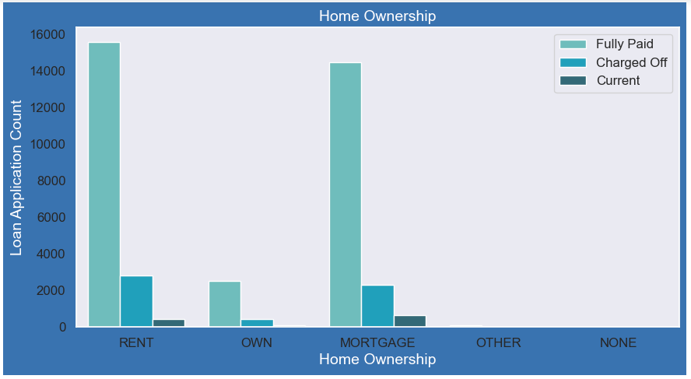
Univariate Analysis
Loan application counts are high for rented home owner and default is also in similar

Slide 23
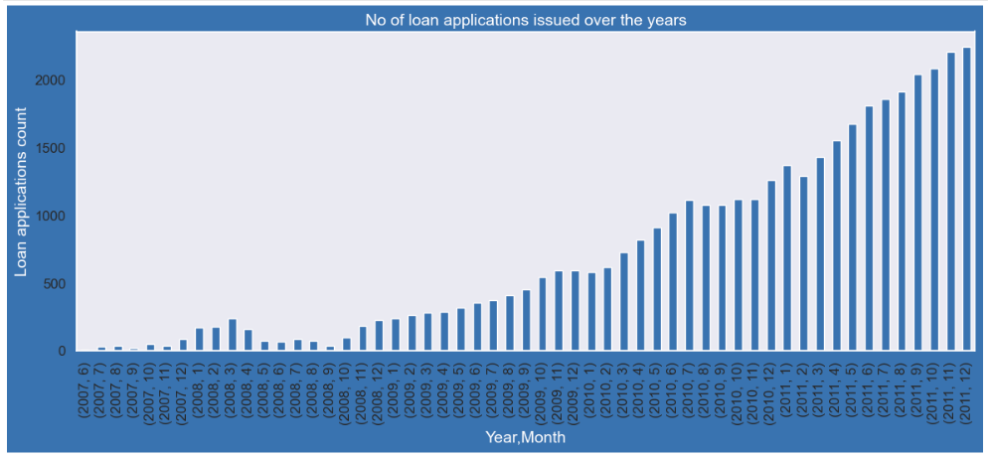
Univariate Analysis
Loan application is increasing every passing year.
Increase in number of loan applications are adding more to number of charged off applications.
Number of loans issued in 2008( May-October) got dipped, may be due to Recession.

Slide 24
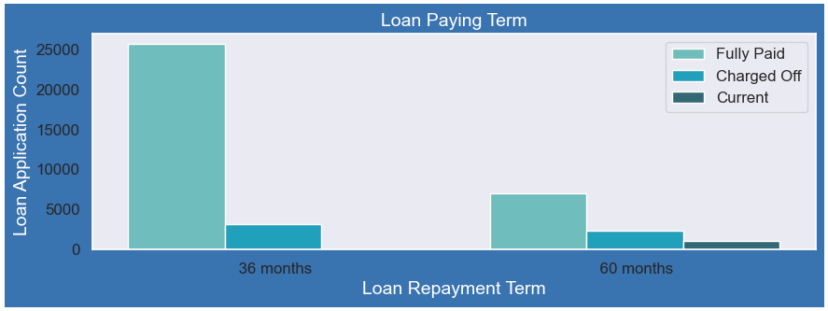
Univariate Analysis
Loan with short tenure are less risky for getting defaulted as compared to loan for long period
Ratio of fully paid to charge Off ratio is better for shorter period and hence less risky

Slide 25
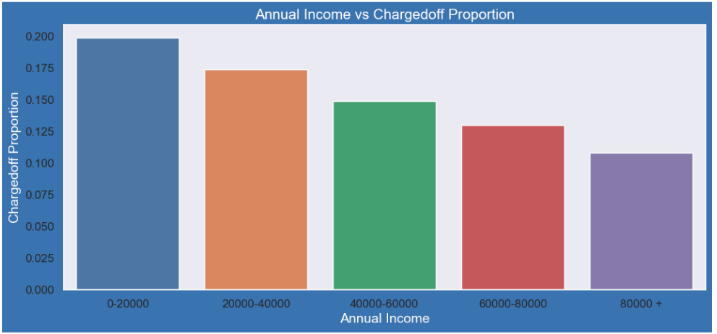
Bivariate Analysis
Income range 80000+ has less chances of charged off
Income range 0-20000 has high chances of charged off.
With increase in annual income charged off proportion got decreased.

Slide 26
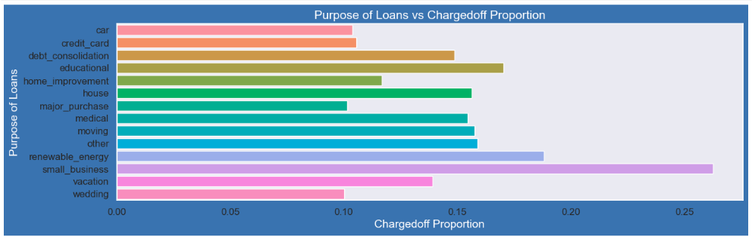
Bivariate Analysis
Small Business applicants have high chances of getting charged off.
Renewable_energy where charged off proportion is higher as compare to other categories.
Wedding and Car loans are low charged off ratio

Slide 27
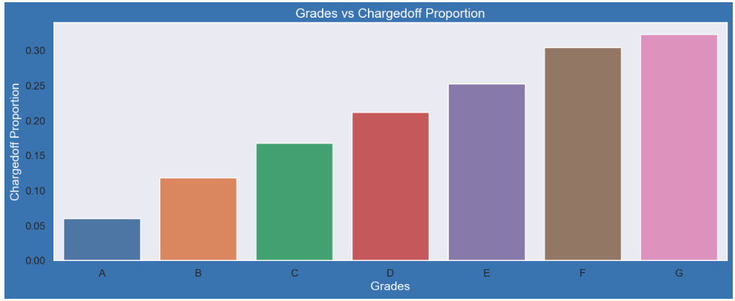
Bivariate Analysis
Grade "A" has very less chances of charged off.
Grade "F" and "G" have very high chances of charged off.
Chances of charged of is increasing with grade moving from "A" towards "G"

Slide 28
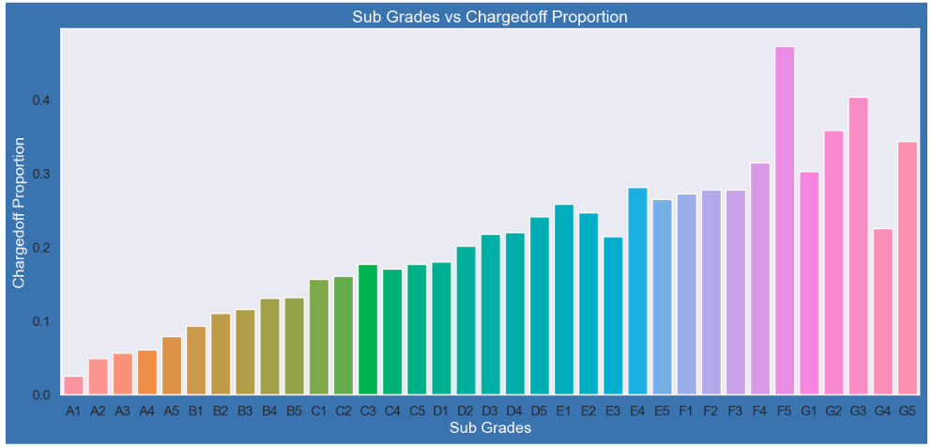
Bivariate Analysis
sub Grades of "A" has very less chances of charged off.
sub Grades of "F" and "G" have very high chances of charged off.
proportion of charged off is increasing with sub grades moving from sub grades of "A" towards sub grades of "G"

Slide 29
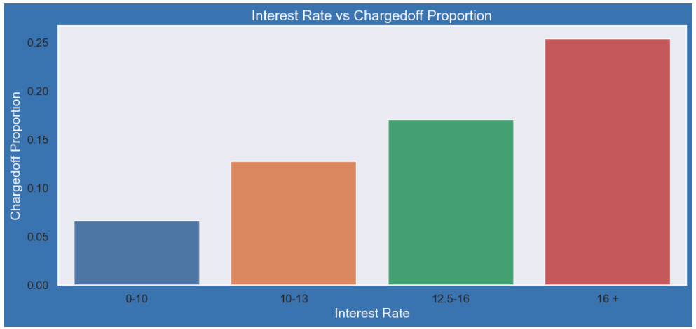
Bivariate Analysis
Interest rate less than 10% has very less chances of charged off. Interest rates are starting from minimum 5 %.
Interest rate more than 16% has good chances of charged off as compared to other category intrest rates.
Charged off proportion is increasing with higher interest rates.

Slide 30
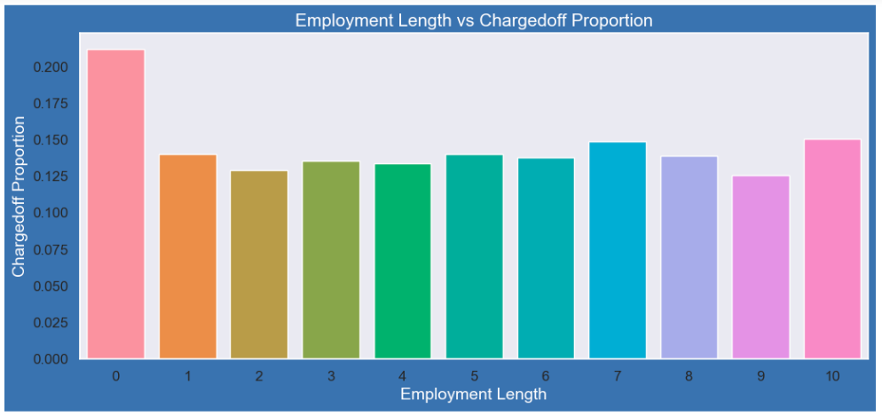
Bivariate Analysis
Those who are not working or have less than 1 year of work experience have high chances of getting charged off.
It makes sense as with less or no experience they don't have source of income to repay loan.
Rest of the applicants have more or less same chnaces of getting charged off.

Slide 31
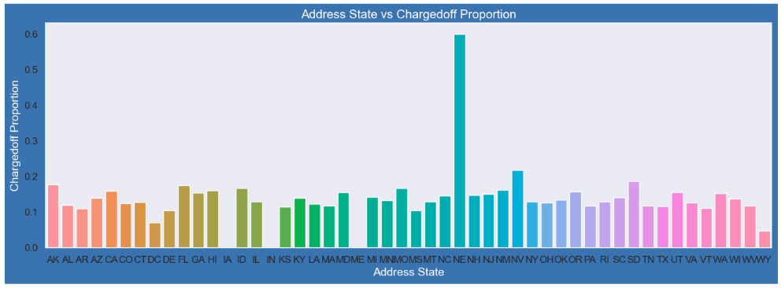
Bivariate Analysis
States NE has very high chances of charged off but number of applications are too low to make any decisions.
NV,CA and FL states shows good number of charged offs in good number of applications.

Slide 32
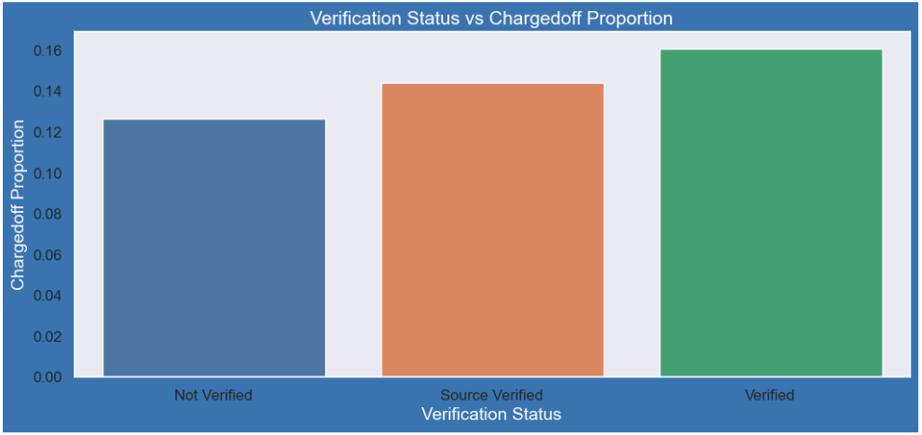
Bivariate Analysis
There is not much difference in charged off proportion.
This variable doesn't provide any insights for charged off.

Slide 33
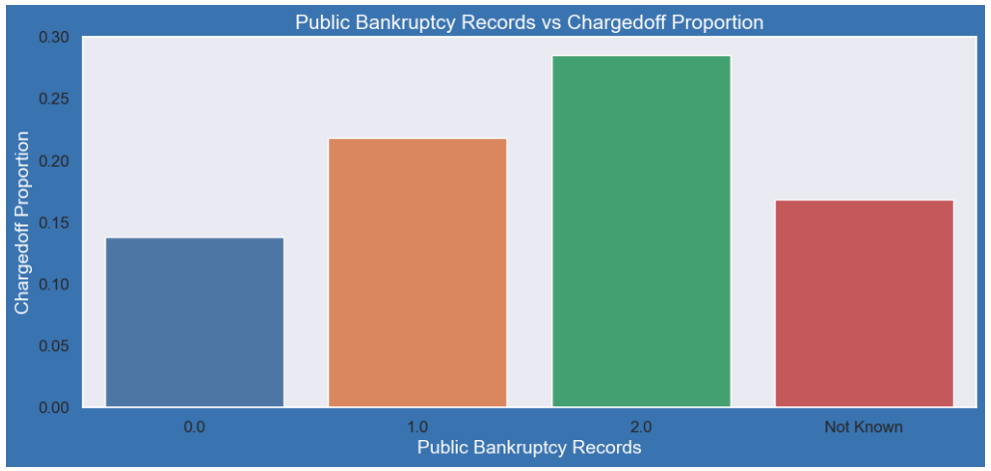
Bivariate Analysis
Those who already have pub_rec_bankruptcies value 1, have charged off proportion higher than who have no pub_rec_bankruptcies.
pub_rec_bankruptcies count 2 has even higher charged off proportion but those numbers are not significant to decide.
Not known is the column for which we don't have any information abount borrower.
This also makes sense that who has defaulted before has more chances of dafaulting in future as well.

Slide 34
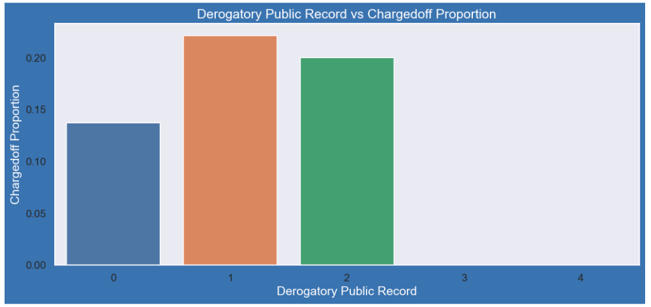
Bivariate Analysis
A derogatory item is an entry that may be considered negative by lenders because it indicates risk
Ability to qualify for credit or other services. Public records and collections are derogatory items
They reflect financial obligations that were not paid as agreed.
Those have pub_rec value 1 or 2 have charged off chances higher than who have no Derogatory Public Record.
pub_rec count 3-4 has less numbers so cannot reach on any conclusions.

Slide 35
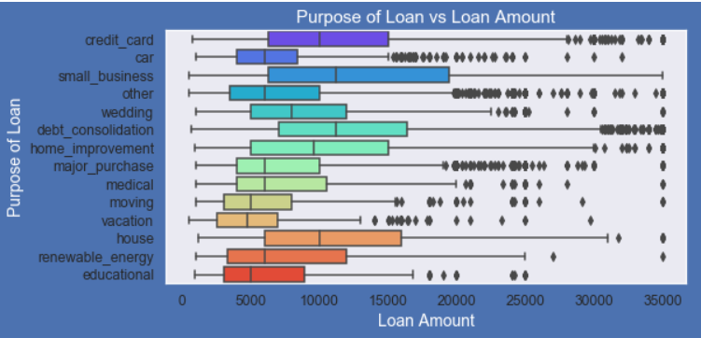
Bivariate Analysis
Purpose of Loan v/s Amount applied for Loan
Most of the loan amounts are big for small business purpose among all purposes.
While the Debt consolidation is second and Credit card is third.

Slide 36
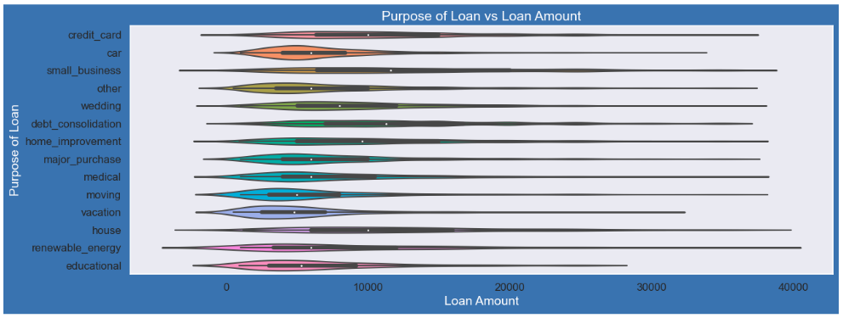
Bivariate Analysis
Loan taken for small business purpose, Debt consolidation and Credit card are somewhat evenly distributed as compare to loan taken for other purposes.

Slide 37
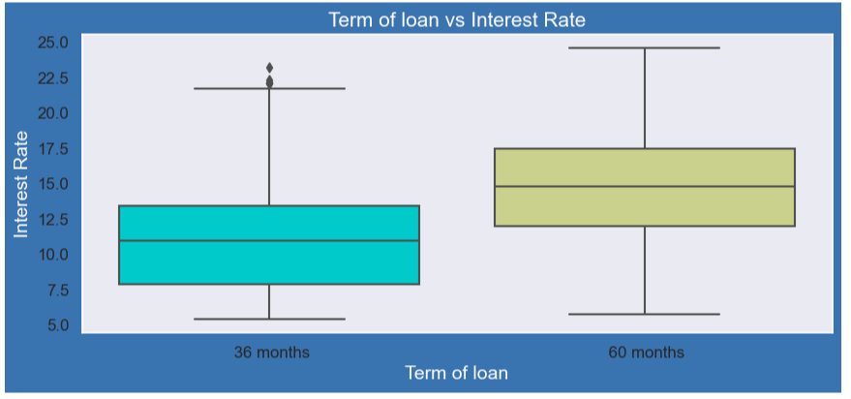
Bivariate Analysis
It is clear that avearge intrest rate is higher for 60 months loan term.
Most of the loans issued for longer term had higher interest rates for re-payment.

Slide 38
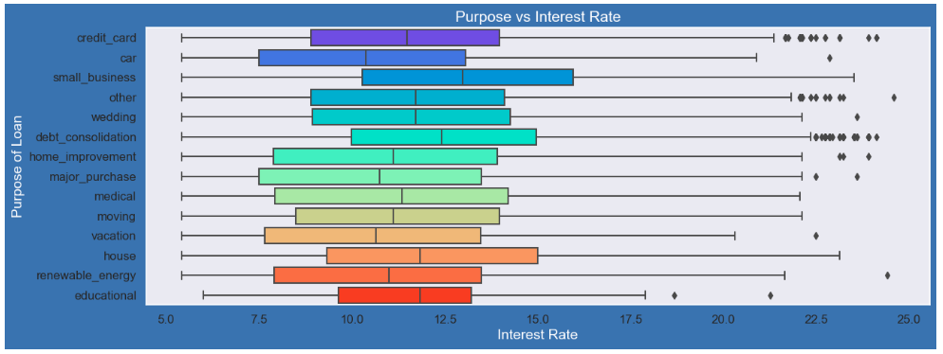
Bivariate Analysis
It is clear that average interest rate is highest for small business purpose.
Loans taken for small business purposes had to repay the loan with more interest rate as compared to other.
Debt consolidation is 2nd where borrowers had to pay more interest rate.

Slide 39
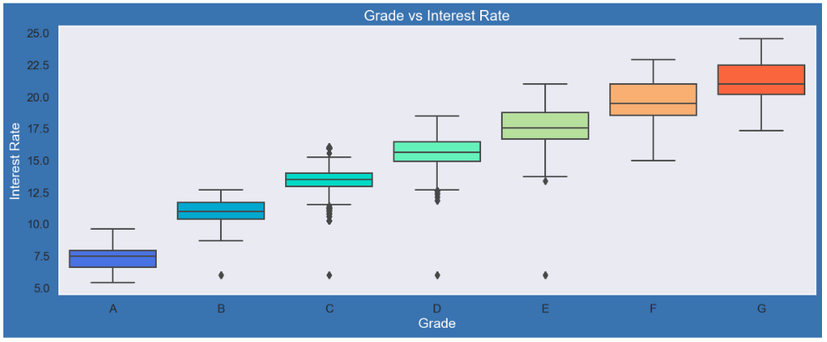
Bivariate Analysis
A-grade is a top letter grade for a lender to assign to a borrower.
The higher the borrower's credit grade, The lower the interest rate offered to that borrower on a loan.
It is clear that interest rate is increasing with grades moving from A to F.

Slide 40
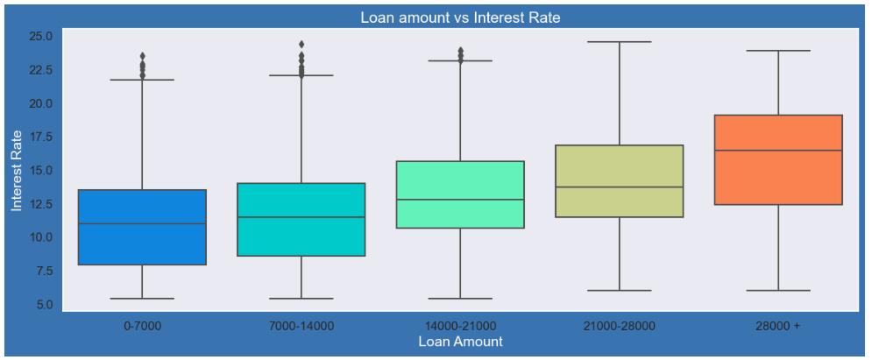
Bivariate Analysis
It is clear that interest rate is increasing with loan amount increase.
When loan amount is more it is taken for longer loan term, we saw earlier that longer the loan term more the interest rate.

Slide 41
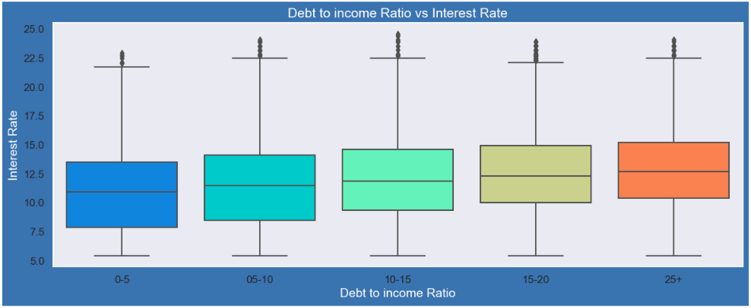
Bivariate Analysis
If your DTI is low enough you may get a lower interest rate.
Plot shows no significant variation but there is slight increase in interest rate with increase in DTI.

Slide 42
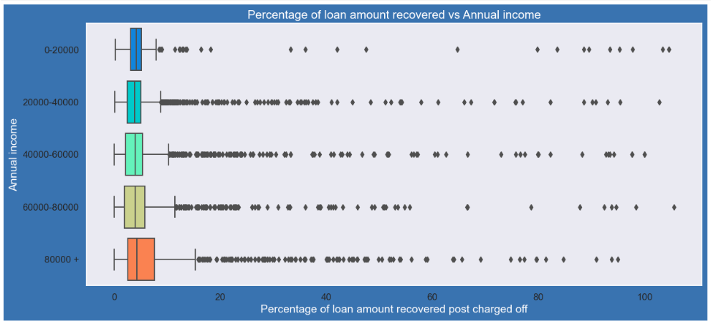
Bivariate Analysis
Higher percentage of loan amount is recovered when annual income is high.
Plot shows no significant variation but there is slight increase in recovery percentage with increase in annual income.

Slide 43
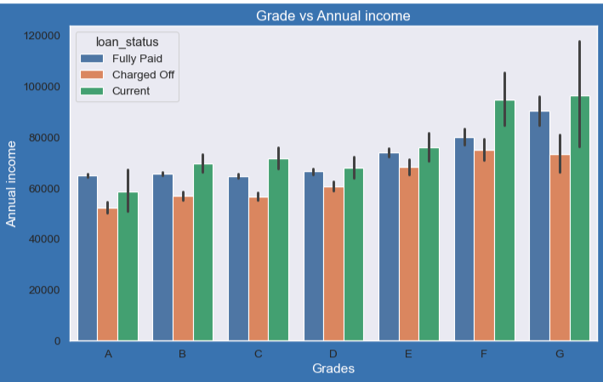
Bivariate Analysis
From this we can conclude that the ones getting 'charged off' have lower annual incomes than the ones who'paid fully' for each and every grade (i.e. at same interest range)

Slide 44
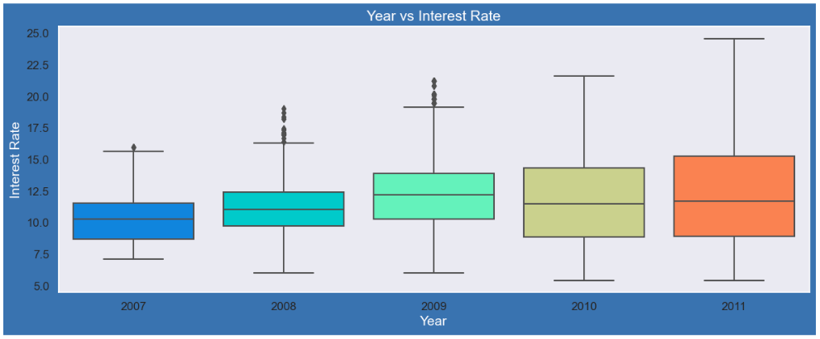
Bivariate Analysis
Plot shows interest rate is increasing slowly with increase in year.

Slide 45
Bivariate Analysis
Plot shows intrest rate is increasing slowly with increase in year.

Slide 46
Bivariate Analysis - Correlation Matrix-Quantitative Variables(Refer worksheet for diagram)
Observation is that Loan amount, investor amount, funding amount are strongly correlated.
Annual income with DTI(Debt-to-income ratio) is negatively correlated. That means when annual income is low DTI is high & vice versa.
Debt income ratio is the percentage of a consumer's monthly gross income that goes toward paying debts.
Positive correlation between annual income and employment years.

Slide 47
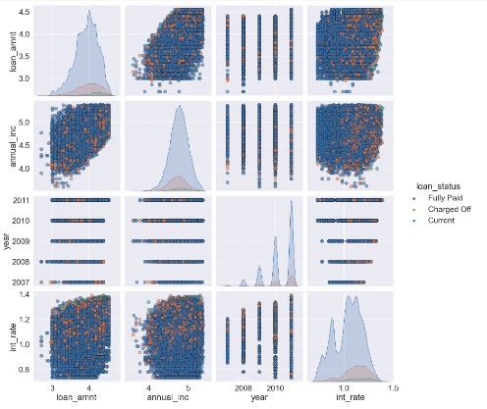
Multivariate Analysis: Pair plot
Observing Loan Amount, Annual Income, Year when loan was taken, Interest Rate at which loan was taken to each other :
Higher the interest rate , Higher charged off ratio
Higher the annual income, Higher the loan amount slightly.
Increase in number of charged off with increase in year.
Interest rate is increasing with loan amount increase

Slide 48
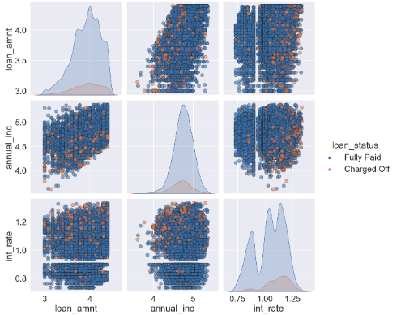
Multivariate Analysis: Pair plot
Observing Loan Amount, Annual Income, Year when loan was taken, Interest Rate at which loan was taken to each other :
Higher the interest rate , Higher charged off ratio
Higher the annual income, Higher the loan amount slightly.
Increase in number of charged off with increase in year.
Interest rate is increasing with loan amount increase

Slide 49
Summary
Based on the Analysis done on the Variables, we conclude the below mentioned points
Small Business Applicants have high chances of getting charged off.
Charged off proportion increases with grades moving from “A” towards “G”.
Charged off proportion increases as Interest Rate Increases.
Higher the public bankruptcy record greater the charged-off proportion.
The loan amounts are bigger on average for small business purpose among all purposes of Loan.
Those who already have Derogatory Public Records have higher charged off chances than others.
Average interest rate is considerably higher for 60 months loan term than 36 months.
Ones getting charged off have lower annual incomes than the ones who has fully paid for each and every grade.

Slide 50
Recommendation
Loans for Small Business Applicants should be checked properly.
Loan approval should be avoided for those who already have Derogatory Public Records.
Loan approval should be avoided for those who already have Public Bankruptcy Records.
Loan approval for Low quality loans should be avoided or given for smaller loan repayment term.
Lower annual income applicants should be avoided for big loan amounts with higher interest Rates.
Loan approval should be avoided for applicants who doesn’t have a source of income.

Slide 51
Thank You!
#LifeKoKaroLift
24

