Slide 1

HomeVault
Product overview & module guide: what the website does and how every part works
A household operating system for families
Notes:
HomeVault is a full-stack web application: a marketing website plus a signed-in household workspace. This deck walks through what it is, who it is for, and every module in detail.

Slide 2
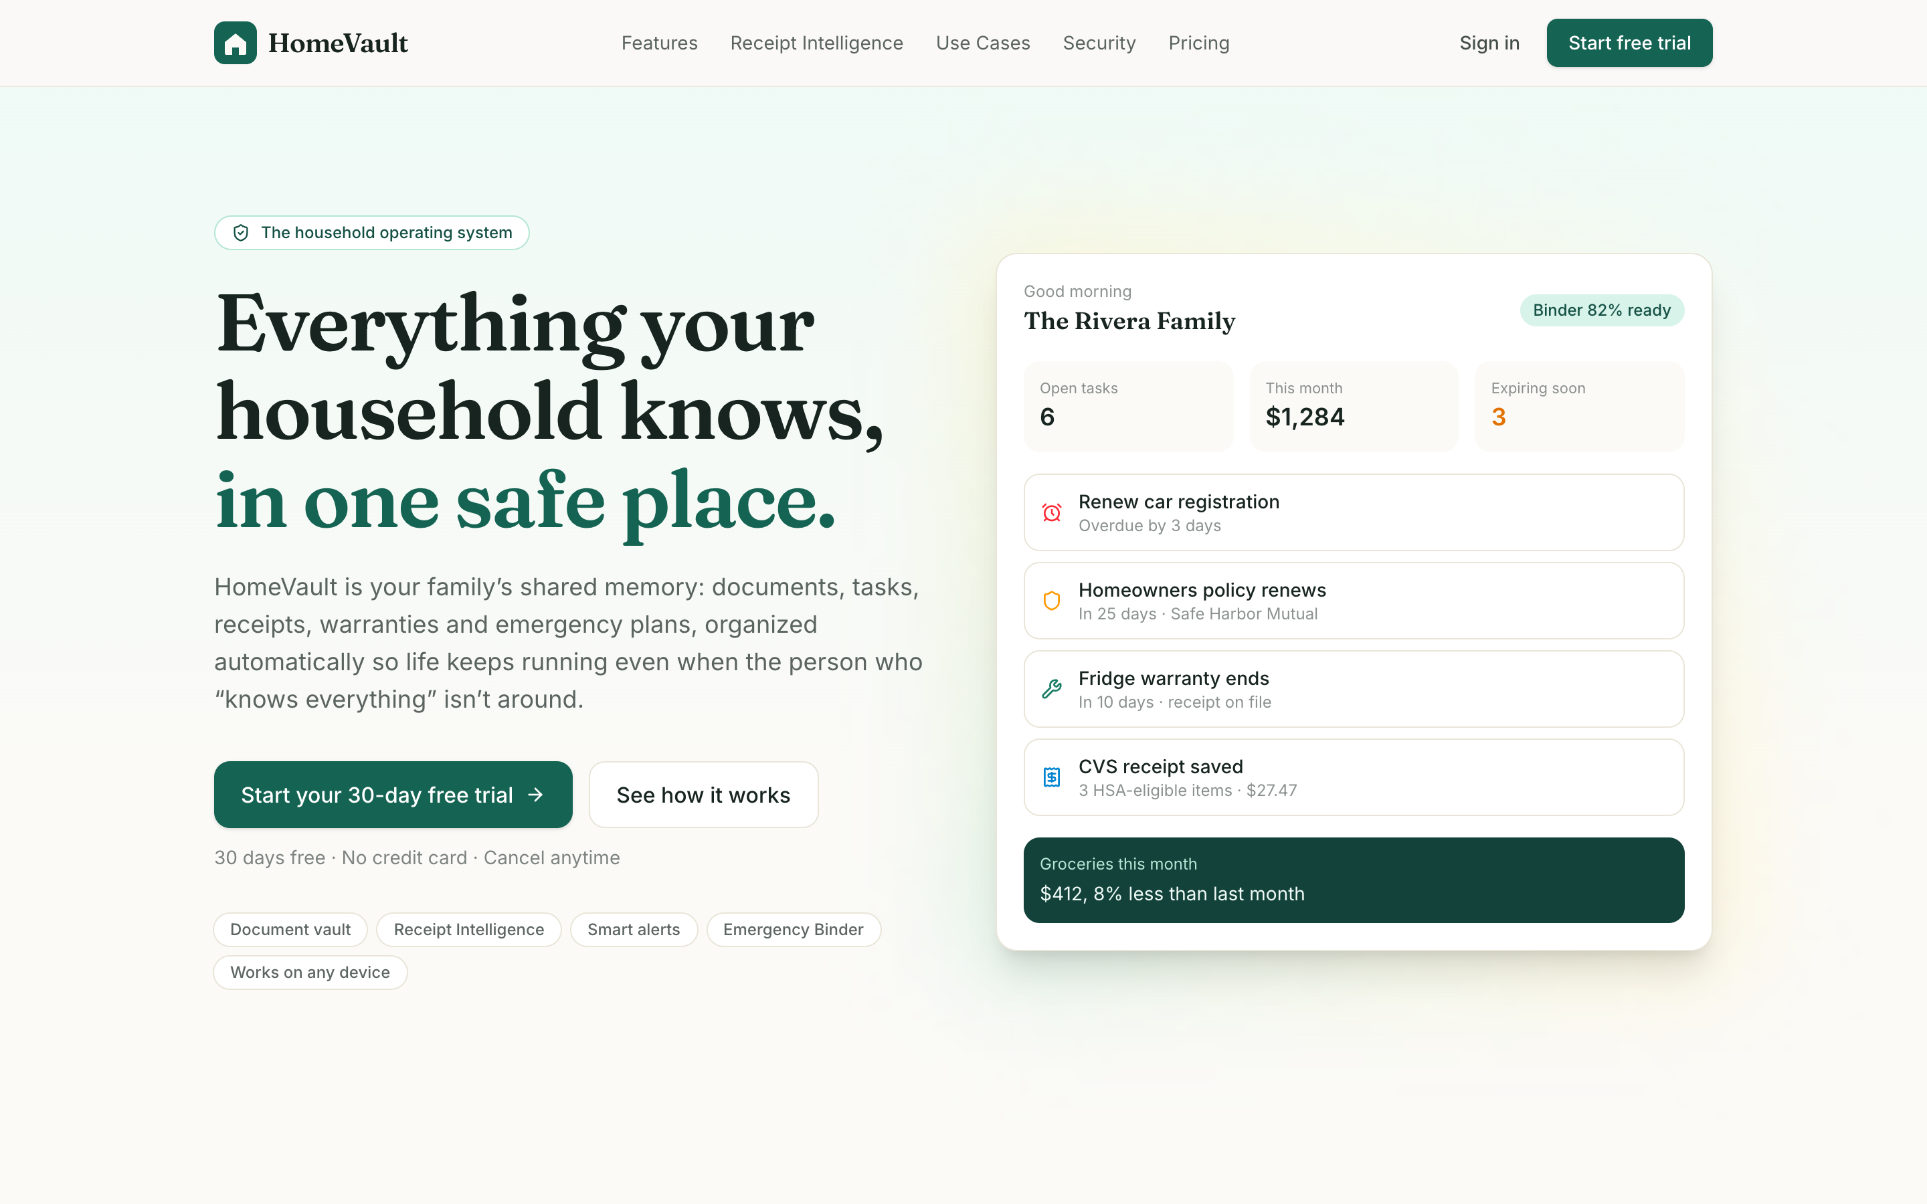
One shared, secure memory for the whole household
The problem
Most homes run on one person’s memory: where the insurance policy is, when a warranty ends, who to call about the furnace. If that person is unavailable, the family is stuck.
The solution
Documents, tasks, calendar, contacts and receipts in one place
Alerts before anything expires or falls overdue
Spending insights from everyday receipts
An emergency binder anyone can follow
Notes:
The landing page explains the value proposition; the app itself starts after sign-up.

Slide 3





Built for every kind of household
New parents
Homeowners
Caring for aging parents
Pediatrician contacts, insurance changes and baby-gear warranties in one place
Maintenance schedules, appliance warranties, contractors and receipts for claims
Medications, doctors and legal documents shared with siblings
Rental property owners
Estate & continuity
Busy families
Leases, repairs, expenses and vendor contacts kept organized
An emergency binder, instructions and messages for loved ones
Shared calendar, assigned chores and one place to find everything

Slide 4












Twelve modules, one household
Landing page
Accounts & roles
Dashboard
Tasks
Public marketing site
Sign-up, login, members
Alerts & overview
To-dos & recurring jobs
Calendar
Documents
Receipts & spending
Assets & warranties
Events & due dates
Vault with expiry tracking
Analytics, HSA, subscriptions
Home inventory
Contacts
Emergency binder
Life-event guides
Settings & plans
People & service pros
Readiness score & print
Checklists → tasks
Household, members, plan
Orange = public / account modules · Green = household workspace modules

Slide 5
Module deep dives
What each module does, its key features and how it works under the hood

Slide 6
Landing page: the public website
The marketing site visitors see first. It explains the product and drives sign-ups.
Key features
Hero with dashboard preview & “Start free trial”
Problem vs. solution and the mission
How it works: Capture, Organize, Act
Use cases, emergency readiness & security
Four pricing plans with a 30-day trial
Under the hood Statically rendered Next.js page; fully responsive down to phone width.

Slide 7
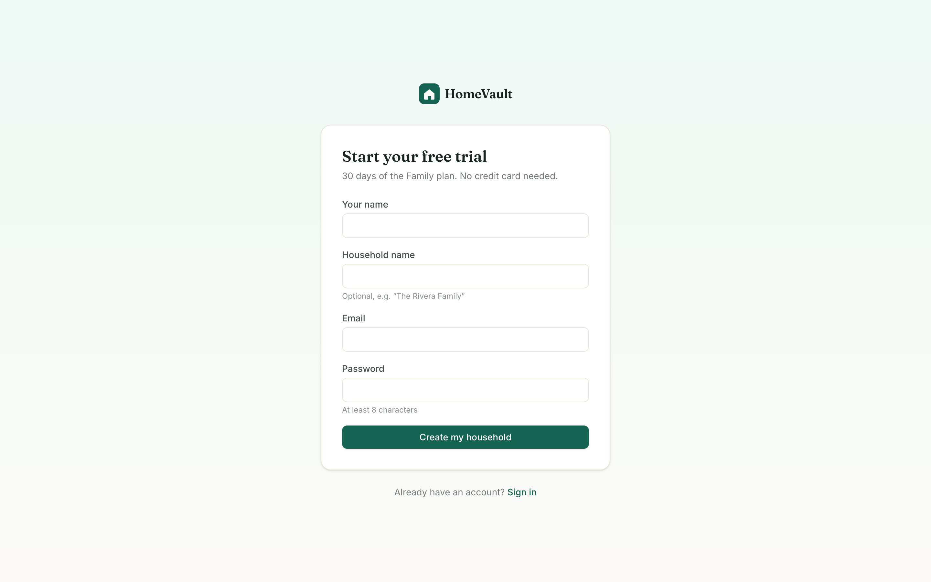
Accounts, households & roles
Each sign-up creates a household. Everything a family stores belongs to that household.
Key features
Register creates a household + 30-day Family trial
Secure login with session tokens
Roles: Owner, Admin and Member
Owners/Admins add or remove members
One-click demo account for testing
Under the hood Passwords hashed with bcrypt; JWT tokens; every query is filtered by household.

Slide 8
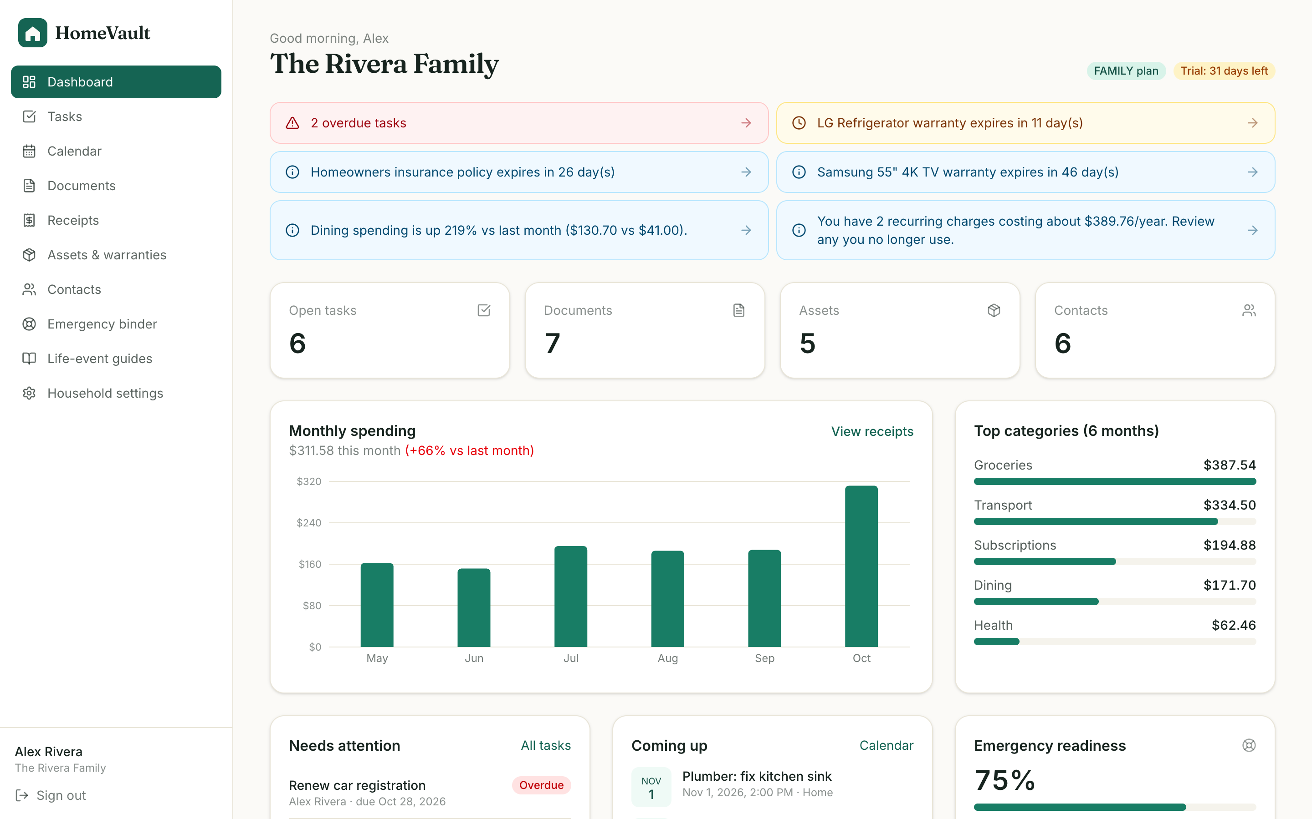
Dashboard: the household at a glance
The home screen after login. It pulls signals from every module into one view.
Key features
Smart alerts: overdue, expiring, spending spikes
Counts of tasks, documents, assets, contacts
Six-month spending chart & top categories
Upcoming tasks and events
Emergency readiness score & expiring items
Under the hood One API call (GET /dashboard) aggregates tasks, events, documents, assets, receipts and the binder.

Slide 9
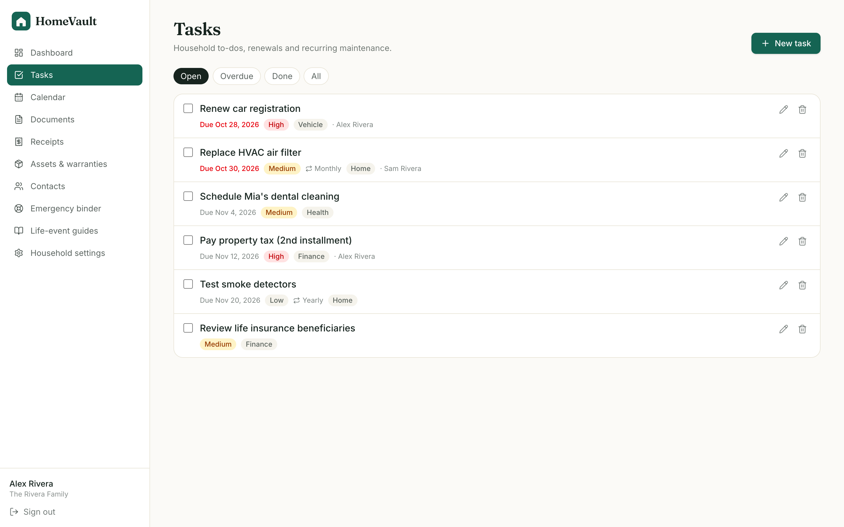
Tasks: to-dos, renewals & maintenance
A shared to-do list for the household, built for recurring home admin.
Key features
Due dates, priority, category and notes
Assign tasks to any household member
Repeat weekly, monthly or yearly
Filters: Open, Overdue, Done, All
Overdue items highlighted in red
Under the hood Completing a recurring task automatically creates the next occurrence.

Slide 10
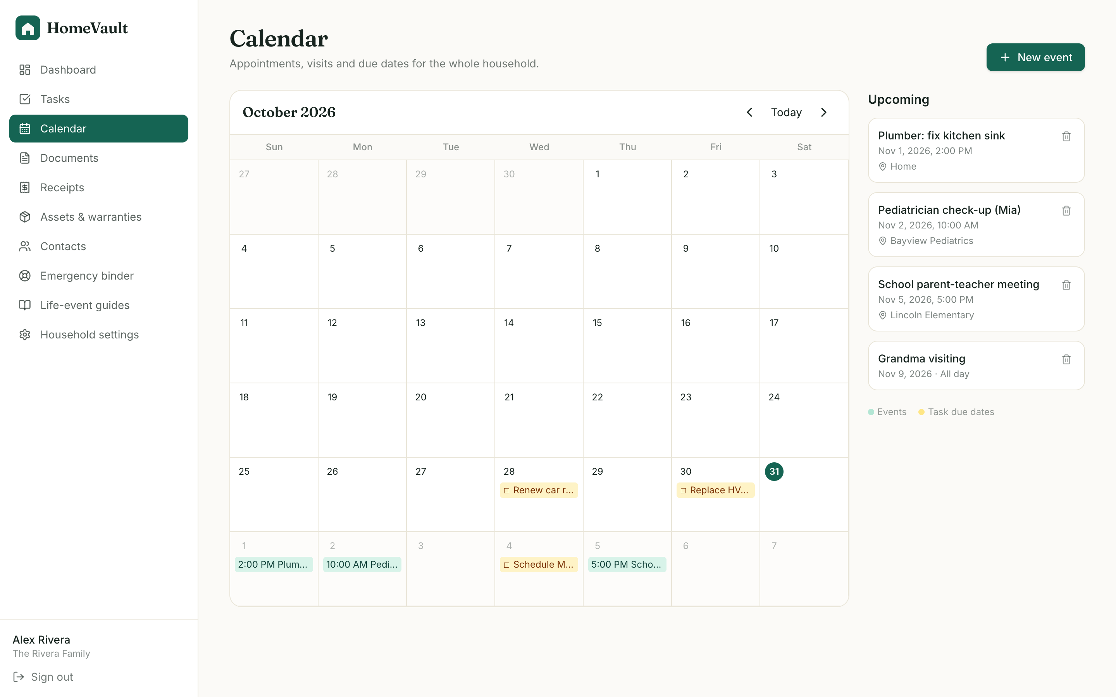
Calendar: everything with a date
A month view of appointments, visits and task due dates for the whole family.
Key features
Click any day to add an event
Timed or all-day events with location
Task due dates shown alongside events
Upcoming list beside the calendar
Edit or delete from the calendar
Under the hood Events and tasks are merged client-side by local date, so nothing shifts across time zones.

Slide 11
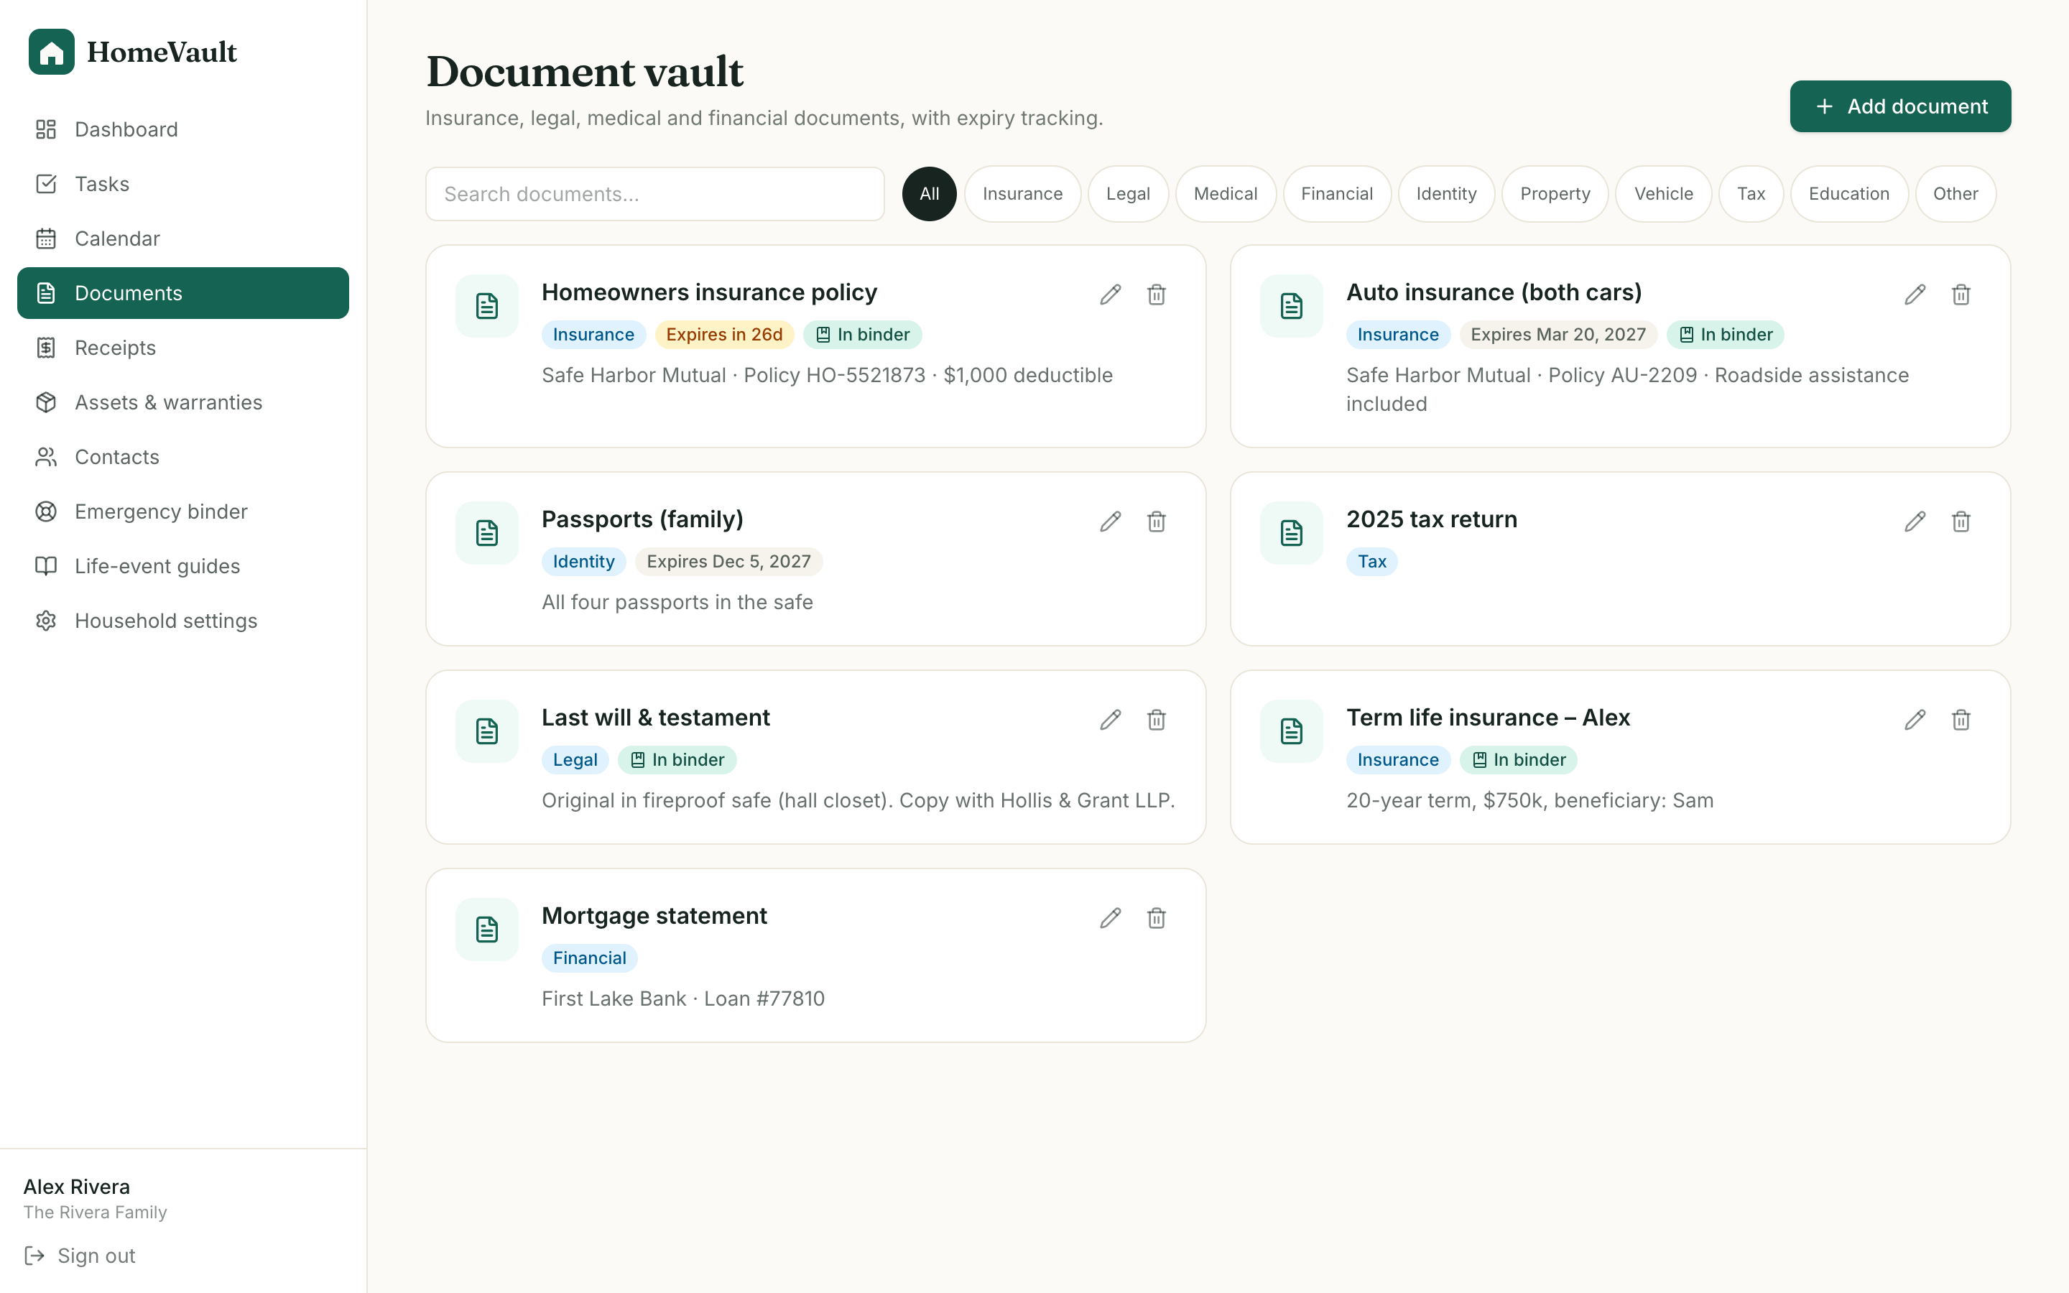
Document vault
Secure storage for insurance, legal, medical, financial and identity documents.
Key features
10 categories with search & filter chips
Attach PDFs, images or Word files (10 MB)
Expiry / renewal dates with warning badges
Key details: policy numbers, where originals are
“Include in emergency binder” option
Under the hood Files go to local disk in development and Cloudinary in production.

Slide 12
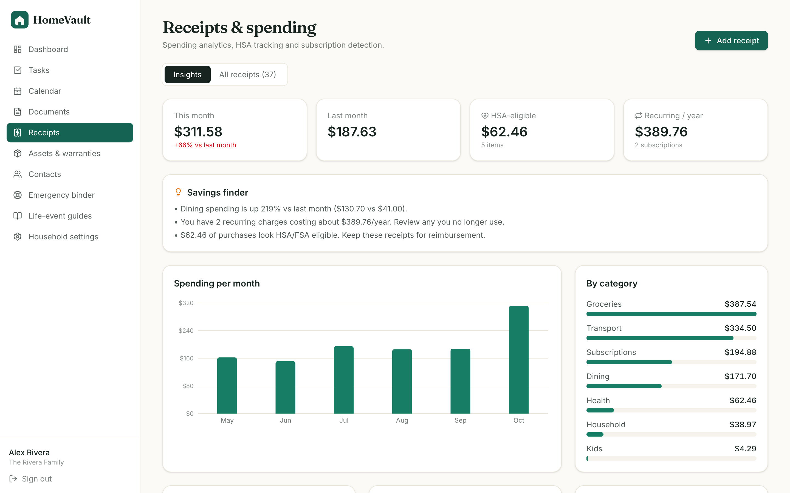
Receipts & spending insights
Log receipts with line items and turn everyday purchases into spending insight.
Key features
Monthly spending chart & category breakdown
Savings finder: spikes and subscriptions
HSA/FSA-eligible item tracking
Top merchants and recurring charges
Warranty items become assets automatically
Under the hood Analytics are computed by GET /receipts/analytics from line items, by month and category.

Slide 13
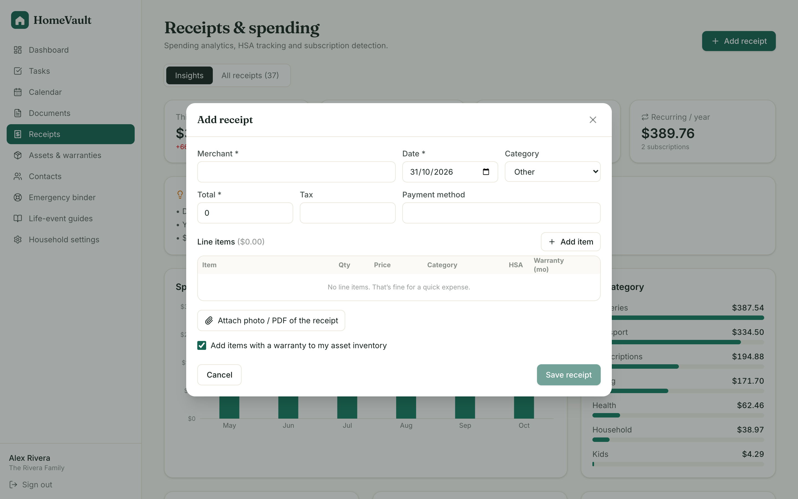
Adding a receipt
Receipts are entered by hand in a single form, with an optional photo or PDF.
Key features
Merchant, date, category, total, tax, payment
Any number of line items with categories
Tick HSA-eligible items
Warranty months per item
Attach a photo or PDF of the original
Under the hood Saving with “add to inventory” creates assets with calculated warranty end dates.

Slide 14
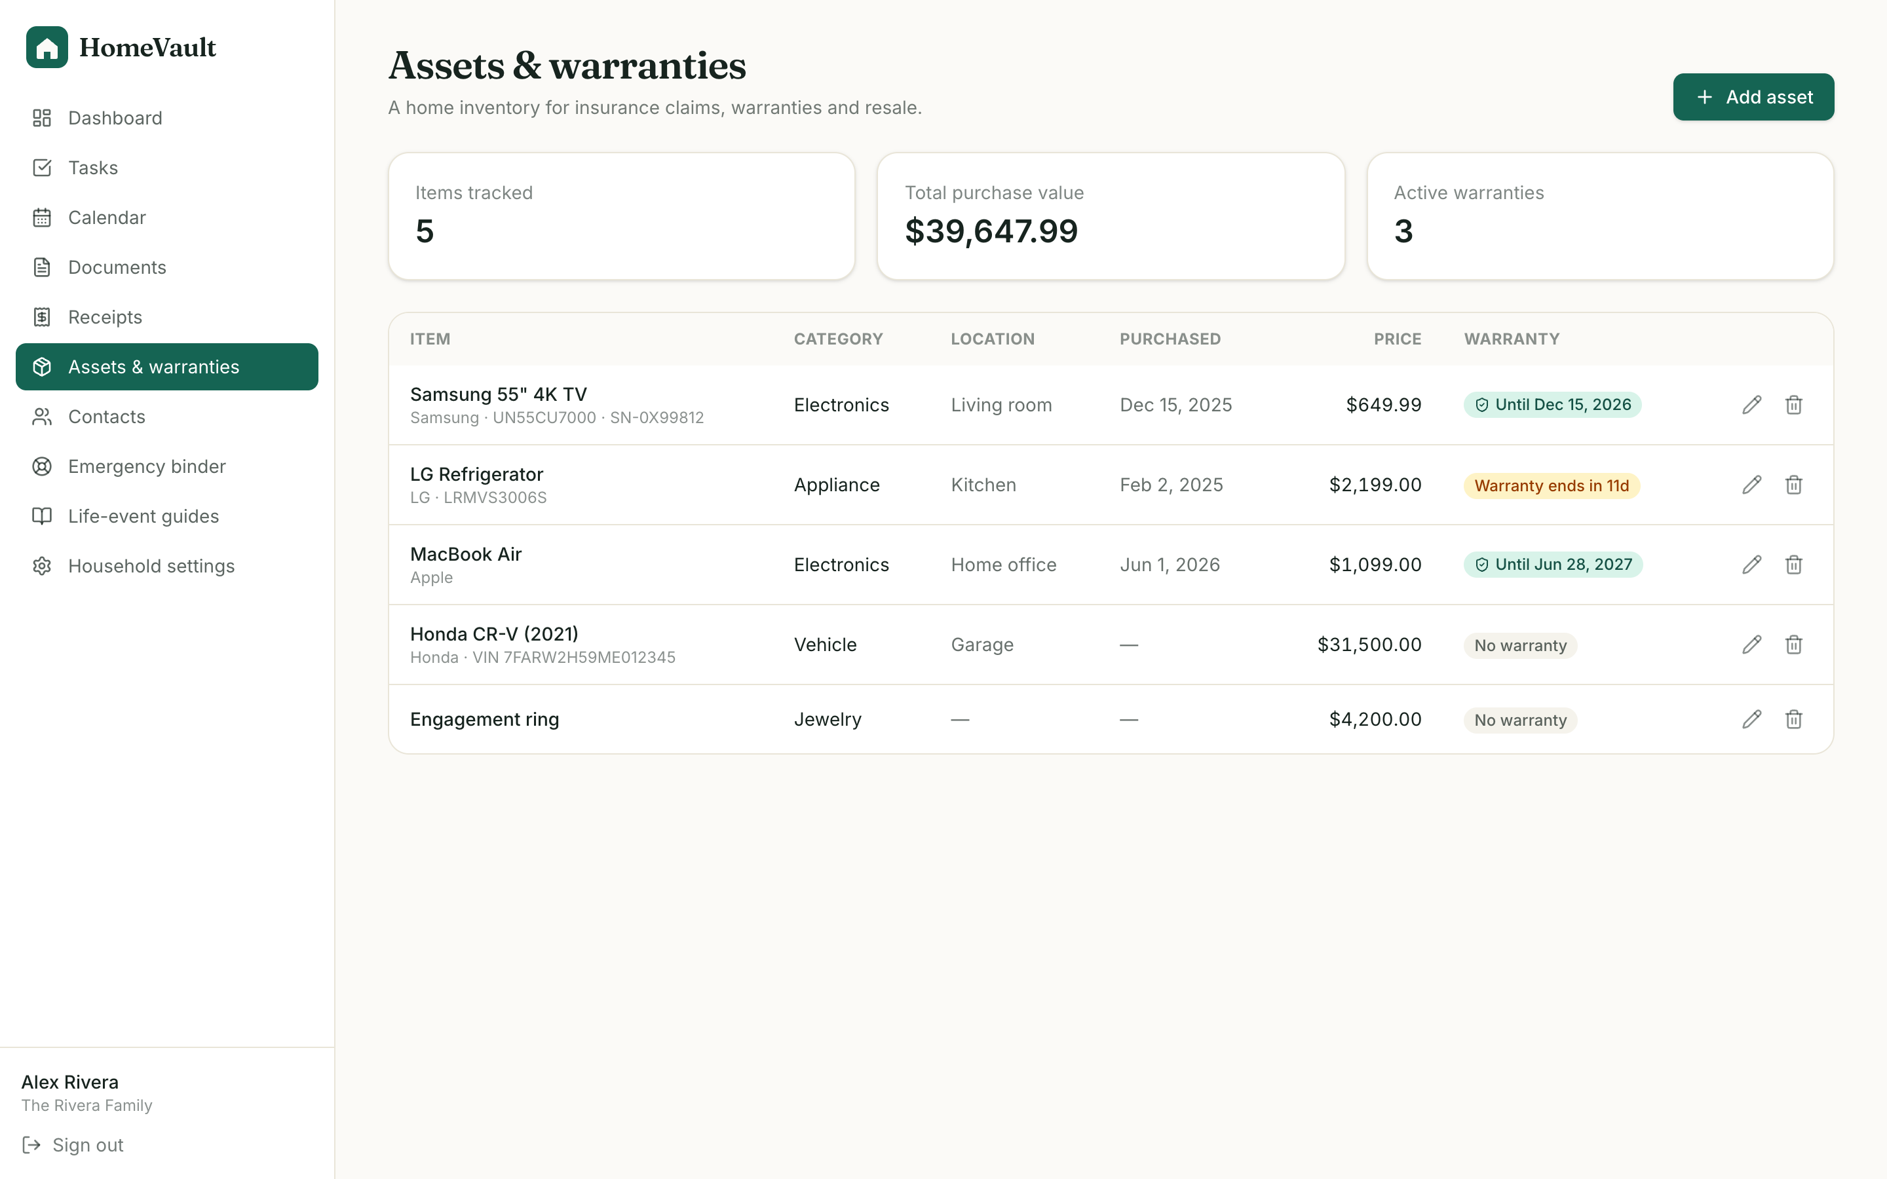
Assets & warranties
A home inventory for insurance claims, warranties and resale.
Key features
Brand, model, serial number / VIN
Purchase date, price and location
Warranty status: active, ending, expired
Total value and active-warranty counts
Linked back to the original receipt
Under the hood Warranties ending within 60 days raise dashboard alerts.

Slide 15
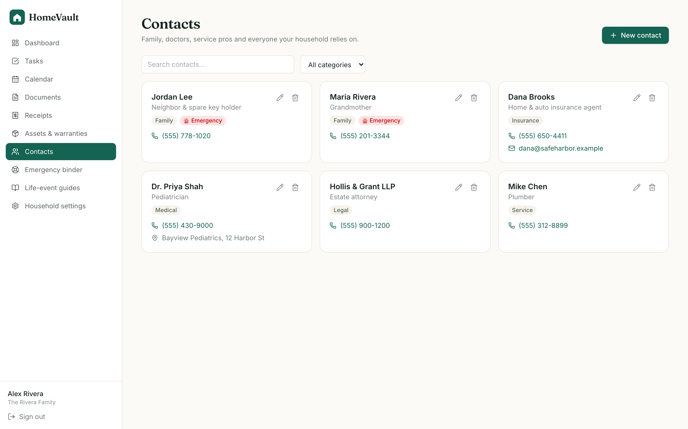
Contacts
Everyone the household relies on: family, doctors, service pros, insurance and legal.
Key features
9 categories with search & filter
Tap-to-call phone and email links
Relationship / role and address
Mark as emergency contact
Emergency contacts feed the binder
Under the hood Emergency contacts are sorted first and count toward the readiness score.

Slide 16
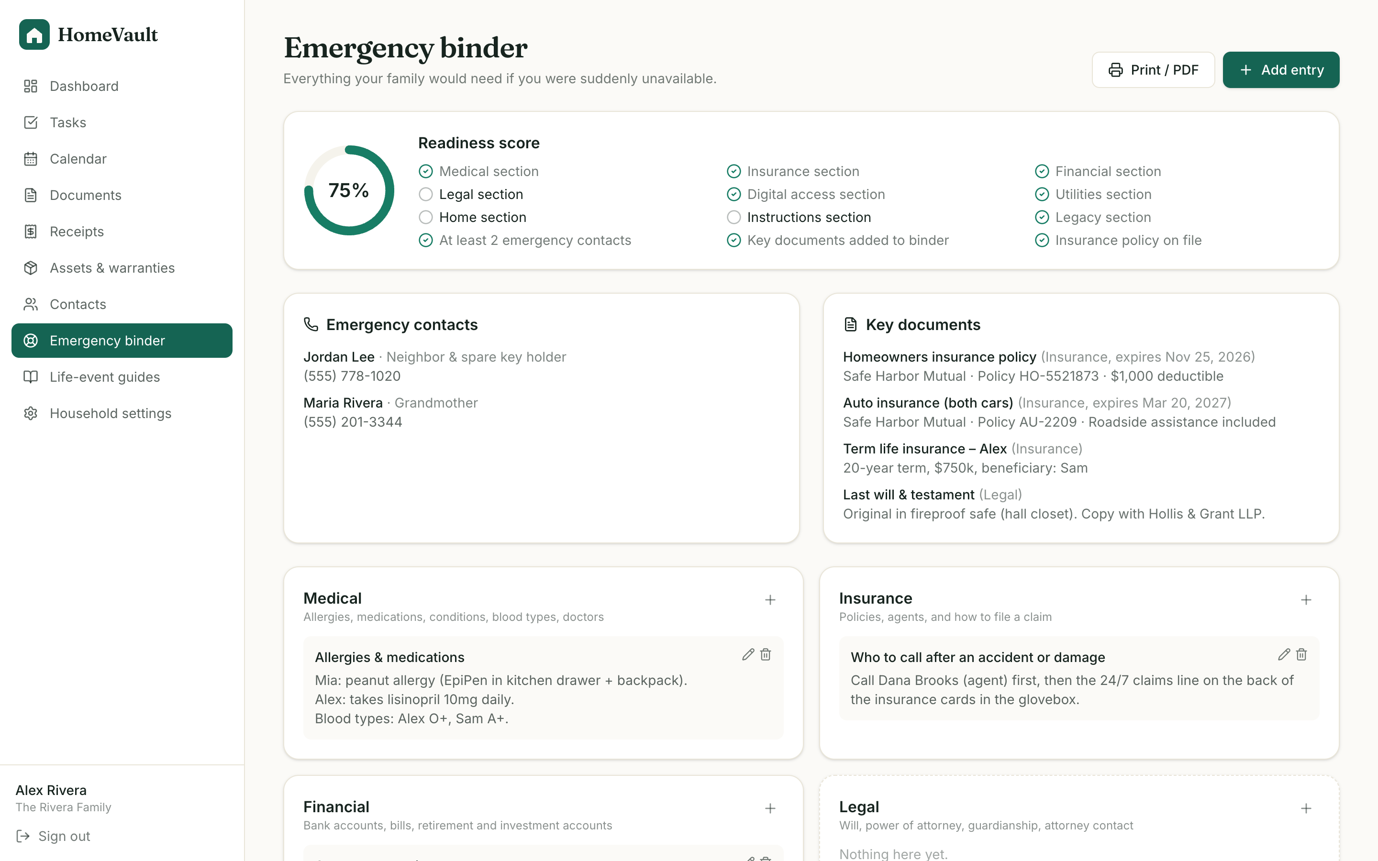
Emergency binder
Everything the family would need if the household organizer were suddenly unavailable.
Key features
9 sections: medical, insurance, financial, legal…
Readiness score with a checklist of gaps
Pulls in emergency contacts & key documents
Print / save as PDF in one click
Guidance to store locations, not passwords
Under the hood Score = filled sections + ≥2 emergency contacts + binder documents + insurance on file.

Slide 17
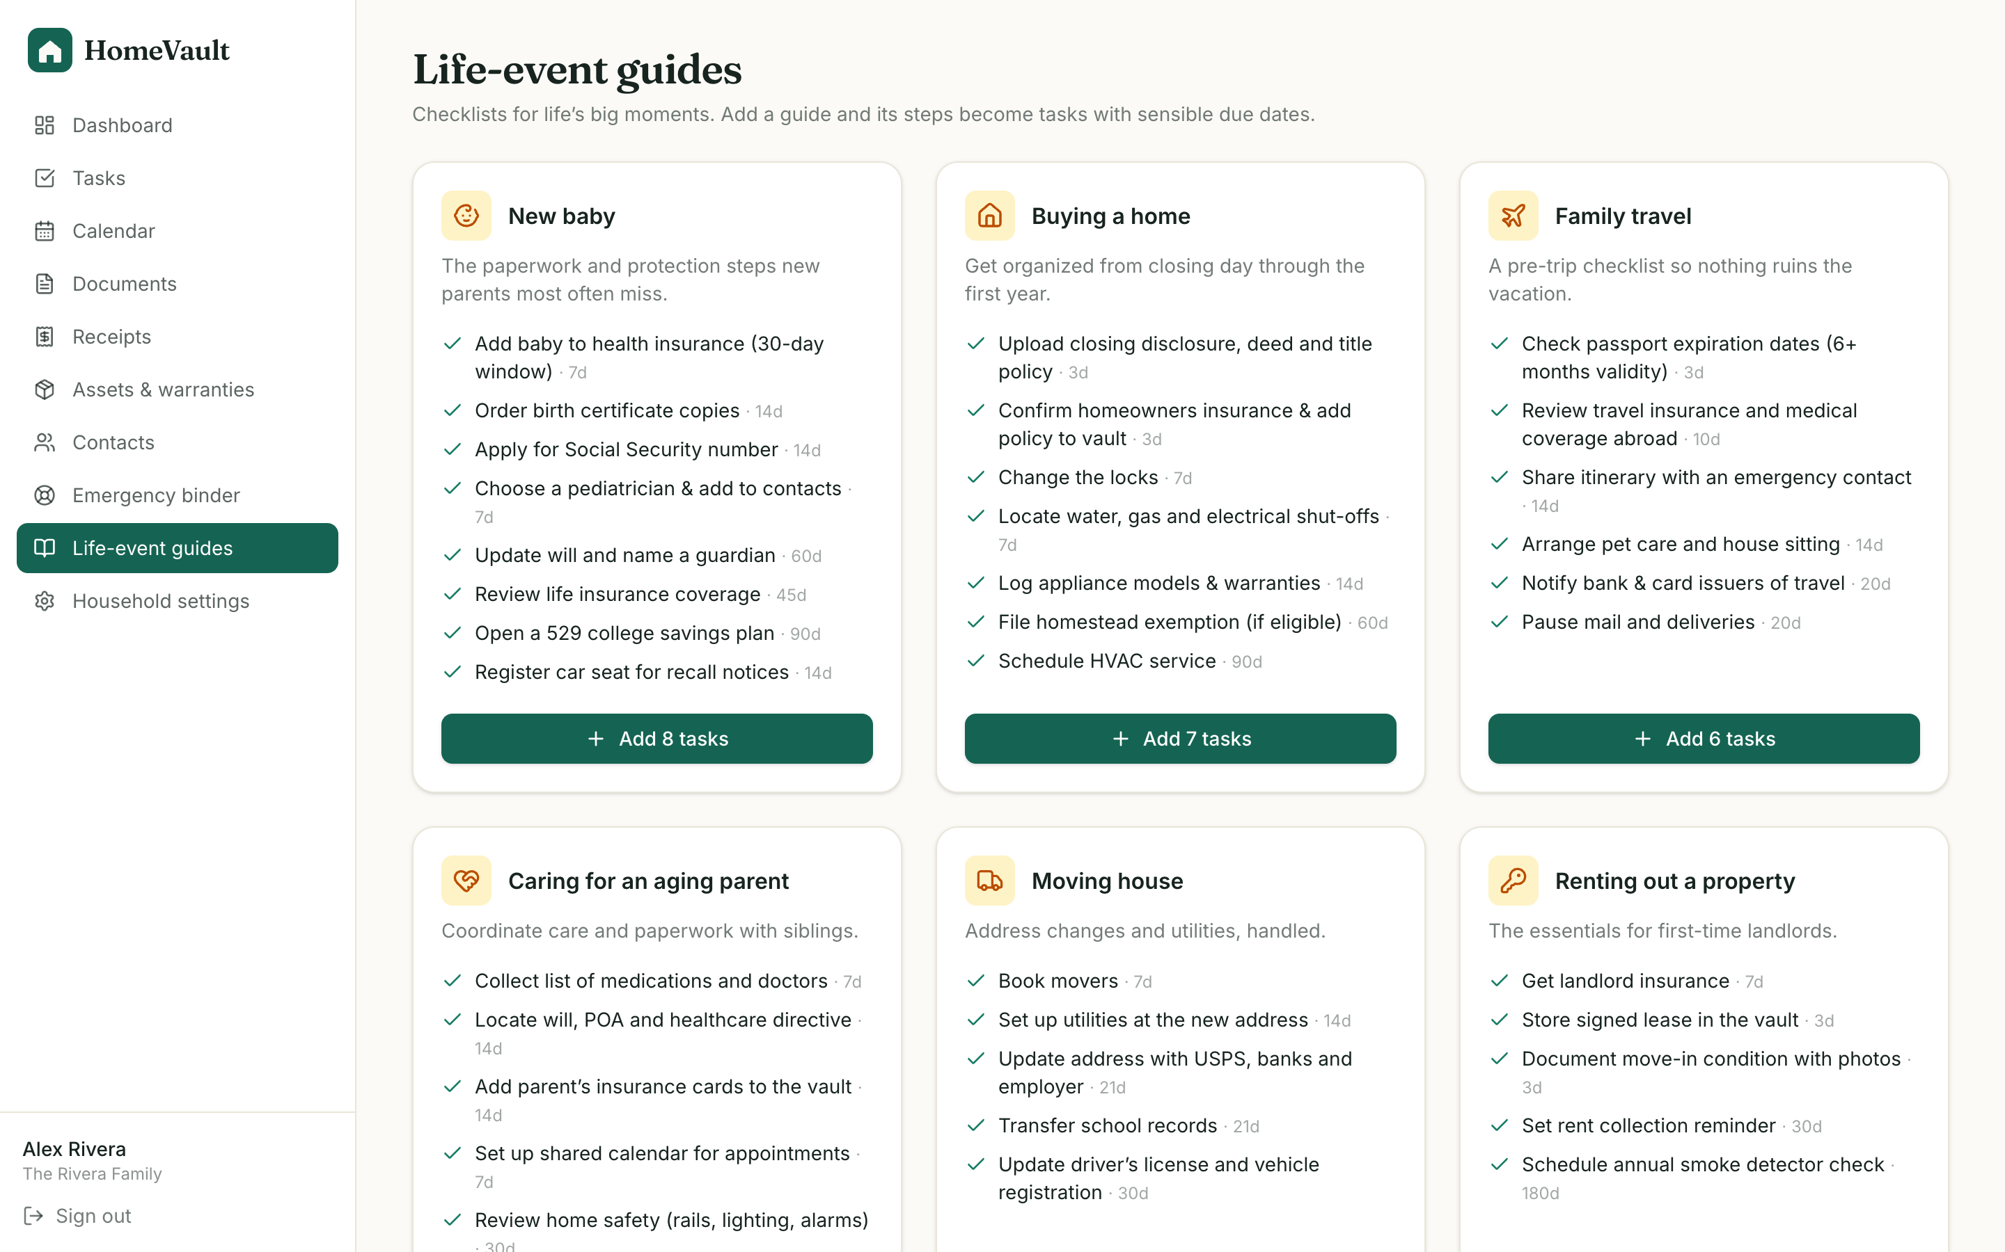
Life-event guides
Ready-made checklists for life’s big moments that become real tasks in one click.
Key features
New baby, buying a home, family travel
Caring for a parent, moving, renting out
Each step has a sensible due date
“Add N tasks” creates them all
Tasks appear on the calendar & dashboard
Under the hood Pure front-end content; each step is created through the Tasks API.

Slide 18
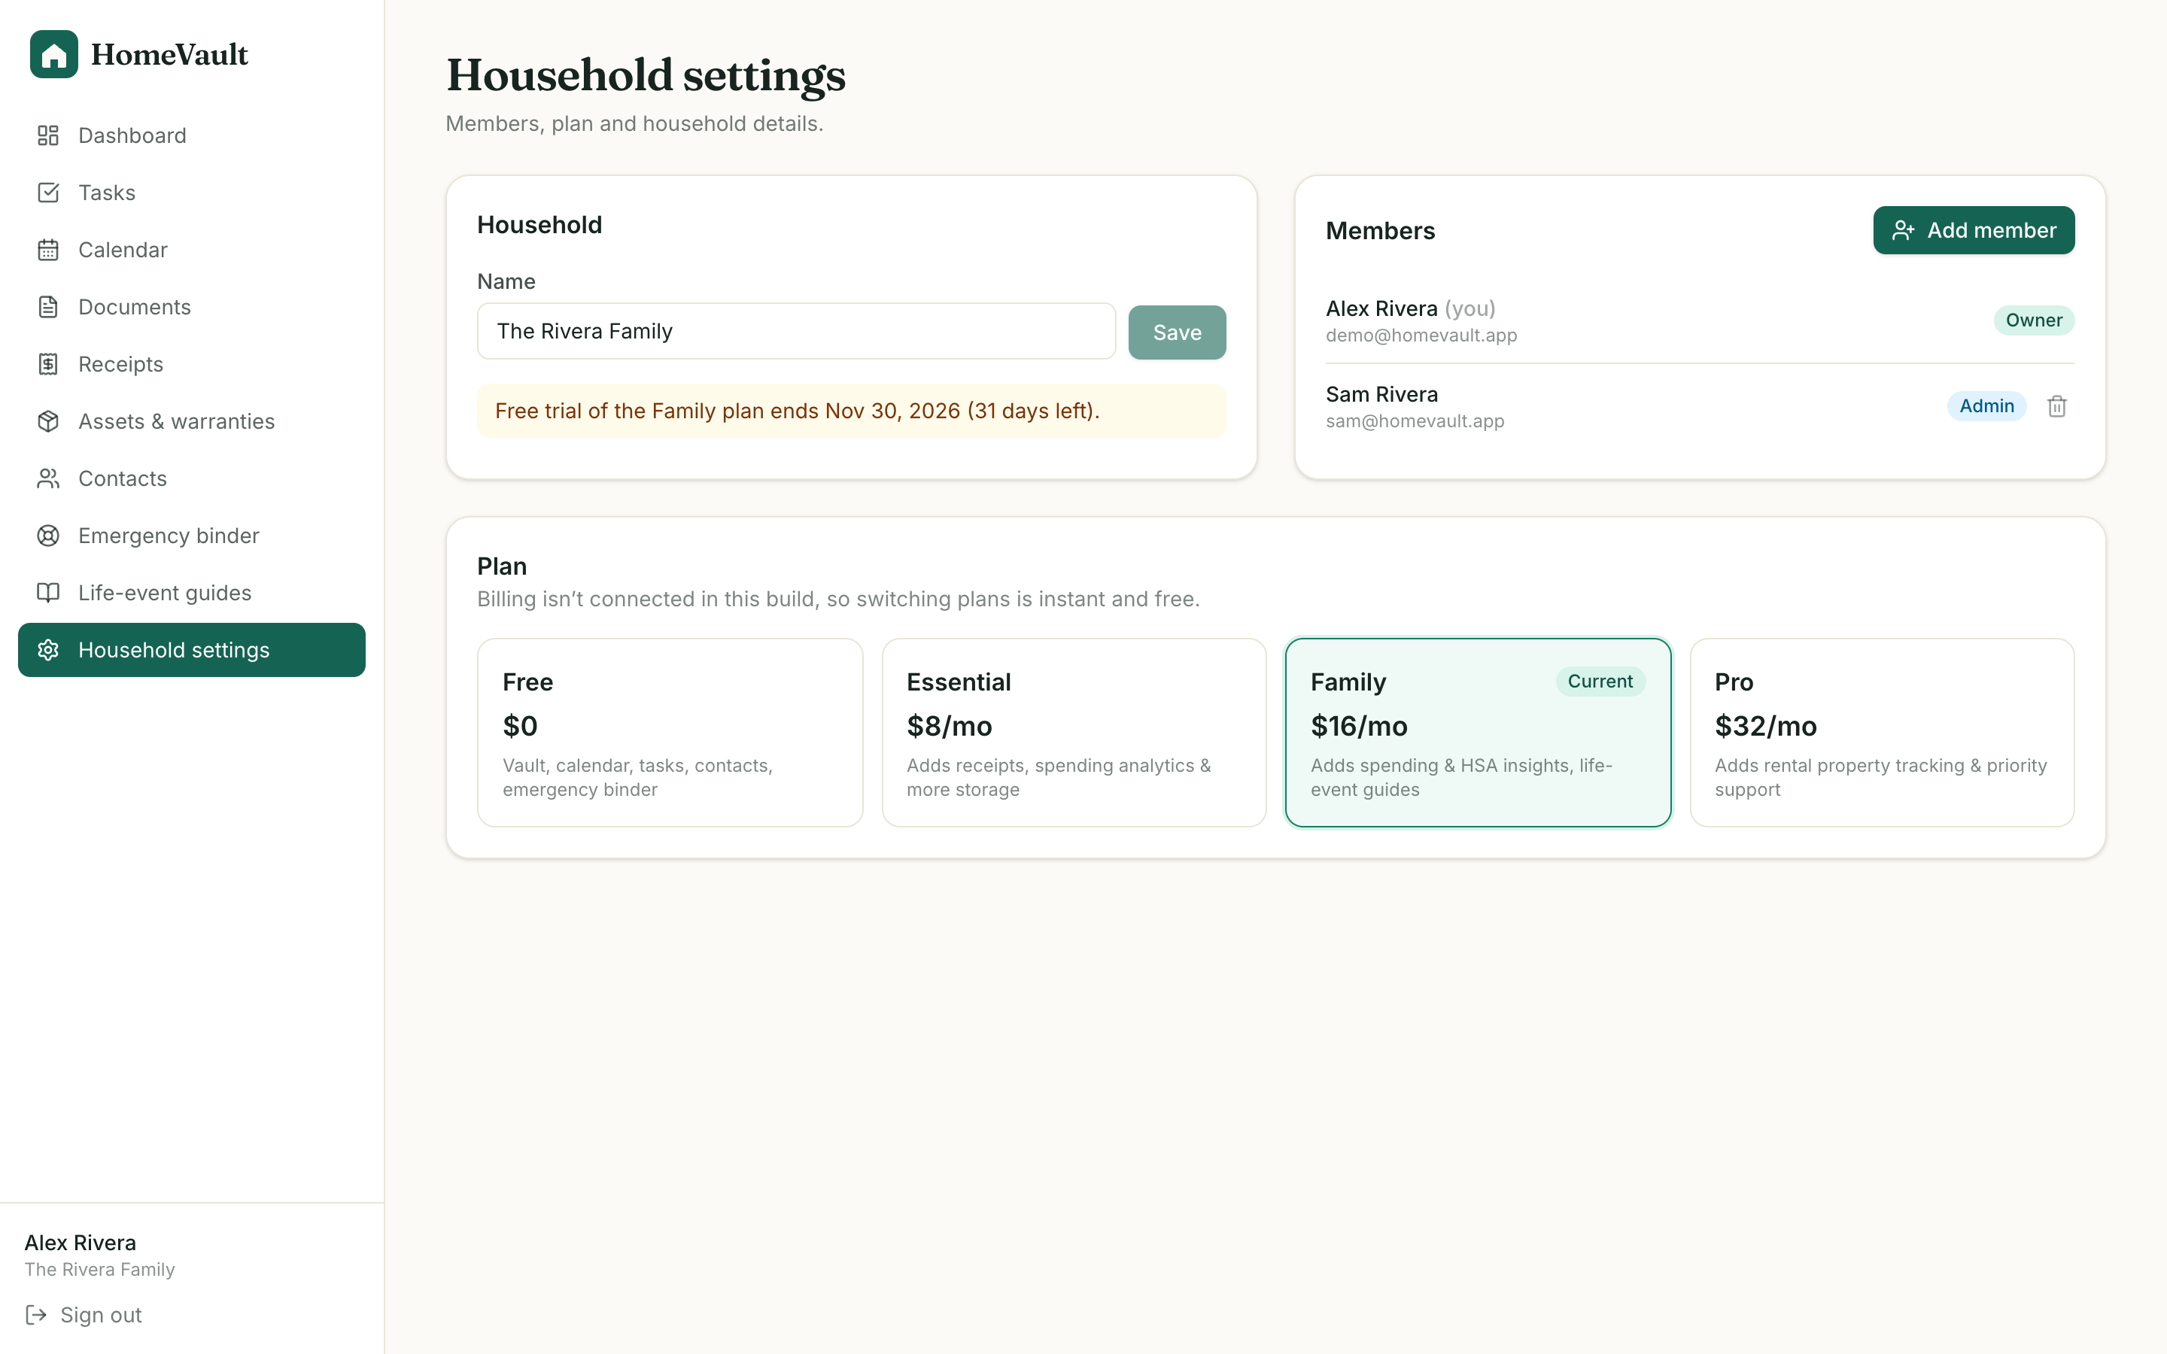
Household settings & plans
Manage the household’s name, members and subscription plan.
Key features
Rename the household
Add members with a role & temporary password
Remove members (never the owner)
Free, Essential, Family and Pro plans
Trial countdown banner
Under the hood Member management is restricted to Owner/Admin by a server-side guard. Billing is not connected yet.

Slide 19



How the modules feed each other
Purchases → protection
Receipt
Asset
Alert
Task
Calendar
TV bought with 12-month warranty
Created with warranty end date
Dashboard warns 60 days before
Owner schedules a claim or check
Due date shown to everyone
Information → preparedness
Documents
Contacts
Binder
Readiness
Print
Policies flagged “in binder”
Emergency contacts marked
Sections, contacts & documents
Score shows remaining gaps
A copy the family can hold

Slide 20
Try it yourself
Open http://localhost:3100 and click “Use the demo account”
demo@homevault.app · demo1234
Suggested tour: Dashboard → Tasks → Receipts → Assets → Emergency binder → Life-event guides

