Slide 1



FinalProject_VishalC
View in Power BI
Last data refresh:
18/08/2025 17:01:16 UTC
Downloaded at:
18/08/2025 17:06:42 UTC

Slide 2
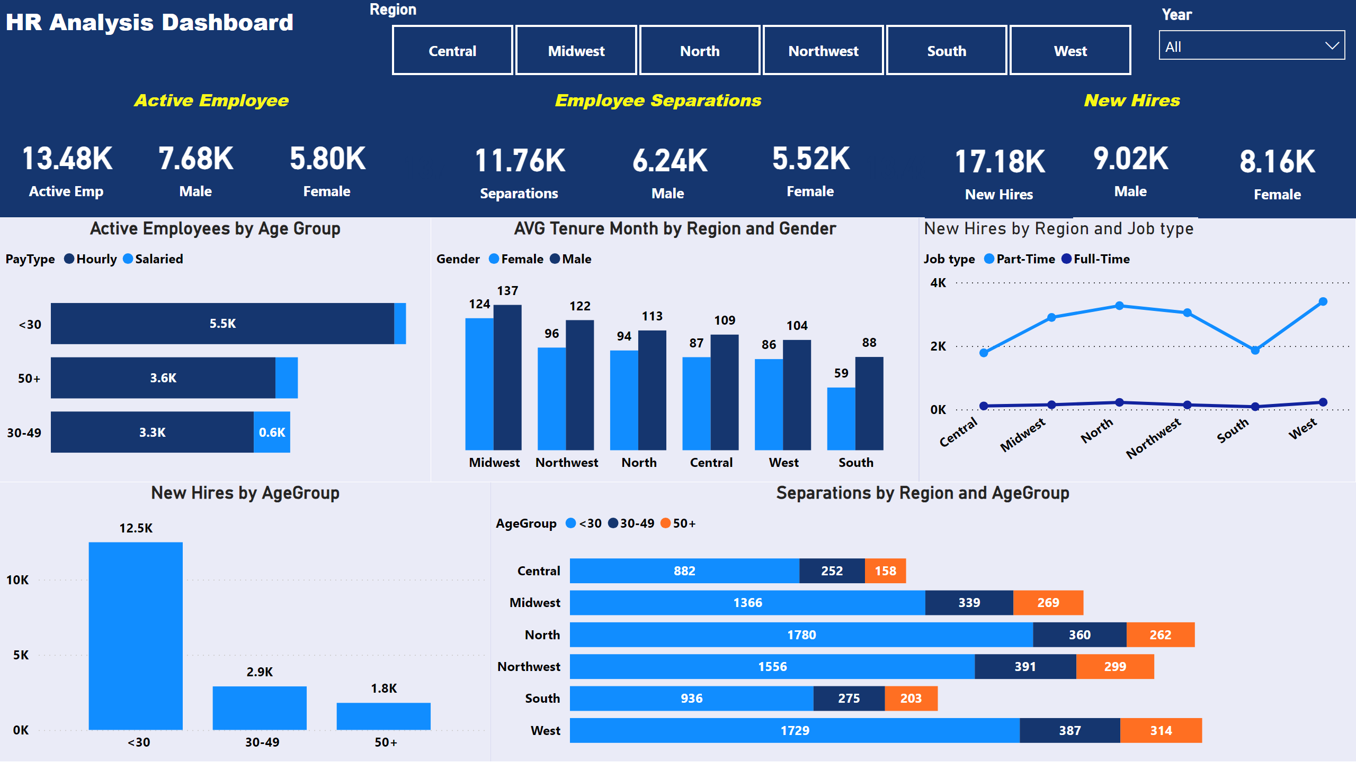
Report
Notes:
textbox
No alt text provided
Region
No alt text provided
slicer
No alt text provided
textbox
No alt text provided
card
No alt text provided
Male
No alt text provided
card
No alt text provided
textbox
No alt text provided
card
No alt text provided
Male
No alt text provided
card
No alt text provided
card
No alt text provided
card
No alt text provided
card
No alt text provided
Male
No alt text provided
card
No alt text provided
textbox
No alt text provided
Active Employees by Age Group
No alt text provided
clusteredColumnChart
No alt text provided
lineChart
No alt text provided
clusteredColumnChart
No alt text provided
barChart
No alt text provided

