Slide 1



INTERNSHIP PROJECT PRESENTATION
ABC Retail Business Performance Analysis
Using Tableau
Submitted By: Vishal Chauhan
B.Com
Asian School of Business
Slide 1 of 28

Slide 2

Internship Project Certificate
CERTIFICATE OF APPROVAL
Asian School of Business — Department of Commerce
This is to certify that the internship project entitled “ABC Retail Business Performance Analysis using Tableau” was completed by Vishal Chauhan, B.Com student at Asian School of Business, under my guidance and supervision.
To the best of my knowledge, the work presented here is a genuine record of the internship project completed by the student.
Slide 2 of 28

Slide 3

Student Declaration
I, Vishal Chauhan, student of B.Com at Asian School of Business, hereby declare that the project titled “ABC Retail Business Performance Analysis using Tableau” is original work completed by me as part of my internship project.
This project was undertaken as part of my internship to gain practical experience in business analytics and data visualization. The analysis and visualizations were created using Microsoft Excel and Tableau based on the supplied ABC Retail dataset.
I confirm that this project report has not been previously submitted to any other college, university, or institution for any academic degree or recognition.
Vishal Chauhan
B.Com Student
Slide 3 of 28

Slide 4

Acknowledgement
I would like to thank my faculty guide and the Asian School of Business for their guidance and support during this internship project.
I am grateful for the learning opportunity and the resources that helped me gain practical experience in Excel, Tableau and data visualization.
Working on this project helped me understand data checking, calculated fields, dashboard creation and basic business analysis.
I am thankful to everyone who supported me during the completion of the project.
Vishal Chauhan
B.Com, Asian School of Business
Slide 4 of 28

Slide 5




Table of Contents
Section I: Project Foundation
Section II: Methodology & Tools
1. Introduction & Background
6. Project Methodology & Process Flow
2. ABC Retail Organization Overview
7. Tools Used (Excel, Tableau, PPT)
3. Project Objectives
8. Calculated Fields & Key Metrics
4. Learning Outcomes
9. Tableau Worksheets & Workspace
5. Dataset Structure & Preparation
10. Dashboard 1: Sales & Customer Performance
Section III: Dashboard Analysis
Section IV: Project Log & Summary
11. Dashboard 2: Customer Analytics
15. Student Challenges & Solutions
12. Dashboard 3: Financial Performance
16. 12-Day Work Log & Daily Tasks
13. Product & Category Performance
17. Recommendations & Final Conclusion
14. Regional Profitability Comparison
Slide 5 of 28

Slide 6



Project Introduction
What is this Project About?
Why Tableau was Selected?
This internship project focuses on analyzing transaction and customer data from the ABC Retail dataset.
▪
Data Connection: Easily connects with Excel spreadsheets containing retail transactions.
The analysis looks at revenue, cost, profit, product performance, regional performance and customer information.
▪
Visual Exploration: Converts plain table rows into bar charts, line graphs, and summary KPIs.
▪
Interactive Dashboards: Allows combining multiple charts into single dashboard views.
Why Analyze Retail Data?
▪
Calculated Fields: Enables custom formulas for profit margin and customer churn percentages.
Retail data analysis is useful for understanding sales patterns, customer status, product performance and regional differences.
▪
Academic Utility: Provides practical exposure to modern business intelligence software used in industry.
Slide 6 of 28

Slide 7



Case Organization Overview: ABC Retail
Organization Profile (Dataset Perspective)
ABC Retail is the case organization represented by the supplied dataset. The available data covers customers, products, categories, regions, revenue and cost.
Geographical Reach
Product Portfolio
Customer Base
The dataset contains four regions:
The dataset contains product and category information.
Customer information is tracked using unique Customer IDs.
▪
East Region
▪
Products include Laptops, Smartphones and Monitors
▪
Tracks Existing Customers
▪
North Region
▪
Records New Customer Acquisitions
▪
South Region
▪
Products include Keyboards, Mice and Headphones
▪
Monitors Churned Customers
▪
West Region
▪
Other products in the dataset include Office Chairs, Desks, Bookshelves, Printers and Tablets
Slide 7 of 28

Slide 8


Project Objectives
Primary Analytical Objectives
Technical & Practical Objectives
▪
Sales Trend Analysis: Track overall sales and monthly revenue variations throughout the financial year.
▪
Product Level Analysis: Compare individual product performance.
▪
Customer Churn & Retention: Study customer status to measure new additions versus customer churn.
▪
Category Breakdown: Determine category contribution across Electronics, Furniture, and Accessories.
▪
Profitability Assessment: Measure overall gross profit and profit margins across products and categories.
▪
KPI & Formula Creation: Develop calculated fields in Tableau for Profit, Profit Margin %, and Churn Rate %.
▪
Regional Comparison: Compare sales revenue and profit distribution across East, North, South, and West regions.
▪
Interactive Dashboards: Build 3 distinct, organized Tableau dashboards for effective presentation.
Slide 8 of 28

Slide 9


Learning Outcomes
1. Data Handling in Excel
2. Tableau Software Skills
3. Calculated Fields & Logic
Learned how to inspect the dataset, check data types and review the table structure before using it in Tableau.
Understood Tableau's interface, dimensions and measures, and how to select suitable charts for the analysis.
Gained practical experience creating calculated fields for Profit, Profit Margin %, customer count and churn rate.
4. KPI & Metric Design
5. Dashboard Formatting
6. Business Interpretation
Understood how KPIs such as Revenue, Profit, Customer Count and Churn Rate summarize the data.
Learned how to arrange worksheets, format charts and maintain a readable dashboard layout.
Developed the ability to explain charts and convert the results into simple business observations.
Slide 9 of 28

Slide 10
Dataset Overview
The project uses the ABC Retail Business Performance Dataset stored in Excel format. Below is the structure of key fields analyzed:
Field Name | Data Type | Tableau Classification | Description / Purpose
Date | Date / Time | Dimension | Records the transaction date (used for monthly trend analysis)
Customer ID | String / Text | Dimension | Unique identifier for individual buyers (e.g., C001, C003)
Region | String / Text | Dimension | Geographical territory (East, North, South, West)
Product | String / Text | Dimension | Item name (Laptop, Monitor, Keyboard, Mouse, Printer, etc.)
Category | String / Text | Dimension | Broad group (Electronics, Furniture, Accessories)
Revenue | Numeric (Currency) | Measure | Total monetary value generated from sales
Cost | Numeric (Currency) | Measure | Direct cost associated with products sold
Customer Status | String / Text | Dimension | Classification of customer (New, Existing, Churned)
Slide 10 of 28

Slide 11




Data Preparation Process
Step 1: Initial Inspection in Excel
Step 2: Data Type Verification
▪
Checked the dataset in Microsoft Excel to understand the columns and table structure.
▪
Checked that the Date field was recognized correctly.
▪
Checked column names and structure.
▪
Checked that Revenue and Cost were numeric measures.
▪
Reviewed the data for missing or incorrect values.
▪
Set Customer ID and Region as text dimensions.
Step 3: Dimension vs. Measure Sorting
Step 4: Connection to Tableau
▪
Categorized categorical attributes (Product, Category, Region) as Dimensions.
▪
Connected the Excel dataset to Tableau Desktop.
▪
Categorized financial numbers (Revenue, Cost) as quantitative Measures.
▪
Checked data types in Tableau before creating worksheets.
Slide 11 of 28

Slide 12








Project Methodology
The project followed a standard step-by-step analytics workflow from raw dataset to final presentation:
Workflow Explanation
Starting from raw transaction rows in Excel, the data was checked and linked to Tableau Desktop. Calculated formulas were built to compute profit and customer counts. Individual charts were developed in separate worksheets and then arranged into three comprehensive dashboards.
Slide 12 of 28

Slide 13




Software Tools Used
Microsoft Excel
Microsoft PowerPoint
Used for primary data storage, preliminary row verification, column structure checks, and quick validation of totals before importing into Tableau.
Used to present the project work, screenshots, findings and final internship presentation.
Tableau Desktop
The core data visualization tool used to create calculated fields, build visual worksheets, format bar/line charts, and construct interactive dashboards.
Slide 13 of 28

Slide 14
Calculated Fields & Key Metrics
To extract financial and customer indicators, custom calculated fields were written in Tableau:
Financial Calculations
Customer Calculations
Profit = SUM([Revenue]) - SUM([Cost])
Total Customers = COUNTD([Customer ID])
Calculates absolute monetary profit for transactions and aggregated views.
Counts distinct individual customer IDs to avoid double counting.
Profit Margin % = SUM([Profit]) / SUM([Revenue])
Churn Rate % = [Churned Customers] / [Total Customers]
Measures percentage efficiency of revenue converted into profit.
Calculates the proportion of lost customers relative to total customer base.
Slide 14 of 28

Slide 15
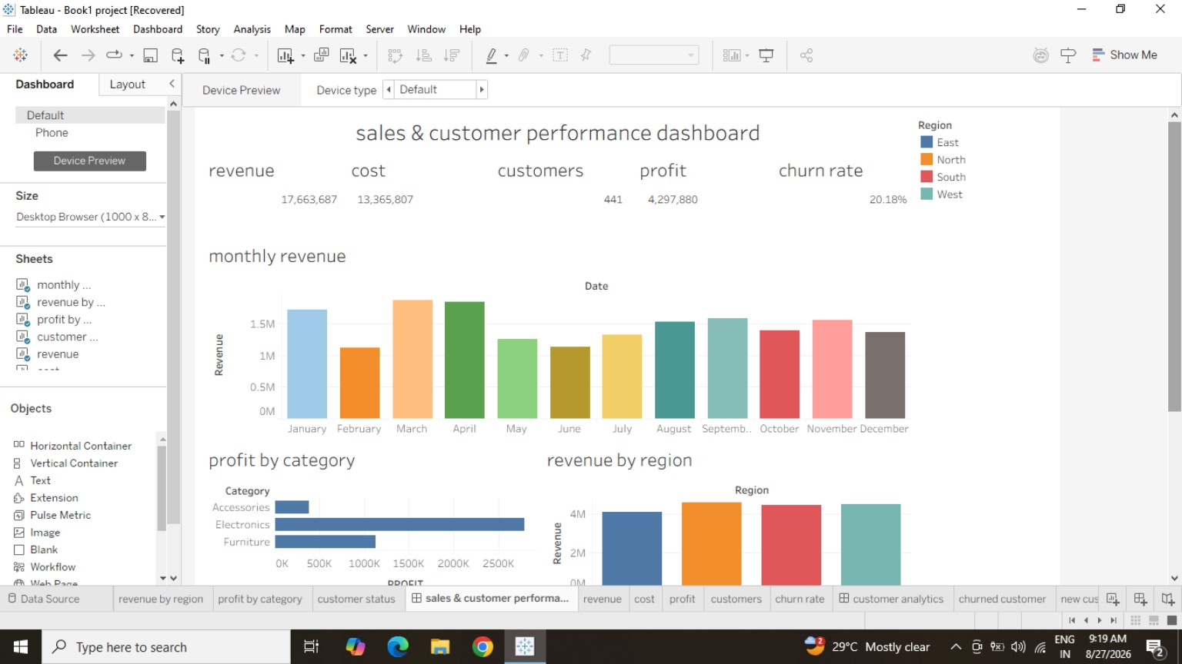


Tableau Workspace Overview
Tableau Working Environment
The screenshot shows the Tableau workspace used during the project.
▪
Data Pane: Contains the fields used for the analysis.
▪
Worksheet Tabs: Show the individual sheets created for the analysis.
▪
Canvas Area: Used to arrange charts and build the dashboards.
Slide 15 of 28

Slide 16
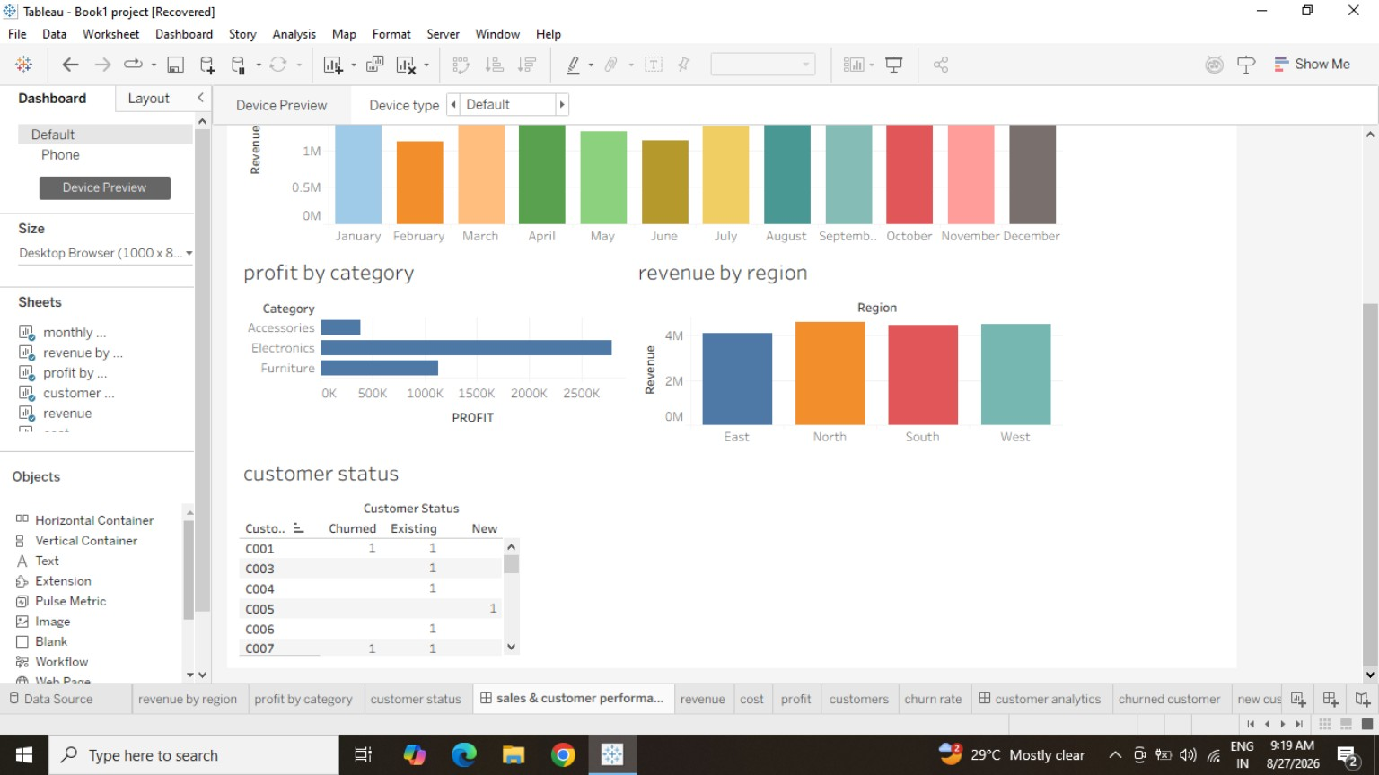


Individual Tableau Worksheets
Worksheet Building Process
Worksheets were created first and then combined to form the dashboards.
▪
Revenue analysis worksheet
▪
Product performance worksheet
▪
Category financial performance worksheet
▪
Regional profitability worksheet
Slide 16 of 28

Slide 17

Dashboard 1: Sales & Customer Performance
Slide 17 of 28

Slide 18
Dashboard 1: Component Breakdown
Summary KPI Cards (Top Banner)
Visual Chart Elements
Displays headline metrics across the business:
▪
Monthly Revenue Bar Chart: Vertical bar chart displaying revenue distribution across January to December.
▪
Revenue: Displays revenue in the dashboard.
▪
Cost: Displays cost in the dashboard.
▪
Profit by Category: Horizontal bar chart highlighting profit generated by Accessories, Electronics, and Furniture.
▪
Customers: Total distinct customer count (441).
▪
Profit: Displays profit in the dashboard.
▪
Revenue by Region: Colored column chart comparing revenue across East, North, South, and West regions.
▪
Churn Rate: Percentage of churned customers (20.18%).
▪
Customer Status Table: Matrix breakdown of customer IDs by Churned, Existing, and New status.
Slide 18 of 28

Slide 19


Dashboard 1: Key Findings
1. Steady Monthly Revenue
2. Category Profit Overview
3. Regional Revenue
Monthly revenue varies across the year, with higher revenue visible in some months.
The dashboard compares profit across the categories shown.
Revenue is compared across the North, South, East, and West regions in the dashboard view.
Summary Observation
Dashboard 1 shows sales activity across the year, while the churn rate of 20.18% is an important customer metric to monitor.
Slide 19 of 28

Slide 20
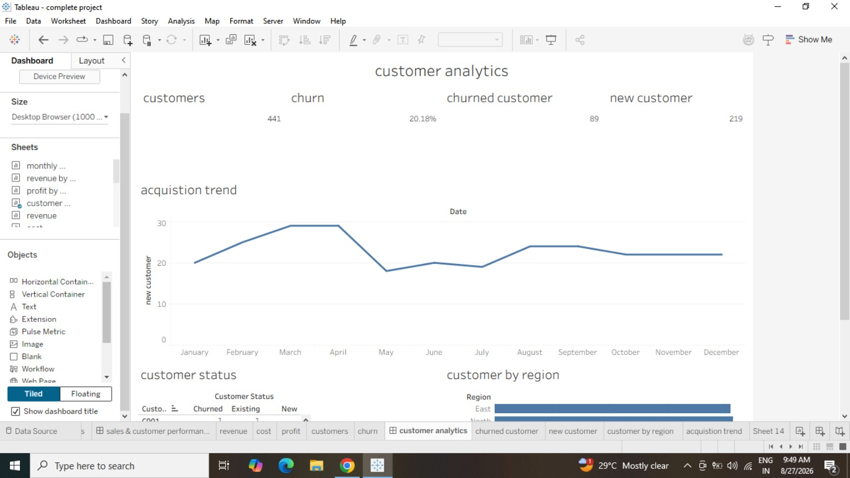
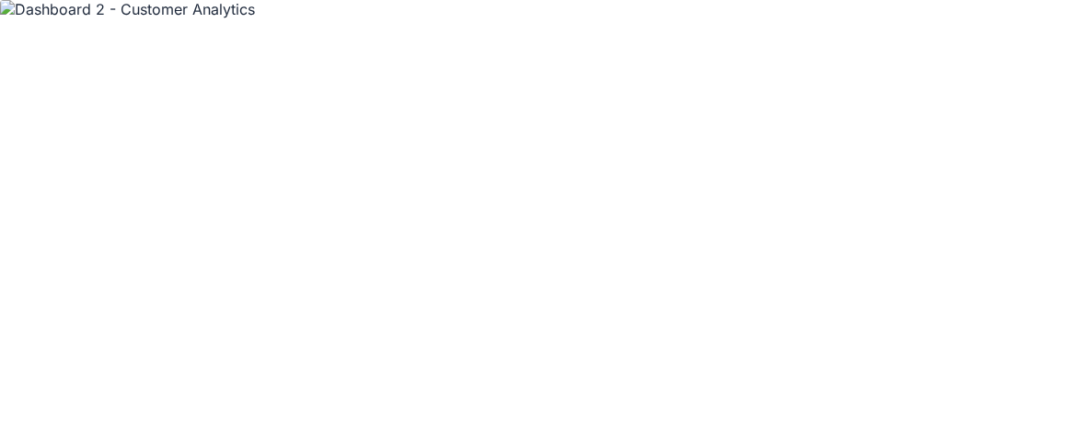
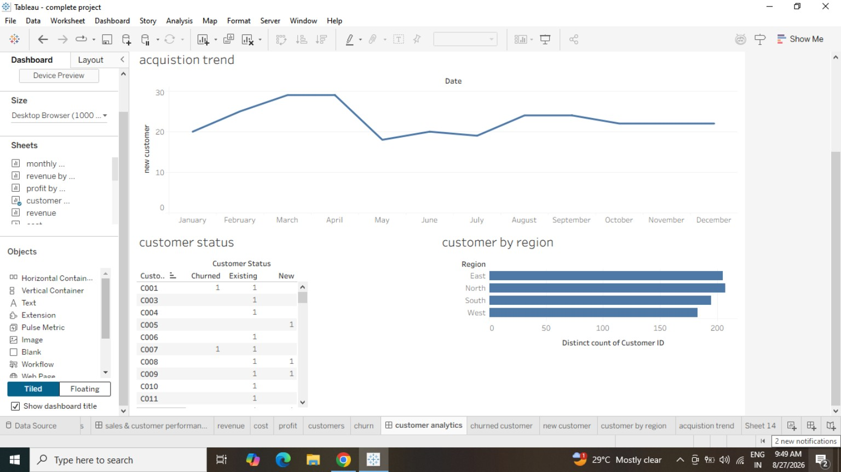
Dashboard 2: Customer Analytics
Slide 20 of 28

Slide 21



Dashboard 2: Customer Metrics Analysis
441
219
89
20.18%
Total Customers
New Customers
Churned Customers
Churn Rate
Customer Acquisition & Churn Findings
Regional Customer Distribution
▪
New Customers: 219 new customers are shown in the dashboard.
▪
Regional Customer Distribution: Distinct Customer ID counts are compared across the four regions.
▪
Customer Churn: 89 customers are shown as churned, with a churn rate of 20.18%.
▪
The dashboard shows customer distribution across East, North, South and West.
▪
Acquisition Trend: The line chart shows monthly new customer additions.
Slide 21 of 28

Slide 22
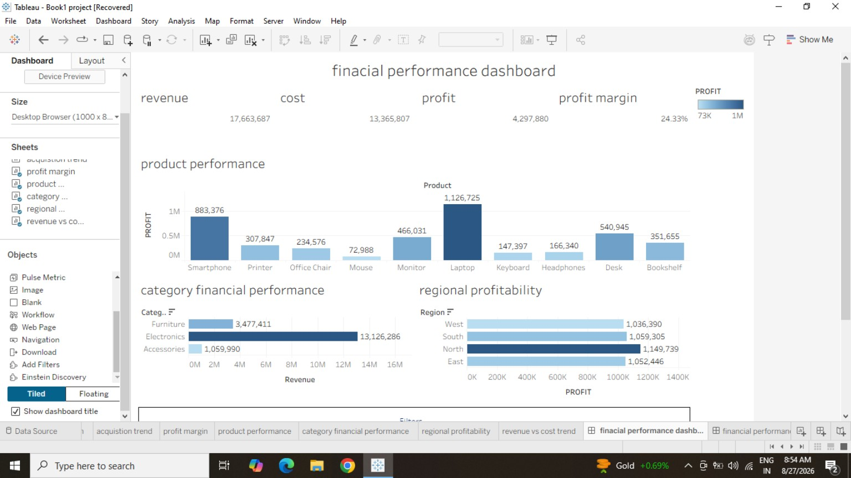

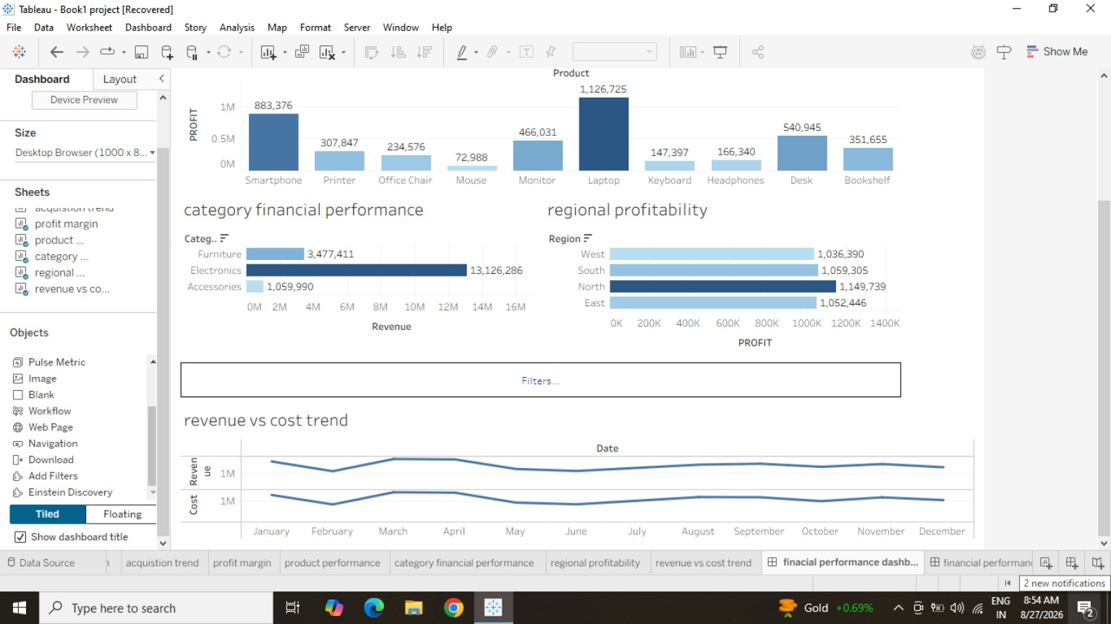
Dashboard 3: Financial Performance
Slide 22 of 28

Slide 23


Dashboard 3: Financial Metrics Analysis
₹1,079,314
₹793,859
₹285,455
≈26.45%
Total Revenue
Total Cost
Total Profit
Profit Margin %
Financial Summary
Key Financial Takeaways
▪
Revenue is higher than cost in the supplied project metrics, resulting in positive overall profit.
▪
Total revenue is ₹1,079,314 and total cost is ₹793,859.
▪
The dashboard compares monthly revenue and cost trends.
▪
Overall business profit margin is approximately 26.45% based on the supplied project metrics.
▪
The dashboard compares profitability across products and categories.
Slide 23 of 28

Slide 24


Product & Category Analysis
Product Name | Category | Total Profit (₹)
Laptop | Electronics | ₹1,126,725
Smartphone | Electronics | ₹883,376
Desk | Furniture | ₹540,945
Monitor | Electronics | ₹466,031
Bookshelf | Furniture | ₹351,655
Printer | Not specified | ₹307,847
Category Breakdown
▪
Electronics: The Tableau view shows ₹13,126,286 in revenue.
▪
Furniture: The Tableau view shows ₹3,477,411 in revenue.
▪
Accessories: The Tableau view shows ₹1,059,990 in revenue.
Product Performance
Laptop and Smartphone are included in the product performance comparison, with the shown profit values from the Tableau view.
Slide 24 of 28

Slide 25
Regional Profitability Comparison
Region | Total Profit (₹)
North | ₹1,149,739
South | ₹1,059,305
East | ₹1,052,446
West | ₹1,036,390
Regional Analysis Observations
▪
The Tableau view compares profitability across North, South, East and West.
▪
The reported regional profit values range from ₹1,036,390 to ₹1,149,739.
▪
The regional results provide a basis for comparing profitability across the four regions.
Slide 25 of 28

Slide 26


Project Challenges & Solutions
1. Tableau Aggregation Levels
2. Distinct Customer Counting
Challenge: Initial confusion between row-level calculations and aggregate calculations when computing profit margins.
Challenge: Standard `COUNT()` was double-counting customers with multiple transaction records.
Solution: Used explicit aggregated expressions `SUM(Profit) / SUM(Revenue)` instead of row level division.
Solution: Applied `COUNTD()` (Count Distinct) formula in Tableau to count unique Customer IDs accurately.
3. Layout Container Alignment
4. Metric Verification
Challenge: Charts overlapping and misaligning when combining multiple sheets onto dashboard canvas.
Challenge: Ensuring Tableau visual outputs matched original dataset figures.
Solution: Cross-checked summary totals in Excel Pivot Tables against Tableau KPI cards.
Solution: Utilized Tableau's Horizontal and Vertical layout containers and fixed padding controls.
Slide 26 of 28

Slide 27
12-Day Project Work Log
Day | Task / Activity | Details & Deliverables
Day 1 | Requirement Understanding | Finalized project title, research scope, and objective outlines with faculty guide.
Day 2 | Dataset Collection & Review | Received ABC Retail dataset; inspected columns and basic transactional attributes.
Day 3 | Data Preparation in Excel | Checked data types, verified numeric fields, and formatted date columns in Excel.
Day 4 | Tableau Connection | Connected dataset to Tableau Desktop; verified dimensions and measures in Data Source tab.
Day 5 | Worksheet Creation (Sales) | Created monthly revenue bar charts and revenue by region bar charts.
Day 6 | Calculated Fields Setup | Wrote Tableau formulas for Profit, Profit Margin %, Distinct Customers, and Churn Rate.
Day 7 | Dashboard 1 Construction | Built "Sales & Customer Performance Dashboard" combining sales, category, and regional sheets.
Day 8 | Dashboard 2 Construction | Built "Customer Analytics Dashboard" featuring churn rate, new acquisition, and regional counts.
Day 9 | Dashboard 3 Construction | Built "Financial Performance Dashboard" focusing on profit margins, product performance, and cost trends.
Day 10 | Formatting & Validation | Adjusted dashboard colors, axis labels, titles, and cross-checked metrics against Excel totals.
Day 11 | Analysis & Observations | Drafted written interpretations of dashboard charts, regional profitability and product performance.
Day 12 | Presentation & Final Report | Compiled final internship presentation and project report for college submission and viva.
Slide 27 of 28

Slide 28


Recommendations & Conclusion
Practical Recommendations
Project Conclusion
▪
Reduce Customer Churn: Investigate causes behind the 20.18% churn rate (89 churned customers) through feedback and post-sale support.
This project demonstrated how transaction data from ABC Retail can be converted into useful business information using Tableau.
The three dashboards helped me understand sales trends, product profitability, regional performance and customer information.
▪
Monitor the profitability of high-performing products such as Laptops and Smartphones.
The project improved my practical understanding of Excel, Tableau, calculated fields and dashboard creation.
▪
Review regional profitability regularly, especially where performance is comparatively lower.
▪
Maintain Tableau Dashboards: Regularly update the underlying Excel data source to enable dynamic, ongoing performance monitoring.
Slide 28 of 28

