Slide 1
Software Development Life Cycle (SDLC)
A systematic process used to develop high-quality software.
It defines phases involved in planning, creating, testing, and maintaining software.

Slide 2
What is SDLC?
SDLC is a framework that describes all phases involved in software development.
It ensures structured and organized development.

Slide 3
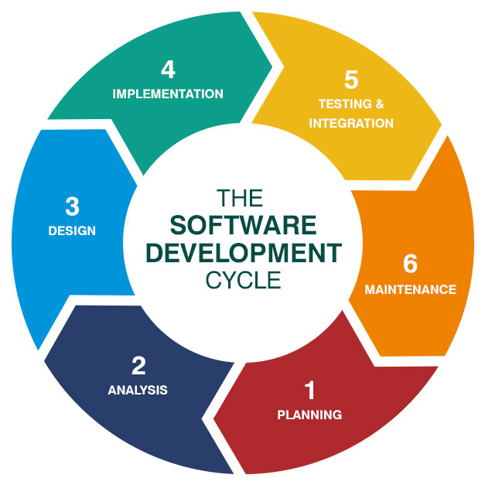
SDLC Phase’s
1. Requirement Analysis 2. System Design 3. Implementation (Coding) 4. Testing 5. Deployment 6. Maintenance

Slide 4
Phase 1: Requirement Analysis
Collect requirements from users or clients.
Understand what the system should do.
Document all requirements clearly.

Slide 5
Phase 2: System Design
Design system architecture.
Prepare database design.
Plan UI and system structure.

Slide 6
Phase 3: Implementation (Coding)
Developers write actual code.
Use programming languages to build software.
Convert design into working system.

Slide 7
Phase 4: Testing
Test software for bugs and errors.
Perform different testing types.
Ensure software works correctly.

Slide 8
Phase 5: Deployment
Release software to users.
Install system in real environment.
Make it available for actual use.

Slide 9
Phase 6: Maintenance
Fix bugs after deployment.
Improve features.
Update system when needed.

Slide 10
Conclusion
SDLC helps in structured development.
Improves software quality.
Ensures proper planning, development, testing, and maintenance.

