Slide 1
SEMANTIC SEGMENTATION FOR AUTONOMOUS DRIVING
NAME: VISHAL M DAVASAM

Slide 2
Overview
Abstract
Problem Statement
Introduction
Social/Environmental Impact
State of the Art work
Design
Deliverables
References

Slide 3
Abstract
This project aims to develop a real-time semantic segmentation model for autonomous driving using U-Net architecture.
The dataset used consists of 5 sets of 1000 images and labelled semantic segmentations captured using the CARLA self-driving car simulator.
U-Net architecture outperformed the other architectures in terms of accuracy and speed, allowing for the capture of both fine-grained and high-level features. After training, the U-net model was able to segment images and videos in real-time with 98% accuracy.
The development of accurate and reliable semantic segmentation models is crucial for improving road safety and advancing autonomous driving systems.

Slide 4
Problem Statement
Problem: Image segmentation is crucial in ADAS and autonomous vehicles, but existing models have limitations. U-Net is an efficient model for detailed segmentation in real-time. However, relying solely on semantic picture segmentation models can result in accidents due to occasional misclassifications. Autonomous vehicles use multiple sensors for obstacle detection. Video input causes temporal inconsistency, leading to segmentation variance. Current trends show that existing systems fail under extreme conditions, and even Level 2 ADAS with basic object detection and warning systems can malfunction.
Solution: Semantic Segmentation

Slide 5
Introduction
Semantic segmentation is the process of assigning each pixel of the input image into one of the predefined classes.
Also referred to as “pixel-wise classification”
Semantic segmentation allows autonomous cars to obtain an accurate representation of the outside world. It is used to define the available navigation space and the presence of obstacles necessary to calculate navigation trajectories.
The study compares three popular segmentation models, FCN, SegNet, and U-Net, and concludes that U-Net is the most effective due to its design features.
Also highlights the challenges of semantic segmentation, such as the relation between pixels in successive frames, and proposes a solution through algorithm comparison and efficient dataset creation.

Slide 6
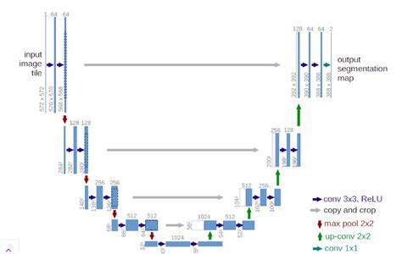
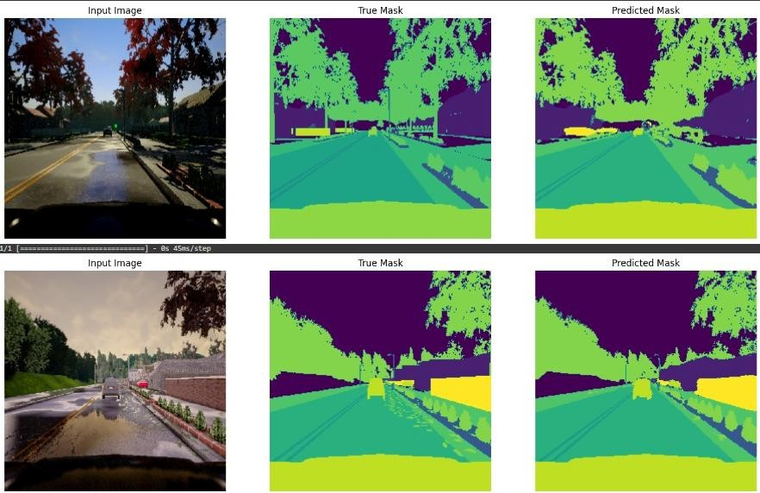
Design with Examples
Fig 3- Architecture of U-NET
Fig 3.1- Predictions with U-Net model

Slide 7
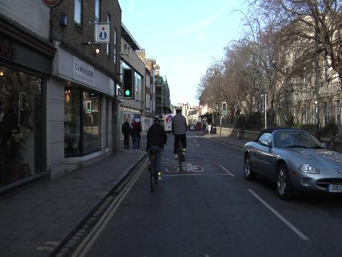
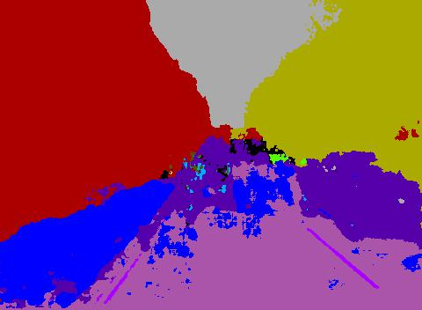
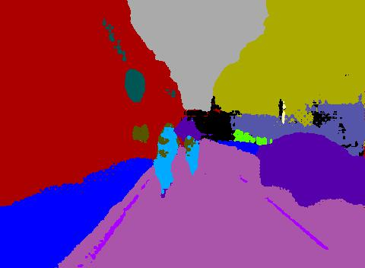
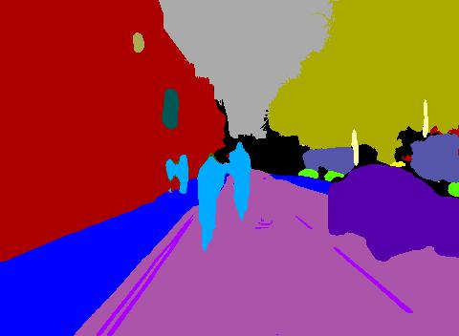
Results
Input Image
SegNet FCN U-Net

Slide 8
Results
Input Image predicted result using U-net

Slide 9
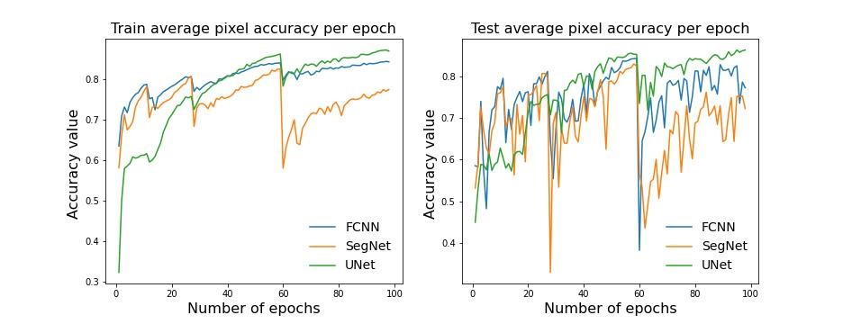
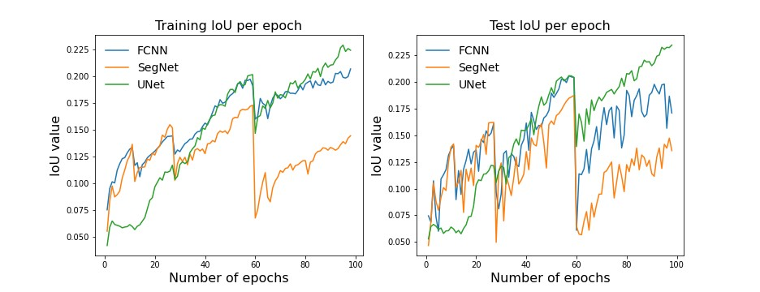
Results
Fig 5 -Train IoU Fig 5.1 -Test IoU
Train Accuracy Test Accuracy
Train IoU Test IoU

Slide 10
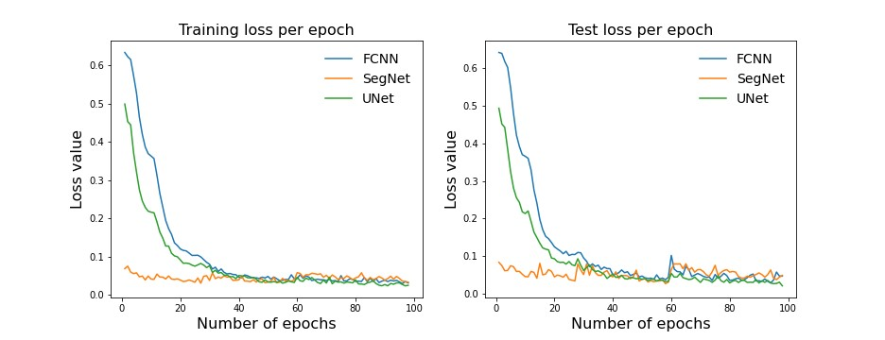
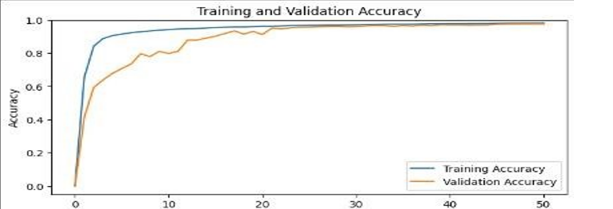
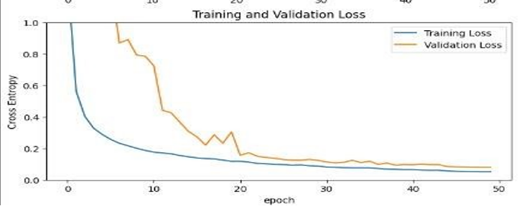
Results
Train Loss Test Loss
Training and Training and
Validation Accuracy Validation loss

Slide 11
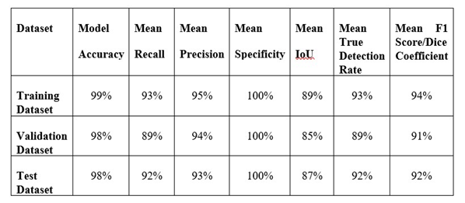
Discussion of Results
Overall result of project

Slide 12
Conclusion
In conclusion, our project focused on developing a U-net model for semantic segmentation in autonomous driving, and we performed a comparative study was conducted on U-Net, Segnet, and FCN models using the Carla dataset. The U-net model was found to be the most efficient, achieving an accuracy of 98%. The model was evaluated on various metrics, and it was able to generalize well to new data.
The study concluded that accurate and reliable semantic segmentation models are crucial for the advancement of autonomous driving and driver assistance systems. With further research and development, more advanced and efficient systems can be expected to improve road safety and make driving a more comfortable and enjoyable experience for everyone.

Slide 13
THANK YOU!

