Slide 1

By, TeamID-T211111 1. Vishal Kumar-IN1241003 2.N Paul Gabriel Richman-IN1241338
Subtitle Semantic Search Engine

Slide 2
Objective
Develop an advanced search engine algorithm specifically designed for retrieving video subtitles based on user queries.
Focus on prioritizing the analysis of video subtitles to deliver the most relevant results to users.
Leverage natural language processing (NLP) and machine learning (ML) techniques to significantly enhance the relevance and accuracy of search results.
Aim to improve the accessibility and usability of video content by providing users with more precise and contextually relevant subtitle search results.

Slide 3
Introduction
The project aims to develop an advanced search engine for movie and series subtitles.
It utilizes natural language processing (NLP) and machine learning (ML) techniques to enhance relevance and accuracy.
Emphasis is placed on understanding the semantic context of both user queries and subtitle content, moving beyond basic keyword matching.
Implemented in Python utilizing libraries such as pandas, scikit-learn, numpy, and Flask.
The goal is to create a robust and efficient subtitle similarity search engine, enhancing accessibility and usability of video content.

Slide 4
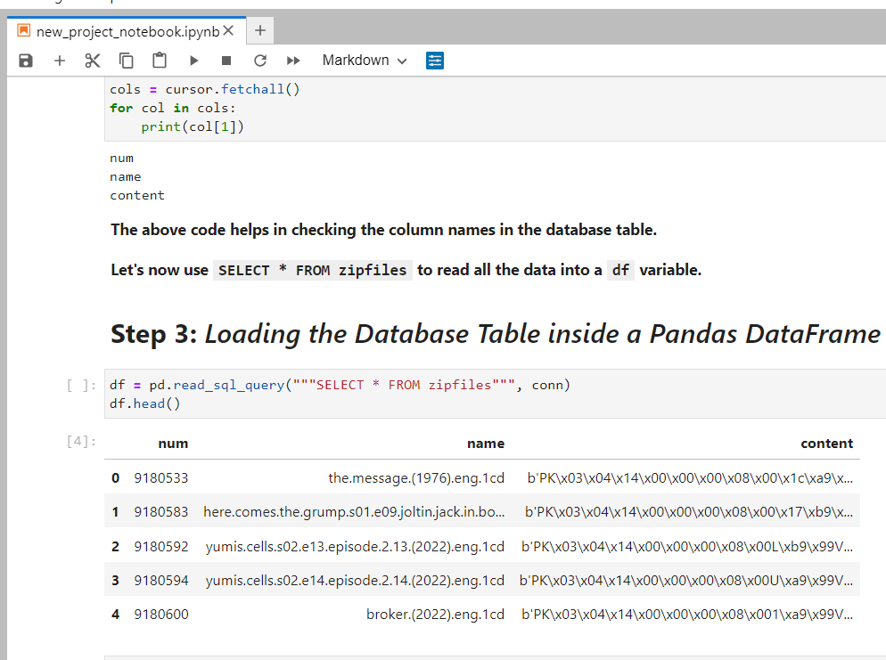
Reading the Data from the Database
Establish a connection to the database file 'eng_subtitles_database.db'.
Retrieve the names of tables present in the database.
Extract column information of the 'zipfiles' table.
Read data from the 'zipfiles' table into a DataFrame.
Since we had limited computing resources, we randomly picked 30% of the data to work with.

Slide 5
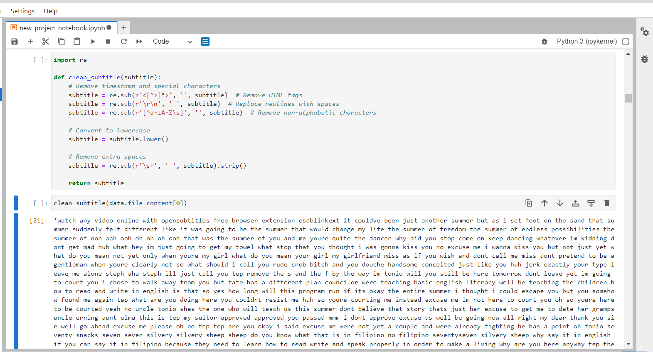
Preprocessing Text Data:
A special function is created to process text data.
Tasks performed include:
Removing timestamps indicating data collection time.
Converting all text to lowercase for consistency.
Eliminating common words (stopwords) lacking significant meaning.

Slide 6
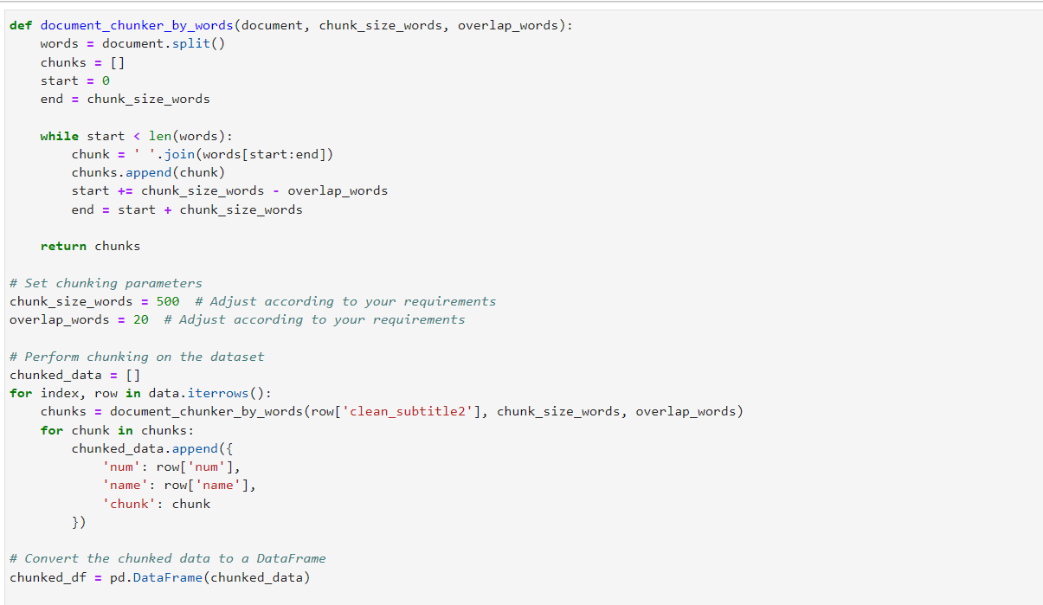
Document Chunking:
Dealing with very large text data involves utilizing the “embeddings” technique to represent text for machine comprehension.
Concerns arise over the potential loss of vital information, particularly with lengthy documents.
The solution involves segmenting large documents into smaller, more manageable pieces, known as "chunks."
Applied the document_chunker function to divide each of our cleaned documents into smaller, digestible sections, enhancing accuracy for generating precise text embeddings.

Slide 7
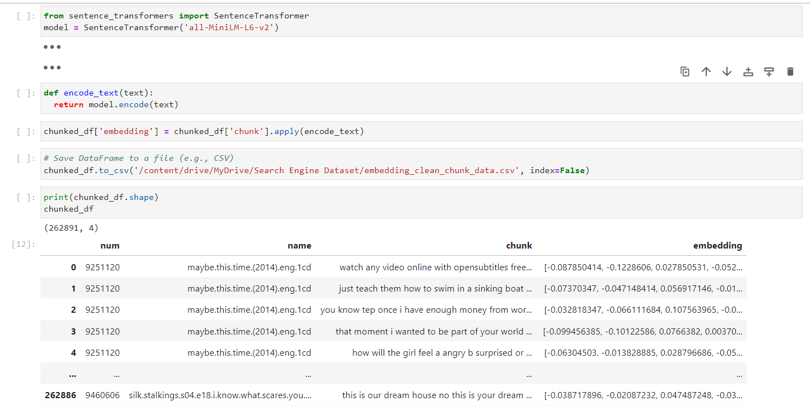
Vectorization
Employed the Sentence Transformers library to convert textual data into numerical representations, making it understandable for machines.
Applied this conversion process to a specific portion of text data, enabling further processing.
Created numerical representations, known as embeddings, for each segment of text, capturing its essence in a machine-readable format.
Saved the DataFrame containing these embeddings to a CSV file, ensuring accessibility for future utilization or analysis of the encoded representations.

Slide 8
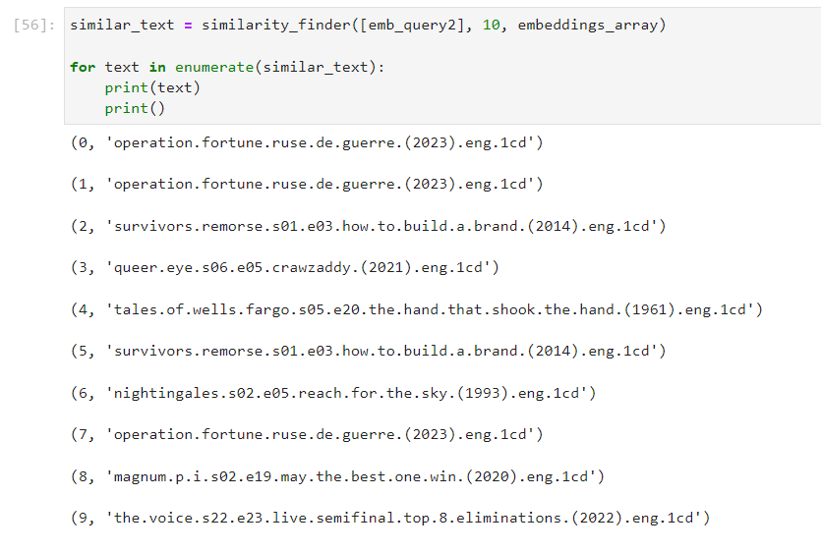
Cosine Similarity
Developed a function to find similar documents by calculating cosine similarity between a search query and document embeddings.
Utilized the cosine similarity metric, which measures the cosine of the angle between two vectors, to quantify the similarity between text representations.
Retrieved the top ‘n' most similar documents based on their similarity scores.
The function returns a list of the most similar documents, allowing users to identify relevant texts related to their search query.

Slide 9
Storing the Embeddings

Slide 10
Building the Flask Web App
The application is built using Flask, a Python web framework.
Users can input their queries, and we'll find matching subtitles from our collection.
The preprocessed query is then transformed into a numerical vector representation, employing the same method utilized for the subtitle documents.
The application computes the cosine similarity between the vector representations of the subtitle documents and the user query.
The app displays top matches, scores showing how similar they are.

Slide 11
Results

Slide 12
Results

Slide 13
Links:
Video Link:
Github:
LinkedIn:

Slide 14
Conclusion
After implementation of our subtitle similarity search system, it's evident that our approach focusing on the content of subtitles has significantly improved the accuracy and relevance of video search results. By diligently following the steps outlined, including importing libraries, preprocessing text data, computing vectors, calculating cosine similarity, and building a user-friendly Flask web app, we've successfully created an efficient tool tailored to our specific requirements.

Slide 15

THANK YOU

