Slide 1


SMART INDIA HACKATHON 2025
TITLE PAGE
Problem Statement ID – SIH25007
Problem Statement Title- Development of a Digital Farm Management Portal for Monitoring maximum Residue Limits (MRL) and Antimicrobial Usage (AMU) in Livestock.
Theme- Smart Farming & Rural Development
PS Category- Software
Team ID-
Team Name(Registered on portal)- BitVengers

Slide 2
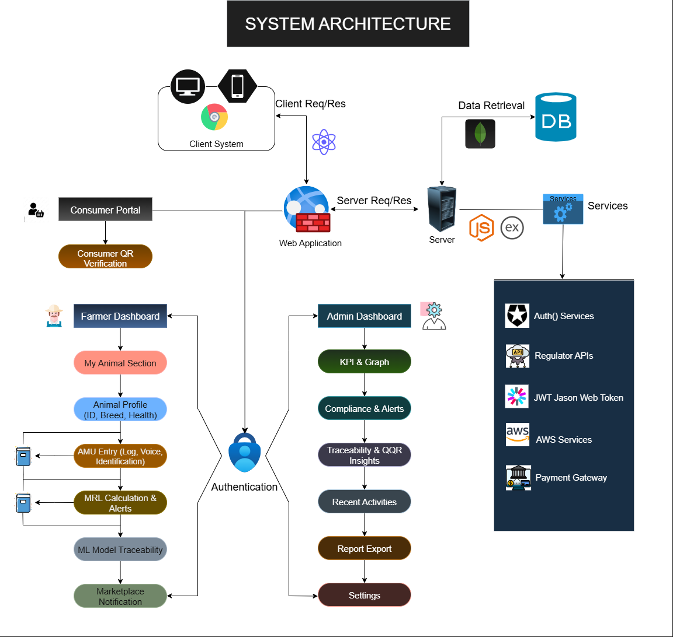
OneHealth Trace – Safe Animal Products for Safe Humans
BitVengers
Proposed Solution
Consumer Portal Integration – Enable consumers to perform QR verification to ensure transparency and build trust in livestock product traceability.
Farmer Dashboard Access – Provide farmers with a centralized dashboard for managing livestock information including My Animal Section and Animal Profile (ID, Breed, Health).
AMU Entry Management – Implement features for Antimicrobial Usage (AMU) logging, including voice input and identification, ensuring easy data entry for farmers.
MRL Monitoring System – Automate Maximum Residue Limit (MRL) calculations with real-time alerts, supporting compliance with food safety standards.
ML Model Traceability – Integrate machine learning models to improve traceability of antimicrobial usage and residue patterns for predictive insights.
Marketplace Notifications – Provide automated notifications for marketplace activities, enhancing farmer awareness and decision-making.
Activity Tracking – Track and display recent activities, with options to export reports and manage system settings for administrators.
Authentication Mechanism – Secure system access through multi-level authentication, ensuring that only authorized farmers, admins, and consumers can interact with the platform.
SYSTEM ARCHITECTURE
Client System Client Req/Res Server Req/Res Data Retrieval
Consumer Portal
Consumer QR Verification
Farmer Dashboard
My Animal Section
Animal Profile (ID, Breed, Health)
AMU Entry (Log, Voice, Identification)
MRL Calculation & Alerts
ML Model Traceability
Marketplace Notification
Authentication
Admin Dashboard
KPI & Graph
Compliance & Alerts
Traceability & QQR Insights
Recent Activities
Report Export
Settings
Services
Auth0 Services
Regulator APIs
JWT Jason Web Token
AWS Services
Payment Gateway
Technologies Used
React (Frontend)
Node.js + Express (Backend)
MongoDB (Database)

Slide 3
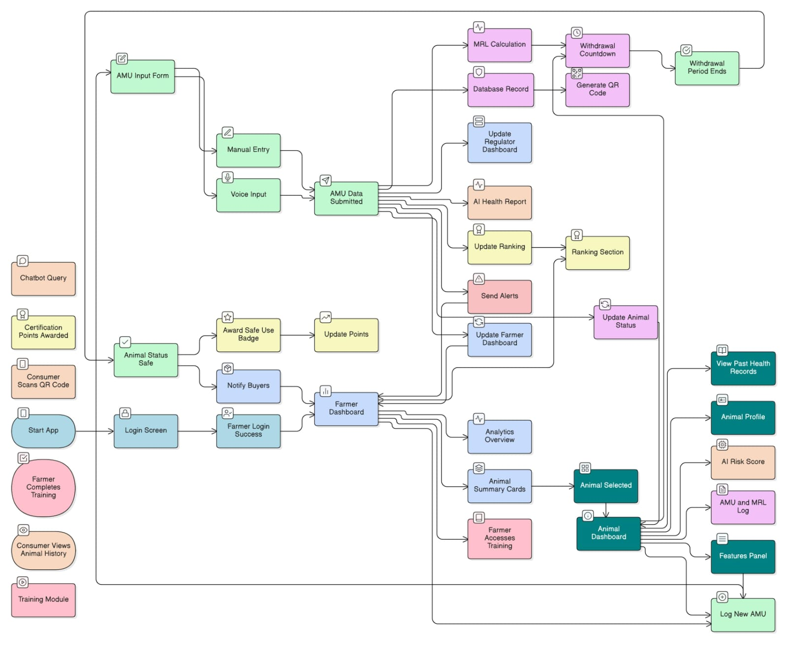













TECHNICAL APPROACH
BitVengers
SYSTEM ARCHITECTURE & PROCESS FLOW
System Architecture
Client System
Client Req/Res
Server Req/Res
Data Retrieval
Consumer Portal
Consumer QR Verification
Farmer Dashboard
My Animal Section
Animal Profile (ID, Breed, Health)
AMU Entry (Log, Voice, Identification)
MRL Calculation & Alerts
ML Model Traceability
Marketplace Notification
Authentication
Admin Dashboard
KPI & Graph
Compliance & Alerts
Traceability & QQR Insights
Recent Activities
Report Export
Settings
Services
Auth0 Services
Regulator APIs
JWT Jason Web Token
AWS Services
Payment Gateway
Technologies Used
React (Frontend)
Node.js + Express (Backend)
MongoDB (Database)
Process Flow
AMU Input Form
Manual Entry
Voice Input
AMU Data Submitted
MRL Calculation Database Record Withdrawal Countdown
Withdrawal Period Ends
Generate QR Code Update Regulator Dashboard AI Health Report Update Ranking Ranking Section Send Alerts Update Farmer Dashboard Update Animal Status
View Past Health Records Animal Profile AI Risk Score AMU and MRL Log Features Panel Log New AMU
Analytics Overview Animal Summary Cards Animal Selected Animal Dashboard Farmer Accesses Training
Farmer Dashboard Farmer Login Success Notify Buyers Award Safe Use Badge Update Points Animal Status Safe
Chatbot Query Certification Points Awarded Consumer Scans QR Code Consumer Views Animal History Start App Login Screen Training Module Farmer Completes Training
Tech Stack
Frontend- React js, Redux, Next js, Tailwind CSS, D3.js, Voice enabled UI.
Backend- Node js, MongoDB, Express AI, REST API, JWT, Socket IO.
AI and ML- NumPy, Pandas, sklearn, matplotlib, seaborn, tensor flow, joblib.
Cloud and Deployment- vercel, Render, Mongo DB Atlas, GitHub Actions.
pandas
Python
React
js
api
redux
Mongo DB
Voice
Enabled
UI
numpy
Tailwind
css
seaborn
github
Next js

Slide 4




FEASIBILITY AND VIABILITY
BitVengers
Feasibility
Digital Tools – Easy to use dashboards and monitoring system.
Real-Time Tracking – Instant updates on AMU and MRL levels.
Regulatory Fit – Matches current compliance needs.
Integrations – Smooth link with APIs and services
Viability
Cost Effective – Affordable for farmers and regulators.
Operational Fit – Works with existing farm practices.
Social Benefit – Builds trust in food safety.
Farmer Value – Health tracking and marketplace updates.
Use Cases
Farmer Support – Manage animals, health, and medicine use.
Consumer Trust – Verify products with QR scan.
Regulator Control – Check compliance and generate reports.
Admin Dashboard – Monitor KPIs, compliance, traceability, and generate reports.
Business Potential
Agri-Tech Growth – Expanding market for digital farm tools.
Revenue Model – Subscription and service-based income.
Brand Value – Stronger trust through transparency.
Premium Subscription- for AI chatbot and recommendation.
Risk
Data Inaccuracy
Low Farmer Adoption
Regulatory Non-Compliance
Solution
Validation Check
Training and Incentives
Automated Alerts

Slide 5
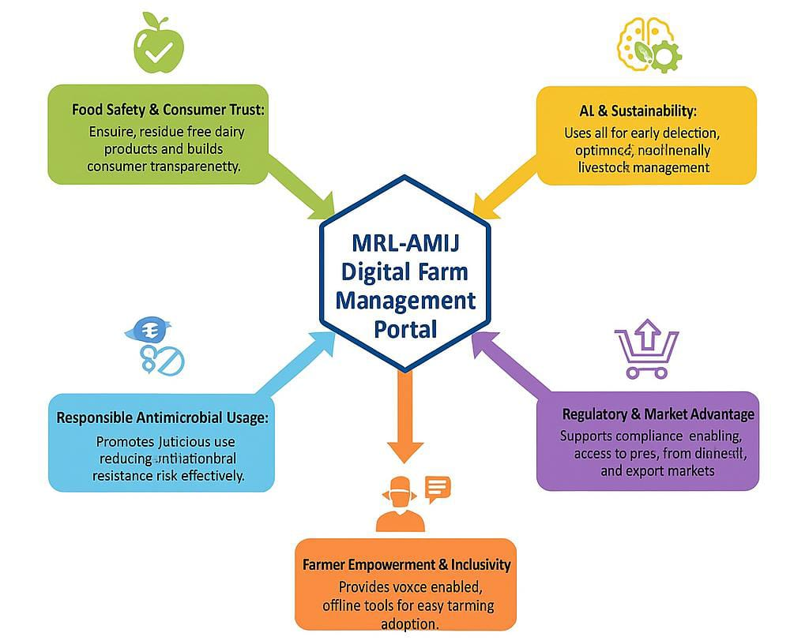
IMPACT AND BENEFITS
BitVengers
Economic
Impact: Boosts income and market access
Benefit: Opens up premium market opportunities.
Benefit: Improves product quality, enabling better pricing.
Educational
Impact: Enhances farmer learning
Benefit: Provides offline, voice-enabled tools for education.
Benefit: Raises awareness on responsible antimicrobial usage.
Technological
Impact: Advances digital farming
Benefit: Uses AI for early detection and optimized management.
Benefit: Simplifies farm management with digital tools.
Environmental
Impact: Promotes sustainable farming
Benefit: Reduces resource waste through optimized management.
Social
Impact: Strengthens farmer engagement and consumer trust
Benefit: Builds confidence through safe, transparent food practices.
Benefit: Promotes inclusivity with accessible tools for all farmers.

Slide 6


RESEARCH AND REFERENCES
BitVengers
References-
FSSAI- Maximum Residue Limits (MRL) Standards
(https://www.fssai.gov.in/)
ICAR- Indian Council of Agricultural Research
(https://nivedi.res.in/amu_tool/about.php)
WHO- Global Action Plan on Antimicrobial Resistance
(https://www.who.int/publications/i/item/9789241509763)
FAO- Antimicrobial Resistance in Food and Agriculture
(https://www.fao.org/antimicrobial-resistance/en/)
Research-
Patel et al., 2022 – Antibiotic residues in Gujarat milk above MRL.
Murugesan et al., 2023 – 21% milk samples in Bengaluru had residues.
Vijay et al., 2023 – Quantified AMU in Punjab dairy herds.
Ramesh & Tripathi, 2022 – Low consumer awareness of residues.
Akhoon et al., 2025 – Drug residues detected in Kashmir milk (HPLC).
Feature / Aspect | Existing Farm Apps (e.g. DeHaat, Stellapps, FarmERP) | Our Digital Farm Management Portal (MRL–AMU)
Basic Farm Management | ✅ Yes | ✅ Yes
Supply Chain & Market Linkage | ✅ Strong focus | ⚪ Not focus
Financial & Advisory Services | ✅ Available | ⚪ Limited
MRL (Maximum Residue Level) Monitoring | ❌ No | ✅ Real-time
AMU (Antimicrobial Usage) Tracking | ❌ No | ✅ Per-animal
Consumer Transparency | ❌ No | ✅ QR code
AI/ML Predictive Analytics | ⚪ Limited | ✅ Forecasting
Regulatory Compliance Reports | ❌ No | ✅ Auto reports
Multi-User Portal (Farmer + Admin) | ❌ Farmer-only | ✅ Yes
AI Chatbot for Farmers | ❌ No | ✅ 24×7 support
Future Roadmap: Consumer Portal (Sell & Buy) | ❌ No | 🟢 Planned
Unique USP | Supply-chain focus | First MRL–AMU system
LIVE DEMO-

