Slide 1
Capstone Project Hotel Booking Analysis
Suhas Sakhare
Vishal Dhore

Slide 2
Points to Discuss:
Agenda
Data Summary
Univariate analysis
Hotel Wise Analysis
Distribution Channel wise analysis
Some important questions
Conclusion

Slide 3
Agenda:
To discuss the analysis of given hotel bookings data set hotel bookings data set from 2015—2017.
We have done analyses in following ways :
Hotel wise analysis
Distribution Channel wise analysis
By doing this we’ll try to find out key factors driving the hotel bookings trends.

Slide 4
Data Summary:
Given data set has different columns of variables crucial for hotel bookings. Some of them are:
Hotel: The category of hotels, which are two resort hotel and city hotel.
Is_Cancelled : The value of column show the cancellation type. If the booking was cancelled or not. Values[0,1], where 0 indicates not cancelled.
Lead_time : The time between reservation and actual arrival.
Stayed_In_Weekend_Nights : The number of weekend nights stay per reservation.
Stayed_In_Weekday_Nights : The number of weekday nights stay per reservation.
Meal : Meal preferences per reservation.[BB,FB,HB,SC,Undefined]
Country : The origin country of guest.

Slide 5
Market_Segment: This column show how reservation was made and what is the purpose this of reservation. Eg, corporate means corporate trip, TA for travel.
Distribution_Channel: The The medium medium through booking was made.[Direct, Corporate, TA/TO, undefined, GDS]
Is_Repeated_Guest: Shows if the guest is who has arrived earlier or not. Values[0,1]---->0 indicates no and 1 indicated yes person is repeated guest.
Days_In_Waiting_List: Number of days between actual booking and transact.
Customer_Type: Type of : Type of customers( Transient, group, etc.)

Slide 6
Univariate analysis
While doing univariate analysis of given hotel booking dataset, we answered following questions:
(1)Which agent made most of bookings?Which agent made most of bookings?
(2)Which room type is in most demand and which room type generates highest adr?Which room type is in most demand and which room type generates highest adr?
(3)What is the most preferred meal by customers?What is the most preferred meal by customers?

Slide 7
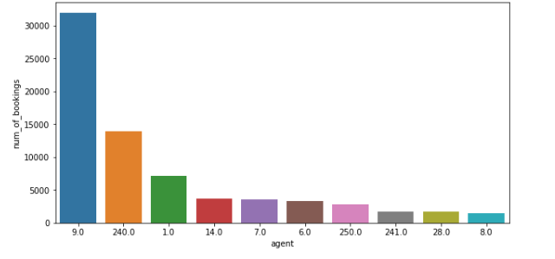
Agent with id no. 9 made most of the bookings.

Slide 8
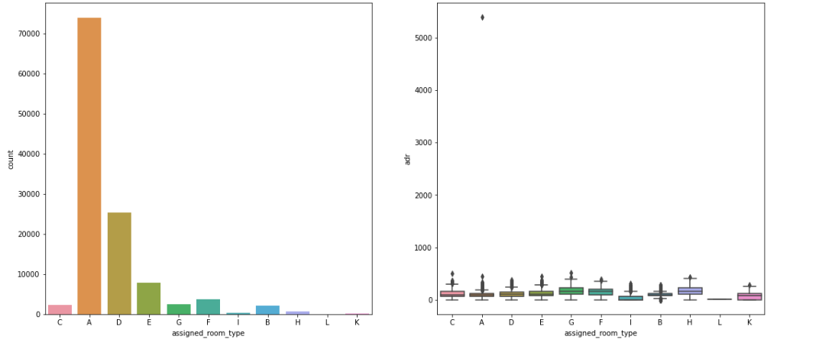
Type A room is most demanded by customers. A room is most demanded by customers.
Room types C, G and H are some of the highest
adr(average daily rate) generating rooms(average daily rate) generating rooms.

Slide 9
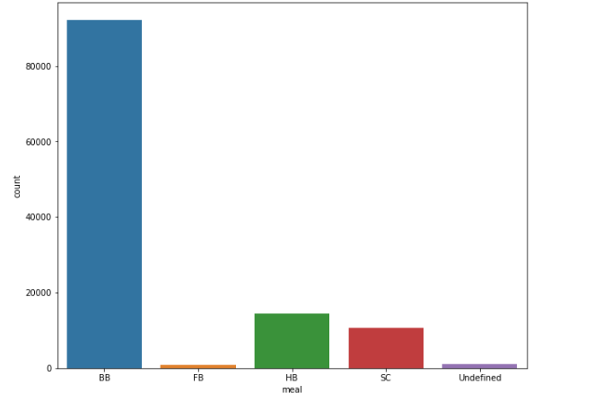
Most preferred meal type is BB( Bed and breakfast).

Slide 10
Hotel Wise Analysis
Percentage of bookings in each hotels?
Which hotel has high chance that its customer will return for another stay?

Slide 11
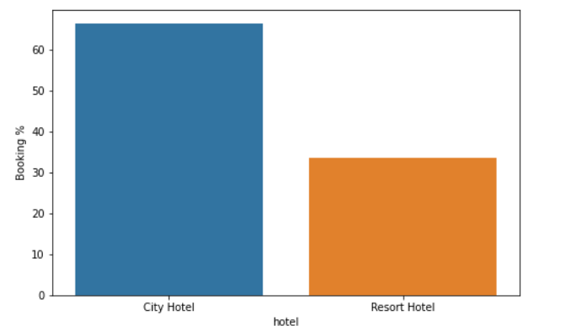
Around 60% bookings are for City hotel and 40% bookings are for Resort hotel.

Slide 12
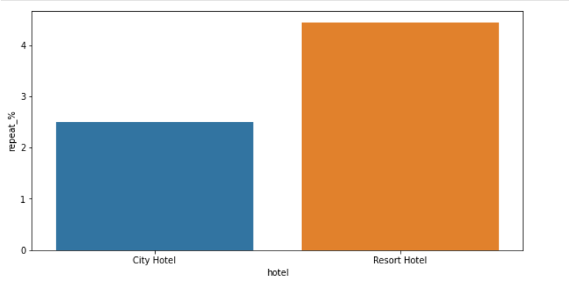
Both hotels have very small percentage that customer will repeat, but Resort hotel has slightly higher repeat % than City Hotel.

Slide 13
Distribution channel wise Analysis
Which is the most common channel for booking hotels?
Which channel is mostly used for early booking of hotels?
Which hotel has higher bookings cancellation rate?

Slide 14
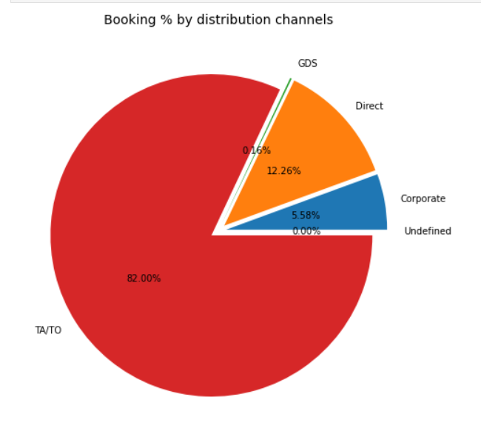

Slide 15
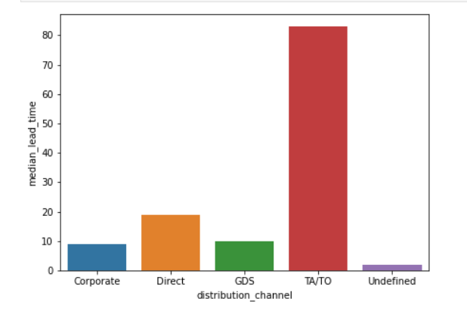
TA/TO is mostly used for planning Hotel visits ahead of time. But for sudden visits other mediums are most preferred.

Slide 16
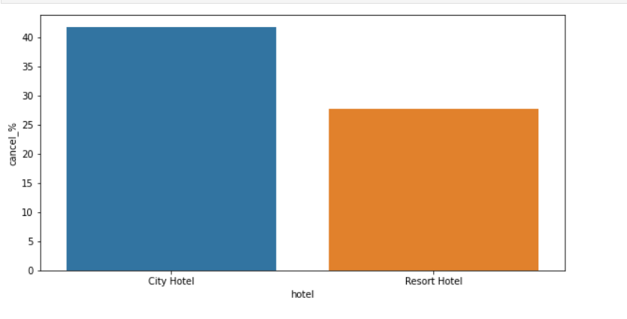
Almost 30 % of City Hotel bookings got canceled.

Slide 17
Conclusion
Around 60% bookings are for City hotel and 40% bookings are for Resort hotel, therefore City Hotel is busier than Resort hotel. Also the overall of City hotel is slightly higher than Resort hotel.
Mostly guests stay for less than 5 days in hotel and for longer stays Resort hotel is preferred.
Both hotels have significantly higher booking cancellation rates and very few guests less than 3 % return for another booking in City hotel. 5% guests return for stay in Resort hotel.
Most of the guests came from European countries, with most no. of guest coming from Portugal.
Guests use different channels for making bookings out of which most preferred way is TA/TO.
For hotels higher ADR deals come via GDS channel, so hotels should increase their popularity on this channel.
Almost 30% of bookings via TA/TO are cancelled.
.

Slide 18
Not getting same room as reserved, longer lead time and waiting time do not affect cancellation of bookings. Although different room allotment do lowers the ADR.
July-August are the most busier and profitable months for both of hotels.
August are the most busier and profitable months for both of hotels.
Within a month, ADR gradually increases as month ends, with small sudden rise on weekends.
Couples are the most common guests for hotels, hence hotels can plan services according to couples need to increase revenue.
More number of people in guests results in more number of special requests..
Bookings made via complementary market segment and adults have on average high no. of special request..
For customers, generally the longer stays (more than 15 days) can result in better deals in terms of low ADR.

