Slide 1






VISVESVARAYA TECHNOLOGICAL UNIVERSITY
IC TESTER USING MATLAB
RAJARAJESWARI COLLEGE OF ENGINEERING
#14,Ramohalli cross, Mysore Road,Kumbalgodu,60074 Affiliated to VTU, Belagavi, Approved by AICTE, New Delhi (Accredited by NAAC ‘A+’ Grade and NBA)
DEPARTMENT OF ELECTRICAL AND ELECTRONICS ENGINEERING
SUBJECT CODE: 21EEMP67
TOPIC: “IC TESTER USING MATLAB”
Presented By:
Bhumika K Ramesh (1RR21EE004) Vishal G (1RR21EE013)
Vivek N (1RR21EE014)
Jyoti (1RR22EE408)
Under the guidance of Kiruthika K
Assistant Professor Dept. of EEE

Slide 2


CONTENTS
IC TESTER USING MATLAB
ABSTRACT
INTRODUCTION
LITERATURE SURVEY
BLOCK DIAGRAM
CIRCUIT DIAGRAM
COMPONENTS
WORKING PRINCIPLE
ADVANTAGES & DISADVANTAGES
HARDWARE RESULTS
TESTING
REFERENCES
CONCLUSION

Slide 3
ABSTRACT
IC TESTER USING MATLAB
In the present world, everything is going to be more developed and user friendly. Digital IC tester is a microcontroller-based circuitry that tests weather the IC is in good working condition or bad condition. In industries, testing of the product is a major and expensive and time-consuming process. Thus, this project is basically a microcontroller-based project and gives response to the user within seconds. Low power consumption, less hardware requirement, less hardware complexities, low cost, PC independent and smaller size makes it unique in the row of IC testers.

Slide 4
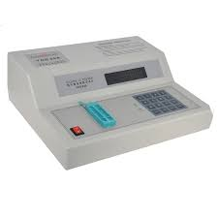
INTRODUCTION
IC TESTER USING MATLAB
An IC tester is a module that can test logic gates, decoders, encoders, flip-flops and counters with great accuracy.
The use of “Microcontroller” makes its performance ideal.
The main purpose of the project is to develop a digital IC tester that is very less expensive and handy than that of what are available in markets.
The aim is to check the ICs in very less time and display results of ICs being good or faulty immediately.

Slide 5
LITERATURE SURVEY
IC TESTER USING MATLAB
SL.NO | TITLE | AUTHOR | YEAR | METHODOLOGY | PARAMETER AND INFERENCE | RESOURC E
1. | Arduino based 74-series integrated circuits testing system at gate level | Yasir Hashim | 2023 | IC tester is demonstrated to accurately identify common faults such as short circuits, open circuits, etc. | Keypad & LCD Interfacing with Arduino Mega | IJECE
2. | Design and Analysis of Integrated Circuit DC Parametric and Functional Testing Module with GUI using Matlab and Microcontroller Interfacing | Siti Zuria Solehah Mohamad Zamri | 2021 | Design and analysis of an integrated circuit (IC) testing module with GUI using MATLAB and microcontroller interfacing. | MATLAB | IEEE
3. | Digital IC Tester using Arduino | D. G. Kanade | 2019 | Automated testing technologies, aiming to enhance the efficiency and precision of IC manufacturing processes. | Interfacing of Arduino UNO | IJTRD
4. | Microcontroller Based Design of Digital IC Tester | Joanne T Peralta | 2014 | User-friendly graphical user interface (GUI) for ease of operation, a database of standard test vectors for different types of ICs. | Test functions | IJAIM
5. | Microcontroller based IC tester | Kashif Mehboob | 2012 | Automating the process of testing and analyzing ICs to identify defects and ensure performance standards | Keypad & LCD Interfacing with Arduino Mega | IJCRT
DEPT. OF EEE
2023-24

Slide 6
BLOCK DIAGRAM
IC TESTER USING MATLAB
ZIF SOCKET
ARDUINO UNO
MATLAB
RESULT

Slide 7
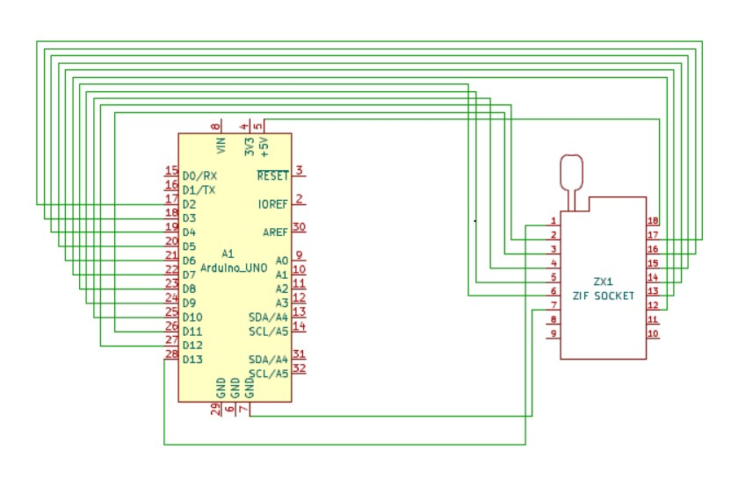
CIRCUIT DIAGRAM
IC TESTER USING MATLAB

Slide 8
WORKING PRINCIPLE
IC TESTER USING MATLAB
MATLAB is used to apply stimuli to the DUT (74xx series digital ICs) and shows the response of the DUT to stimuli.
It then compares the response of the DUT with the correct response to test whether the
device is faulty or not.
For a digital IC, the correct response is given in the form of a truth table. Acting as a response analyzer, the MATLAB verifies each possible outcome according to the truth table of a particular IC.

Slide 9
ADVANTGES & DISADVANTAGES
IC TESTER USING MATLAB
ADVANTAGES
Less Expensive
No External Power Supply Is Required
MATLAB Interfacing
Light Weight
Portable
DISADVANTAGES
Internal Codes may corrupt sometimes
Cable problems

Slide 10
APPLICATIONS
IC TESTER USING MATLAB
Quality control
Research & Development
Education Institutes (Labs)
Electronic Shops

Slide 11
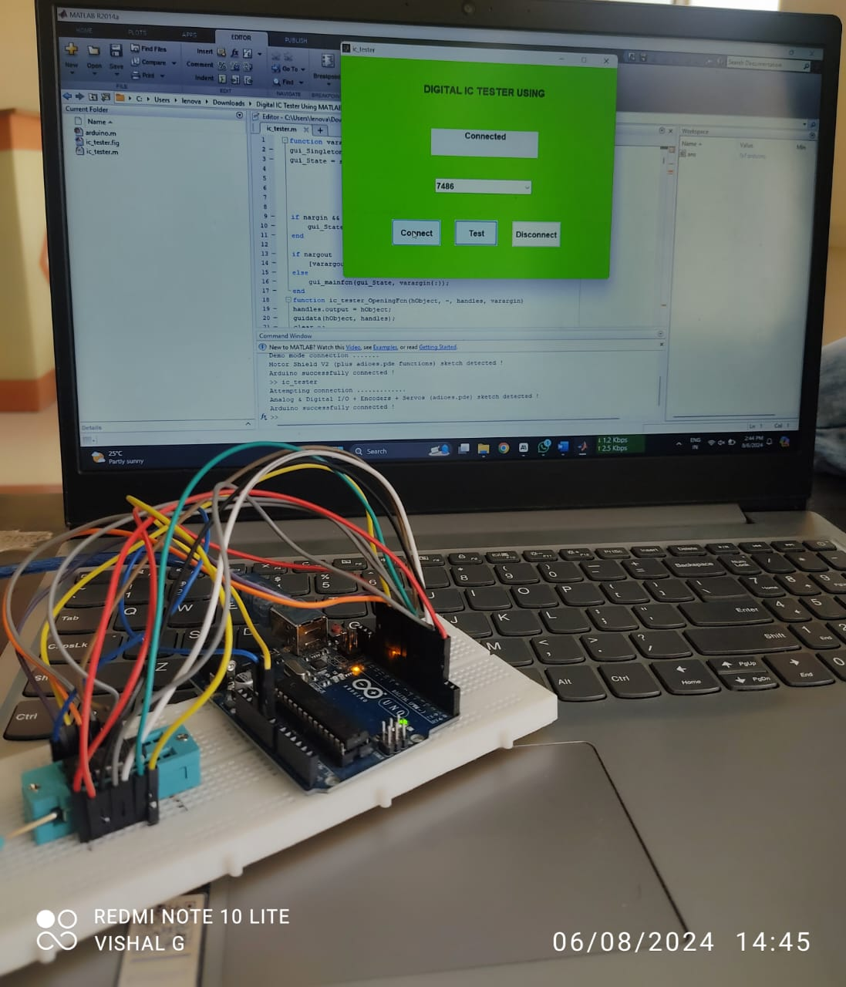
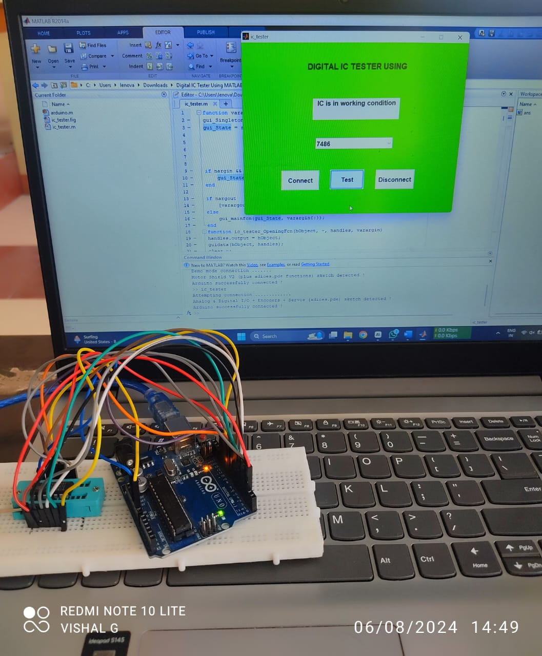
HARDWARE RESULT
Output screen of IC tester using MATLAB

Slide 12
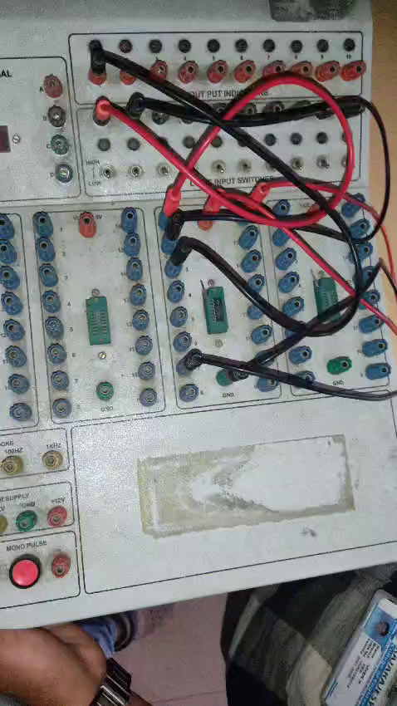
TESTING

Slide 13
CONCLUSION
In this project, we developed an IC tester utilizing MATLAB to streamline the testing and verification processes for integrated circuits. The primary objectives were to automate the testing procedures, enhance accuracy, and provide a user-friendly interface for real-time analysis.

Slide 14
REFERENCES
IC TESTER USING MATLAB
[1] Prof. D. G. Kanade, Nikhil Zambare and Krishna Rathode, Department of Electronics, Vishwakarma Institute of Technology, Pune, Maharashtra, India.
[2] Maribelle D. Pabiania , Joanne T. Peralta, Leo Anthony T. De Luna,Phillipines.
[3] Mirza Shoaib Ahmed, Iqbal Muhammad Umair, Kashif Mehboob NED University of Engineering and Technology, Karachi.
[4] Yasir Hashim, Marwa Awni, Abdullah Mufeed Computer Engineering Department, Faculty of Engineering, Tishk International University, Erbil, Iraq.
[5] Muhammad E. S. Elrabaa, Amran A. Al-Aghbari, and Mohammed A. Al-Asli Computer Engineering Department, King Fahd University for Petroleum and Minerals Dhahran, Saudi Arabia.

Slide 15
THANK YOU
IC TESTER USING MATLAB

