Slide 1

WELCOME TO
DEPARTMENT OF AI&DS
MINI PROJECT EXPO-2026

Slide 2

Department of Artificial Intelligence and Data Science
MedMesh: Real-Time Healthcare Capacity Exchange Network
Guide by:
Mrs. M. Geethapriya Assistant Professor AI&DS
Presented By:
Vishal G (23AD060) Sabarivasan E (23AD043) Sanjaieswaran A (23AD048)

Slide 3




ABSTRACT
Hospitals across a city or state operate as isolated islands each tracking
bed, ICU, and ventilator status internally, while citizens, ambulance crews, and health officials have no real-time view of where capacity actually exists.
MedMesh adds a shared data layer on top of hospitals'
existing
a live, patient-
management systems, turning siloed occupancy records into
searchable capacity map. This project focuses on cutting
placement delays and replacing phone-call guesswork with
real-time
visibility for emergency responders and health officials.
MedMesh

Slide 4

INTRODUCTION
Hospitals track bed, ICU, and ventilator availability inside their own systems, but that data never leaves the building ambulances and citizens have no way to see it.
Today's process runs on phone calls dispatchers ring hospitals one by
one during an emergency, with no shared, live picture of who has room.
Patients don't need another hospital app they need one place to see
where help is available. This isn't a hardware problem, it's a
"connectivity" problem.
As a result, critical minutes are lost during transfers and disasters while some hospitals sit overloaded and others nearby have empty beds
MedMesh

Slide 5
OBJECTIVE
To reduce patient-placement delays by giving ambulances and hospitals a shared,
real-time view of bed and ICU capacity
To connect existing hospital management systems into one live capacity feed,
without replacing what hospitals already use
To give government health agencies a district-level dashboard for occupancy, ICU load, and emergency-department congestion
To cut dispatcher decision time from minutes of phone calls to seconds of live lookup
MedMesh

Slide 6

Existing Solution
Hospital platforms
TeleTracking, Oracle Health, GE Healthcare — see inside one hospital or health system only
Hospital
Platforms
Government
Layers
Government layers
HBEDS, CDC NHSN — real-time and EHR-integrated, but access stays officials-only
Single-hospital dashboards
AIIMS Delhi — live for one site; a unified cross-hospital view remains an aspiration
Public
Dashboards
Dispatch
Tools
Ambulance dispatch tools
AngelTrack, PatientERP — bed visibility limited to
directly partnered hospitals
No shared visibility between systems
MedMesh: one shared layer across all four
The gap: no open, cross-hospital, citizen-facing layer exists — that unclaimed space is where MedMesh sits.
MedMesh
Page 3

Slide 7
PROPOSED SYSTEM AND ITS ADVANTAGES
Proposed Work:
Connect each hospital's existing management system to a central capacity platform via lightweight APIs
Advantages:
Cuts ambulance-to-hospital placement time significantly
Replaces manual phone-call
coordination with instant, live lookup
Provide a simple manual dashboard for hospitals without compatible software
Works alongside each hospital's existing software no system replacement needed
Surface live bed, ICU, and specialist availability to citizens, ambulances, and government
Scales as a per-facility government or hospital-network subscription
MedMesh

Slide 8
MODULES
Data Ingestion Module – Pulls bed, ICU, and ventilator data from each hospital's existing management system
Data Quality & Trust Module – Flags stale or unverified updates so
responders can trust what they see
Matching & Routing Module – Filters hospitals by specialty, distance, and capacity for ambulance dispatch
Government Analytics Module – Aggregates district-level occupancy trends for health department dashboards
MedMesh

Slide 9
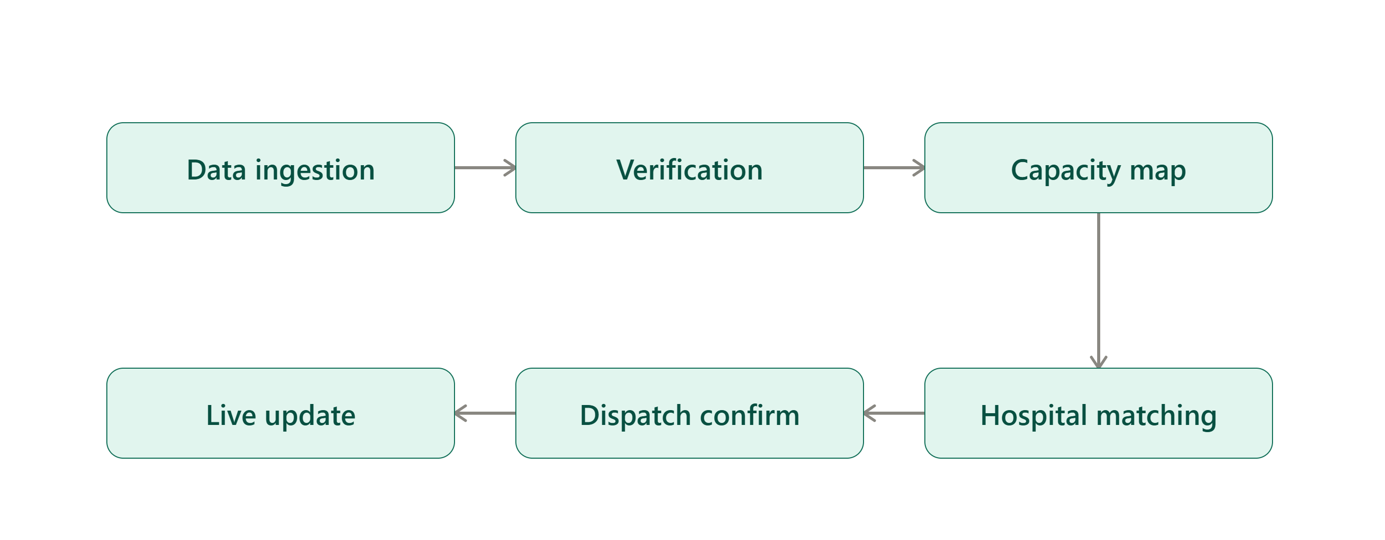
METHODOLOGY
MedMesh

Slide 10
Trends
Application:
Ambulance and emergency dispatch services
Government health departments and
disaster response agencies
Hospital networks coordinating inter-facility patient transfers
Citizens searching for nearby
available care during emergencies
Challenges
Regulatory and privacy weight of health-related occupancy data
Simulated hospital data for the MVP demo vs.
real integration at pilot stage
Getting hospitals to report accurate data despite competing incentives
Scaling integrations as more hospital systems
and data formats are added
MedMesh

Slide 11
FUTURE TRENDS
Real hospital data integration once in pilot deployment with a metro health
network
Built-in access controls and data residency to meet healthcare privacy regulations
Predictive surge forecasting using historical admission and occupancy trends
Expansion beyond hospitals into ambulance fleets, blood banks, and pharmacy stock
MedMesh

Slide 12
THANK YOU

