Slide 1
Discovering symbolic models from deep learning with inductive biases – reproduction
Vishal Jain
Oral Presentation
Notes:
What is the goal of this talk? Get people interested in the domain and wanting to learn more Motivate some kind of the following: problem is worthwhile, hard and this power point solves it.

Slide 2
Prelude…
Discovering symbolic models from deep learning with inductive biases.
Notes:
Break down title -> what are we talking about here discovering symbolic models
Eg symbolic model
From deep learning
NN with more than 1 hidden layer
With inductive biases – choosing the architecture sensibly, so image -> cnn, text / sequence -> transformers,

Slide 3
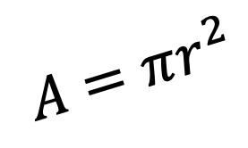
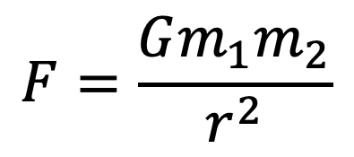
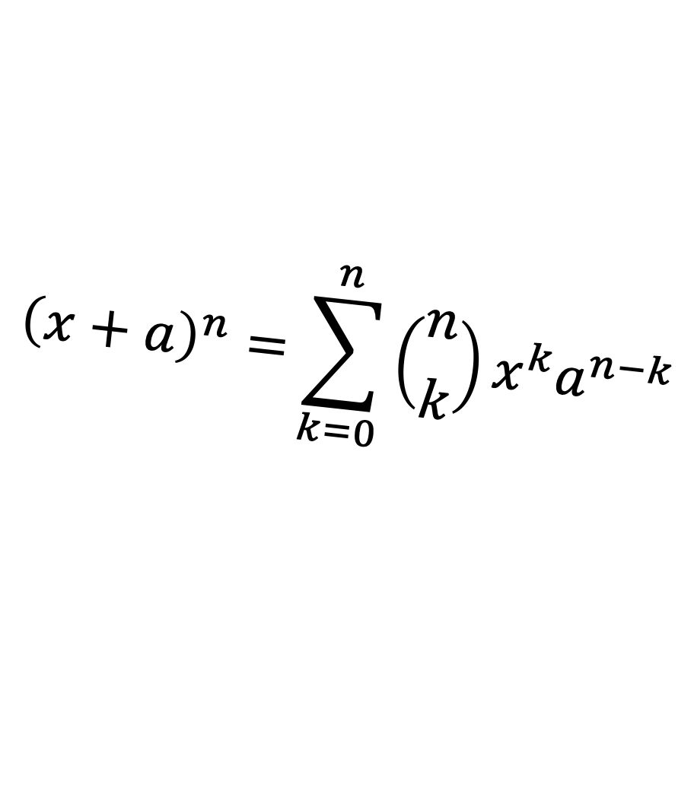
Prelude…
Discovering symbolic models from deep learning with inductive biases.
$$A=πr^{2}$$
$${\left(x+a\right)}^{n}=\sum_{k=0}^{n}{\left({n \atop k}\right)x^{k}a^{n−k}}$$
$$F=\frac{Gm_{1}m_{2}}{r^{2}}$$
Notes:
Break down title -> what are we talking about here discovering symbolic models
Eg symbolic model
From deep learning
NN with more than 1 hidden layer
With inductive biases – choosing the architecture sensibly, so image -> cnn, text / sequence -> transformers,

Slide 4
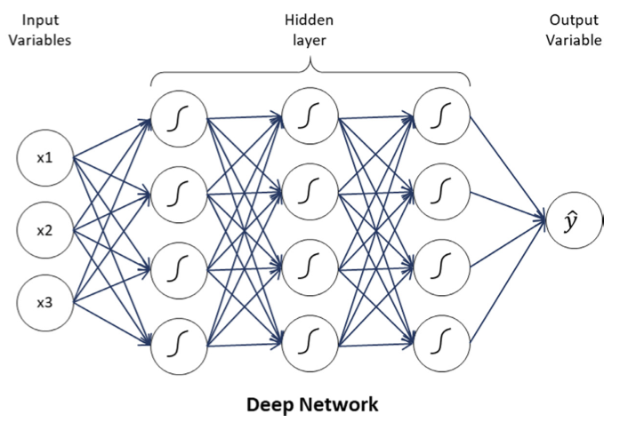
Prelude…
Discovering symbolic models from deep learning with inductive biases.
Notes:
Break down title -> what are we talking about here discovering symbolic models
Eg symbolic model
From deep learning
NN with more than 1 hidden layer
With inductive biases – choosing the architecture sensibly, so image -> cnn, text / sequence -> transformers,

Slide 5


Prelude…
Discovering symbolic models from deep learning with inductive biases.
$$L=MSE\left(y,f\left(x\right)\right)$$
Notes:
Break down title -> what are we talking about here discovering symbolic models
Eg symbolic model
From deep learning
NN with more than 1 hidden layer
With inductive biases – choosing the architecture sensibly, so image -> cnn, text / sequence -> transformers,

Slide 6
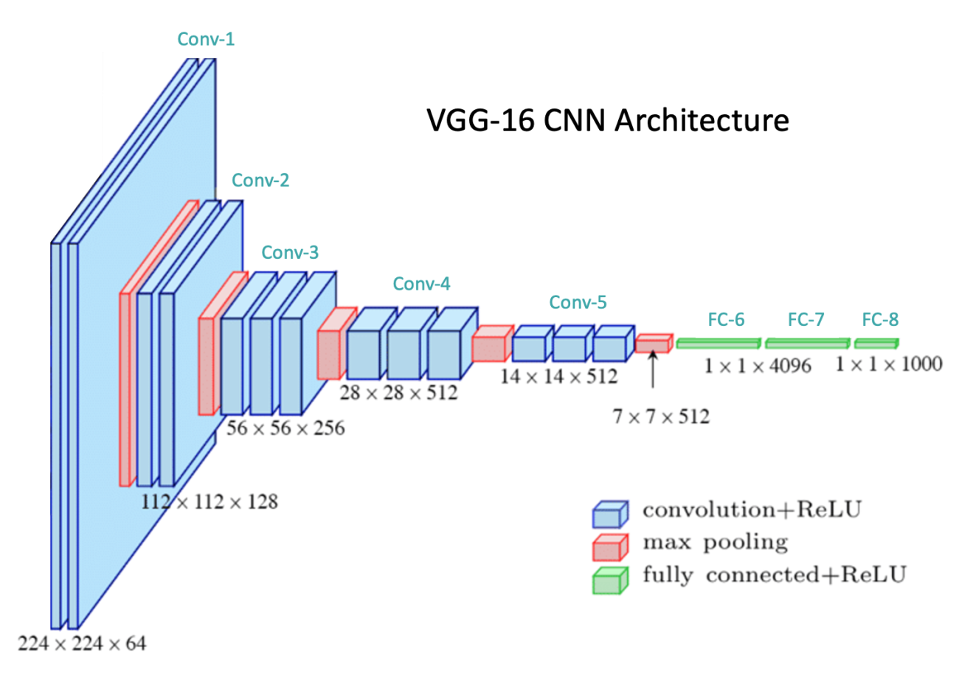
Prelude…
Discovering symbolic models from deep learning with inductive biases.
$$L=MSE\left(y,f\left(x\right)\right)$$
Notes:
Break down title -> what are we talking about here discovering symbolic models
Eg symbolic model
From deep learning
NN with more than 1 hidden layer
With inductive biases – choosing the architecture sensibly, so image -> cnn, text / sequence -> transformers,

Slide 7

Prelude…
Discovering symbolic models from deep learning with inductive biases.
$$L=BCE\left(y,f\left(x\right)\right)$$
Notes:
Explain why the CNN and BCE loss provide better inductive biases
Follow through on UDL to check that this checks out.

Slide 8
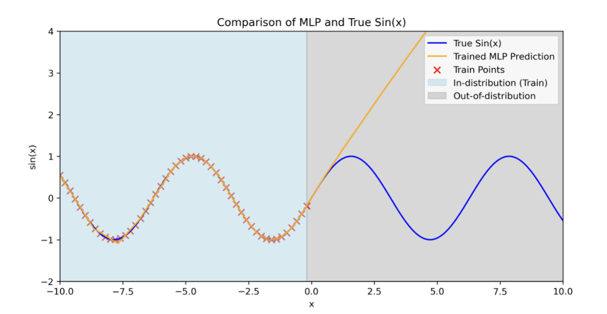
Motivation
Notes:
Why do we even want symbolic models, why not just train these NNs

Slide 9
Symbolic distillation framework
Design a neural network with a separable internal structure and suitable inductive bias.
Train the model and encourage learning a low-dimensional representation.
Replace a learned component with a symbolic model.
Retrain model and repeat until all components are replaced.
Notes:
How are we going to do tackle

Slide 10
Scope
Rediscovering Hamiltonians
Rediscovering Force Laws
Discovering a new equation for a real-world cosmology
problem
Notes:
Original papers findings, scope of this.

Slide 11

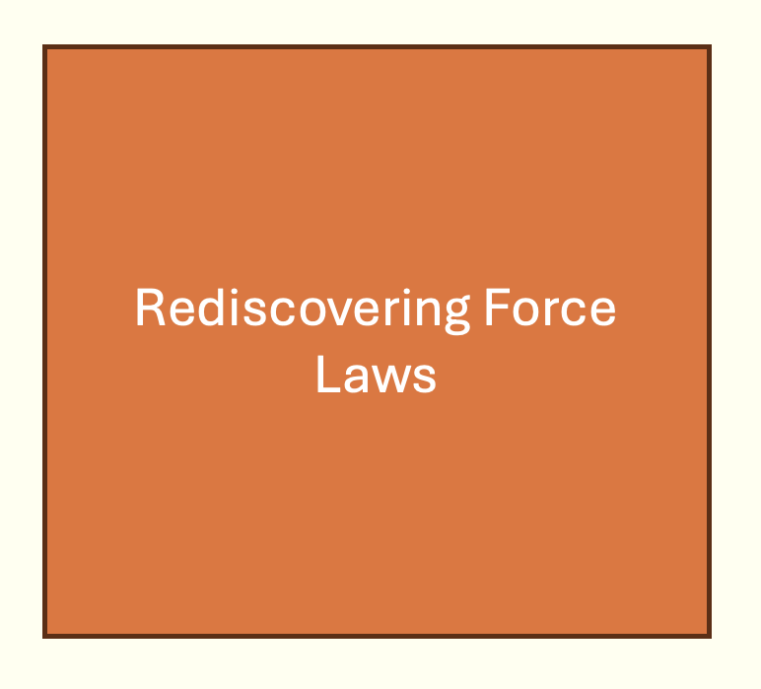
Scope
Notes:
Original papers findings, scope of this.

Slide 12
Outline
Background
Data
Model
Training
Symbolic distillation
Evaluation
Results
Conclusion

Slide 13
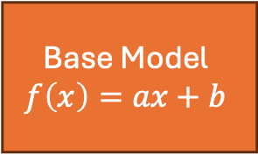
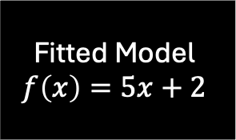




Background pt 1 – Symbolic regression
User specified
Dataset
$$(x,y)$$
$$argmin_{\left\{consts\right\}}(Loss(y,f\left(x\right))$$
Fitted Model
$$f\left(x\right)=5x+2$$
$$y_{new}$$
Base Model
$$f\left(x\right)=ax+b$$
via grad descent
Loss
$$x_{new}$$

Slide 14
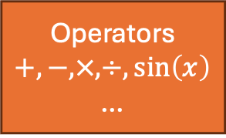

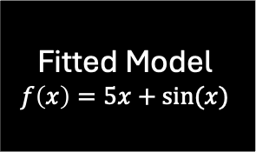
Background pt 1 – Symbolic regression
User specified
Dataset
$$(x,y)$$
$$argmin_{model}(Loss(y,f\left(x\right), c)$$
Fitted Model
$$f\left(x\right)=5x+sin⁡(x)$$
Operators
$$+, −, ×, ÷,\sin\left(x\right)$$
…
$$y_{new}$$
Base Model
$$f\left(x\right)=ax+b$$
via genetic algorithm
Loss
$$x_{new}$$

Slide 15






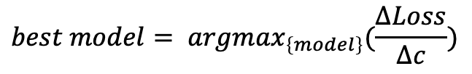
Background pt 1 – Symbolic regression
Solutions
Loss
Complexity
$$f\left(x\right)=5$$
100
1
$$×$$
$f\left(x\right)=5$x
80
2
$$×$$
$f\left(x\right)=5$x + sin(x)
20
3
Loss
Sharpest drop
$$×$$
Complexity
$$best model= argmax_{\left\{model\right\}}(\frac{ΔLoss}{Δc})$$

Slide 16
Background pt 2 – Graph Neural Networks
Notes:
Gnns walk through model
Nodes
Edges

Slide 17
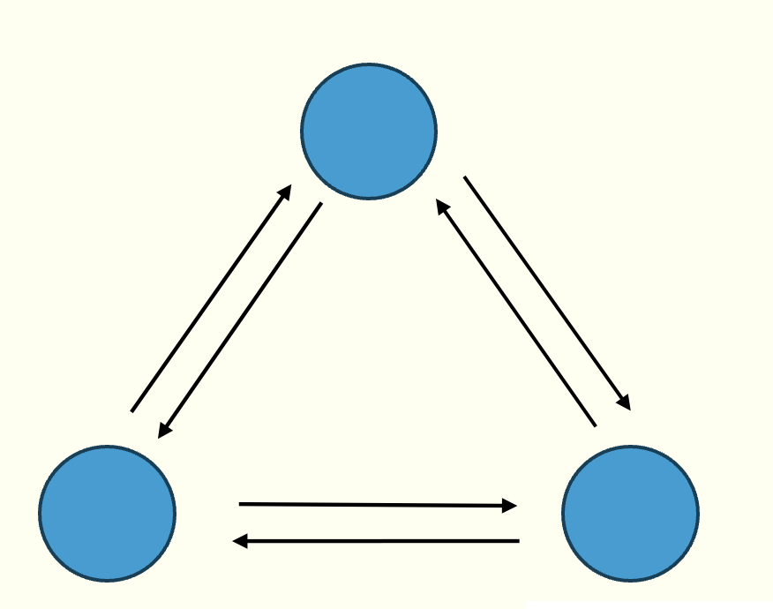
Background pt 2 – Graph Neural Networks
Notes:
Linear regression -> symbolic regression conceptual black box
How it works briefly

Slide 18
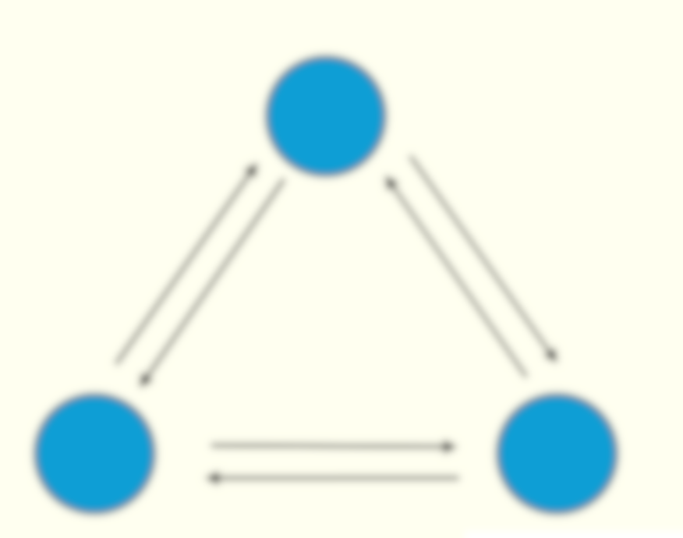
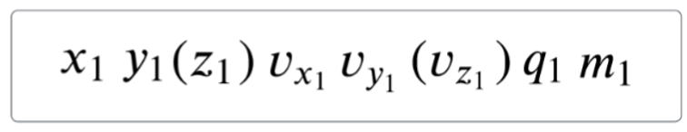

Background pt 2 – Graph Neural Networks
$$X_{1}$$
T
Notes:
Linear regression -> symbolic regression conceptual black box
How it works briefly

Slide 19



Background pt 2 – Graph Neural Networks
$$X_{2}$$
$$e_{1}$$
$$X_{1}$$
$$φ^{e}\left(X_{i}, X_{j}\right)=e_{k}$$
Notes:
Linear regression -> symbolic regression conceptual black box
How it works briefly

Slide 20






Background pt 2 – Graph Neural Networks
$$X_{2}$$
$$e_{4}$$
$$e_{1}$$
$$e_{5}$$
$$e_{3}$$
$$X_{3}$$
$$e_{2}$$
$$X_{1}$$
$$e_{6}$$
$$φ^{e}\left(X_{i}, X_{j}\right)=e_{k}$$
Notes:
Edge message aggregation and node model.

Slide 21
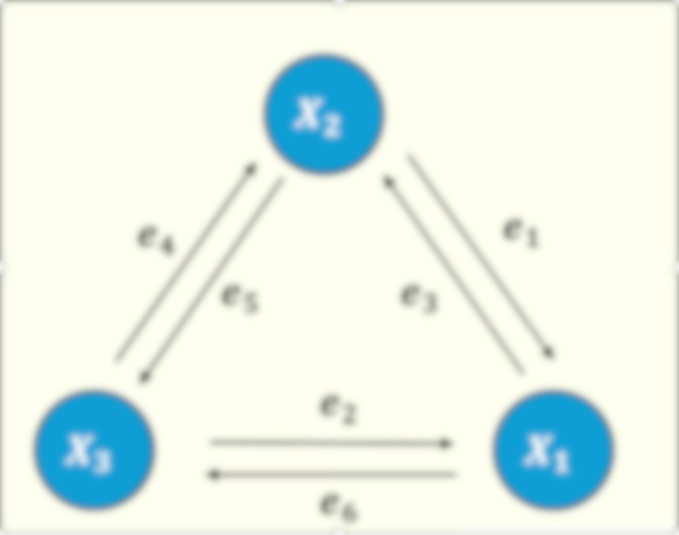
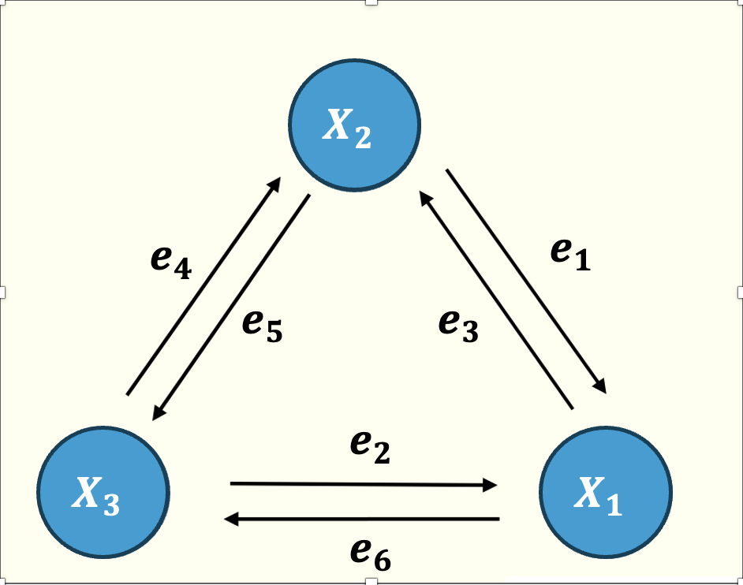


Background pt 2 – Graph Neural Networks
$$e_{1}+e_{2}=\overline{e}$$
$$φ^{v}\left(X_{i}, \overline{e}\right)=X_{i}′$$
Notes:
Edge message aggregation and node model.

Slide 22
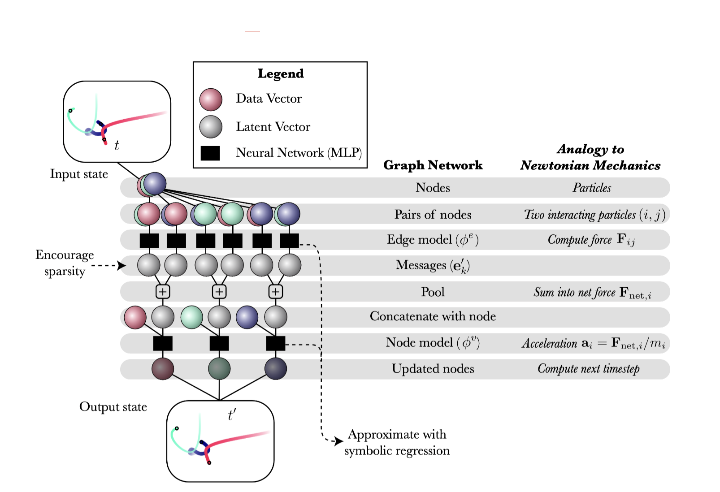
Overview
Notes:
Tie it all back together
+ Why the GNN is good – permutation invariant – seperable internal components, summation of edge message an appropriate inductive bias to use

Slide 23
Data
Notes:
Force laws
Explain in a bit more detail what the input looks like – how it was generated – using the original code.

Slide 24
Dataset pruning
Notes:
Dataset
What was the need, what was the steps, what was the effect, why it is a sensible thing to do.

Slide 25
Model architecture
Notes:
Describe the model architecture : edge and node models

Slide 26
Training strategies
Notes:
Describe the 4 training strategies

Slide 27
Model Training
Notes:
Describe the hyper parameters epochs and differences in training between this work and the original

Slide 28
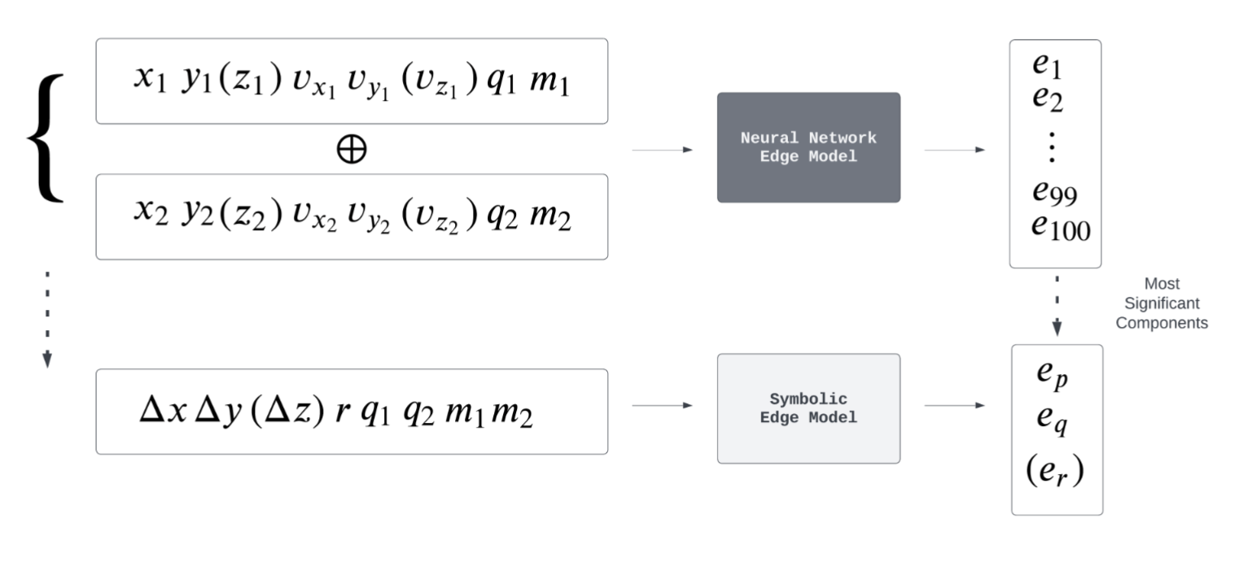
Model Distillation : Edge Model
Notes:
Talk through the plot, again cmment on differences in the symbolic search used here vs in the paper – pysr vs eureka, not using all the operators…

Slide 29
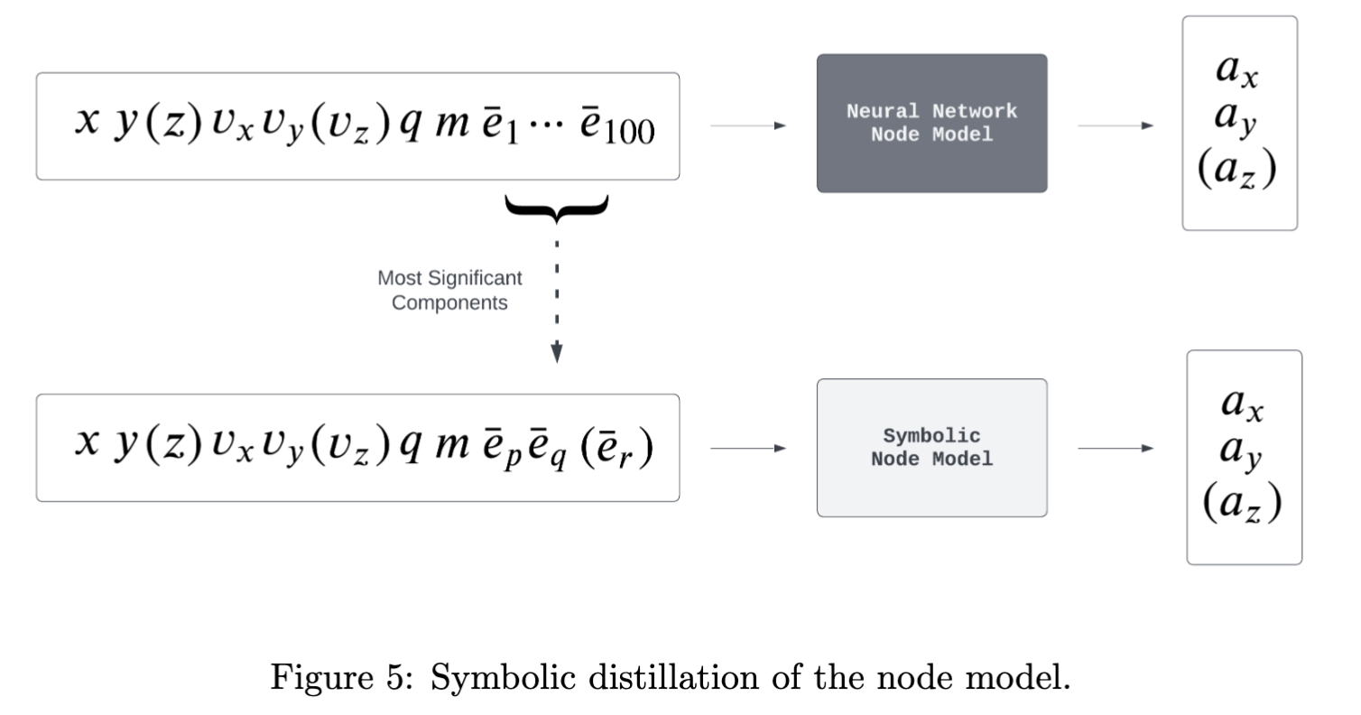
Model Distillation : Node Model
Notes:
Talk through the plot

Slide 30
Evaluation criteria
Notes:
Introduce what will be shown for results
Mae
R2 (!?)
Sparsity
Symbolic reconstruction

Slide 31
Results: MAE
Notes:
Compare original MAE and reproduced

Slide 32
Results: R2
Notes:
Compare original R2 and reproduced

Slide 33
Results: R2 aside
Notes:
Go over acceleration vs true force

Slide 34
Results: Sparsity
Notes:
Sparsity results

Slide 35
Results: Symbolic reconstructions examples
Notes:
Symbolic reconstructions good and bad examples

Slide 36
Results: Symbolic reconstructions
Notes:
Symbolic reconstruction table

Slide 37
Results: Symbolic model vs NN model
Notes:
Compare

Slide 38
Future work
Notes:
Compare

