Slide 1

PARVATIBAI GENBA MOZE
Genba Sopanrao Moze Trust's
COLLEGE OF ENGINEERING, PUNE
DEPARTMENT OF COMPUTER ENGINEERING
PRESENTATION ON
E-Commerce Website: Built using A.I and Machine
learning.
PRESENTED BY : OM CHOUHAN RAJAN PRAJAPTI TUSHAR CHAVAN
SAKET DESHMUKH VISHAL KUMDALE
HOD : PROF. SHRIKANT DHAMDHERE
(HOD) COMPUTER ENGINEERING
GUIDED BY : PROF. VIJAY O. RATHI
(PROJECT COORDINATOR)

Slide 2
CONTENTS
PROBLEM STATEMENT
OTHER FEATURES
REQUIREMENTS
OBJECTIVE
LITRATURE SURVEY
ADVANTAGES
ARCHITECTURE
DISADVANTAGES
FUTURE SCOPE
RECOMMENDATION MODEL
FAKE REVIEW DETECTION
CONCLUSION

Slide 3
PROBLEM STATEMENT
Design and develop an e-commerce website using Django framework that includes functionalities such as recommendation model, adding items to a shopping cart, filter products, integrating PayPal for payment processing, providing an admin dashboard for managing products and orders, and implementing a review system for users to share feedback on products, detecting fake reviews added by users to improve feedback quality and overall experience.

Slide 4
LITERATURE SURVEY
Problems of Online Shopping
Online shopping presents various challenges for customers, including issues related to credit card security, uncertainty about product quality and value, difficulties in after-sales support, and general drawbacks such as the inability to physically inspect products, delays in delivery, additional costs, limited seller interaction, and potential security risks.
Scalability and Performance Optimization: Investigate how Django's architecture facilitates scalability and performance optimization in e-commerce applications. Explore studies or articles that discuss techniques such as caching, load balancing, asynchronous processing, and database optimization within the Django framework. Understanding how Django handles high traffic volumes and large datasets is crucial for building a robust and efficient e-commerce platform.
Challenges in E-commerce Review Trustworthiness: Delve into research uncovering the myriad challenges to trusting reviews on e-commerce platforms. Explore issues such as fake reviews, biased ratings, and manipulation tactics by sellers, competitors, or incentivized reviewers. Investigate how anonymity and lack of verification exacerbate these problems, leading to discrepancies between reviews and actual product experiences.

Slide 5
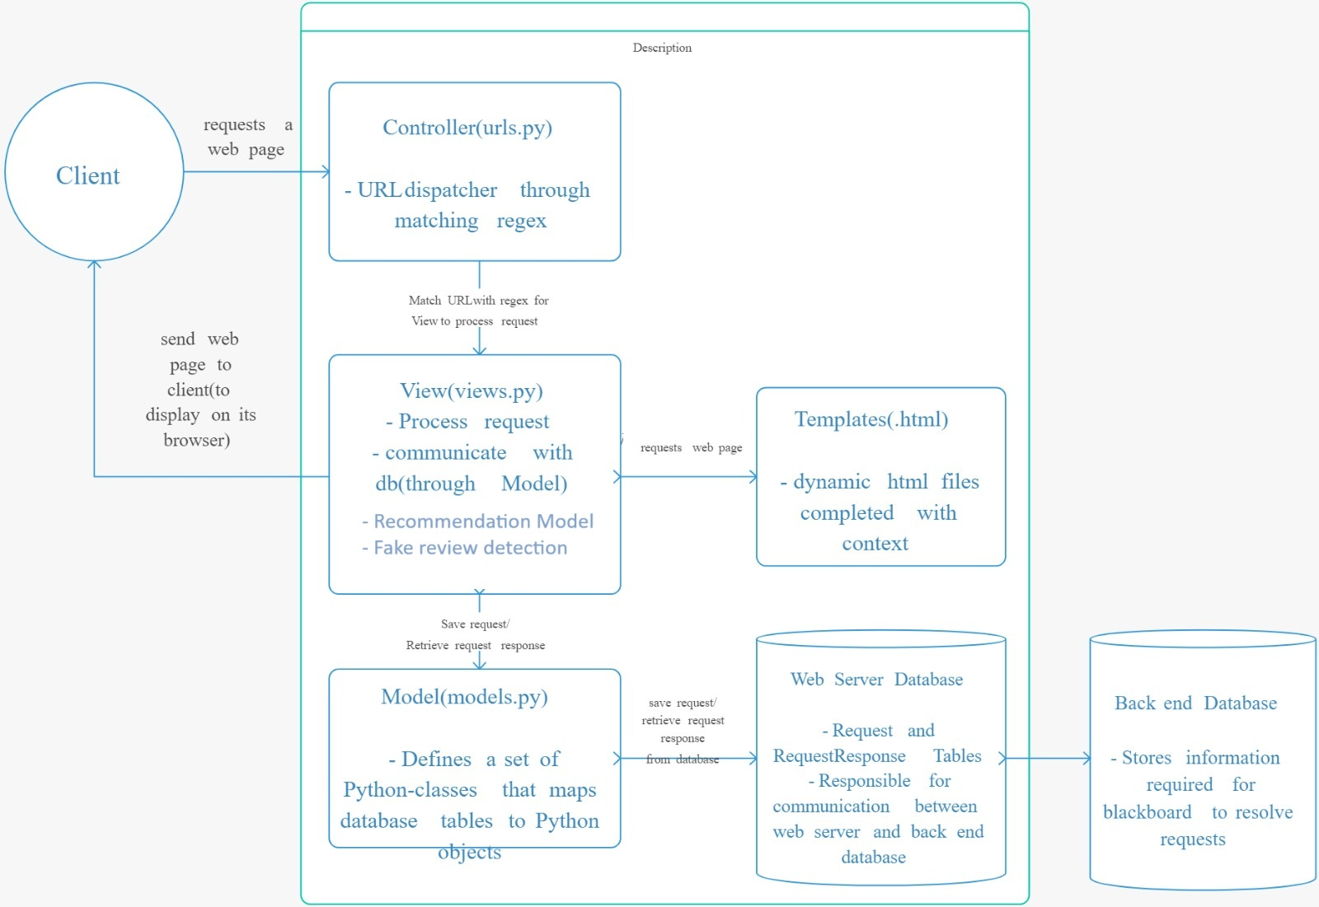
ARCHITECTURE
MVC architecture

Slide 6
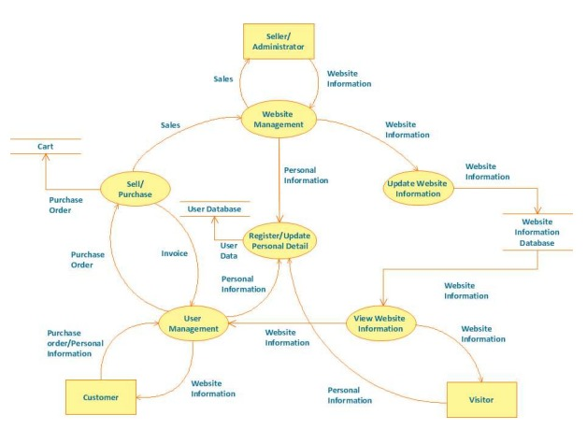
UML DIAGRAM

Slide 7
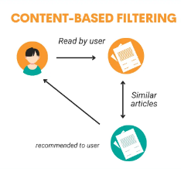
RECOMMENDATION MODEL
In our e-commerce application, we have implemented a content-based filtering recommendation model to enhance the user experience by suggesting products that align closely with their preferences. The model primarily focuses on the product descriptions to identify similarities among products. Initially, we gather all the product descriptions from our database. Using the Term Frequency-Inverse Document Frequency (TF-IDF) vectorizer, we transform these textual descriptions into numerical values that reflect the importance of words within the descriptions while minimizing the effect of common but less informative words. This process results in the creation of a TF-IDF matrix. Subsequently, we compute a similarity matrix using the linear kernel, which measures the cosine similarity between these vectors. When a user views a product, the model identifies similar products by referencing this similarity matrix and recommends products within the same category, ensuring that the recommendations are both relevant and diverse.

Slide 8
FAKE REVIEW DETECTION
Our implemented fake review detection system utilizes basic Natural Language Processing (NLP) techniques to identify potentially fraudulent reviews in our e-commerce platform. The system begins by collecting textual reviews from users. These reviews undergo preprocessing steps such as tokenization, lowercasing, and removal of stop words to normalize the text data. Following this, a TF-IDF (Term Frequency-Inverse Document Frequency) vectorizer is applied to convert the reviews into numerical vectors, capturing the importance of each word in relation to the entire corpus. Using these vectors, a logistic regression model is trained to classify reviews as either genuine or fake based on the learned patterns. During inference, the system computes the probability of a review being fake and flags reviews with high probabilities for further inspection. This approach not only enhances user trust by filtering out suspicious content but also ensures the integrity of the review system on our platform.

Slide 9
OTHER FEATURES
Add to Cart
The "Add to Cart" functionality allows users to easily add desired products to their shopping cart with a single click. It dynamically updates the cart's contents and displays the total number of items, ensuring a seamless shopping experience. Users can view, modify, and remove items from the cart before proceeding to checkout. This feature enhances the user's shopping journey by providing a straightforward way to manage selected products.
Wishlist
The Wishlist functionality enables users to save products they are interested in for future reference. By clicking the "Add to Wishlist" button, users can store items without immediate purchase, helping them keep track of desired products. The wishlist is accessible from the user's account, allowing easy retrieval and purchase later. This feature enhances user engagement by providing a personalized shopping experience and encouraging repeat visits.

Slide 10
PayPal Integration
The PayPal integration allows users to securely make payments using their PayPal accounts. It provides a convenient and trusted payment method, enhancing the overall shopping experience. Users are redirected to PayPal’s secure platform to complete their transactions, ensuring the safety of their financial information. This integration simplifies the checkout process, making it quick and efficient for users to finalize their purchases.
Admin Dashboard
The Admin Dashboard offers a comprehensive interface for managing the e-commerce platform. Administrators can oversee product listings, monitor orders, manage users, and analyze sales data. It includes features such as inventory management, order tracking, and sales reporting. This functionality empowers administrators with the tools needed to efficiently run the online store and make data-driven decisions.

Slide 11
Filtering System
The Filtering System allows users to refine their product search based on various criteria such as price, category, and brand. This functionality enhances the shopping experience by helping users quickly find products that meet their specific needs. Users can apply multiple filters simultaneously to narrow down their choices. The system ensures a more efficient and user-friendly navigation through the product catalog.
Discount System
The Discount System provides the ability to apply discounts and promotional offers to products. It uses coupon code as percentage off discount. Users can add coupon code at checkout to get discounted prices. This functionality helps attract customers, boost sales, and move inventory by offering attractive deals and savings.

Slide 12
REQUIREMENTS
General Requirements
Operating System:
Windows 10 or later / macOS 10.15 or later / Linux (Ubuntu 18.04 or later)
Web Browser: Latest versions of Chrome, Firefox, Safari, or Edge
2. Client-Side Requirements
HTML/CSS Framework:
Bootstrap 4 or later
JavaScript Framework/Library:
jQuery 3.5 or later
React.js (optional)
AJAX:
Used for dynamic content updates without full page reloads

Slide 13
3. Libraries and Dependencies:
Django REST framework
Django Allauth
Pillow
Requests
NumPy
Scikit-learn
Pandas
Matplotlib
Natural Language Toolkit (nltk)

Slide 14
ADVANTAGES
Enhanced User Experience: The recommendation system provides personalized product suggestions, improving user engagement and helping customers discover items that align with their preferences.
Increased Conversion Rates: Personalized recommendations can lead to higher conversion rates as users are more likely to make purchases when presented with relevant options.
Customer Retention and Loyalty: Tailored recommendations foster a sense of user satisfaction and loyalty, encouraging repeat visits and purchases..
Efficient Product Discovery: Users can quickly find products that meet their needs and interests, reducing the time spent searching and increasing the likelihood of making a purchase.

Slide 15
LIMITATIONS
Dependency on User Interaction: The accuracy and effectiveness of the recommendation system heavily rely on user interactions. If a user’s behavior is limited or inconsistent, the system may struggle to provide accurate suggestions.
Overemphasis on Popular Products: Personalized recommendations can lead to higher conversion rates as users are more likely to make purchases when presented with relevant options.
Lack of Explanation for Recommendations: Some recommendation algorithms, particularly complex machine learning models, may lack transparency in how they arrive at their suggestions, potentially making it challenging to explain recommendations to users.
Initial Setup and Integration Efforts: Setting up and integrating the recommendation system may require a significant initial investment in terms of development time and resources.

Slide 16
FUTURE SCOPE
Advanced Machine Learning and AI Integration: Expanding the use of machine learning and AI beyond the current content-based recommendation system to include collaborative filtering, predictive analytics, and personalized marketing. Implementing advanced AI techniques in fake review detection, such as neural networks and deep learning, can significantly improve the accuracy of detecting fraudulent activities.
Enhanced User Experience: Incorporating features like augmented reality (AR) for product visualization, voice search capabilities, and chatbots for customer support can provide users with a more interactive and immersive shopping experience.
Mobile Application Development: Developing a mobile application for both iOS and Android platforms will cater to the growing number of mobile shoppers. A dedicated app can offer a more streamlined and optimized user experience compared to a mobile-responsive website.
Social Commerce Integration: Leveraging social media platforms to enhance product visibility and user engagement. Features like social sharing, user-generated content, and influencer marketing can drive traffic and increase sales.

Slide 17
CONCLUSION
The development of this e-commerce platform utilizing Django has successfully achieved a robust and scalable solution tailored to modern online shopping needs. Key functionalities such as the 'Add to Cart' feature, 'Wishlist', and 'PayPal Integration' provide a seamless shopping experience for users, while the 'Admin Dashboard' allows for efficient management of products, orders, and users. The implementation of a content-based recommendation system enhances user engagement by suggesting relevant products, and the integration of a basic NLP-based fake review detection system helps maintain the platform's integrity by identifying potentially deceptive reviews. Additionally, features like dynamic filtering systems and discount mechanisms ensure that users can easily find and purchase products that suit their preferences and budgets.
The project adheres to best practices in web development, with careful consideration of security, performance, and usability. By leveraging Django's powerful framework, the platform is well-equipped to handle future growth and adapt to evolving market demands. The incorporation of machine learning and AI elements in the recommendation and review detection systems sets a foundation for more advanced enhancements in the future. This project not only demonstrates technical proficiency but also a deep understanding of e-commerce requirements, positioning it as a competitive and user-centric solution in the digital marketplace.

Slide 18

Thank you.

