Slide 1

Theme 2 – Locate, Extract and Match Signatures/Handwritten Texts from multiple formats and sources

Slide 2
Prerequisites (libraries)
Python
Opencv
Flask
Matplotlib
Numpy
Scikit
Scipy
Pillow
Os
Operator

Slide 3
IDEA
We will be using Python for carrying out the processes . The first step of which would be to take the scanned copies of Mandate.
Then it will scan the given jpg file (form) by Python and retrieve the signature , date, Mandate start and end date.
Then we will check the account number and will retrieve the details of the account holder from the data base of the core banking system using flask.
Then we will compare the signatures using python code and will get a confidence score according to which we can verify the account holder.

Slide 4
Design/
We are implementing this Web based application using python in Windows OS.
Firstly , there will be a login page for the Guest(Bank Customer)with an option for the Bank Employee. This would be connected to the python using flask.
Then we will ask the Bank employee whether he/she wants to upload the scanned copies of the mandate .
Then after uploading the mandate it will be scanned by python code which uses KNN (k-nearesr-neighbours) method. From this we can scan and extract all the handwritten text data including the account number and signatures .
By using the scanned account number of the person we will retrieve the details of the account holder from CBS(Core Banking System).
Then we will match the name which was scanned with the name from the CBS and then determine the confidence score for the name by using strings in python.
Then for the signatures detection we can use SSIM(Structural Similarity Index ) in Scikit which will convert the signatures to grey scale and then compare both of them giving a confidence score between 1-100. Taking the mean of all the confidence scores of multiple images which would be the final confidence score of the details and then verify the signatures accordingly.
DEVELOPMENT

Slide 5
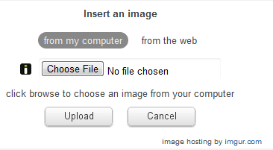
UploaDation

Slide 6
Working of product
I have attached a Python Code which is used to calculate the similarity between signatures. All the prerequisite library are there Lib.rar which is attached

Slide 7
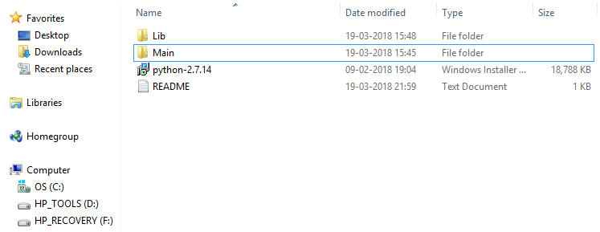
Step -1
Place your screenshot here
First open main folder in Theme 2 folder.

Slide 8
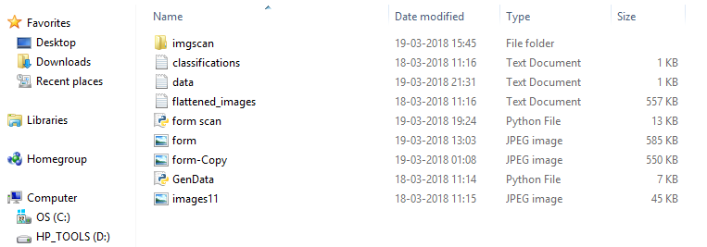
Step -2
Place your screenshot here
Here inside imgscan folder you will have original folder in which there is original signature.
form.jpg is the image of filled mandate form and form-Copy.jpg is unfilled one.
Run the form scan.py file
Don’t edit classification.txt and flattenedimages.txt and don’t run Gendata as I have used them for machine learning

Slide 9
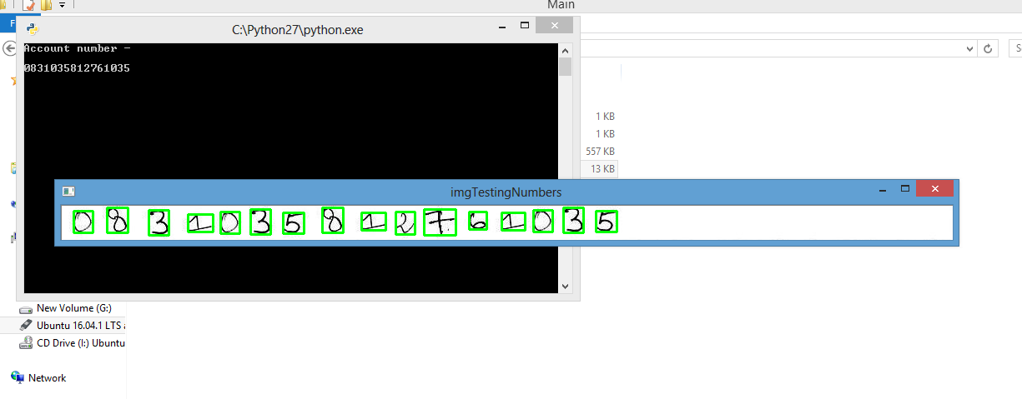
Step -3
Place your screenshot here
The Account number , mandate start date and the end date are scanned and retrieved by using machine learning

Slide 10
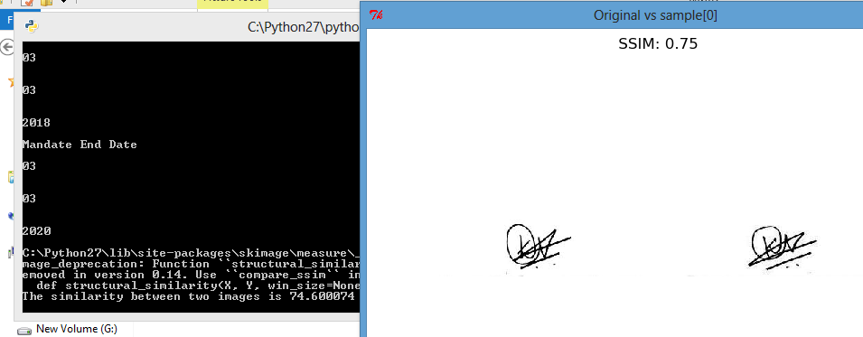
Step -4
Place your screenshot here
Now the comparison of signatures takes place . The image window shows the comparisons of signatures .
After seeing the comparision close them to continue the running of program.
After the program ends open data.txt

Slide 11
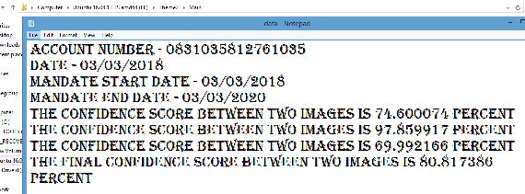
Step -5
Place your screenshot here
The data.txt will have the all the information about the account number , mandate start and end date and the confidence score of signatures

Slide 12
wireframe
I have attached the wireframe which is in wireframe folder.

Slide 13
Thank you

