Slide 1
Interfacing payment gateway to web enabled application
PRN : 2019BTECS00033
NAME : Teknath Krishna jha
Advance DATABASE - ASSIGNMENT -1
Video LINK

Slide 2
What is a payment gateway?
It is a service provider that provides payment authorization.
Basically, it’s a software application connecting a website with the bank, so that the customers can pay you right there on the spot without leaving their apartment.
This type of service can be used by anybody, including eCommerce websites, other service providers that want their users to pay online, and even non-profit organizations that collect donations online.

Slide 3
There are many different payment gateways, including Stripe, PayPal, Authorize.net, Google Checkout and direct MasterCard/Visa payments. All of them have their advantages and disadvantages, and each one takes particular commissions.

Slide 4
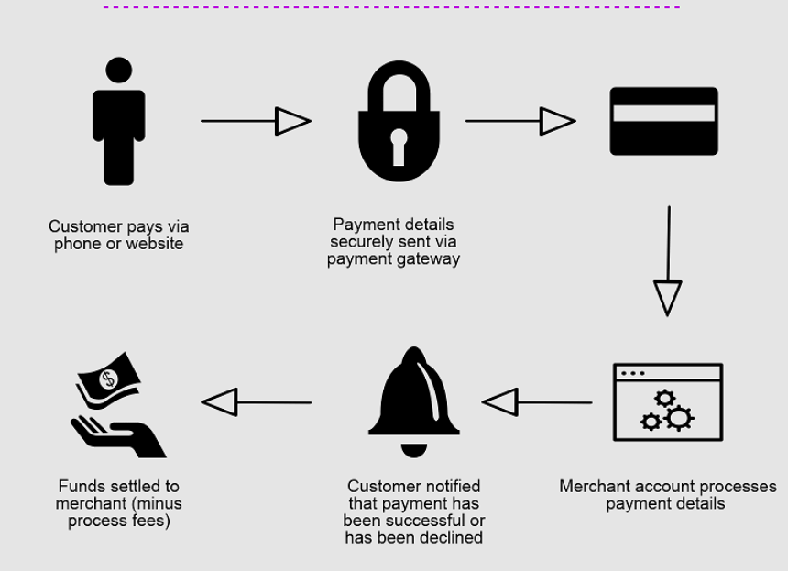
How does it work?

Slide 5
How the eCommerce payment gateway works ?
Order confirmation and provide credit card information.
Information encryption for security reasons.
Information being sent to credit card associations: Visa, MasterCard, etc.
Transaction approval or denial.
In case of approval, transaction changes status to authorized.
Approval on the merchant’s side.
Payment gets to the card issuing company.
Payment is sent to the relevant bank.
The bank confirms the transaction and adds it to the cardholder’s statement.

Slide 6
The cost of payment gateway integration OR THINGS YOU SHOULD KNOW.
Recurring bills on a subscription-based pricing scheme.
Notifications to verify transactions.
Payment information storage so that your customers don’t have to re-enter their personal information.
Virtual terminal imitation physical credit card terminal for convenient input.

Slide 7
DEMO WITH RAZORPAY
REFERENCES : WIKIPEDIA , youtube channel priyanshu Gupta .
Using Django MY WEBSITE LINK ICE-VREAM SELLER

Slide 8
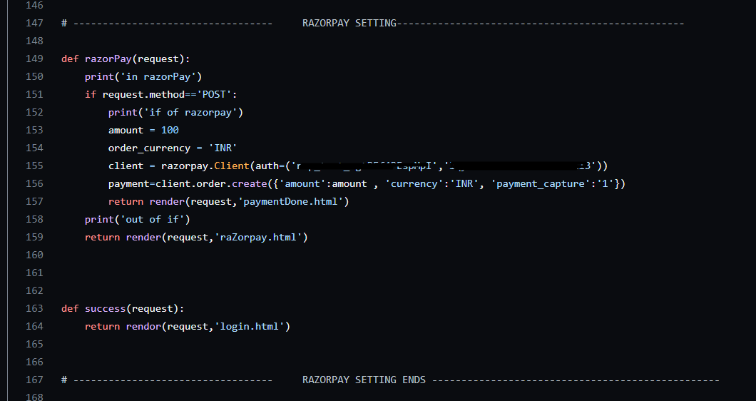
Integration Session:
This is my project in one of my club activity which I have developed using DJANGO framework
This is online ice selling website
Where I have used RAZORPAY gateway for online payment
A dummy payment can be done and after that you can download that ICE-CREAM image.

Slide 9
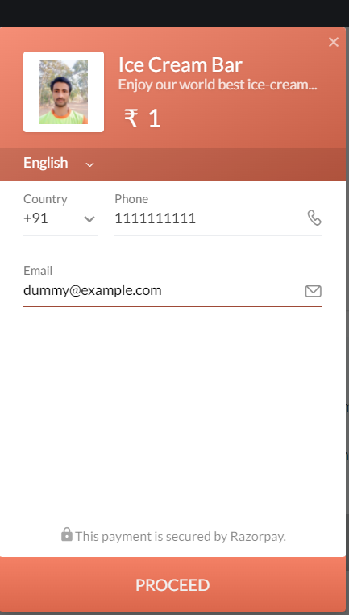
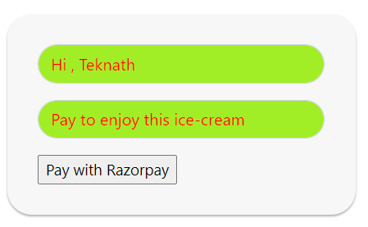
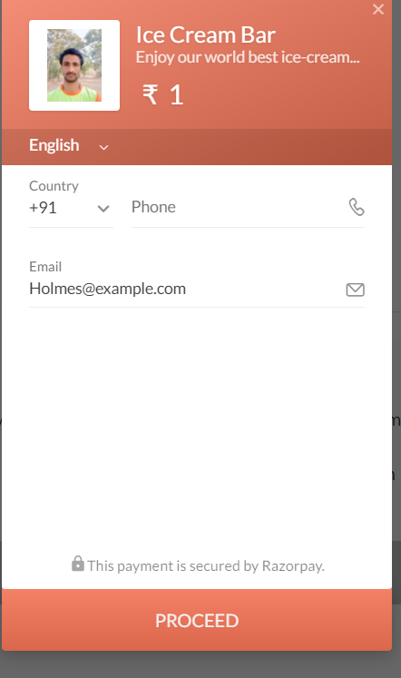
Screenshots of live payment

Slide 10
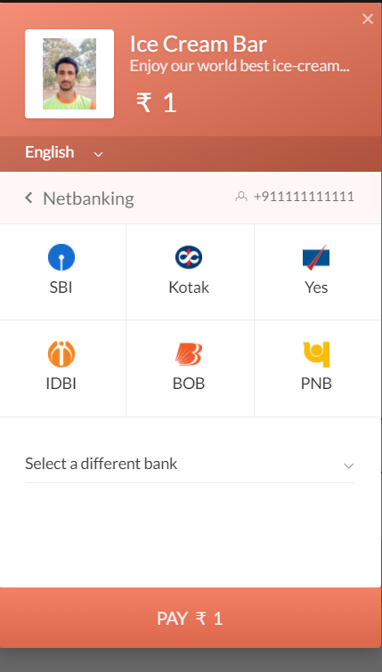
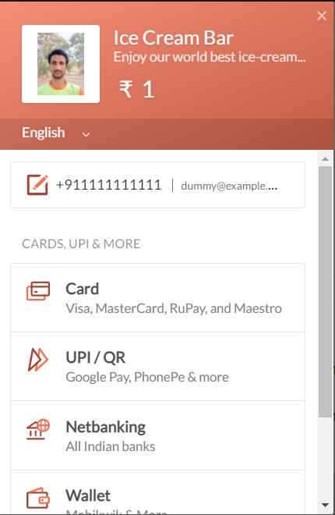
Screenshots of live payment

Slide 11
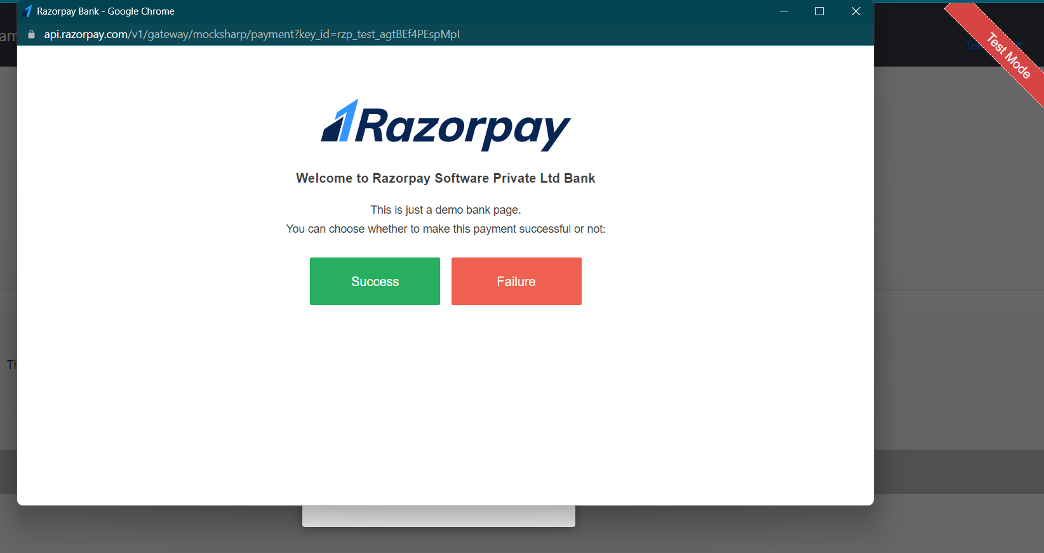
AS this is dummy we can do :

