Slide 1
OUTLINE
Introduction
Literature Survey
Problem Identification
Objective
Methodology
Simulation Results
Conclusion & Future Scope
References
List of Publication

Slide 2
INTRODUCTION
Phishing is known as one of the oldest forms of cyber attacks, which started way back in the 1990s, and it remains to be one of the most common and malicious attacks.
Phishing websites are fraudulent websites that are designed to trick users into revealing sensitive information such as login credentials, credit card details, or personal information.
Predicting whether a website is a phishing website or not is an important task in cybersecurity, as it can help prevent users from falling victim to phishing attacks.

Slide 3
Cont…
This research presents artificial neural network deep learning algorithm for classification.
Artificial neural networks (ANNs) is a powerful deep learning technique for phishing website prediction.
ANNs can learn to recognize complex patterns in website features and can generalize their predictions to new, unseen data.
The dataset is taken from kaggle machine learning repository.

Slide 4
LITERATURE SURVEY
Sr. no | Author Name | Year of Publication | Work | Outcome
1 | F. Yahya et al., | IEEE 2021 | Detection of Phishing Websites using Machine Learning Approaches | Decision Tree has an accuracy of 91.16% , 97.6 % for the KNN model
2 | K. E. Aydın et al., | IEEE 2020 | Machine Learning for Web Content Classification | Highest classification success was 87.56%
3 | N. Megha et al., | IEEE 2019 | An Intelligent System for Phishing Attack Detection and Prevention | Performance and accuracy of the proposed method and obtained results ensures its efficiency.

Slide 5
Sr. no | Author Name | Year of Publication | Work | Outcome
4 | M. Karabatak et al., | IEEE 2018 | Performance comparison of classifiers on reduced phishing website dataset | Feature selection algorithms were applied to reduce the dimension of phishing website dataset and to obtain higher classification performance
5 | F. Ali et al., | IEEE 2017 | A Fuzzy Ontology and SVM–Based Web Content Classification System | Proposed fuzzy ontology then extracts web content to find website type (adult content, normal, and medical)
6 | S. Khurshid et al., | IEEE 2017 | Text-Based Intelligent Content Filtering on Social Platforms. | Propose filtering technique uses sentiment analysis of the text and feature engineering

Slide 6
PROBLEM IDENTIFICATION
During Literature survey following problem is identified in previous research work-
Low accuracy rate of true data prediction from given Phishing Websites dataset.
More classification error.
Low precision and F measure value.

Slide 7
OBJECTIVE
The main objective of this work is summarized as-
To collect Phishing Websites dataset from kaggle machine learning repository.
To implement proposed approach based on artificial neural network (ANN) deep learning classification algorithm.
To use spyder python 3.7 software for simulation.
To calculate various parameters like precision, recall, f-measure and accuracy.
To generate results graph and compare from previous work.

Slide 8
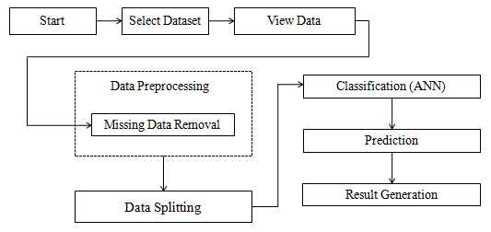
FLOW CHART

Slide 9
METHODOLOGY
Collect data set
For implementation of the research work, the phishing website dataset is taken from kaggle machine learning repository.
Preprocess of data
Data pre-processing involves converting any string variable to the numerical one so that it gets easy for evaluation. Also handle missing and null values.
Feature Extraction
Feature extraction is a process of dimensionality reduction by which an initial set of raw data is reduced to more manageable groups for processing.

Slide 10
Classification
The artificial neural network (ANN) classification algorithm to predict the phishing website prediction.
Simulation is done using Python Software
Python is open source software having large library of AI, machine learning etc work.
The spyder IDE is platform using by the python for the implementation and simulation of the proposed concept.

Slide 11
Artificial Neural Network (ANN)
The activation signal is passed through a transfer function to produce a single output of a neuron.
In this model, ANN is applied to classification prediction of Phishing Websites.
The output layer consists of only one neuron.
The ANN considers local features of a given problem for extracting important information for prediction.
Thus, in case of Phishing websites prediction, it receives different features like domain, server, protocol, URL, DNS etc.

Slide 12
Parameters Calculation
Confusion Matrix- A confusion matrix is a table that is used to describe the performance of a classification model (or "classifier“).
True Positive (TP): Predicted values correctly predicted as actual positive
False Positive (FP) : Predicted values incorrectly predicted an actual positive. i.e., Negative values predicted as positive
False Negative (FN): Positive values predicted as negative
True Negative (TN): Predicted values correctly predicted as an actual negative

Slide 13
Parameters Calculation
Precision
Precision is the ability of a model to correctly identify the instances of a particular class.
Precision = True Positive/(True Positive + False Positive)
Recall
Recall is the ability of a model to identify all the instances of a particular class.
Recall = True Positive/(True Positive + False Negative)
Recall is also known as sensitivity.

Slide 14
Parameters Calculation
F1-score
The F1-score is a performance metric in machine learning that combines precision and recall into a single score. It is the harmonic mean of precision and recall, and it provides a balance between the two metrics.
F1-Score = 2x (Precision x Recall)/(Precision + Recall)
Accuracy
Accuracy is a performance metric in machine learning that measures the proportion of correct predictions made by a model among all the predictions made. It is a simple and commonly used metric that provides a general idea of how well a model is performing..
Accuracy = [TP +TN] / [TP+TN+FP+FN]

Slide 15
Parameters Calculation
Classification Error
Classification error is a performance metric in machine learning that measures the proportion of incorrect predictions.
Classification Error = 100- Accuracy
Specificity
Specificity is the ability of a model to correctly identify all the negative instances.
Specificity = True Negatives / (True Negatives + False Positives)

Slide 16
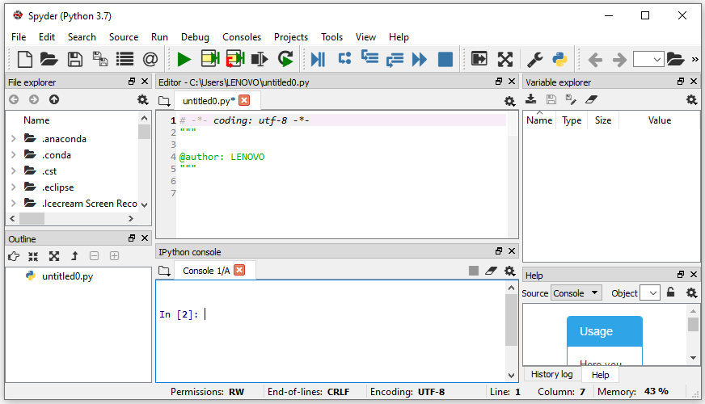
SIMULATION RESULT
Figure 2: Snap shot of Spyder environment

Slide 17
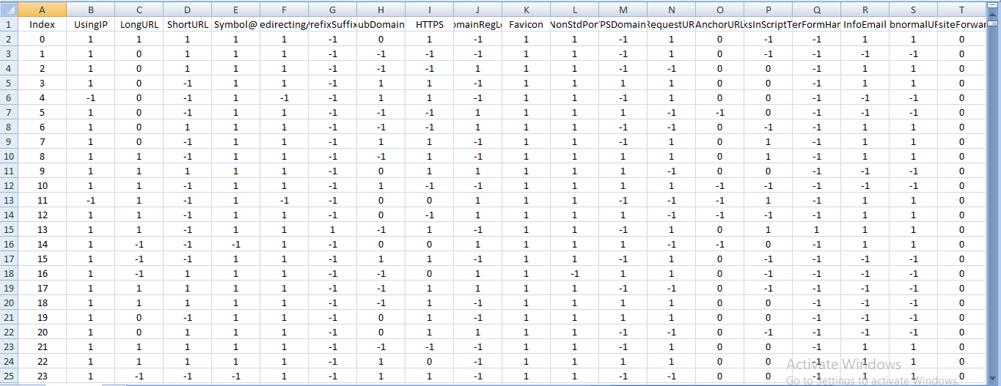
Figure 3: Dataset

Slide 18
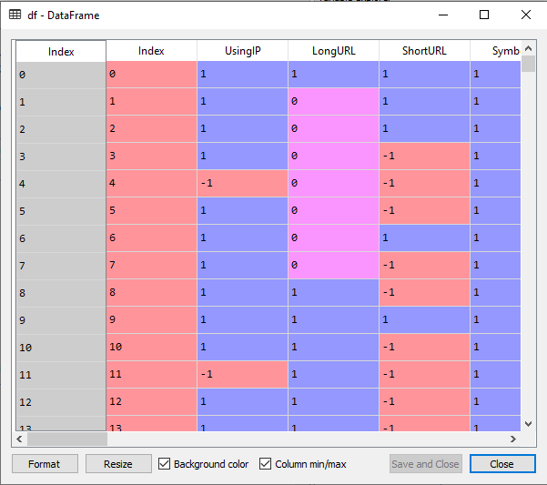
Figure 4: Data frame in the python spyder

Slide 19
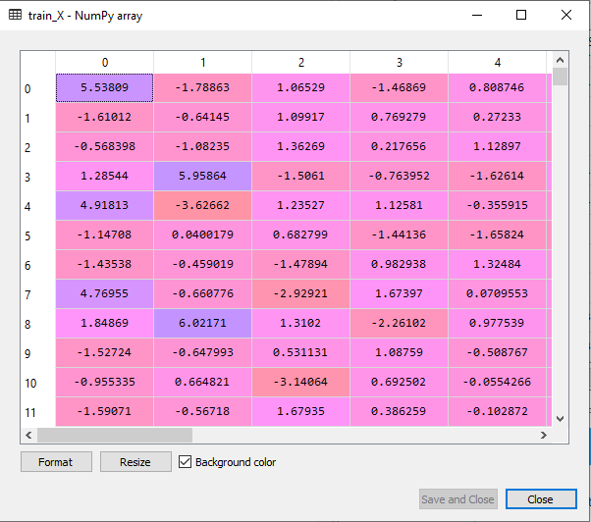
Figure 5: X train data

Slide 20
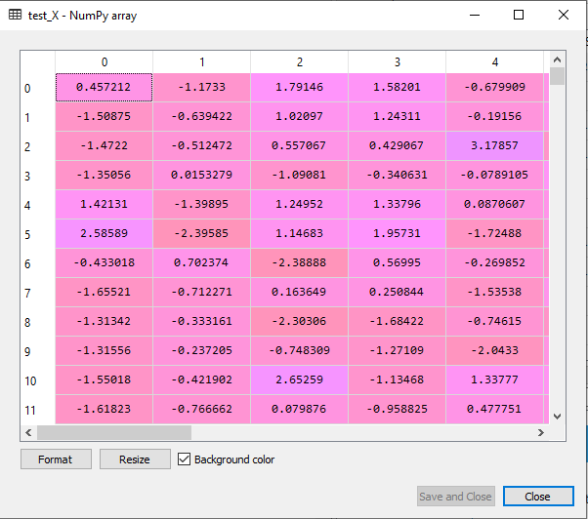
Figure 6: X test data

Slide 21
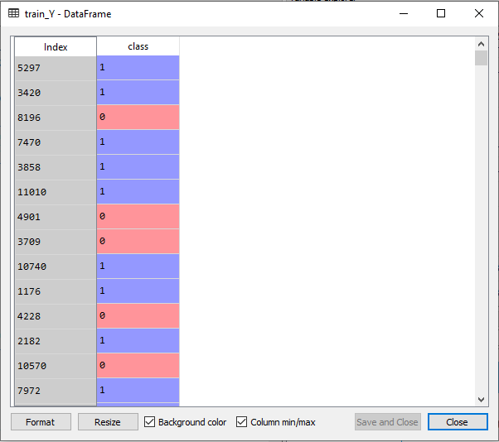
Figure 7: Y train data

Slide 22
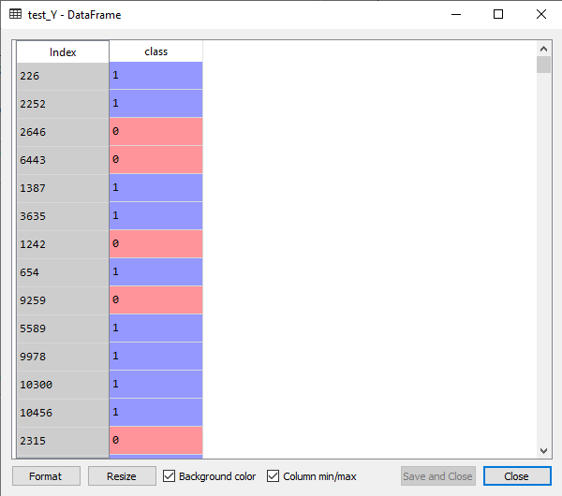
Figure 8: Y test data

Slide 23
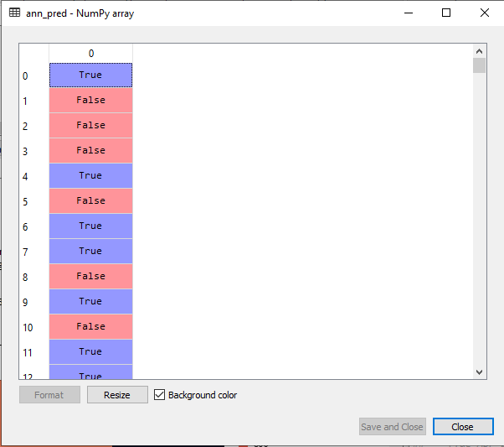
Figure 9: ANN prediction

Slide 24
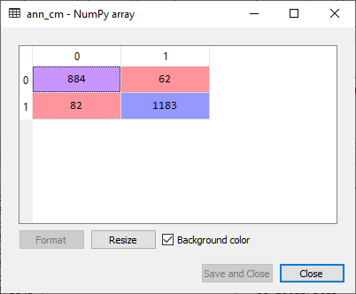
Figure 10: Confusion matrix

Slide 25
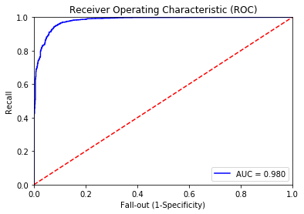
Figure 11: ROC Curve

Slide 26
Table 1: Simulation Scenario
Sr. No. | Parameter Name | Value (%)
1 | Windows | 10 or 11
2 | RAM | 8 GB
3 | Processor | I3
4 | Software | Python
5 | IDE | Spyder
6 | Version | 3.7

Slide 27
Table 2: Simulation Results
Sr. No. | Parameter Name | Value (%)
1 | Precision | 97%
2 | Recall | 96%
3 | F measure | 98%
4 | Sensitivity | 96%
5 | Specificity | 99%
6 | Accuracy | 98.04%
7 | Classification Error | 1.96%

Slide 28
Table 3: Result Comparison
Sr. No. | Techniques | Accuracy
1 | Decision Tree | 91.51%
2 | K-Nearest Neighbor | 97.69%
3 | Random Forest | 94.44%
4 | ANN (Proposed) | 98.04%

Slide 29
Figure 12: Accuracy Result graph

Slide 30
CONCLUSION
This research proposed ANN deep learning approach for prediction of phishing.
The validation of proposed techniques is done by performing simulation using most relevant publicly available dataset.
In this context, the phishing website is used as a dataset.
The proposed approach is implemented using python spyder IDE 3.7 software.
The accuracy of the proposed ANN technique is 98.04%.
Therefore it is clear from the simulation results; the proposed work is achieved significant better results than existing work.

Slide 31
FUTURE SCOPE
In future, it is possible to provide extensions or modifications to the proposed classification algorithms to achieve further increased performance.
Consider different dataset with the some novel approach.
Make a prediction model real time with help of advance software and analysis.

Slide 32
REFERENCES
F. Yahya et al., "Detection of Phising Websites using Machine Learning Approaches," 2021 International Conference on Data Science and Its Applications (ICoDSA), 2021, pp. 40-47, doi: 10.1109/ICoDSA53588.2021.9617482.
K. S. Swarnalatha, K. C. Ramchandra, K. Ansari, L. Ojha and S. S. Sharma, "Real-Time Threat Intelligence-Block Phising Attacks," 2021 IEEE International Conference on Computation System and Information Technology for Sustainable Solutions (CSITSS), 2021, pp. 1-6, doi: 10.1109/CSITSS54238.2021.9683237.
S. M. Istiaque, M. T. Tahmid, A. I. Khan, Z. A. Hassan and S. Waheed, "Artificial Intelligence Based Cybersecurity: Two-Step Suitability Test," 2021 IEEE International Conference on Service Operations and Logistics, and Informatics (SOLI), 2021, pp. 1-6, doi: 10.1109/SOLI54607.2021.9672437.
R. Yaqoob, Sanaa, M. Haris, Samadyar and M. A. Shah, "The Price Scraping Bot Threat on E-commerce Store Using Custom XPATH Technique," 2021 26th International Conference on Automation and Computing (ICAC), 2021, pp. 1-6, doi: 10.23919/ICAC50006.2021.9594223.
M. Min, J. J. Lee, H. Park and K. Lee, "Honeypot System for Automatic Reporting of Illegal Online Gambling Sites Utilizing SMS Spam," 2021 World Automation Congress (WAC), 2021, pp. 180-185, doi: 10.23919/WAC50355.2021.9559478.
H. Dao, J. Mazel and K. Fukuda, "CNAME Cloaking-Based Tracking on the Web: Characterization, Detection, and Protection," in IEEE Transactions on Network and Service Management, vol. 18, no. 3, pp. 3873-3888, Sept. 2021, doi: 10.1109/TNSM.2021.3072874.

Slide 33
R. Nanjundappa et al., "AWAF: AI Enabled Web Contents Authoring Framework," 2020 IEEE 17th India Council International Conference (INDICON), 2020, pp. 1-5, doi: 10.1109/INDICON49873.2020.9342385.
K. E. Aydın and S. Baday, "Machine Learning for Web Content Classification," 2020 Innovations in Intelligent Systems and Applications Conference (ASYU), 2020, pp. 1-7, doi: 10.1109/ASYU50717.2020.9259833.
U. Iqbal, P. Snyder, S. Zhu, B. Livshits, Z. Qian and Z. Shafiq, "AdGraph: A Graph-Based Approach to Ad and Tracker Blocking," 2020 IEEE Symposium on Security and Privacy (SP), 2020, pp. 763-776, doi: 10.1109/SP40000.2020.00005.
N. Megha, K. R. Remesh Babu and E. Sherly, "An Intelligent System for Phishing Attack Detection and Prevention," 2019 International Conference on Communication and Electronics Systems (ICCES), 2019, pp. 1577-1582, doi: 10.1109/ICCES45898.2019.9002204.
S. S. Hashmi, M. Ikram and M. A. Kaafar, "A Longitudinal Analysis of Online Ad-Blocking Blacklists," 2019 IEEE 44th LCN Symposium on Emerging Topics in Networking (LCN Symposium), 2019, pp. 158-165, doi: 10.1109/LCNSymposium47956.2019.9000671.
T. Vo and C. Jaiswal, "ADREMOVER: THE IMPROVED MACHINE LEARNING APPROACH FOR BLOCKING ADS," 2019 IEEE 10th Annual Ubiquitous Computing, Electronics & Mobile Communication Conference (UEMCON), 2019, pp. 1-4, doi: 10.1109/UEMCON47517.2019.8993052.

Slide 34
M. Karabatak and T. Mustafa, "Performance comparison of classifiers on reduced phishing website dataset," 2018 6th International Symposium on Digital Forensic and Security (ISDFS), 2018, pp. 1-5, doi: 10.1109/ISDFS.2018.8355357.
G. Chakraborty and T. T. Lin, "A URL address aware classification of malicious websites for online security during web-surfing," 2017 IEEE International Conference on Advanced Networks and Telecommunications Systems (ANTS), 2017, pp. 1-6, doi: 10.1109/ANTS.2017.8384155.
F. Ali et al., "A Fuzzy Ontology and SVM–Based Web Content Classification System," in IEEE Access, vol. 5, pp. 25781-25797, 2017, doi: 10.1109/ACCESS.2017.2768564.
T. Dinh, T. Ngo and D. Vu, "A Model for Automatically Detecting and Blocking Pornographic Websites," 2015 Seventh International Conference on Knowledge and Systems Engineering (KSE), 2015, pp. 244-249, doi: 10.1109/KSE.2015.77.
S. Khurshid, S. Khan and S. Bashir, "Text-Based Intelligent Content Filtering on Social Platforms," 2014 12th International Conference on Frontiers of Information Technology, 2014, pp. 232-237, doi: 10.1109/FIT.2014.51.

Slide 35
T. A. Almeida and T. C. Alberto, "Learning to Block Undesired Comments in the Blogosphere," 2013 12th International Conference on Machine Learning and Applications, 2013, pp. 261-266, doi: 10.1109/ICMLA.2013.133.
M. Ahmad and R. F. Munir, "Malfree web server response," 2011 7th International Conference on Emerging Technologies, 2011, pp. 1-6, doi: 10.1109/ICET.2011.6048478.
Q. Chen, Y. Wu and X. Chen, "Research on Customers Demand Forecasting for E-business Web Site Based on LS-SVM," 2008 International Symposium on Electronic Commerce and Security, 2008, pp. 66-70, doi: 10.1109/ISECS.2008.204.
B. T. Logan, U. Karaoz, P. J. Moreno, Z. Weng and S. Kasif, "Protein seer: a Web server for protein homology detection," The 26th Annual International Conference of the IEEE Engineering in Medicine and Biology Society, 2004, pp. 3064-3067, doi: 10.1109/IEMBS.2004.1403866.
https://www.kaggle.com/datasets/isatish/phishing-dataset-uci-ml-csv?select=uci-ml-phishing-dataset.csv.

Slide 36
LIST OF PUBLICATION
[1] Gaurav Tiwari, Prof. Atul Barve “Detection of Phishing Websites using Machine Learning Approaches: A Review” International Journal of Research and Analytical Reviews, ISSN 2348-1269, Volume 9, Issue 3, September 2022, pp 304-308.
[2] Gaurav Tiwari, Prof. Atul Barve “Artificial Neural Network Deep Learning Approach for Phishing Websites Prediction” International Journal of Computer Applications (0975 – 8887) Volume 184 – No. 51, March 2023, pp 7-11.

