Slide 1
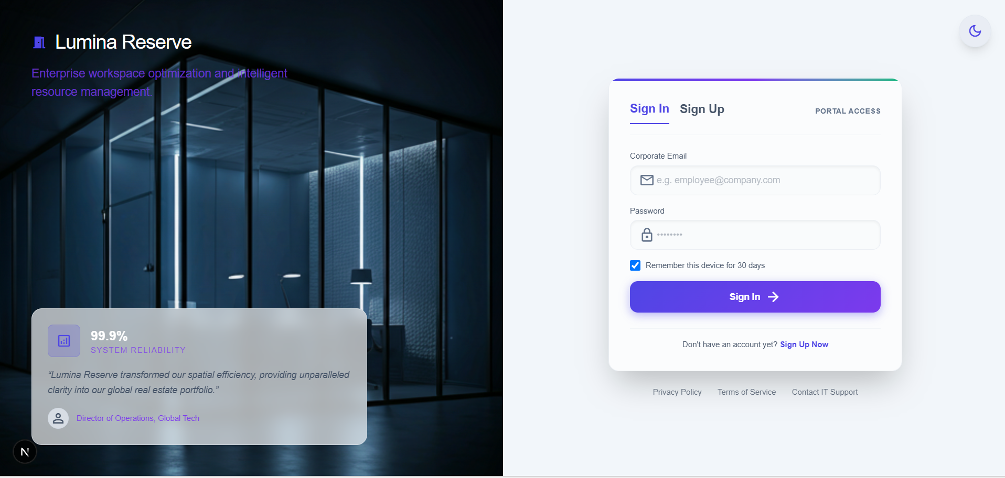
Lumina Reserve
Corporate Spatial Management & Meeting Room Reservation Suite
KEY SYSTEM HIGHLIGHTS:
✔ Strict Relational Database Engine (MySQL 8.0 InnoDB)
✔ Automated 15-Minute Approval Window Engine
✔ Multi-Channel Automated WhatsApp (Green API) & Gmail Calendar Emailing
📸 [INSERT SCREENSHOT HERE: Lumina Reserve App Logo & Hero Homepage]

Slide 2
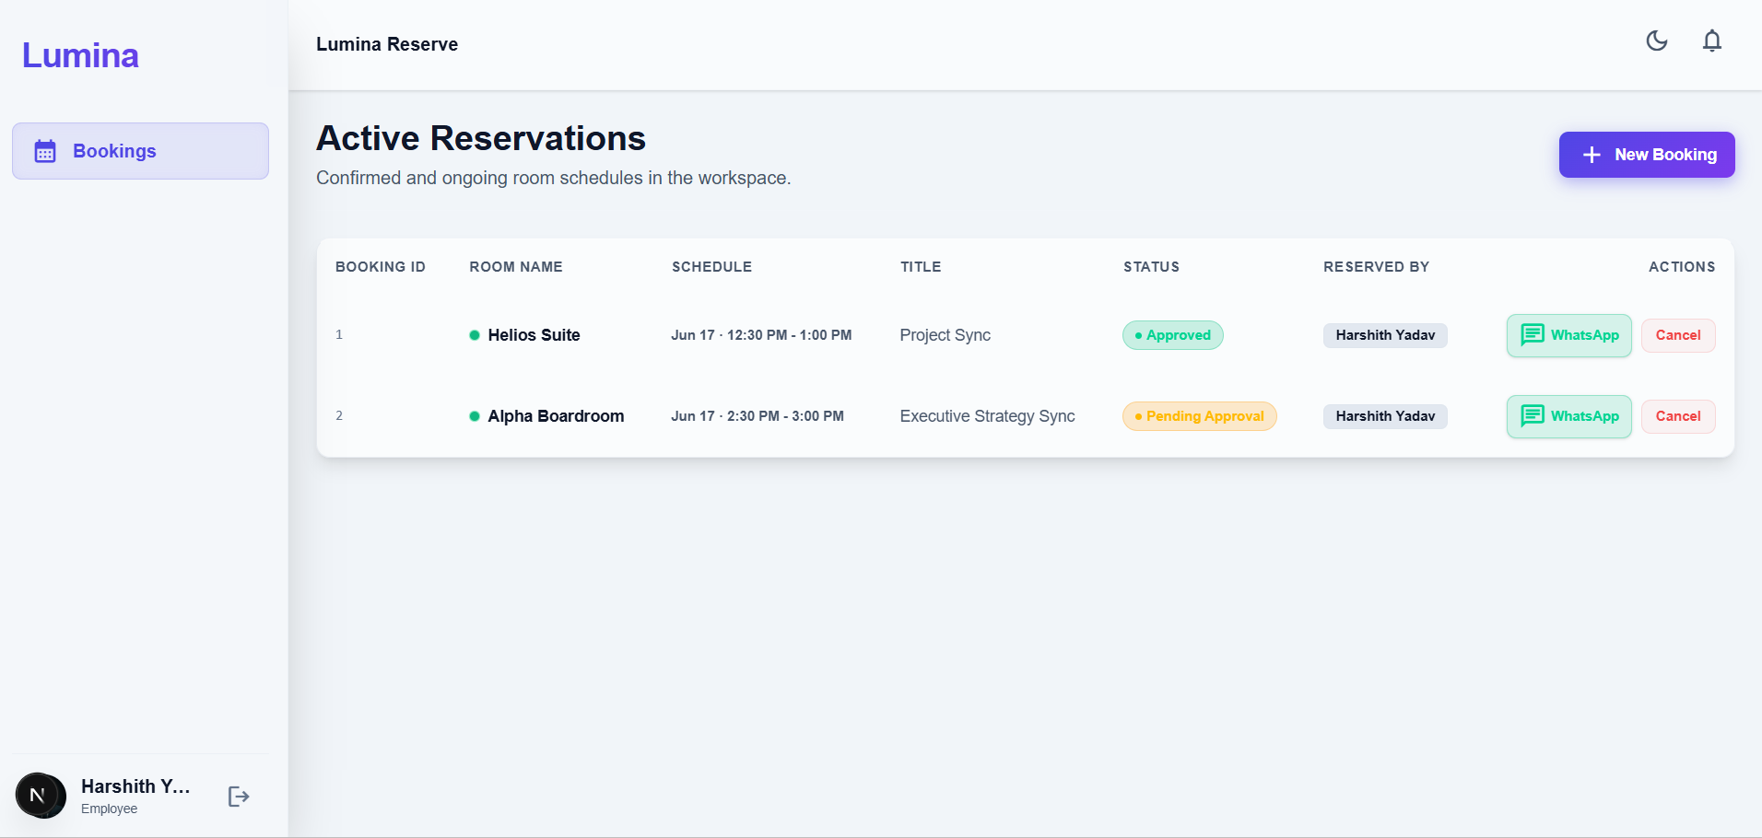
[ PROBLEM STATEMENT & IMPACT ] — SLIDE 2
Executive Problem Statement & Business Impact
Eliminating Office Scheduling Conflicts & Approval Bottlenecks
KEY ARCHITECTURE & HIGHLIGHTS:
🔹 The Problem: Meeting room double-bookings cause meeting delays and friction.
🔹 The Problem: Managers tied up in manual approval queues.
🔹 The Solution: Real-time slot locking with zero conflicts guaranteed.
🔹 Business Impact: 100% elimination of room scheduling collisions.

Slide 3
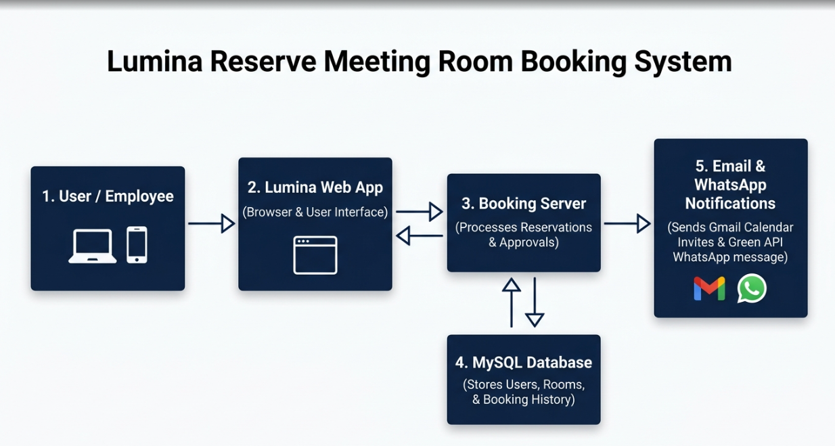
[ SYSTEM ARCHITECTURE ] — SLIDE 3
Non-Technical System Architecture Overview
Lightweight, High-Performance 3-Tier Enterprise Design
KEY ARCHITECTURE & HIGHLIGHTS:
🔹 Presentation Layer: Interactive Web UI built with Next.js & React
🔹 Database Layer: MySQL 8.0 with InnoDB Storage Engine for data security
🔹 Messaging Layer: Real Gmail SMTP Mailer & Green API WhatsApp Gateway

Slide 4
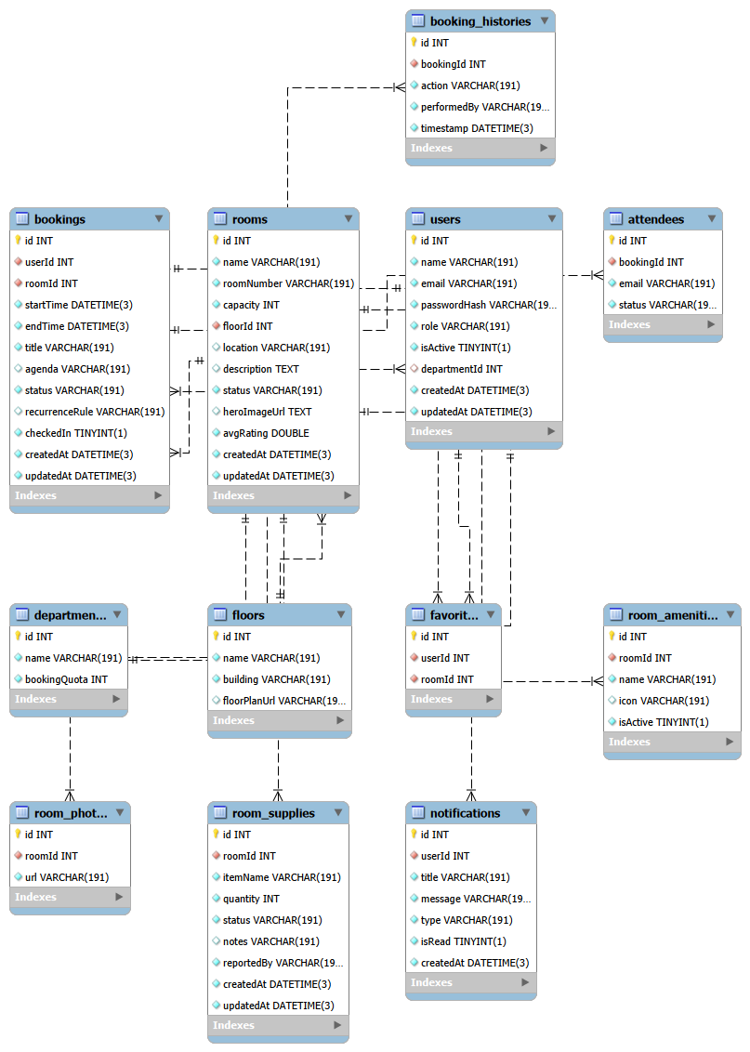
[ DATABASE MODEL ] — SLIDE 4
MySQL Relational Schema & Workbench EER Diagram
12 Interconnected SQL Tables Linked via Foreign Keys
KEY ARCHITECTURE & HIGHLIGHTS:
🔹 Structured Tables: users, rooms, bookings, attendees, supplies, histories
🔹 Workbench Ready: Press Ctrl + R in MySQL Workbench to generate visual map
🔹 Data Integrity: Foreign key constraints prevent orphaned records

Slide 5
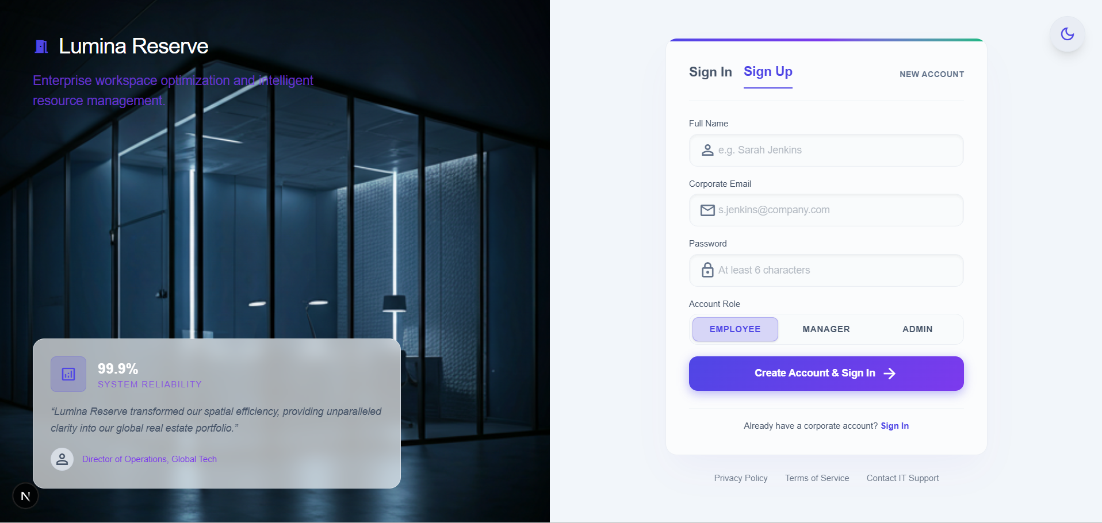
[ AUTHENTICATION & ROLES ] — SLIDE 5
Sign In & Sign Up Authentication Portal
Secure Employee & Manager Account Management
KEY ARCHITECTURE & HIGHLIGHTS:
🔹 Sign In Tab: Auto-trims email inputs and validates bcrypt password hash
🔹 Sign Up Tab: Self-registration for new employees into MySQL database
🔹 Role Routing: Automatic redirection to Employee (/), Manager (/manager), or Admin (/admin)

Slide 6
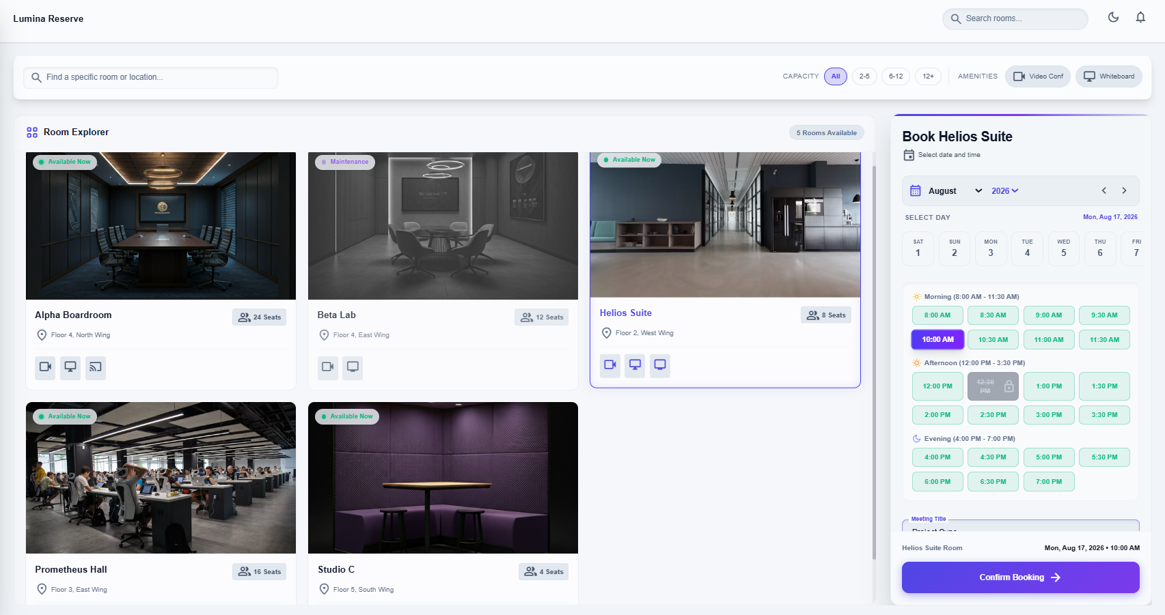
[ SPATIAL EXPLORER ] — SLIDE 6
All-Rooms Explorer & Filter Engine
Complete Real-Time Visibility of Corporate Facilities
KEY ARCHITECTURE & HIGHLIGHTS:
🔹 Default Open View: All rooms displayed immediately upon page load
🔹 Search Engine: Search rooms by designation or floor location
🔹 Filter Pills: Instant filtering by seats (All, 2-5, 6-12, 12+) or amenities

Slide 7
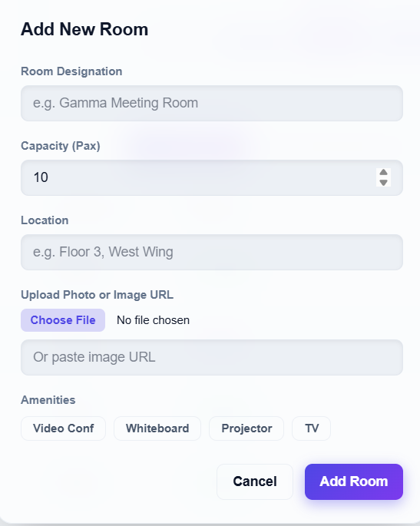
[ MEDIA & ASSETS ] — SLIDE 7
Direct Computer Photo File Upload (<input type='file'>)
Custom Local Computer Hard Drive Image Uploading
KEY ARCHITECTURE & HIGHLIGHTS:
🔹 Computer File Picker: Admins click 'Choose File' to pick local photos
🔹 Base64 Conversion: Converts images to Data URLs stored in MySQL
🔹 Flexible Options: Web image links are also fully supported

Slide 8
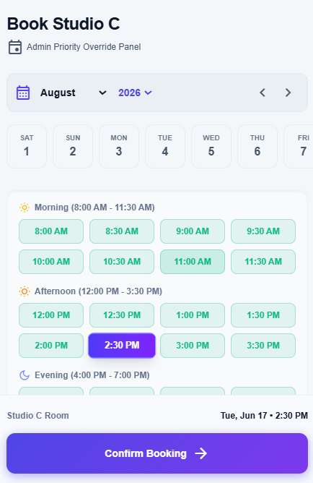
[ SLOT SCHEDULING ] — SLIDE 8
Conflict-Free Real-Time Room Booking
Interactive Date & Half-Hourly Slot Selector
KEY ARCHITECTURE & HIGHLIGHTS:
🔹 Time Grid: Select date and time slot (Morning, Afternoon, Evening)
🔹 Slot Lock: Booked slots are instantly highlighted and disabled
🔹 Attendee Invites: Add team member emails to receive calendar invites

Slide 9
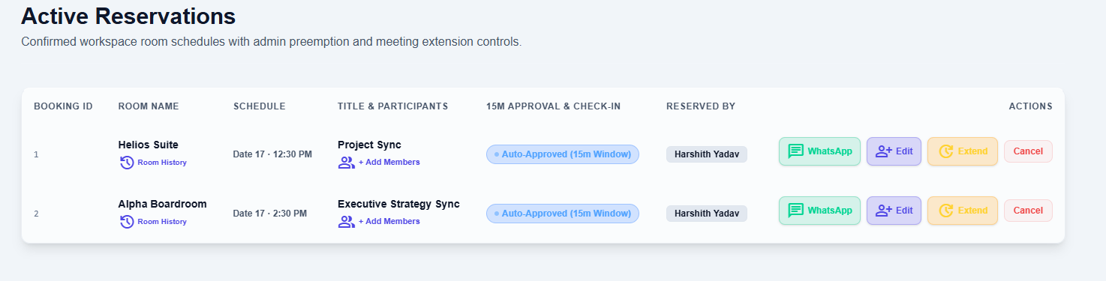
[ AUTOMATED APPROVALS ] — SLIDE 9
15-Minute Auto-Approval Mechanism
Eliminating Administrative Approval Bottlenecks
KEY ARCHITECTURE & HIGHLIGHTS:
🔹 Smart Timer: Pending requests auto-approve after 15 minutes
🔹 Zero Delays: Ensures employees can proceed even if managers are in meetings
🔹 Status Badges: Displays 'Approved' or 'Auto-Approved (15m Window)'

Slide 10
[ WHATSAPP INTEGRATION ] — SLIDE 10
Multi-Channel WhatsApp Automated Broadcasting (Green API)
Background Messaging & 1-Click Web Links
KEY ARCHITECTURE & HIGHLIGHTS:
🔹 Green API Integration: Automated background WhatsApp message dispatch
🔹 Designated Chats: Sends to Primary (+919652456879), Vishal, & Malavika
🔹 1-Click Web Link: Fallback button opens WhatsApp Web with formatted text

Slide 11
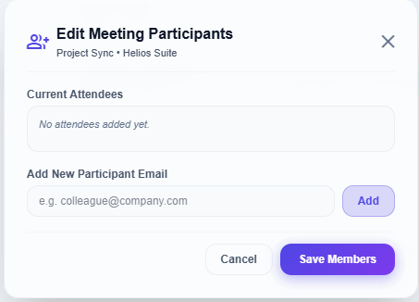
[ ATTENDEE MANAGEMENT ] — SLIDE 11
Edit Participants on Active Meetings
Dynamic Member Management for Managers & Admins
KEY ARCHITECTURE & HIGHLIGHTS:
🔹 Edit Members Button: Modify attendee lists on active reservations
🔹 Flexibility: Add late invitees or remove members without canceling meeting
🔹 Audit Persistence: Saves member modification events in history log

Slide 12
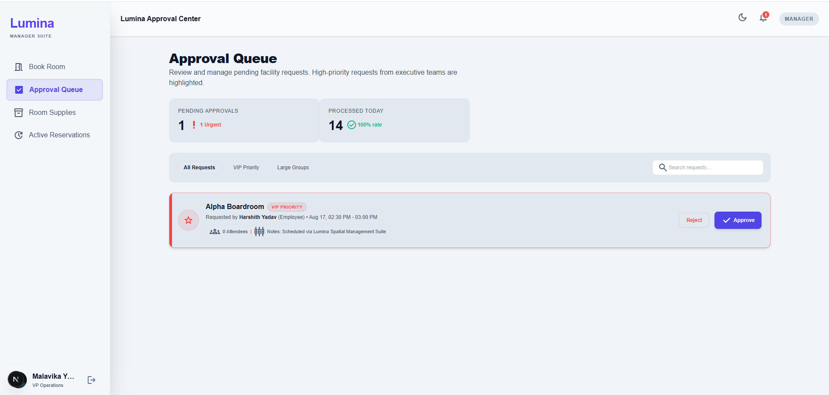
[ MANAGER SUITE ] — SLIDE 12
Manager Approval Suite & Priority Requests
Real-Time Priority Queue for Operations Leadership
KEY ARCHITECTURE & HIGHLIGHTS:
🔹 Pending Queue: Review incoming meeting requests in real time
🔹 Priority Tagging: Highlights VIP, Executive, and Training sessions
🔹 1-Click Actions: Approve or decline requests with custom reason notes

Slide 13
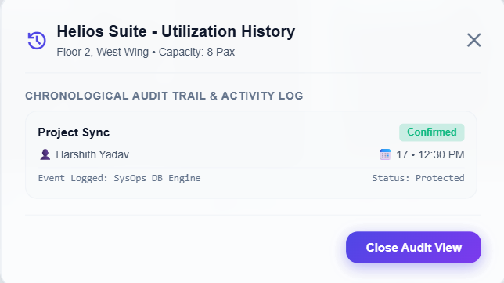
[ AUDIT & TIMELINE ] — SLIDE 13
Room-Specific Audit History & System Logs
Chronological Utilization & Event Tracking
KEY ARCHITECTURE & HIGHLIGHTS:
🔹 Room History Modal: Click any room card to open its dedicated audit log
🔹 Full Timeline: Displays booking creations, edits, cancellations, and notes
🔹 SQL Persistence: Stored permanently in the booking_histories table

Slide 14
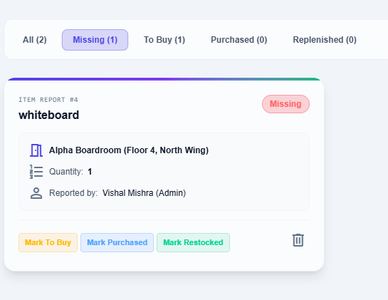
[ FACILITY HEALTH ] — SLIDE 14
Facility Room Supplies & Maintenance Tracking
Equipment Restocking & Room Health Lifecycles
KEY ARCHITECTURE & HIGHLIGHTS:
🔹 Equipment Reports: Report missing items (HDMI cables, markers, remotes)
🔹 Status Lifecycle: Cycle items: Missing -> To Buy -> Purchased -> Restocked
🔹 Maintenance Mode: Temporarily pause room availability for repairs

Slide 15
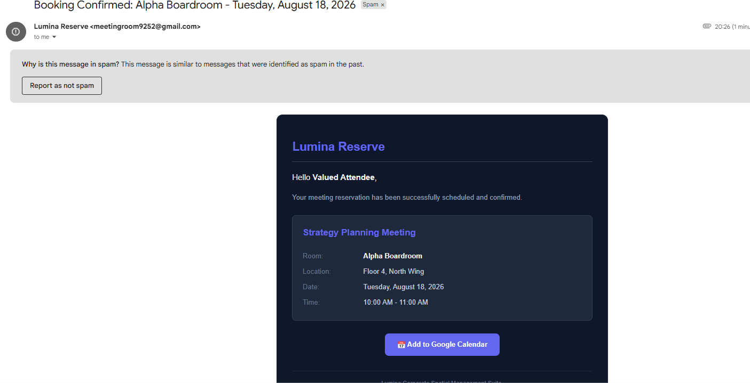
[ EMAIL AUTOMATION ] — SLIDE 15
Automated Gmail Calendar Email Notifications
Interactive Calendar Invitations via Gmail SMTP
KEY ARCHITECTURE & HIGHLIGHTS:
🔹 Gmail SMTP Transporter: Real emails sent via meetingroom9252@gmail.com
🔹 Interactive Button: Includes '📅 Add to Google Calendar' link
🔹 File Attachments: Sends standard .ics calendar invite attachments

Slide 16
[ SECURITY & GOVERNANCE ] — SLIDE 16
System Security & Role-Based Permissions (RBAC)
Enterprise Compliance & Password Encryption
KEY ARCHITECTURE & HIGHLIGHTS:
🔹 Password Security: Bcrypt salt round password hashing
🔹 Employee Role: Booking & Room Explorer access
🔹 Manager Role: Approvals, Member Edits, Supplies & Room History
🔹 Admin Role: Room Management, Direct Uploads, Maintenance & Audit
📷 SCREENSHOT INSERTION FRAME
📸 [INSERT SCREENSHOT HERE: User Roles Matrix Table]

Slide 17
[ LIVE DEMONSTRATION ] — SLIDE 17
Step-by-Step 3-Minute Live Demo Walkthrough
Seamless Live Presentation Script for Managers
KEY ARCHITECTURE & HIGHLIGHTS:
🔹 Step 1: Show MySQL Workbench EER Diagram (Ctrl + R)
🔹 Step 2: Log in as Employee, book room, click WhatsApp Share
🔹 Step 3: Log in as Manager, Edit Members, and check Room History
🔹 Step 4: Check Gmail inbox for automated calendar invite email
📷 SCREENSHOT INSERTION FRAME
📸 [INSERT SCREENSHOT HERE: Multi-Window Demo Overview]

Slide 18
CONCLUSION & Q&A
Summary of Business Benefits
Ready for Executive Management Review
KEY SYSTEM HIGHLIGHTS:
✔ 100% Conflict-Free Spatial Booking System
✔ Automated 15-Minute Approvals & Equipment Restock Tracking
✔ Strict Relational SQL Database Core (MySQL 8.0 InnoDB)
✔ Access App Live: http://localhost:3000/login
📸 [INSERT SCREENSHOT HERE: Final Closing Slide / Login Portal]

