Slide 1
Shelter Made Safer: A Price and Safety Prediction System for Airbnb Listings using Crime Demographics
Team Mates:
Lakshmanan vivek
Aaditya Deowanshi
Vishal Praanesh

Slide 2
The Problem?
Predicting optimal Airbnb Prices.
Visualizing Crime information to tell how safe is the place
Datasets:
Airbnb Dataset: 40,754 Records with 96 features
NYPD crime Dataset: 5.58 million records with 24 features

Slide 3
Algorithms Used
Linear Regression
SGD Regression
Ridge Regression
Lasso Regression
Bayesian Regression

Slide 4
Preprocessing
Feature Selection
Feature Engineering
AIRBNB Dataset
NYPD Crime Dataset
Imputing NAN’s with Mean value,
Corresponding feature values,
by feature engineering
Feature Selection
Removing Outliers
Calculating the location by using
latitude and longitude
Feature Selection
Removing NAN’s

Slide 5
Evaluations
Initial Training/Test split (80/20)
Stratified K-fold Evaluation
Mean Absolute Error (MAE) is calculated

Slide 6
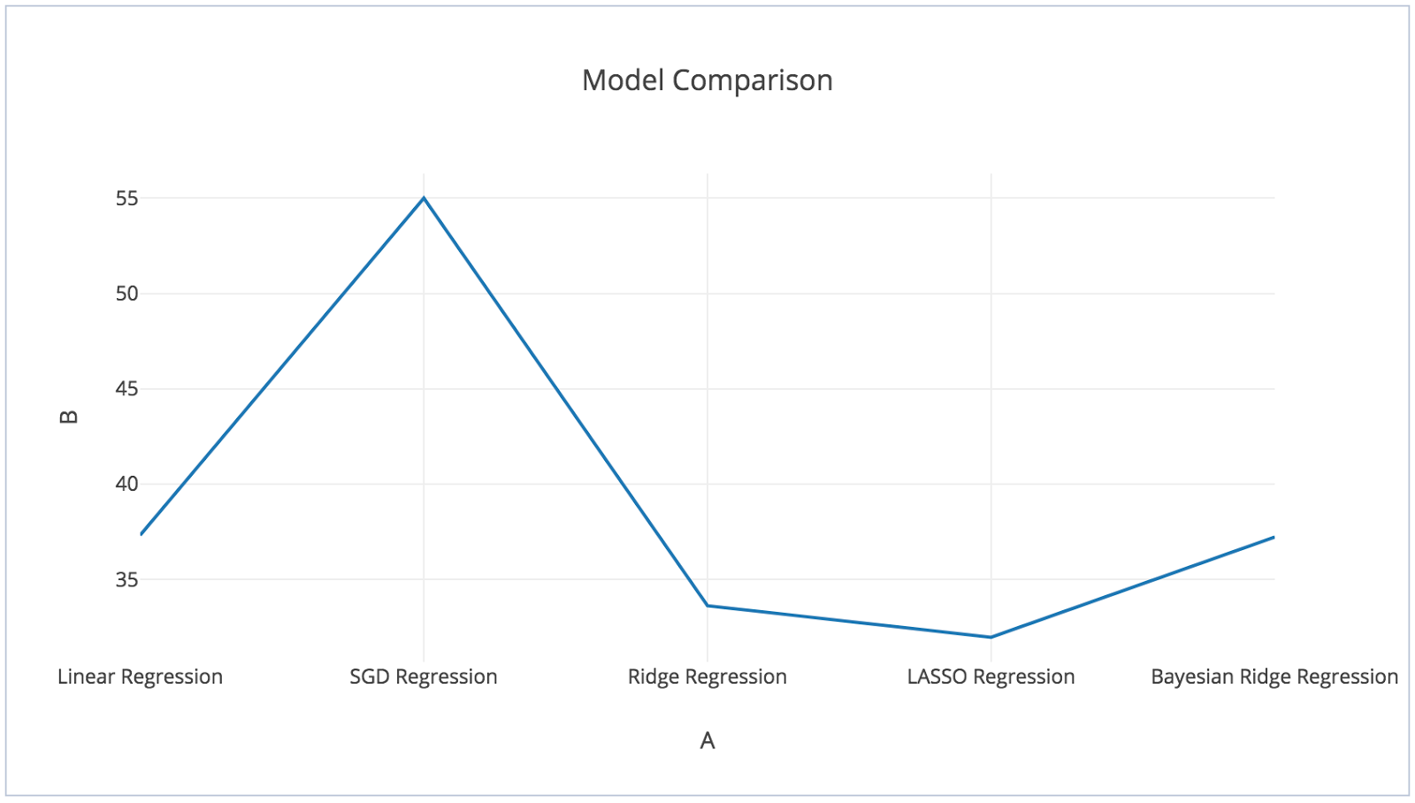
Evaluations of AirBNB regression models.

Slide 7
Data Visualization of NYPD Crime Dataset
Log stash
Elastic Search
Kibana

Slide 8
Demo

Slide 9
Questions?

Slide 10
Thank You!!! ☺

