Slide 1


Slide 2
PROJECT NAME- WINE QUALITY PREDICTION
NAME- VISHAL MANOJKUMAR RAJBHAR
IT VEDANT THANE
Description:
In this notebook we are going to predict the quality of wine using the feature like acidity, alcohol content, residual sugar.
The dataset we are going to use is the wine quality dataset from Kaggle which contains about 1599 rows and 12 features.
The dataset contains the labels which we have t predict and the labels are discrete and binary . So the problem we have is a Supervised Classification type.

Slide 3
Motivation:
Building such predictive models can help Wineries to predictive analytics to identify market trends, consumer preferences, and emerging tastes.
By producing high-quality wines that align with consumer preferences, wineries can strengthen their competitive position and capture market share.
This leads to more strategic and effective decision-making, ultimately improving overall business performance.

Slide 4
Features Description:
Column ID | Column Name | Description
1 | fixed acidity | Higher levels might contribute to a more robust flavor.
2 | volatile acidity | Too much can lead to unpleasant flavors, so lower levels are generally preferred.
3 | citric acid | Adds freshness and can enhance the overall acidity, contributing positively to quality.
4 | residual sugar | Sweeter wines might be preferred by some, but it depends on personal taste.
5 | chlorides | Lower levels are generally preferred as high chloride content can lead to a salty taste.
6 | free sulfur dioxide | Acts as a preservative; an appropriate amount is crucial for wine quality.
7 | total sulfur dioxide | Should be monitored to avoid excess, as too much can affect taste and aroma negatively.
8 | density | Can indicate the body of the wine, with higher density often associated with richer wines.
9 | pH | Affects the acidity; balanced pH is usually desired for a harmonious taste.
10 | sulphates | Can contribute to the wine's stability and preservation.
11 | alcohol | Higher alcohol content might be preferred by some, but balance is key.
12 | quality | This is the target variable, representing the overall quality or rating of the wine.

Slide 5
Load Libraries and Dataset
Import Numpy as np
Import Pandas as pd
Import Matplotlib.pyplot as plt
Import Seaborn as sns
from warnings import filterwarnings
from sklearn.linear_model import LogisticRegression
from sklearn.model_selection import train_test_split
from sklearn.metrics import accuracy_score,confusion_matrix
import Warnings
Warnings.filterwarnings(“ignore”)

Slide 6
Importing Dataset:
wine=pd.read_csv(r"C:\Users\visha\Downloads\winequality-red final.csv")
print("Successfully Imported Data!")
Wine

Slide 7
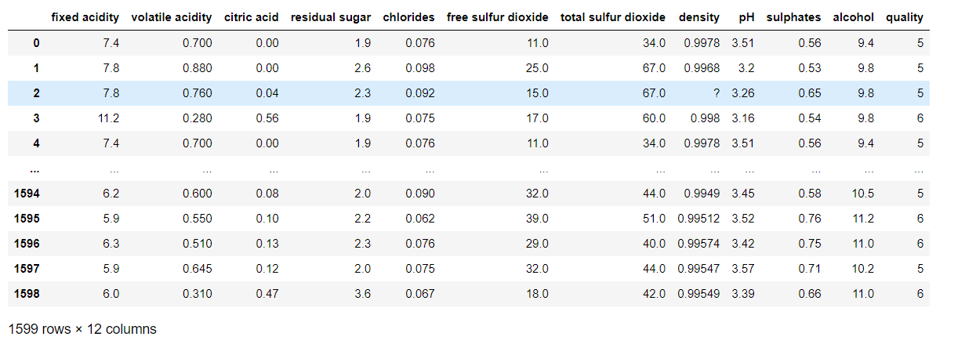

Slide 8
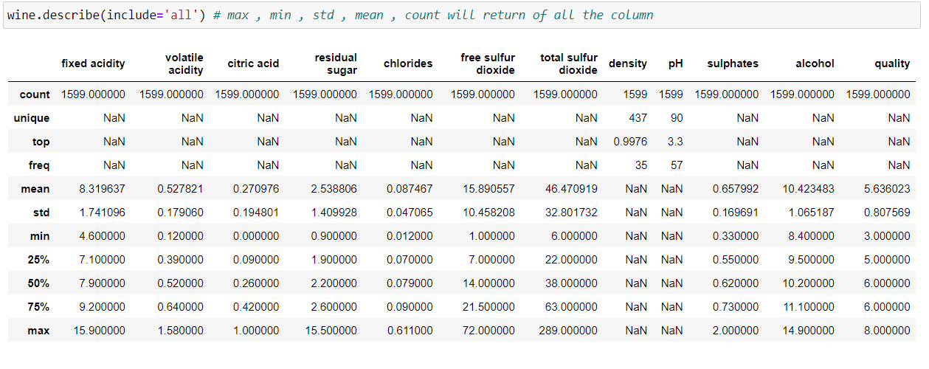
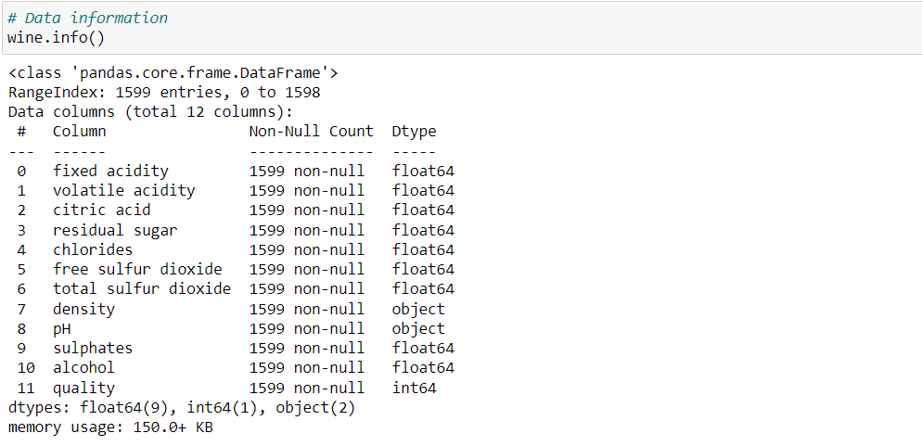

Slide 9
Exploratory Data Analysis
Observations:
The dataset doesn’t have any Null values, but column “pH” and “density” it contains missing values in the form of “?” which need to be preprocessed and must replace with the mean value.

Slide 10
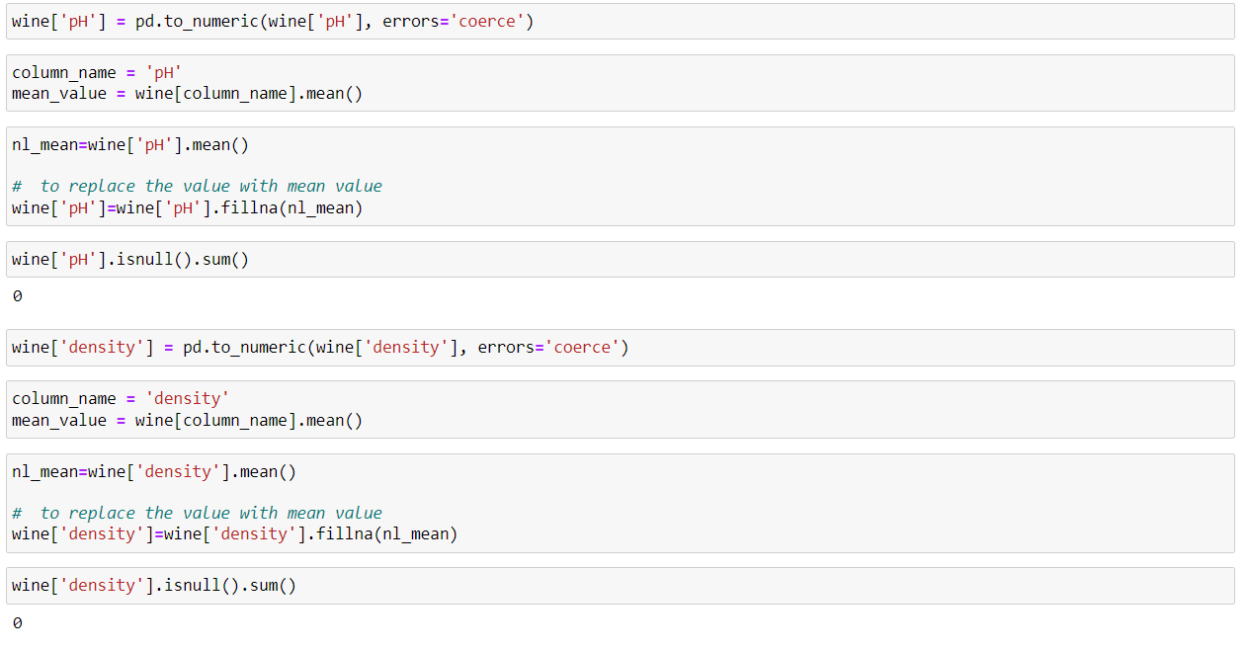

Slide 11
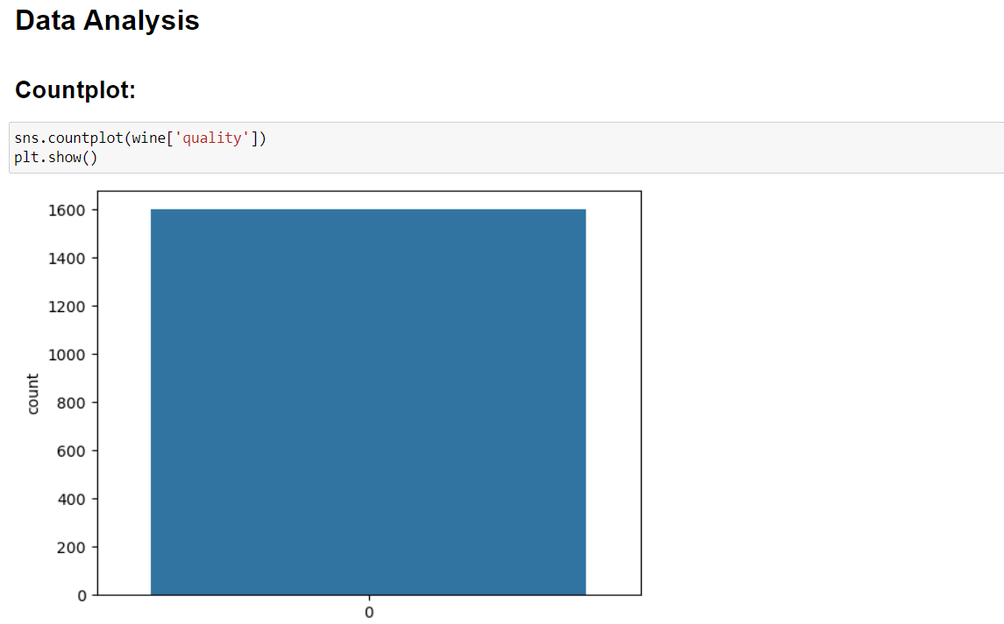
Data Analysis:
This line of code creates and displays a bar plot showing the distribution of different quality levels of wine in the dataset. Each bar represents the count of observations for a specific quality level.
Countplot

Slide 12
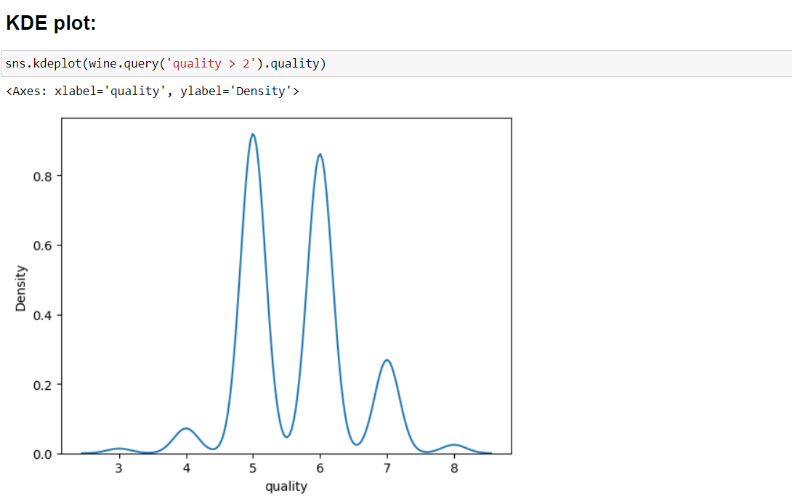
The resulting plot will display the KDE of quality levels for wines with a quality greater than 2, giving you an idea of the distribution of quality in that subset of the data.

Slide 13
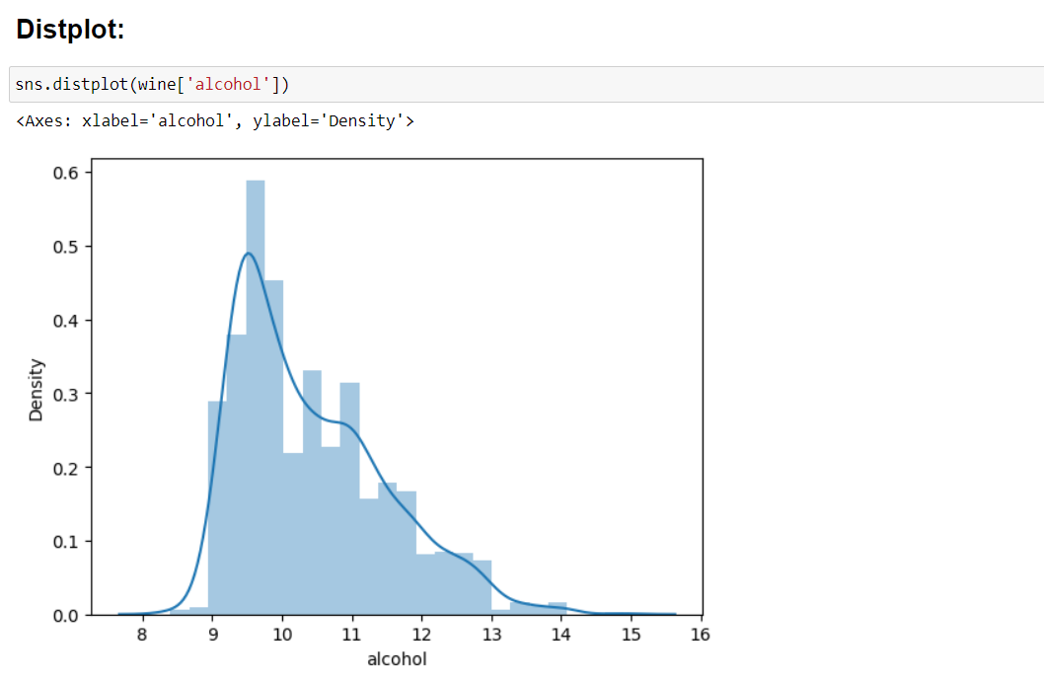
The code creates a distribution plot, which combines a histogram (to represent the distribution of the data) and a kernel density estimate (KDE) plot (to estimate the probability density function of the variable).
Overall, this line of code generates a visualization showing the distribution of alcohol percentages across the wines in the dataset.

Slide 14
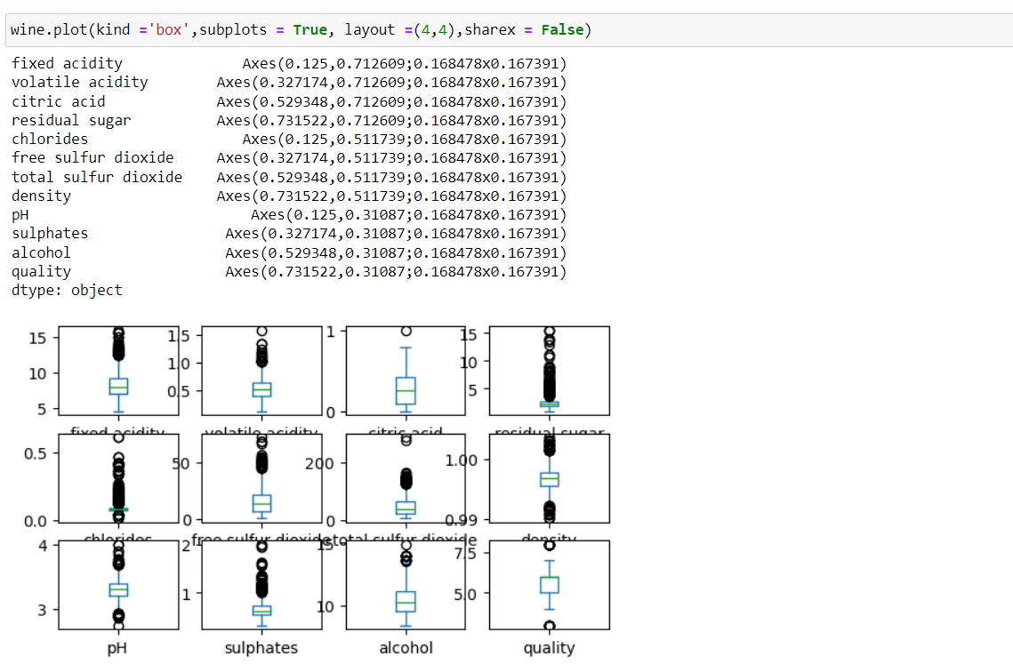
This line of code will produce a grid of 16 boxplots, each representing the distribution of a different variable in the wine dataset. The layout will be organized as a 4x4 grid. Each row of the grid will represent a different variable, and each column will represent a different quartile of that variable's distribution.

Slide 15
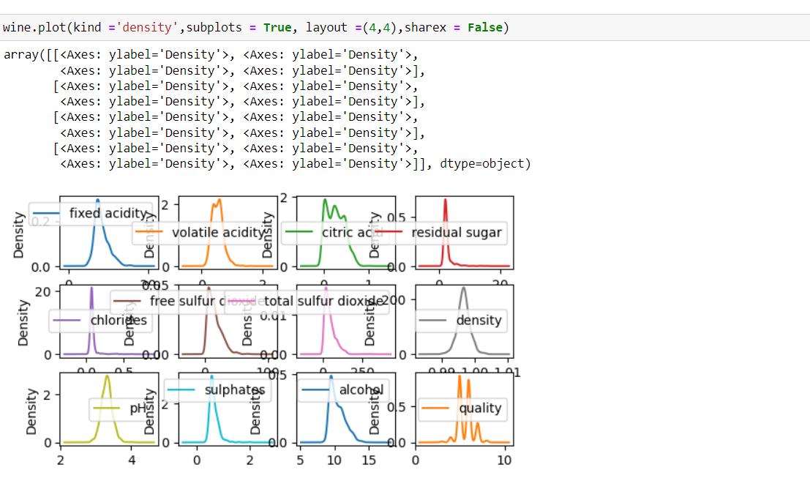
This line of code will produce a grid of 16 density plots, each representing the distribution of a different variable in the wine dataset. The layout will be organized as a 4x4 grid. Each row of the grid will represent a different variable, and each column will represent a different quartile of that variable's distribution.

Slide 16
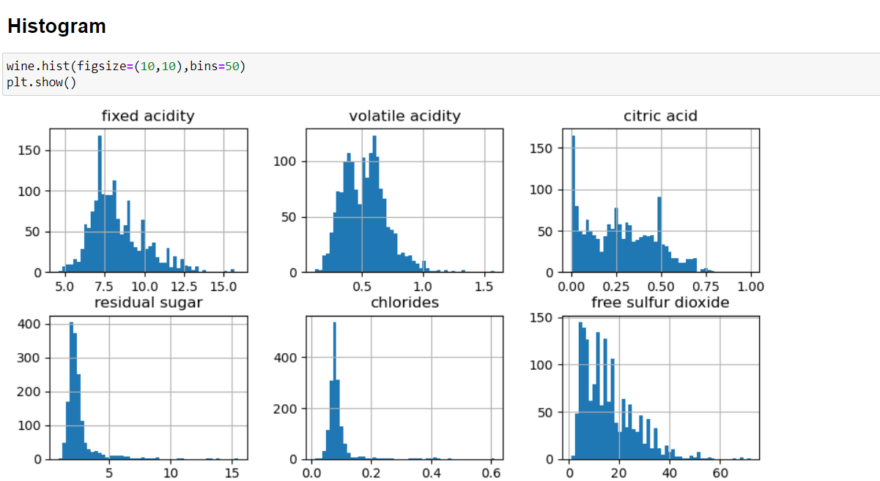
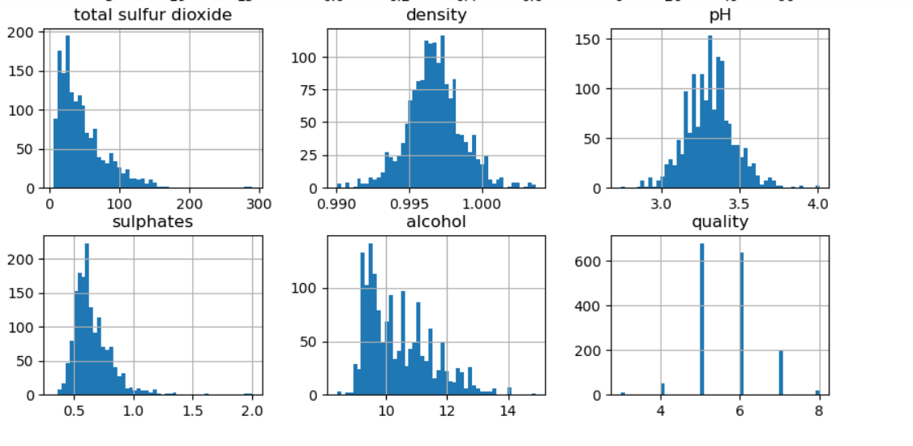
This line of code will generate a set of histograms for each variable in the wine dataset. The figsize parameter controls the size of the overall plot, and bins control the granularity of the histograms. Each histogram will represent the distribution of a different variable in the dataset.

Slide 17
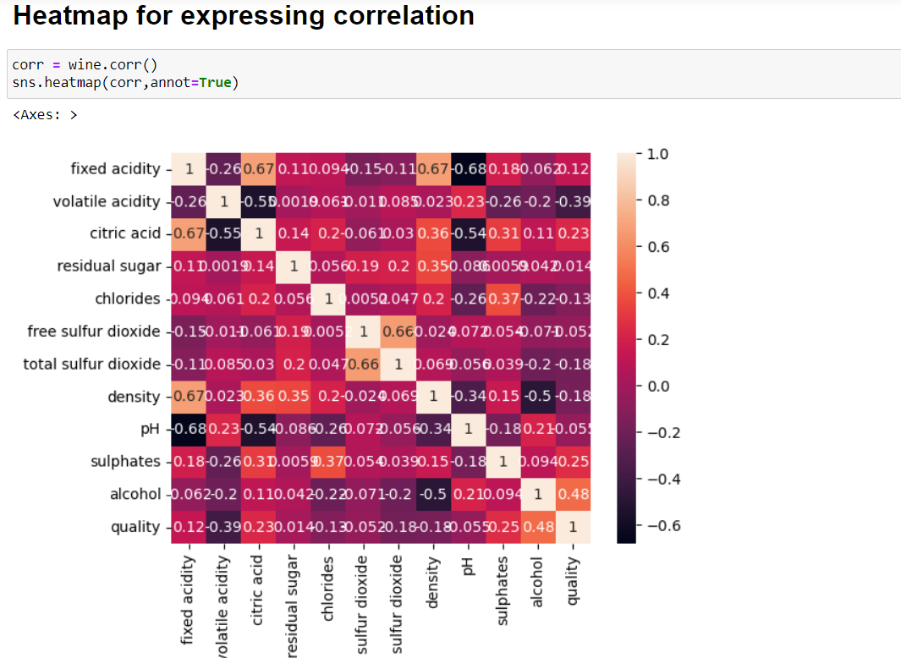
This line of code generates a heatmap that visualizes the correlations between different variables in the wine dataset. The color intensity represents the strength and direction of the correlation: positive correlations are shown in one color spectrum, negative correlations in another, and no correlation in a neutral color. The numerical annotations provide the exact correlation coefficient values.

Slide 18
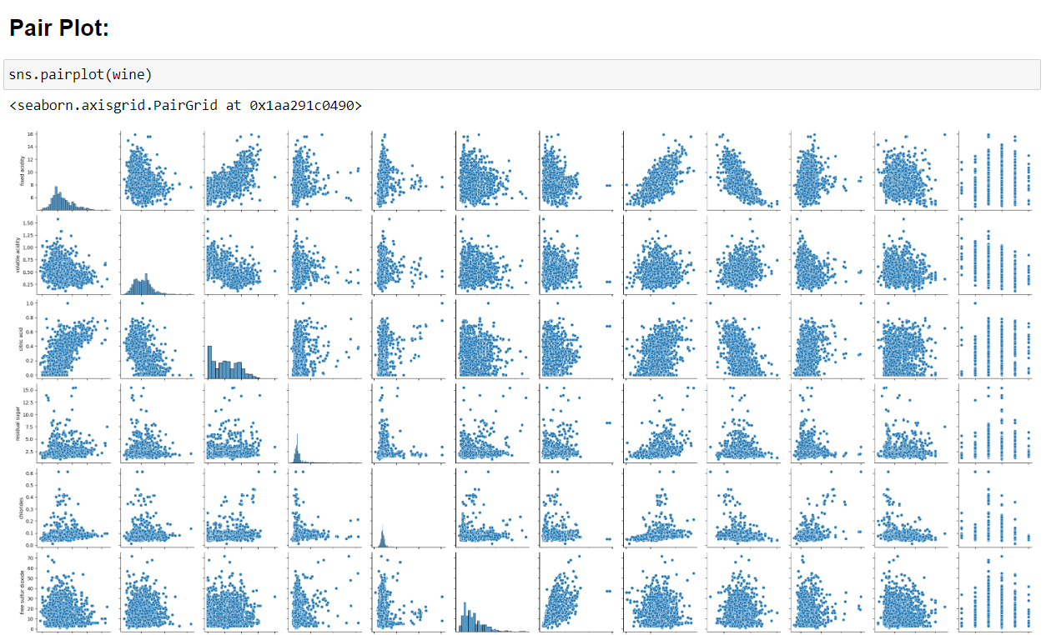
This line of code will produce a grid of scatterplots where each cell in the grid represents a pairwise comparison between two variables in the wine dataset. This visualization is useful for exploring relationships and distributions between variables in the dataset.

Slide 19
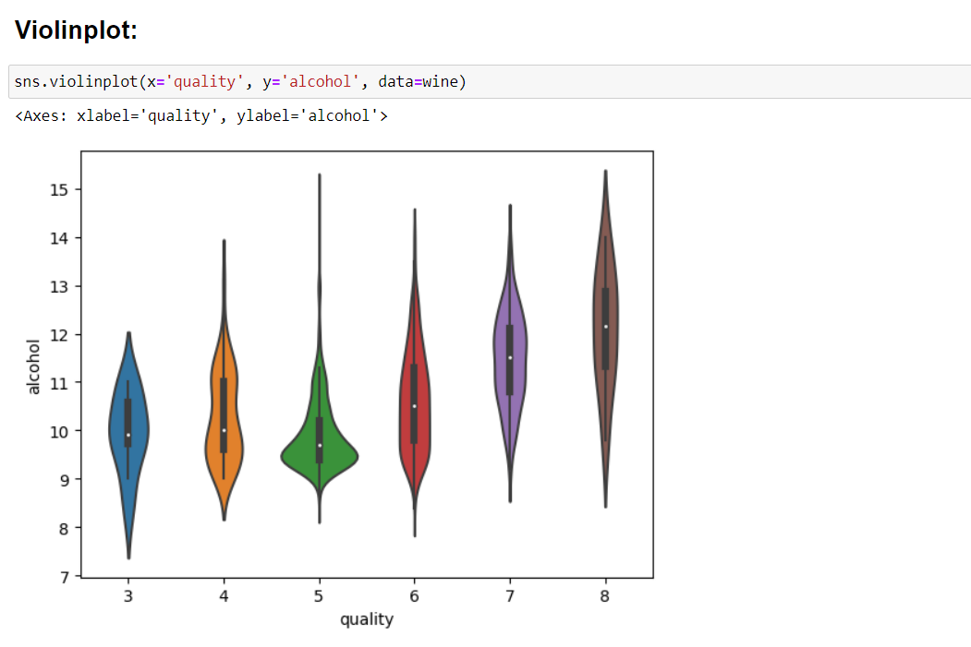
The violin plot is a combination of a box plot and a kernel density plot. It shows the distribution of the alcohol content across different quality levels of wine. Each "violin" represents a different quality level, and the width of the violin at any given point indicates the probability density of observing a certain value of alcohol content.

Slide 20
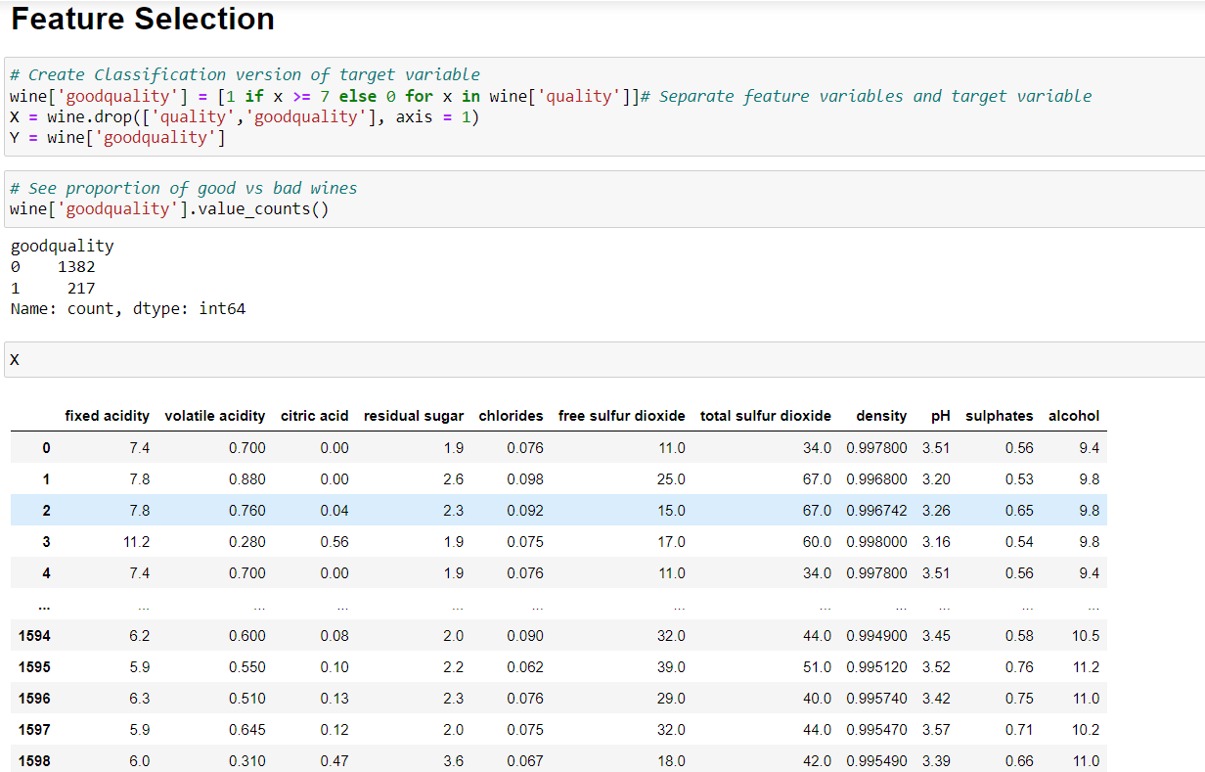
This block of code prepares the dataset for a classification task by creating a binary target variable indicating whether each wine is of good quality or not, and separating the features and target variable into X and Y, respectively, for model training.

Slide 21
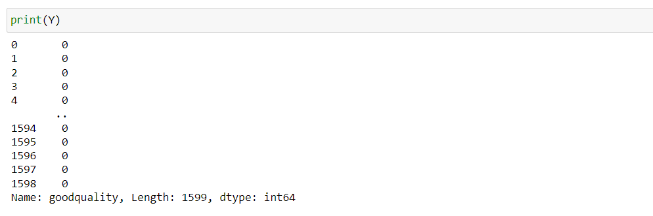
It will display the values stored in the variable Y, which will be a series of 0s and 1s corresponding to the classification of each wine in the dataset as either good quality or not.

Slide 22
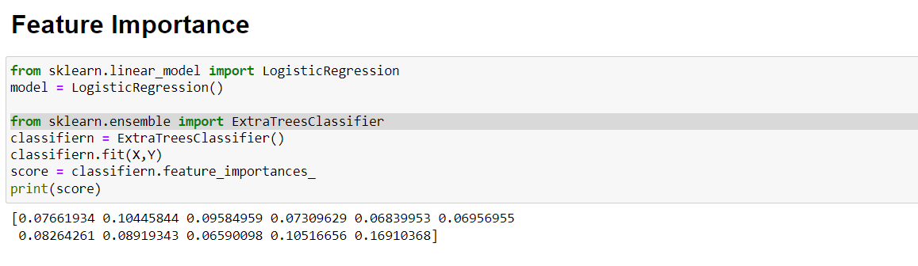
This block of code trains an Extra Trees Classifier model on the dataset (X and Y), calculates the feature importances, and then prints these importances to the console. The feature importances provide insights into which features (input variables) are most important for making predictions with the model.

Slide 23
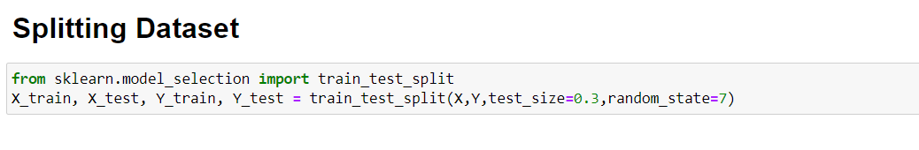
X_train: Features for the training set
X_test: Features for the testing set
Y_train: Target values for the training set
Y_test: Target values for the testing set
These sets are then typically used to train a machine learning model on the training data and evaluate its performance on the testing data.

Slide 24
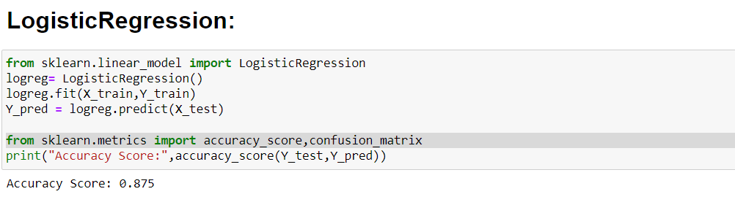
This block of code fits a Logistic Regression model to the training data, makes predictions on the test data, and then evaluates the accuracy of the model's predictions on the test set.

Slide 25
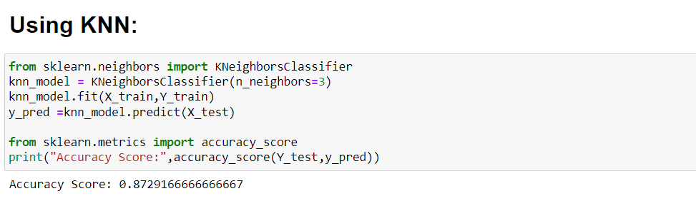
K-Nearest Neighbors (KNN) This block of code fits a KNN model to the training data, makes predictions on the test data, and then evaluates the accuracy of the model's predictions on the test set.

Slide 26
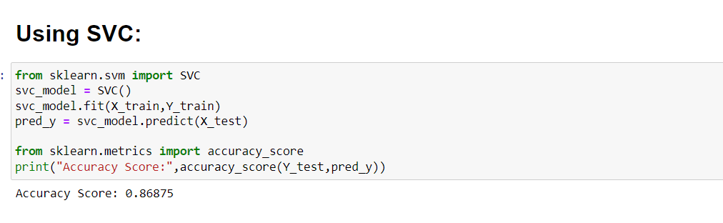
Support Vector Classifier (SVC) This block of code fits an SVC model to the training data, makes predictions on the test data, and then evaluates the accuracy of the model's predictions on the test set.

Slide 27
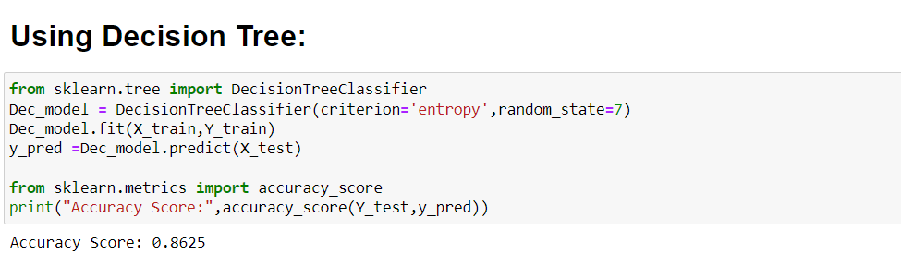
This block of code fits a Decision Tree model to the training data, makes predictions on the test data, and then evaluates the accuracy of the model's predictions on the test set.

Slide 28
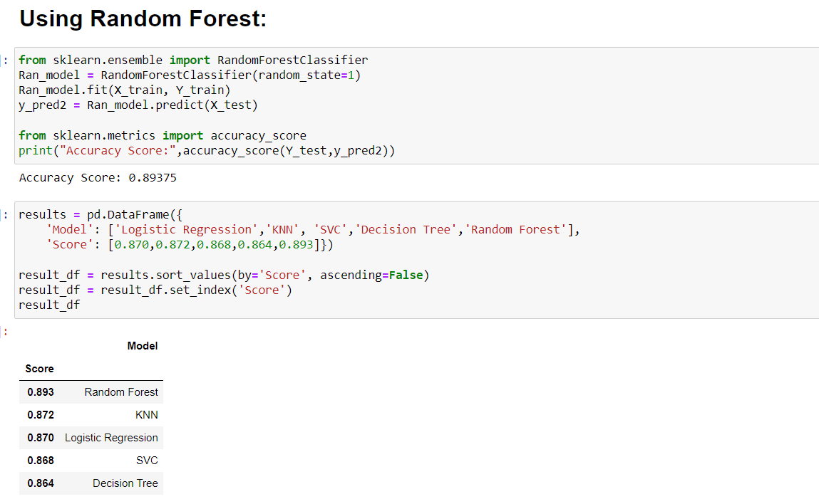
This block of code fits a Random Forest model to the training data, makes predictions on the test data, and then evaluates the accuracy of the model's predictions on the test set.

Slide 29
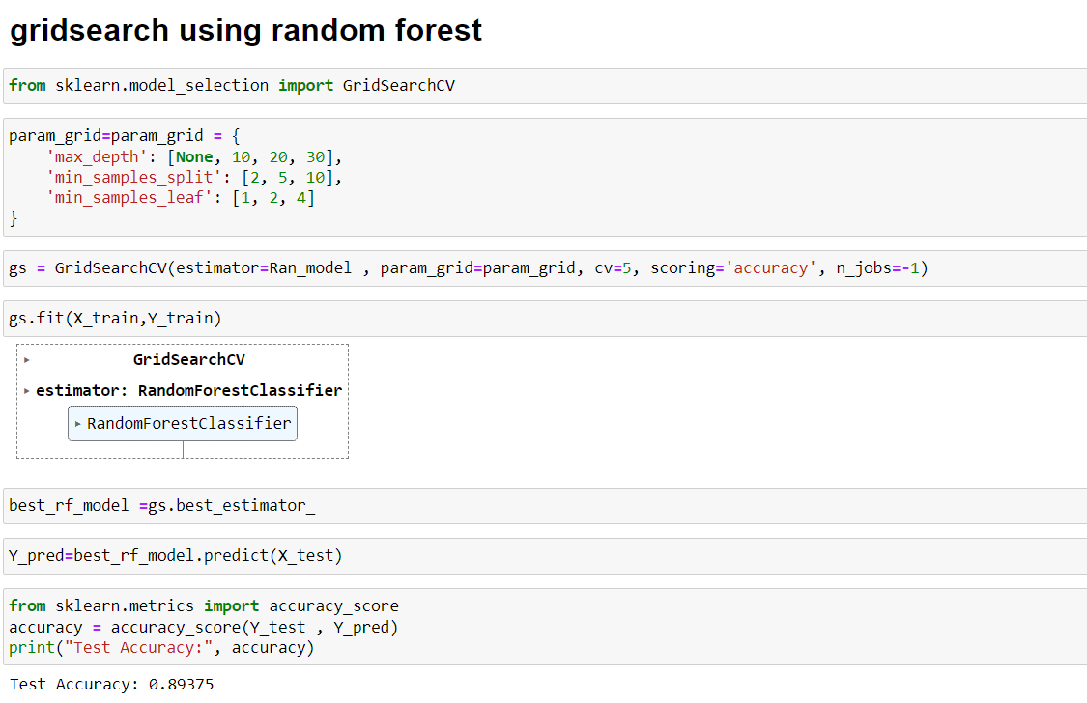
This block of code performs hyperparameter tuning for a Random Forest model using GridSearchCV, identifies the best model based on cross-validation, and then makes predictions on the test set using the best model. this block of code calculates and prints the accuracy of the model's predictions on the test set. It provides a measure of how well the model is performing in terms of correctly classifying instances.

Slide 30
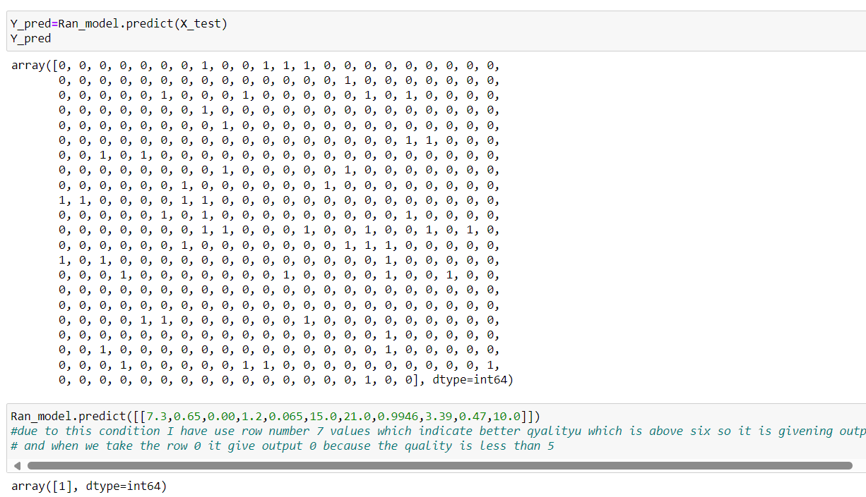
Y_pred will contain the predicted values of the target variable based on the test features using the trained Random Forest model. These predictions can be compared with the actual target values (Y_test) to evaluate the performance of the model.

Slide 31
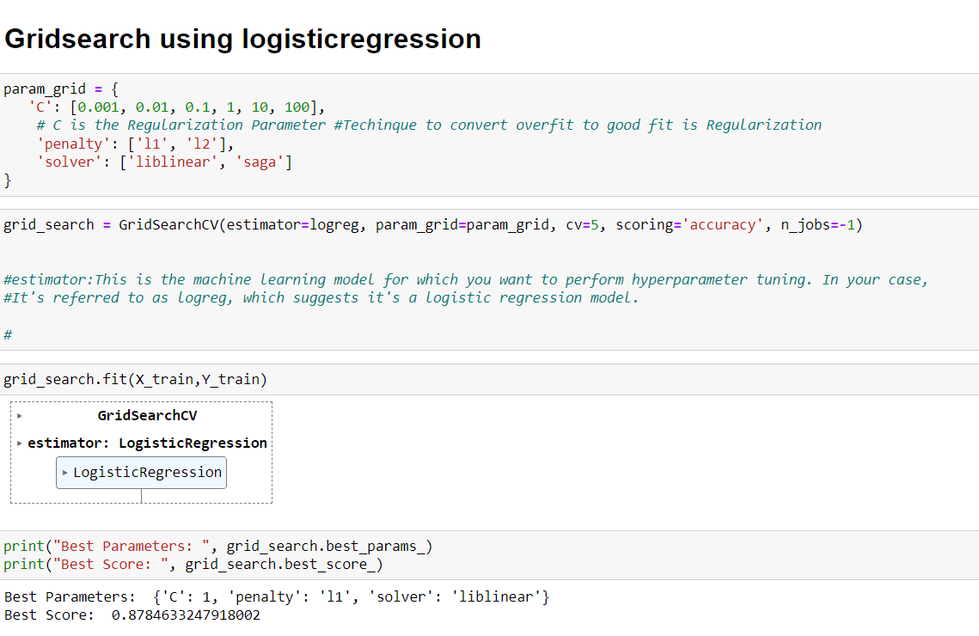
param_grid defines a grid of hyperparameters to be explored during hyperparameter tuning using GridSearchCV for a Logistic Regression model. this line of code initializes a GridSearchCV object for hyperparameter tuning of a logistic regression model, with specified parameters for the estimator, parameter grid, cross-validation, scoring metric, and parallelization.

Slide 32
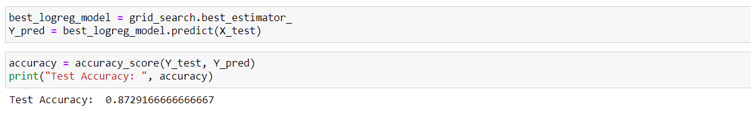
This line of code, the grid search process is completed, and the best hyperparameters are identified based on the performance on the training data. These best hyperparameters can then be accessed through the best_params_ attribute of the grid_search object.
This line give the information about the best hyperparameters and the corresponding performance of the model on the training data. This information helps in understanding which hyperparameters are most effective for the given dataset and problem.

Slide 33
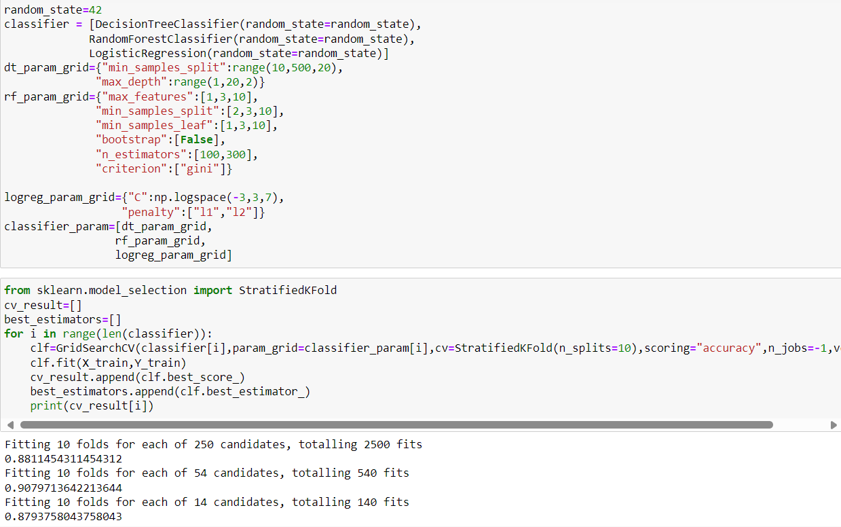
This block of code sets up a list of classifiers along with their respective hyperparameter grids, which will be used in a GridSearchCV for hyperparameter tuning. This setup allows for systematic exploration of hyperparameters for each classifier to find the optimal combination that maximizes model performance.

Slide 34
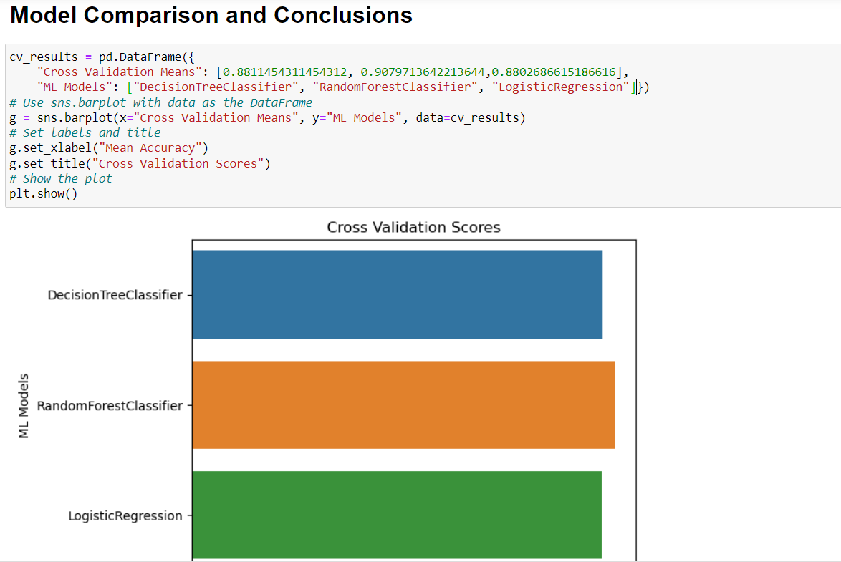
This line creates a bar plot using Seaborn's barplot function. The x-axis represents the mean accuracy scores (Cross Validation Means column in the DataFrame), and the y-axis represents the machine learning models (ML Models column in the DataFrame). Each bar represents the mean accuracy score for a specific machine learning model.

Slide 35
Conclusion:
In This Project, we build various models like logistic regression , knn classifier,decision tree classifier , random forest classifier and Hyper Tuning Parameter Using GridSearchCV for logistic regression & decision tree classifier.
A Random Forest Classifier gives the highest accuracy scores of 89.00 percent among all ML Models.
Thus, for the Wine Quality Prediction Dataset, the best accuracy can be achieved using Random Forest Model.

Slide 36
THANK YOU!

