Slide 1
Project Name: BeckonUs
Group Members: Dineile Guevara Vishal Ramkissoon Christine Russell

Slide 2
Problem & Solution
Problem
Stores are having problems generating sales.
Customers in a shopping mall don’t have a simple way to receive information about ongoing promotions in stores.
Solution
Beacons present an excellent opportunity to connect and engage with smartphone users whenever they're within range.
The BeckonUs Android application is an easy-to-use platform for users to receive information on stores.

Slide 3
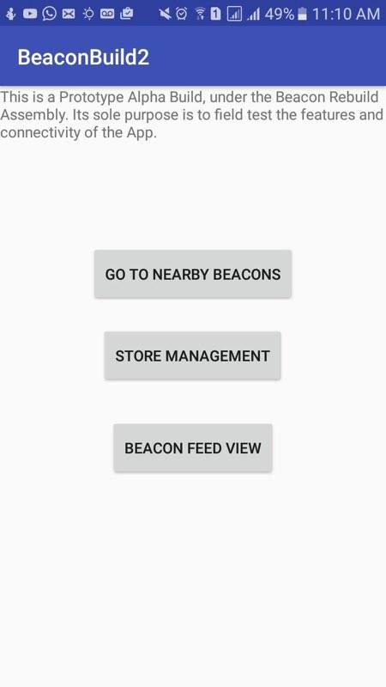
Implementation of Solution
An Android Application (BeckonUs) is used. This utilizes Bluetooth and Wifi to communicate between the users’ smartphones, the server and the beacons available at each store.
The server is built on the very efficient NoSQL database, RethinkDB.
Python is used to create an interface between client and database.

