Slide 1
Airline Booking System GROUP-G3
Submitted To:
Margret Anouncia S
Jayalakshmi
Submitted By:
Vishal Salvankar(16BCE0723) Vansh Agarwal(16BCE0839) Stuti Agarwal(16BCE0963)

Slide 2
INTRODUCTION
Airline reservation systems were first introduced as simple standalone systems to control flight inventory, maintain flight schedules, seat assignments . The modern day airline reservation system is comprehensive suite of products to provide a system that assists with a variety of airline management tasks and service customer needs from the time of initial reservation through completion of the flight. Customers now have a variety of airlines and a range of timings to choose from.The World Wide Web has become tremendously popular over the last four years, and currently most of the airlines have made provision for online reservation of their flights.

Slide 3
The Internet has become a major resource for people looking for making reservations online without the hassle of meeting travel agents. Our project intends to solve these purposes. It intends to check the available airline database and return a string of results, which can help them in their travel plans.

Slide 4
SCOPE STATEMENT
AIM: To develop a computerized reservation system meeting the rising customer interest in booking online air travel reservations The system should allow the user to view entire flight information of the airline, book tickets, view or, if required, cancel current reservations, and create member login for standalone users as well as agents
OBJECTIVE: To design a maintainable, reliable, secure, flexible,user friendly system which is 24x7 available.
APPLICABILITY: Passengers can book the flights online while sitting at their home.

Slide 5
PROCESS MODEL
Suitable Process model : Waterfall Model
We have used Waterfall Model for our system , in which development is seen as flowing steadily downwards(like a waterfall) through the test phases of requirements analysis , design ,implememtation , testing.
Justification:
Requirements are very well clear and fixed.
Product definition is stable.
Technology is understood and is not dynamic.
There are no ambiguous requirements.
The project is short.

Slide 6
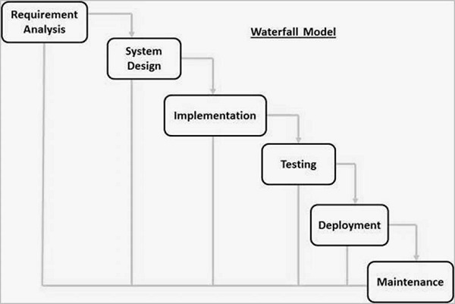

Slide 7
STAKE HOLDERS
Airline Company - The company will use this software to keep track of their flights and passengers
Software User – The airline passengers must be able to search and book flights
Software Engineering Team

Slide 8
Requirement W.R.T Stake Holders
1.Software user
System shall have provision to:
To view different airlines
To view flights and its timings
To select journey date
To provide login name
To provide password
To pay online for flights
To generate e-ticket
2.Airline Comapany
System shall have provision to:
To provide login name
To provide Password
To update Flight Timings
To update Flight Status
To provide Flight prices

Slide 9
Viewpoint
Viewpoints can be used as a way of classifying stakeholders and other sources of requirements. There are 3 generic types of viewpoint:
Interactor Viewpoints: represent people or other systems that interact directly with the system. Here, e.g. the passengers and their database of booked flights.
Indirect viewpoints: that represent stakeholders who do not use the system themselves but who influence the requirements in some way. Here e.g. The maintenance persons, airline company staff
Domain viewpoints: that represent domain characteristics and constraints that influence the system requirements. e.g the Pricing Policy set up by different airline companies

Slide 10
Viewpoint Hierarchy of the Project
All Viewpoints
Indirect
Interactor
Domain
Maintenance Personal
Pricing Policy
Airline Company Staff
Admin
Passenger
Flight Database

Slide 11
SYSTEM MODEL
Suitable System Model :
Object Oriented Design (OOD)

Slide 12
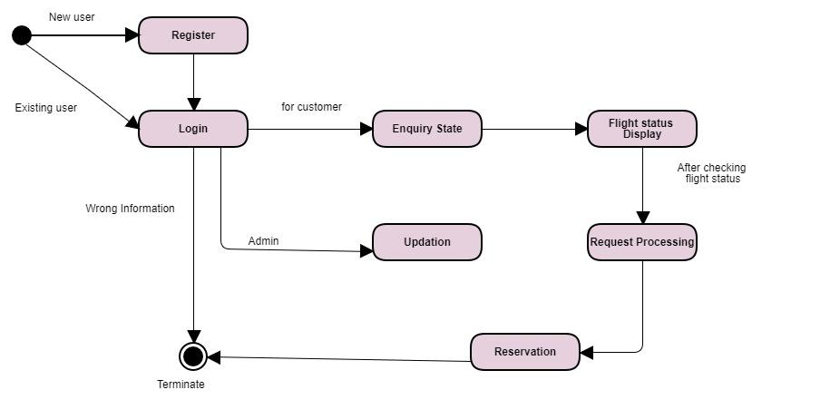
STATE TRANSITION DIAGRAM

Slide 13
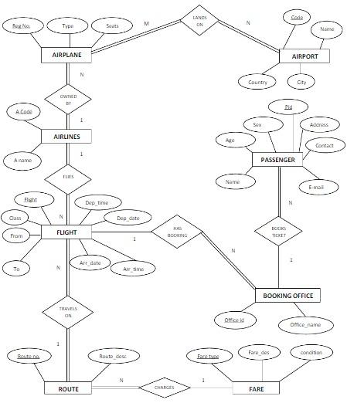
DATA MODEL ER DIAGRAM

Slide 14
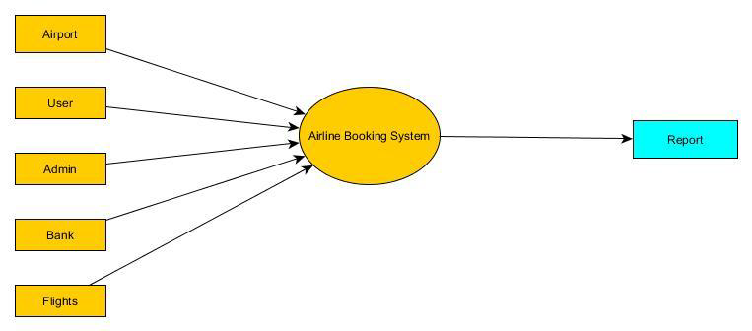
DATA PROCESSING MODEL
Data Flow Diagram
Level 0:

Slide 15
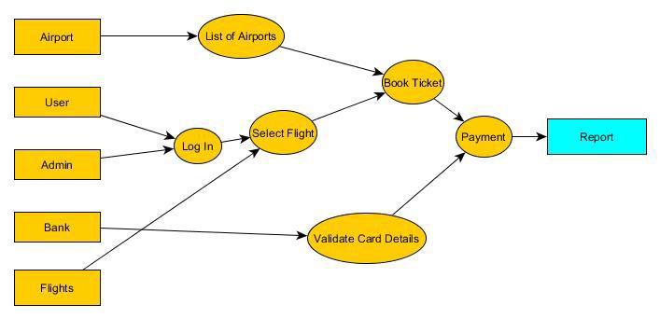
Level 1:

Slide 16
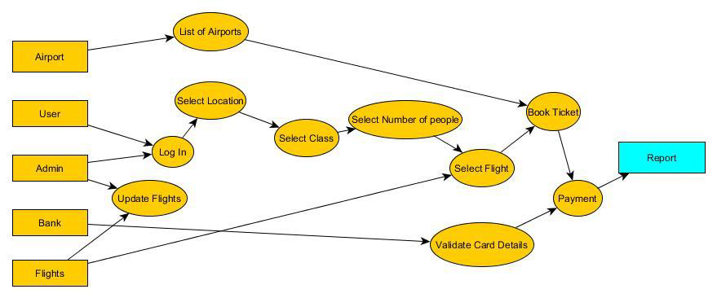
Level 2:

Slide 17
Architecture
SUITABLE ARCHITECTURAL PATTERN : CLIENT/SERVER MODEL
JUSTIFICATION:
The web-based ticket system uses client/server architecture. In client/server computing model, a server hosts, provides and manages the resources and services made for the client. This kind of model usually has more than one client computers connected to central server over internet connection. All requests and services are delivered over the network in this model and the system shares resources. In online ticket booking model, a client can use a web browser to access the website and book online tickets. It is very easy to make the booking as the system is user-friendly. The user does not have to worry about the operating system either as the web page is supported in all popular browsers on all platforms. At the flight search query, when the user searches preferred choices, the web server searches the database for similarities and returns the result in user-readable form. After the customer books the selection and the payment is verified, the data of client is saved to the company's database.

Slide 18
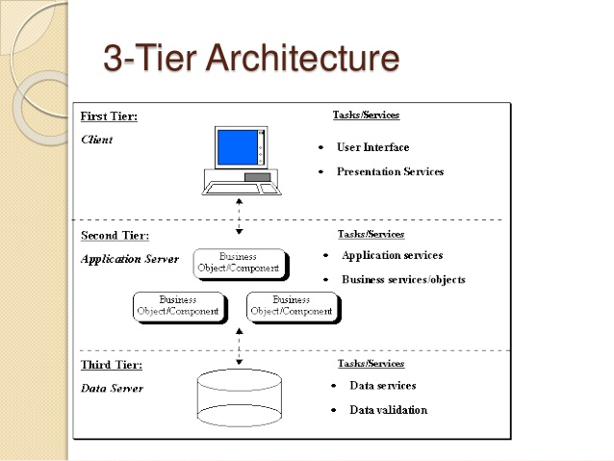

Slide 19
Deployment diagram for Airlines Reservation System.
The Airlines reservation system will be deployed in the web server.
The client computer will access the software deployed at the server using web browser.
The data will be accessed through the database server

Slide 20
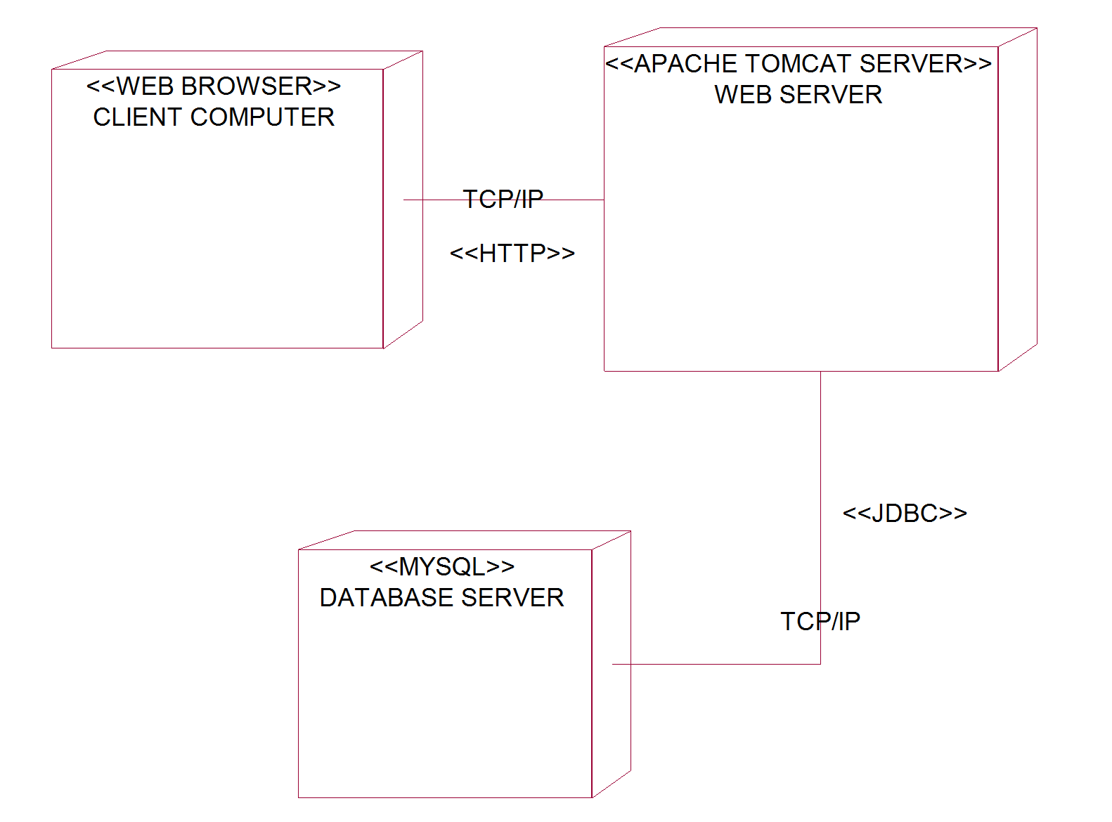
Deployment Diagram
Printer
Traveller No.1
Traveller No.2
Traveller No.3

Slide 21
Test Cases
Unit Test Cases for
User Login/Signup Page

Slide 22
Test Case Id | Input Value | Actual Output | Expected Output
1. | For User Username U Password xxxxxxxxx (Valid Input) | To be observerd after execution | Proceed to online reservation or flight status
2. | For User Username U Password xxxxxxxxx (Invalid Input) | To be observerd after execution | Display Error message or login again
3. | For New User Enter Registration Details (Valid Input) | To be observerd after execution | Account created and proceed to login
4. | For New User Enter Registration Details (Invalid Input) | To be observerd after execution | Display Error Message

Slide 23
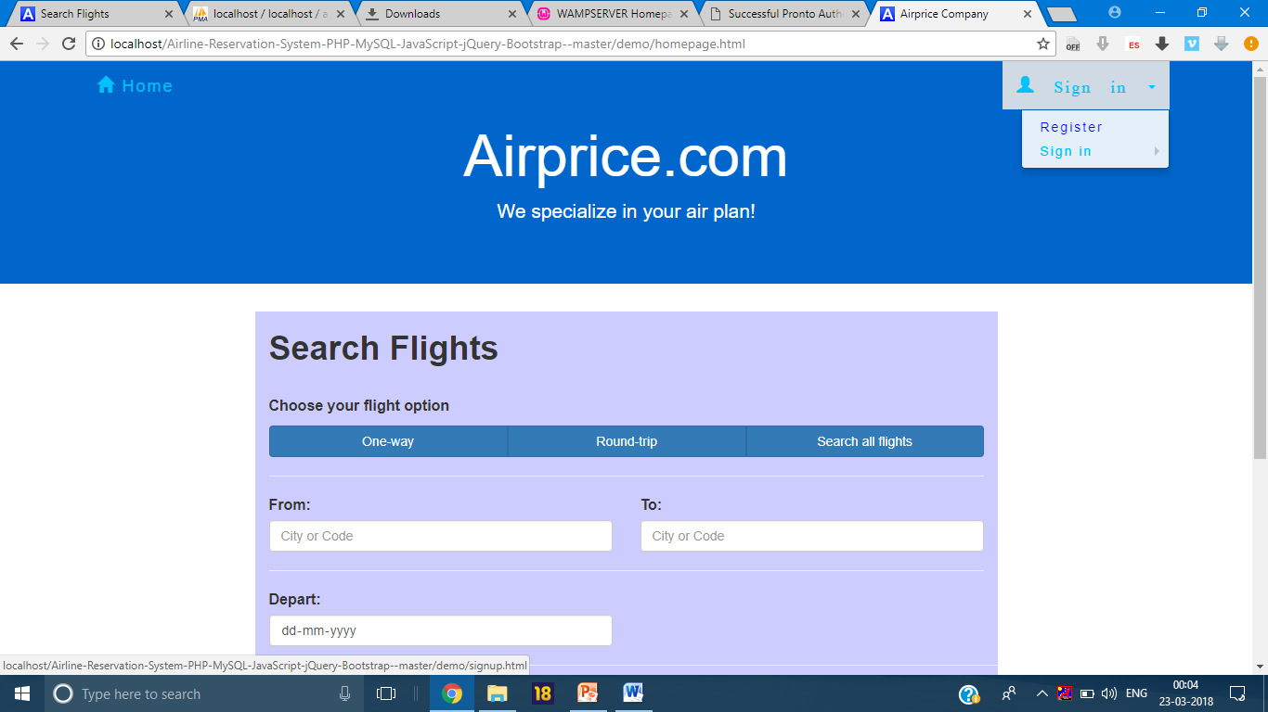
Screenshots: Home Page

Slide 24
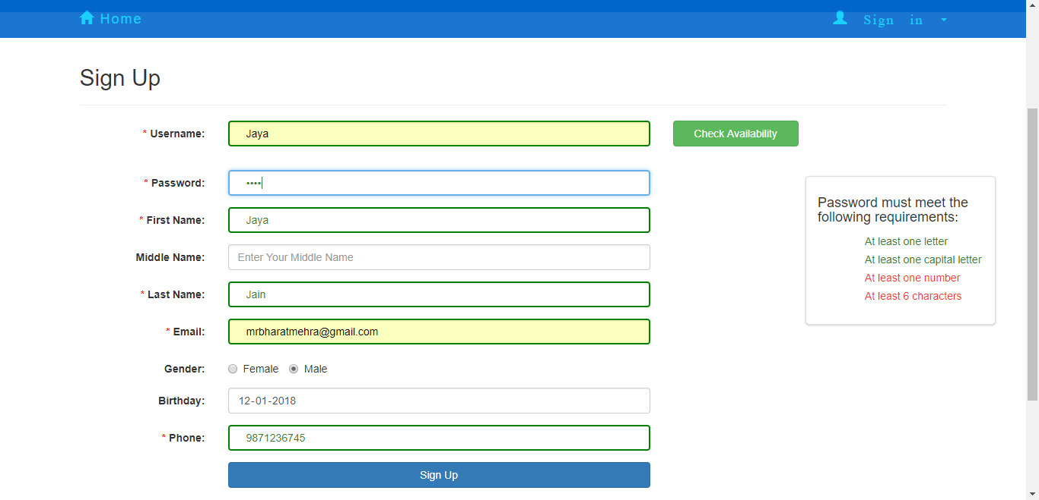
Sign Up

Slide 25
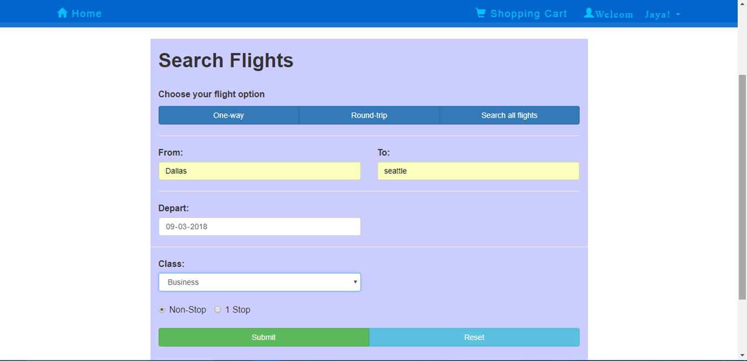
Registered User Searching

Slide 26
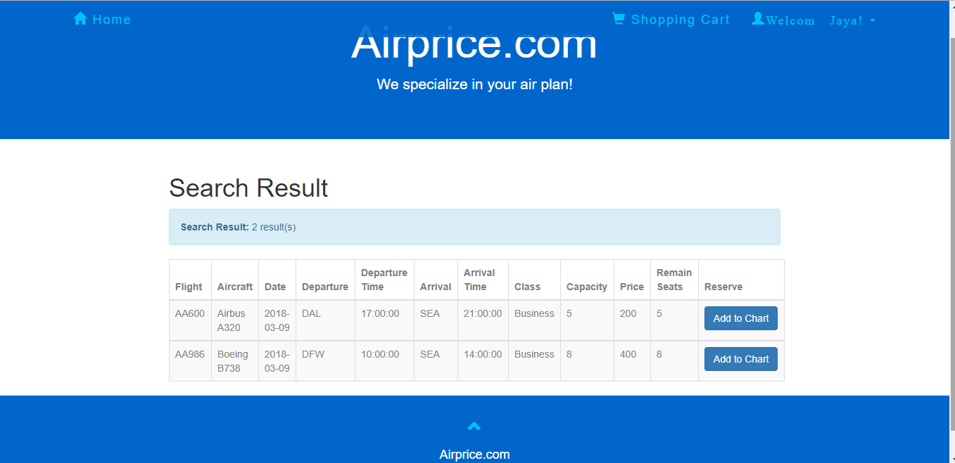
Search Results

Slide 27
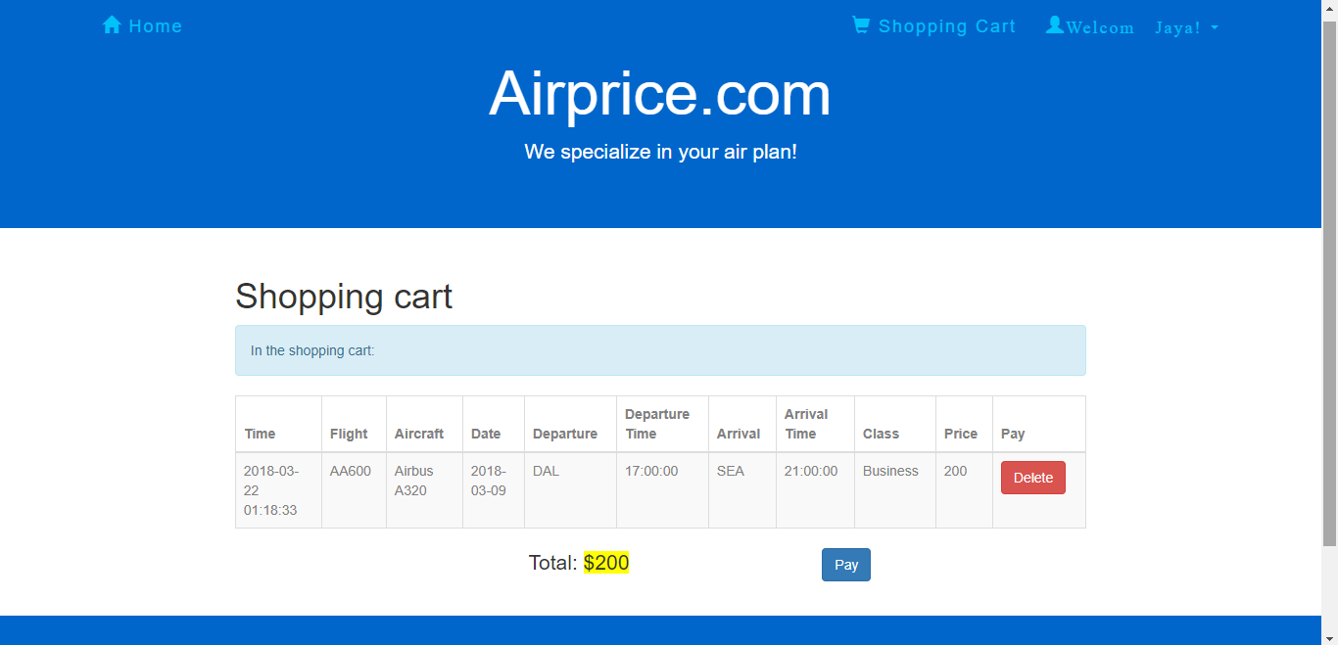
Booking A Flight

Slide 28
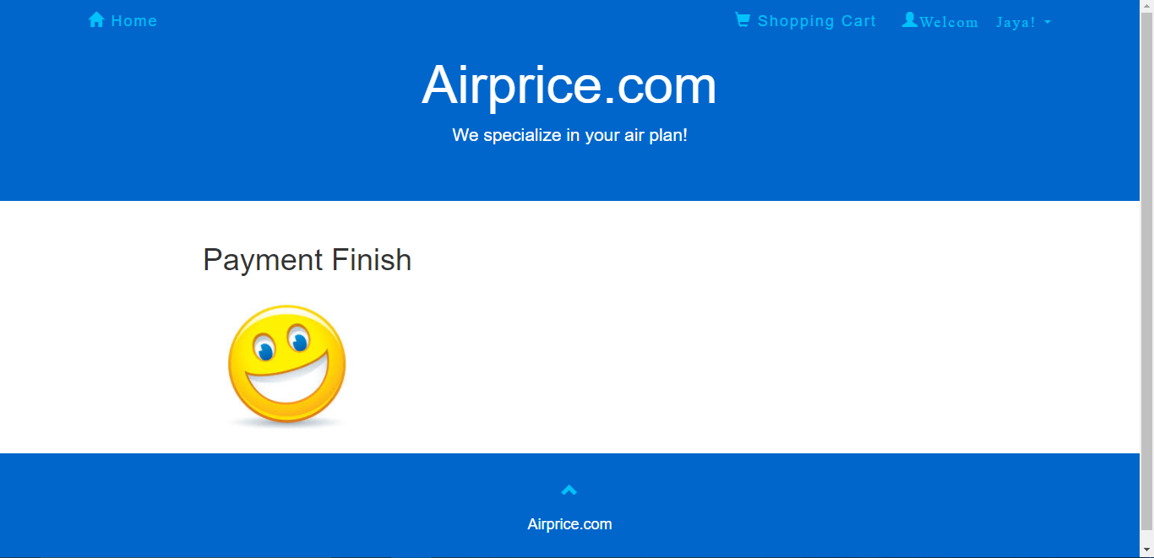
Payment

Slide 29
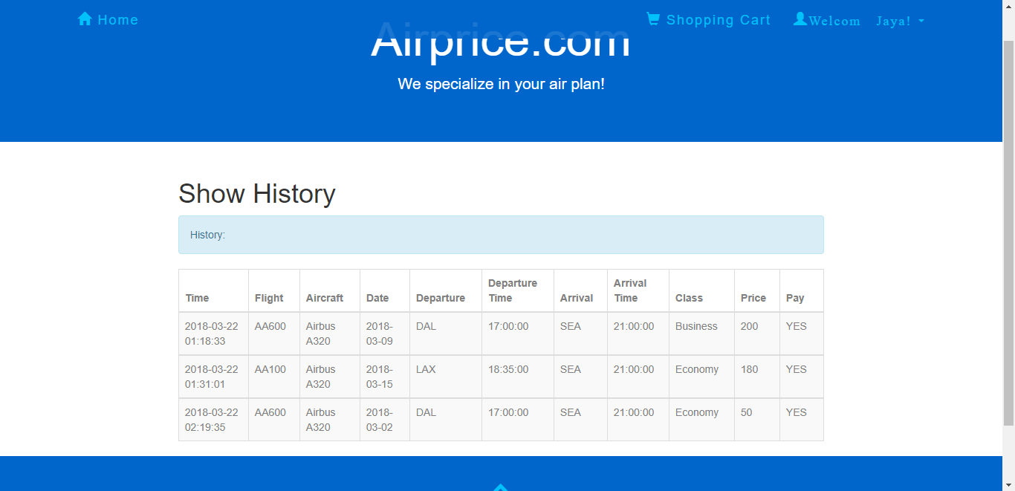
History

