Slide 1
DATA ANALYTICS PROJECT
Customer Shopping
Behavior Analysis
Turning 3,900 retail transactions into segmentation, pricing, and retention insights
using Python, PostgreSQL, and Power BI.
Python · SQL (PostgreSQL) · Power BI
vishal Sang

Slide 2
PROJECT OVERVIEW
From raw checkout data to strategic insight
The dataset captures 3,900 individual retail purchases spanning apparel, footwear, accessories, and outerwear. The goal was to move beyond raw transactions and uncover patterns in spending, loyalty, and channel behavior that a retail team could act on — who buys, what drives discount reliance, and which segments deserve investment.
3,900
18
Transactions analyzed
Data fields per record
37
10
Missing ratings imputed
SQL business questions answered
SCOPE
Demographics Age, gender, location, subscription status
Purchase details Item, category, amount, season, size, color
Shopping behavior Discounts, promo codes, frequency, ratings, shipping
2

Slide 3






METHODOLOGY — PYTHON
Preparing the data before analysis
Data loading
Missing-data handling
Column standardization
Imported the raw dataset with pandas; profiled structure with df.info() and .describe().
Imputed 37 missing Review Rating values using each product category's median rating.
Renamed all fields to snake_case for consistent, query-ready documentation.
Feature engineering
Consistency checks
Database integration
Built age_group bins and a purchase_frequency_days field from raw purchase data.
Tested discount_applied against promo_code_used; dropped the redundant column.
Loaded the cleaned DataFrame into PostgreSQL to power the SQL analysis stage.
3

Slide 4
SQL ANALYSIS — POSTGRESQL
Revenue splits by gender and subscription
Revenue by Gender
Subscribers vs. Non-Subscribers
Subscribed
Not subscribed
Customers
1,053
2,847
Avg. spend
$59.49
$59.87
Total revenue
$62,645
$170,436
Male shoppers generate over 2× the revenue of female shoppers in this dataset — a strong signal for gender-targeted merchandising.
Insight: subscribers spend almost the same per order as non-subscribers — the subscription program is driving loyalty, not yet driving basket size. Non-subscribers still account for the majority of revenue simply on volume.
4

Slide 5
SQL ANALYSIS — POSTGRESQL
Customer segments and repeat-buying behavior
Customer Segmentation
Classified by purchase history
Repeat Buyers by Subscription Status
Customers with more than 5 purchases
80% of customers already qualify as “Loyal,” leaving a small but valuable Returning segment (701) as the clearest target for conversion campaigns.
Insight: as a share of each group, subscribers repeat-purchase at a slightly higher rate (91%) than non-subscribers (88%) — loyalty programs correlate with repeat behavior, even without a big spend lift.
5

Slide 6
SQL ANALYSIS — POSTGRESQL
What sells well — and what needs a discount to move
Top-Rated Products
Most Discount-Dependent Products
By average review rating (out of 5)
Share of purchases made on discount
1
Gloves
3.86
2
Sandals
3.84
3
Boots
3.82
4
Hat
3.80
5
Skirt
3.78
Note: Hat appears on both lists — well reviewed, but almost half its sales rely on a discount, a useful pricing test candidate.
6

Slide 7
SQL ANALYSIS — POSTGRESQL
Shipping preference and revenue by age group
Avg. Purchase by Shipping Type
Total Revenue by Age Group
Express-shipping customers spend slightly more per order — a small but consistent premium worth testing with faster delivery upsells.
7

Slide 8
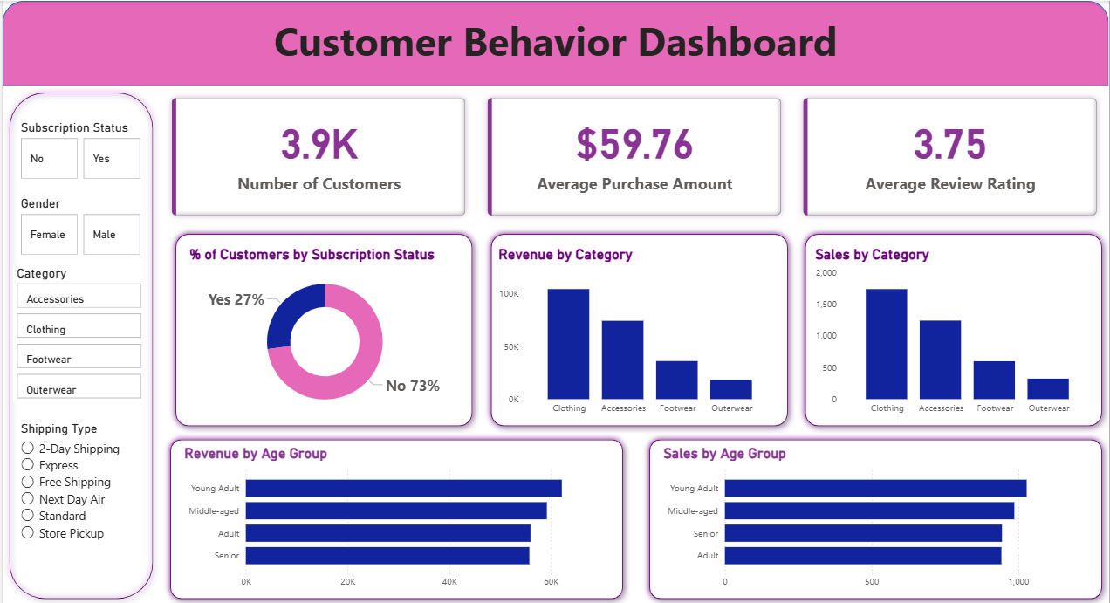
VISUALIZATION
An interactive Power BI dashboard
Filterable by subscription status, gender, category, and shipping type — built for a business stakeholder to self-serve the same insights shown in this deck.
8

Slide 9




FROM INSIGHT TO ACTION
Business recommendations
Boost subscriptions
Promote exclusive subscriber benefits — spend per order is already at parity, so growth here is pure incremental volume.
Build loyalty programs
Create structured incentives to convert the 701 “Returning” customers into the “Loyal” segment.
Review discount policy
Re-price high discount-dependency items like Hat, Sneakers, and Coat to protect margin.
Sharpen product positioning
Feature top-rated items — Gloves, Sandals, Boots — in campaigns and homepage placements.
Target high-value segments
Prioritize marketing spend on male shoppers, Young Adults, and Express-shipping customers.
9

Slide 10


TOOLS & TECHNIQUES
Built with
Python
PostgreSQL
Power BI
pandas · data cleaning · feature engineering
SQL joins, aggregation, and segmentation queries
interactive, filterable executive dashboard
Thank you
Full write-up, SQL queries, and the Power BI file are available on request.
10

