Slide 1
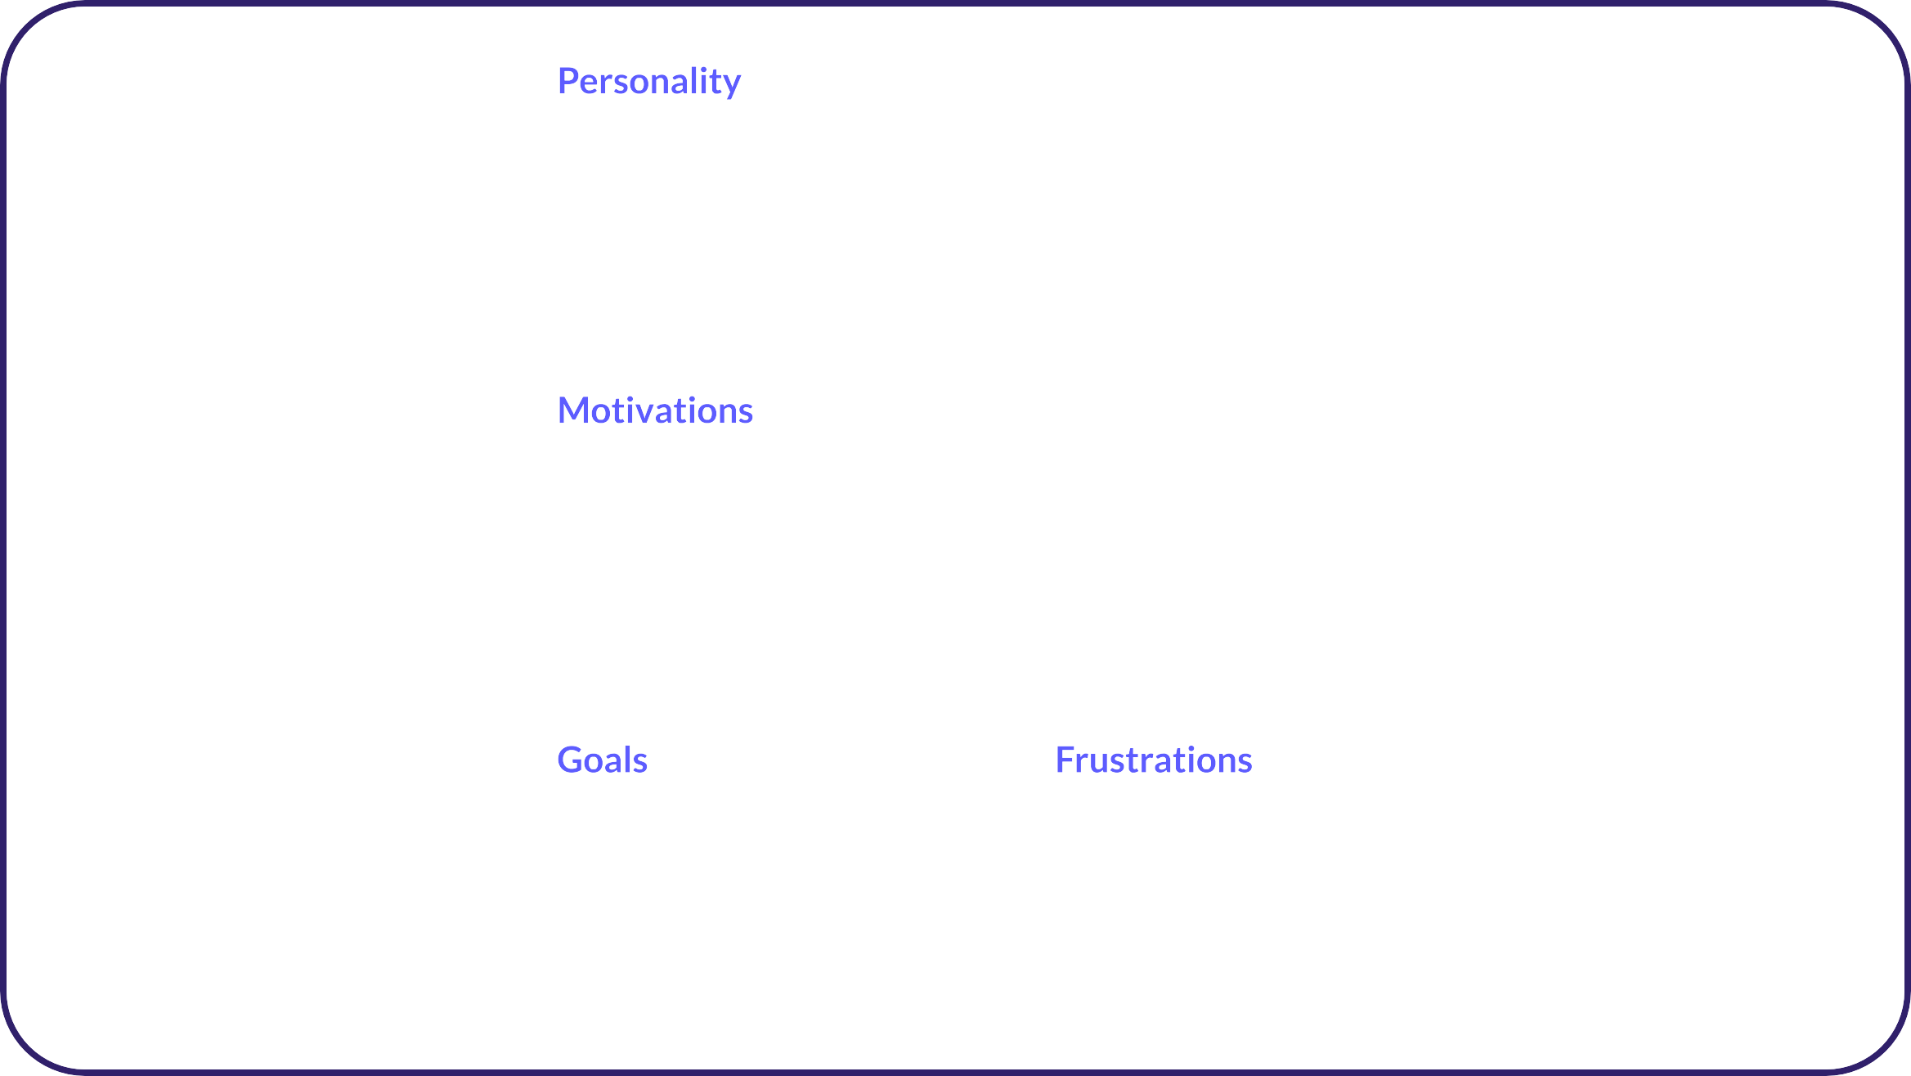





Candidate Persona Proﬁle
Name: Occupation:

Slide 2
Candidate Persona Proﬁle: An Example
Conﬁdent, outgoing, energetic Analytical and methodical approach to tasks | A dynamic marketing professional with passion for understanding consumer behavior and trends. With a bachelor's degree in Marketing, Jordan brings a unique perspective & data-driven decision to the role.
Desire to create impactful marketing campaigns that drive brand growth Working with high level professionals Aspiration to be recognized in the industry as a thought leader
Become a senior marketing manager or head of marketing within 5 years | The challenge of working with limited budgets while expectations remain high Find a balance between data-driven decisions & intuitive marketing strategies
Marketing is not just about selling products, it's about telling stories that resonate.
s
Actively looking for
a new role in marketing
Name: Jordan
Occupation:
Marketing Manager
Family and partner

Slide 3







AIHR | Academy to Innovate HR
At the Academy to Innovate HR (AIHR), it is our mission
to make HR future-proof by offering world-class, online education programs available anywhere, anytime.
⬣ 100% Online & Self-Paced Learning
⬣ Personal Career Coach
⬣ Resource and Template Library
⬣ HRCI, SHRM & HRDA Credits
Learn More
COPYRIGHT © 2024 AIHR. All rights reserved.

