Slide 1
CSL7110 · Machine Learning with Big Data
Real-Time Traffic Prediction
using Big Data Analytics
Ashwini Gerigenti
M L Lakshmi Narayana
M25DE1052
M24DE1054
Bharat Vishal Sharma
M25DE1045
IIT Jodhpur · April 2026

Slide 2
Problem Statement
Urban traffic congestion affects millions of daily commuters and is a classic big-data problem.
10+ GB
3 M+
Millions
of NYC taxi data generated per year
trip records in a single month alone
of daily commuters affected by delays
Goal: Build a distributed ML pipeline that predicts NYC taxi trip duration using Apache Spark and Scikit-learn — trained and evaluated on 2.96 million real trip records.
Real-Time Traffic Prediction · CSL7110
2 / 10

Slide 3
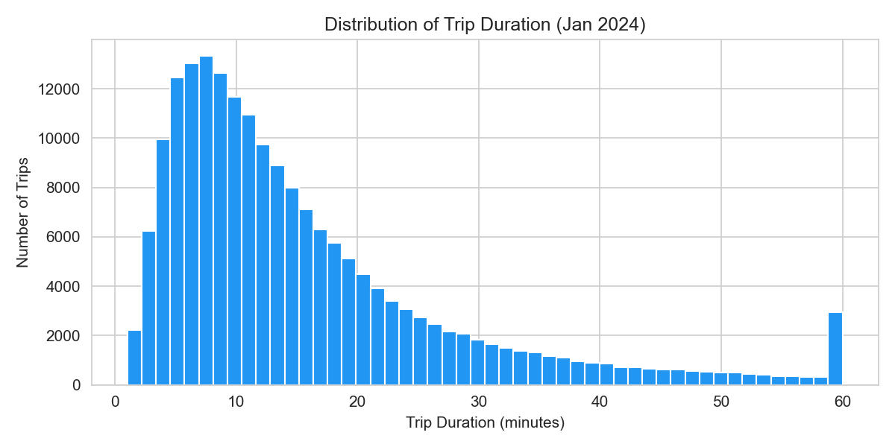
Dataset — NYC Yellow Taxi, Jan 2024
Source:
NYC Taxi & Limousine Commission (TLC)
Format:
Parquet · downloaded via official TLC endpoint
Period:
January 2024
Size:
2,964,624 rows · 19 columns
Retained:
190,941 rows after cleaning (95.5%)
Dropped:
nulls, speed > 80 mph, fare ≤ 0, duration < 1 min
Key columns used:
Most trips last 5–20 minutes. The right-skewed distribution is expected — we clipped outliers beyond 180 min before training.
tpep_pickup_datetime / tpep_dropoff_datetime · trip_distance · PULocationID / DOLocationID · passenger_count · fare_amount · payment_type
Real-Time Traffic Prediction · CSL7110
3 / 10

Slide 4
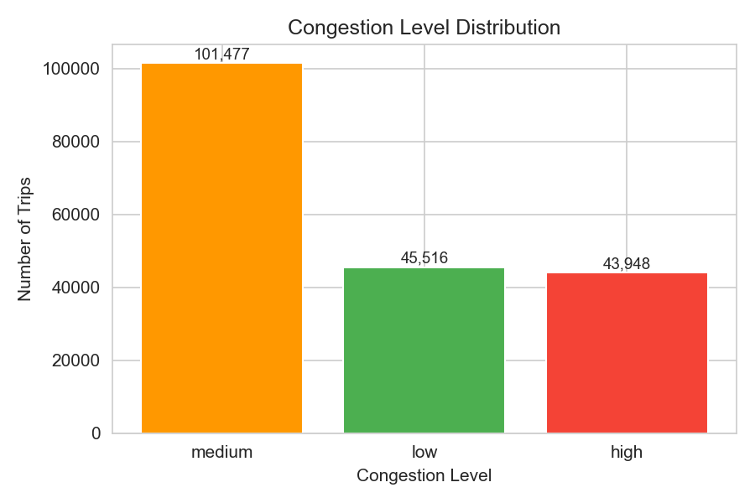
Feature Engineering
8 features derived from raw trip records · target variable: trip_duration_minutes
Temporal
Boolean Flags
Speed-based
pickup_hour (0–23) pickup_weekday (0–6) pickup_month
is_weekend Saturday / Sunday → 1 is_rush_hour 07–09 h and 16–19 h → 1
trip_speed_mph = distance ÷ duration Used to label congestion
Spatial
Congestion Labels
PULocationID DOLocationID (NYC taxi zones 1–265)
High: speed < 8 mph (23%) Medium: 8–16 mph (53%) Low: > 16 mph (24%)
Real-Time Traffic Prediction · CSL7110
4 / 10

Slide 5
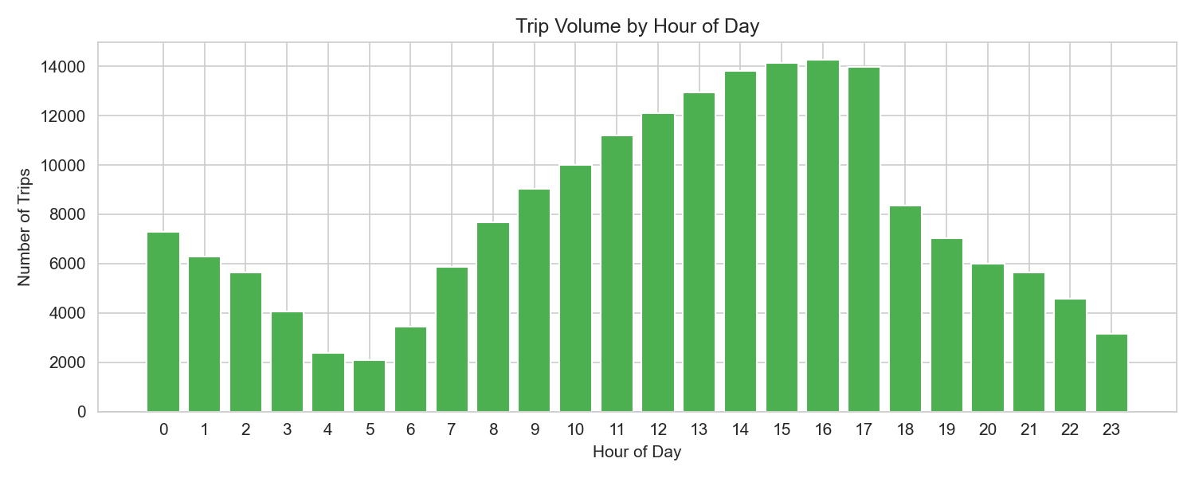
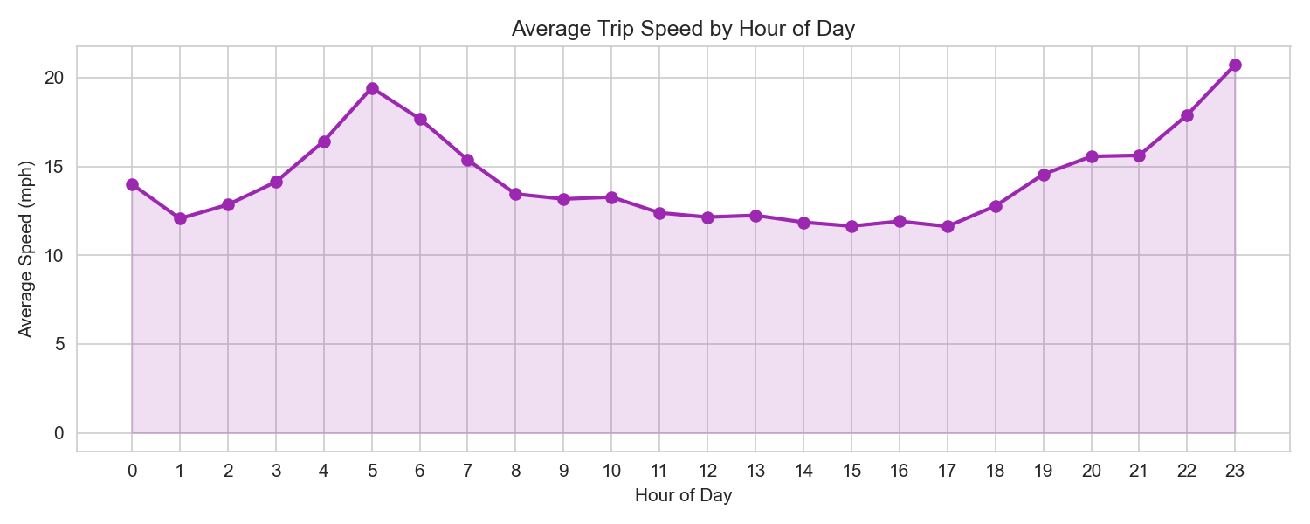
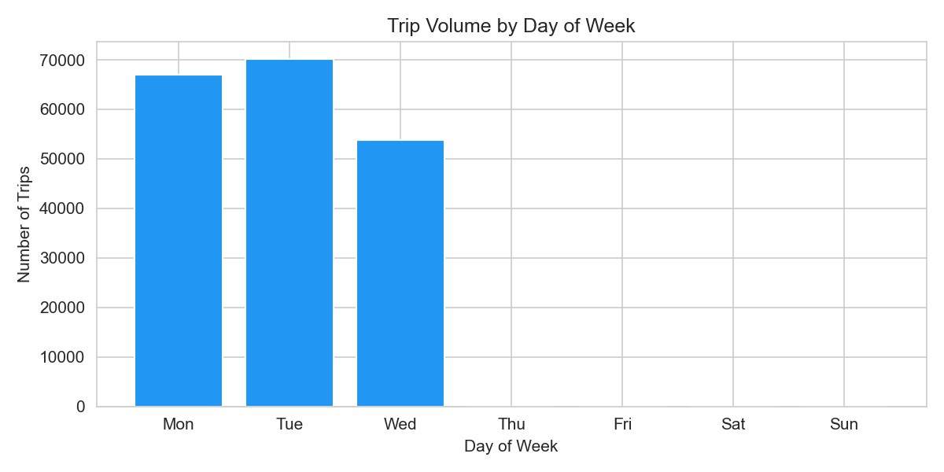
Exploratory Analysis
Trip Volume by Hour of Day
Average Speed by Hour
Peak at 8 AM and 6 PM — classic commute pattern visible in the data.
Speed drops to ~9 mph during rush hours — validates our congestion thresholds.
Real-Time Traffic Prediction · CSL7110
5 / 10

Slide 6
Machine Learning Models
We trained two regression models on 13 features, 80/20 train-test split, random_state=42.
Linear Regression
Random Forest
Baseline model
Our main model — clear winner
Hyperparameters
Hyperparameters
fit_intercept = True n_features = 13 (sklearn default settings)
n_estimators = 60 max_depth = 12 min_samples_leaf = 10 n_jobs = −1 (all cores)
Assumes a straight-line relationship between features and trip duration. Fast to train but cannot capture non-linear patterns like the interaction between rush hour and location. Result: RMSE = 6.861 min | MAE = 4.315 min
Ensemble of 60 decision trees, each trained on a random subset of features and rows. Naturally handles non-linear relationships and is robust to the outliers we didn’t fully remove. Result: RMSE = 3.939 min | MAE = 1.581 min
Real-Time Traffic Prediction · CSL7110
6 / 10

Slide 7
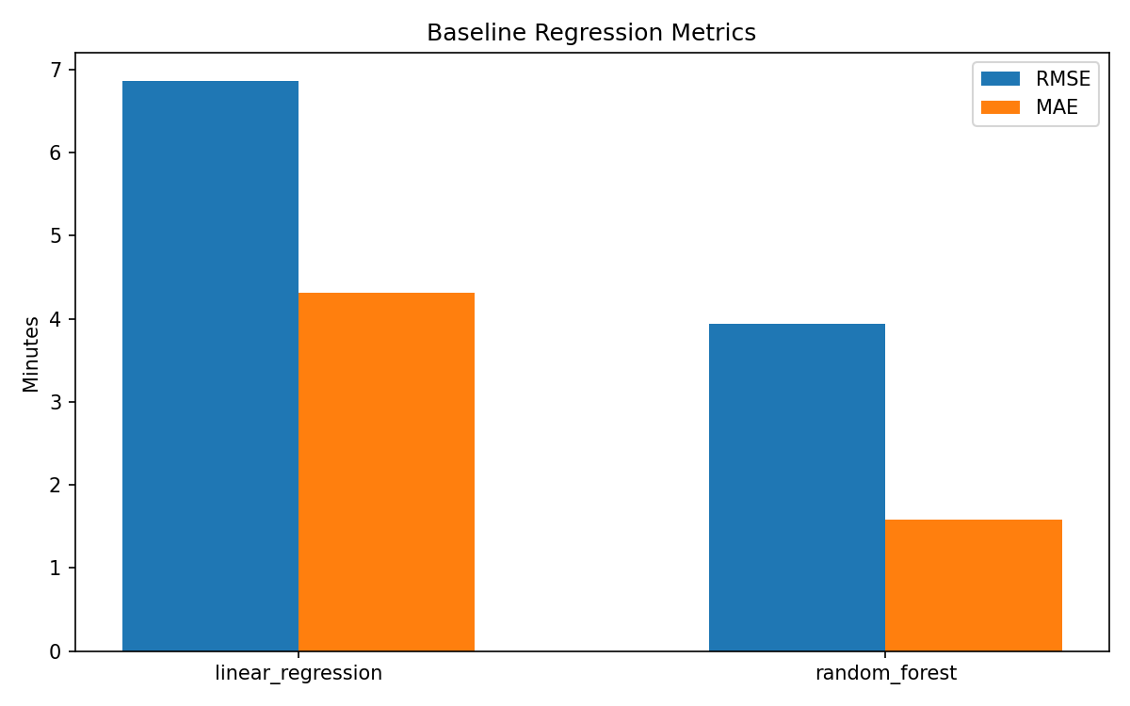
Results — Model Comparison
WINNER
Random Forest
RMSE 3.939 min MAE 1.581 min 43% lower RMSE than baseline
Model
RMSE (min)
MAE (min)
vs. Baseline
Linear Regression
6.861
4.315
—
Random Forest
3.939
1.581
−43%
Real-Time Traffic Prediction · CSL7110
7 / 10

Slide 8
Scaling with Apache Spark
PySpark 3.5 was used to load and process all 2.96 M rows on a local machine without memory issues.
Full dataset processed with PySpark
1
Lazy evaluation and disk spill let us aggregate 2.96 M rows that would exhaust Pandas memory.
MLlib ready for distributed model training
2
The same LR and RF algorithms in PySpark MLlib can train on the full data across a cluster with zero code change.
Path to production scale
3
Move scripts to GCP Dataproc or AWS EMR with HDFS — horizontal scaling gives near-linear throughput increase.
Real-Time Traffic Prediction · CSL7110
8 / 10

Slide 9
CONCLUSION
Scalable. Accurate. Reproducible.
43%
3.939
1.581
RMSE improvement vs. Linear Regression
Random Forest RMSE in minutes
Random Forest MAE in minutes
NEXT STEPS
Gradient Boosted Trees (PySpark MLlib) · Weather data integration · Spark Structured Streaming for live predictions · Cloud deployment (GCP / AWS)
Thank you · Questions?

Slide 10
Team Contributions
Ashwini Gerigenti
M L Lakshmi Narayana
Bharat Vishal Sharma
M25DE1052
M24DE1054
M25DE1045
Data preprocessing & cleaning
PySpark environment & distributed pipeline
EDA visualisations (5 charts)
Feature engineering pipeline
NYC TLC dataset download & inspection
Model comparison chart & metrics JSON
ML model training — LR & Random Forest
data/raw → data/processed pipeline
Scalability analysis & documentation
Model evaluation (RMSE, MAE)
Project coordination & Git management
Final report & presentation generation
Real-Time Traffic Prediction · CSL7110
10 / 10

