Slide 1
Smartphone based Seizure Detection Solution
Team:
Sagar Patel
Vishal Shelke
Varun Pillai
Avichal Chum
Hilfe Force

Slide 2
Motivation
Stats: 7% of the world population has had at least
one epileptic seizure – nearly 80% live in
developing countries
Current market doesn’t have a cost effective solution
No way to track and help in time
Provide an easy interface to call for help

Slide 3
Our Solution
Proposed Application

Slide 4
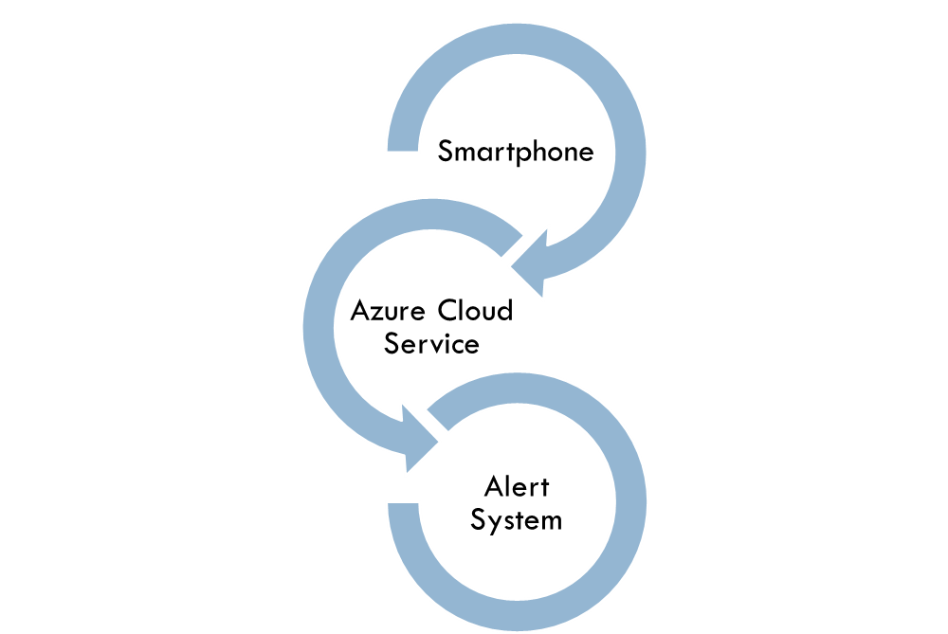
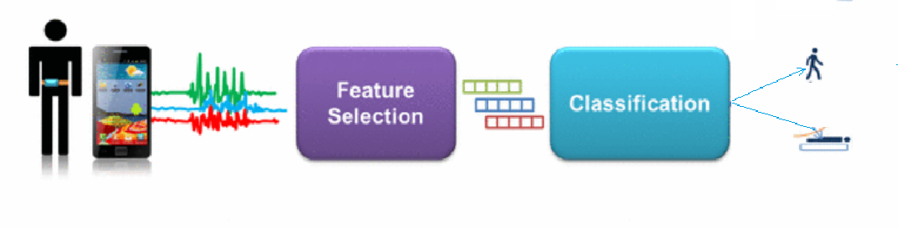
Get the Accelerator and Gyroscope Data

Slide 5

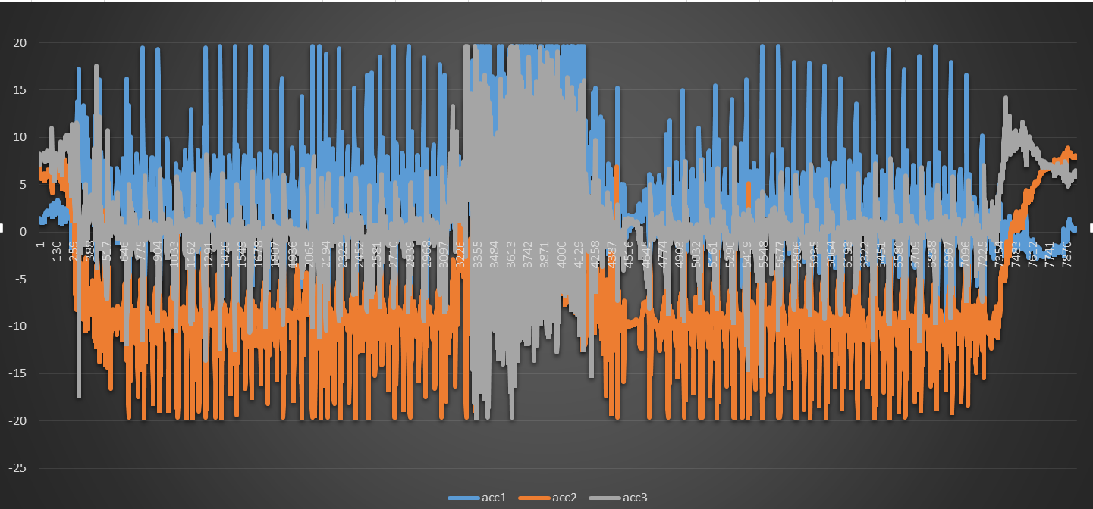
Detection Engine based on Machine Learning
Visualization: Raw Data

Slide 6
Economic Viability
The detection feature will be promoted for free
Find sponsors to use this feature to their applications
Hospital Apps with existing user base would be
approached

Slide 7
Future Work
Including more features for improving detection
Fine-tuning the interconnections between
mobile service and cloud detection engine
Mechanism to deal with false positives

