Slide 1

CRIME RATE ANALYSIS
28 Kritarth Kambli
50 Rahul Patil
52 Pooja Patkar
64 Vishal Shirke
BE Sem VIII- 2022-23
:Guide:
Prof. Avinash Gondal
Department Of Computer Engineering
Watumull Institute Of Electronics Engineering And Computer Technology

Slide 2

INTRODUCTION
Growing crime rate is a major concern and it is essential to find techniques to reduce it.
Crime analysis gives us better understanding of crime trends which is highly beneficial.
Ability to use big data for easy and efficient understanding of patterns.
In India, GIS (Geographic Information System) is used for crime mapping. But applications for GIS in policing is in starting stages and GIS based data analysis can be useful.

Slide 3
SCOPE
Criminal data is available for public but it is mostly focused on combined data about a state. The data for individual cities is not easily accessible and is mostly in the form of FIR/charge sheets in local languages.
This can be solved by analyzing, classifying and creating a GIS environment for individual cities. Simple crime maps and statistical data in the form of graphs can help the police as well as the citizens in many ways.
Much of the current work is useful for policing and focused in two major directions.
Predicting surges and hotspots of crime and understanding patterns of criminal behavior that could help in solving criminal investigations.

Slide 4
PROPOSED SYSTEM
For easy accessibility and use we propose to build a mobile application/website which will be available for public and private use.
The application will provide a brief overview of current state of crime.
The frontend of the application will focus on statistical data visualization and crime mapping.
The backend system will focus on generating accurate statistical data and intensity of crime for GIS mapping.

Slide 5
PROJECT WORKFLOW/METHODOLOGY
1. Data Collection:
From :National Crime Records Bureau(NCRB)
Website link: https://ncrb.gov.in/en
Structure: Consists of latest data of IPC Crimes from 2017-2020 across all the states and holds records of all different IPC crimes.
2. Data Refining and Preprocessing:
Extracting data of the Maharashtra state.
Removing inconsistencies in data across the years and normalizing the data for ML Models.
3. Data Analysis:
Selecting the Major Crimes among all the types.
Analyzing different Performance metrics for calculating Crime Rate.
Selecting appropriate Models on the basis of data for ML.

Slide 6
PROJECT WORKFLOW/METHODOLOGY
4. Creating Models using machine learning :
Types of models based on the data:
Crime rate density analysis using clustering.
Area crime rate prediction using regression.
5. Data Visualization:
Collecting administrative map data(Shapefile)
Using GIS techniques to plot the model analysis.
Displaying statistical data using graphical chart

Slide 7
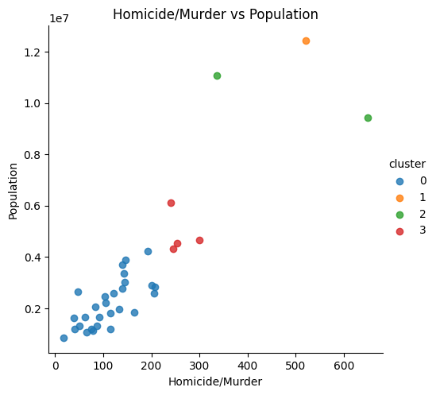
CRIME RATE ANALYSIS USING CLUSTERING
In clustering, the data items are clustered according to their logical relationships or natural groupings and a structure as a whole is generated.
Each cluster is collection of homogeneous elements, which may be exclusive to that group, but are similar to each other.
In crime analysis clustering can help identify
certain crime patterns with different crimes
and factors.

Slide 8
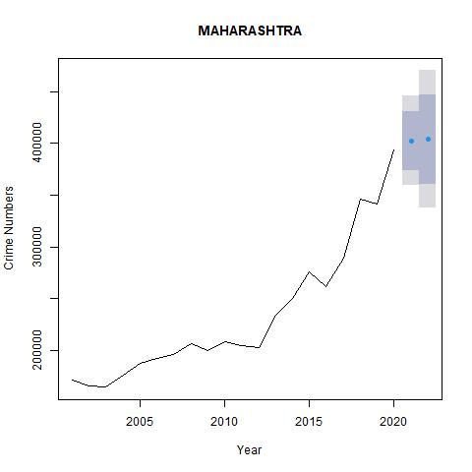
CRIME RATE PREDICTION USING REGRESSION
Regression can be applied to a crime dataset to predict future crime rate for different districts.
An autoregressive integrated moving average, or ARIMA, is a statistical analysis model that uses time series data to either better understand the data set or to predict future trends.
ARIMA models predict future values based on past values.

Slide 9
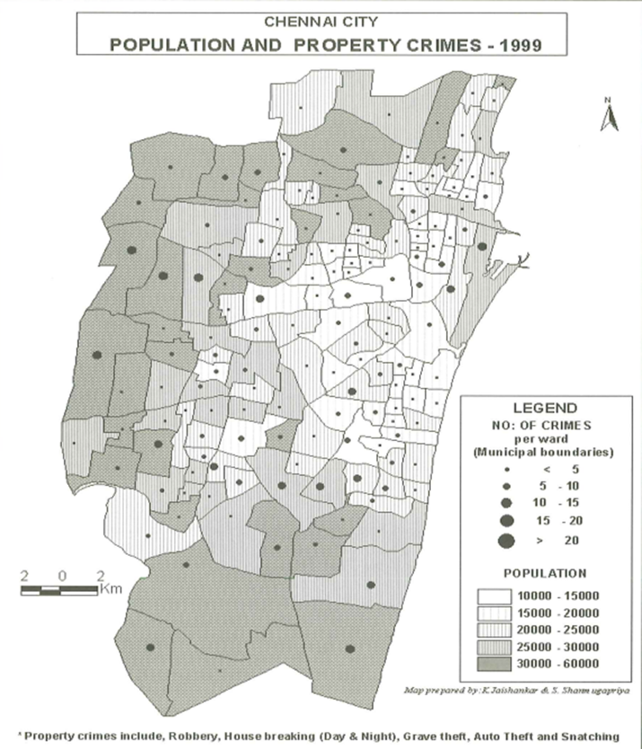
VISUALIZATION – GIS
A geographic information system (GIS), is a system that creates, manages, analyzes, and maps all types of data.
GIS connects data to a map, integrating location data with all types of descriptive information.

Slide 10
EXISTING SYSTEMS AND THEIR MERITS
Existing Systems:
For Chennai Police, ESRI India has sold two licenses of Arc view GIS software and has imparted training.
GIS based systems are being used by New Delhi, Hyderabad and Assam Police Departments.
Government of Maharashtra has sanctioned the proposal of Mumbai Police to implement GIS/GPS based systems.
Merits:
With current trend of digitization, GIS/GPS systems provide a robust and unique method for analyzing and solving crime related problems.
Systems provide a well mapped view of different areas and previous crime data of those areas.
Currently used for locating different hotspots of crime.

Slide 11
DEMERITS OF EXISTING SYSTEM
Demerits:
The current available systems are in initial phase and still being developed.
Police officers lack training in these new computerized systems and the systems are not well optimized and easy to use.
Properly mapped and statistical information is not available for public.
Currently available systems are only capable of mapping past data and not for prediction and other analytical use.
Such GIS systems are recently being considered and it might take a few years to develop properly working systems which even public can access.

Slide 12
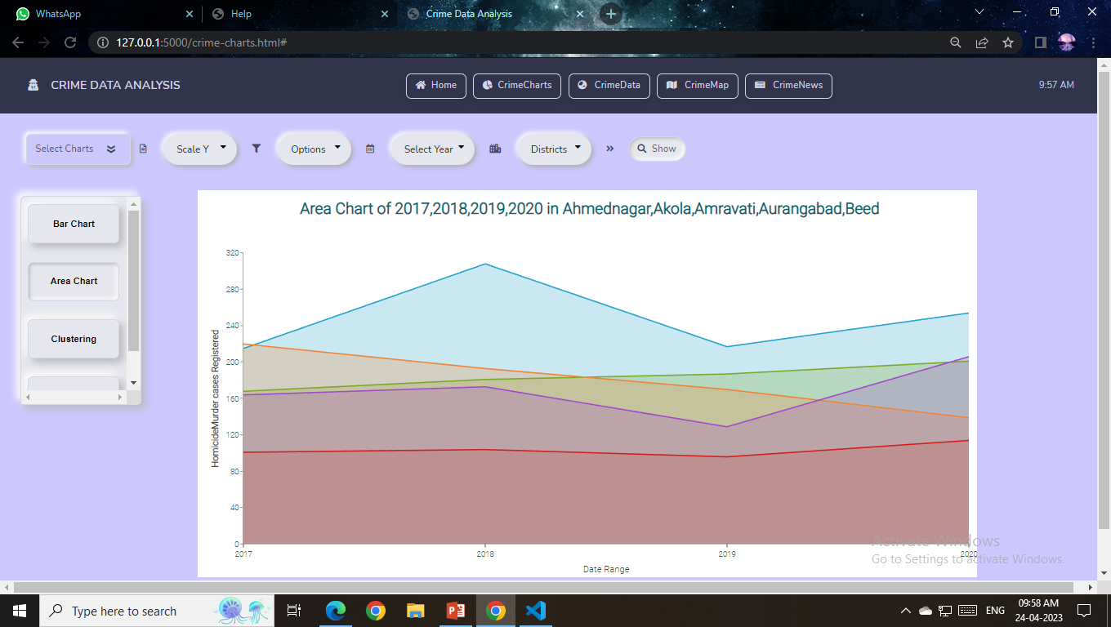
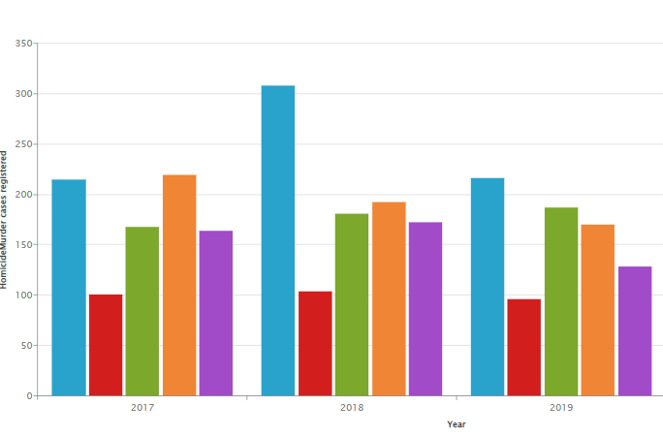
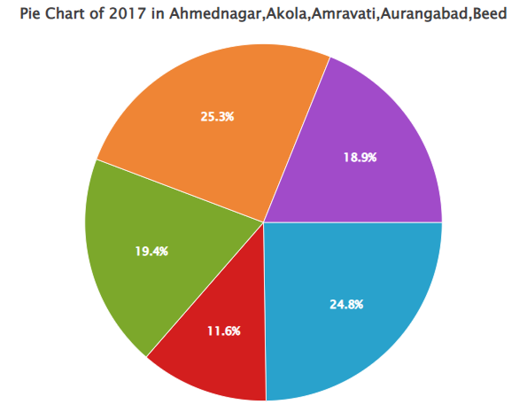
VISUALIZATION & RESULTS
Crime Charts: Charts help to understand changes in crime and other factors over time using easily understandable visual format.

Slide 13
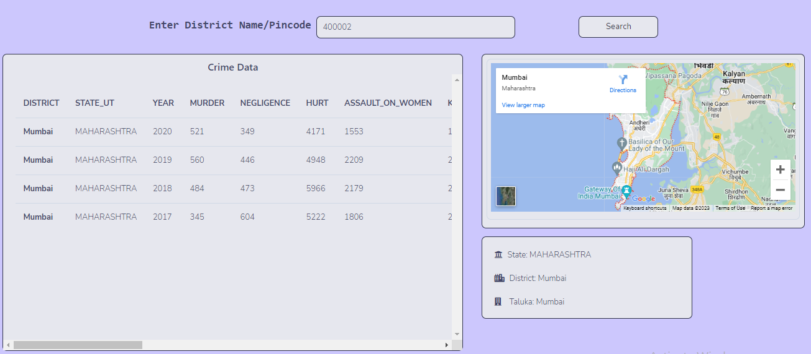
VISUALIZATION & RESULTS
Crime Data: Crime data page helps to find crime data for particular place using pin code or district name along with a map view.

Slide 14
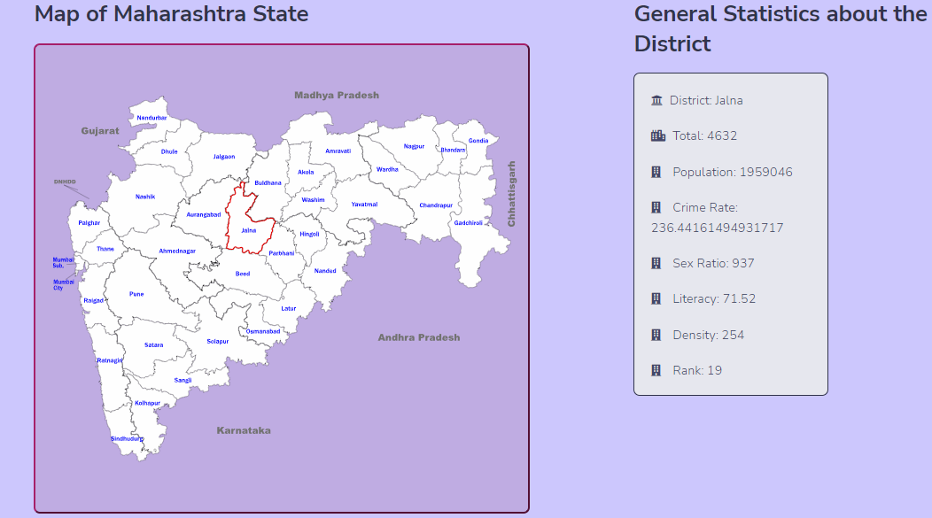
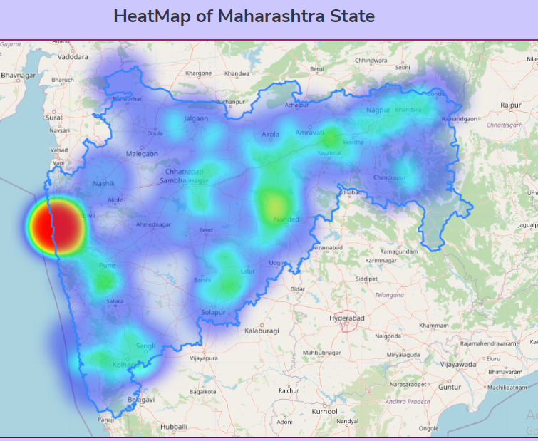
VISUALIZATION & RESULTS
Crime Maps: It displays detailed information district wise for various factors on the map of Maharashtra. For Map SVG file was used.
Heat map shows the overall distribution of crime rate all over Maharashtra.

Slide 15
APPLICATIONS
Crime maps and statistical data in the form of graphs can help the police as well as the citizens.
These maps can be used by tourists as well while planning a trip in particular place.
The simple graphical representation of the crime data is easily understandable.
A base for developing advanced AI systems for crime analysis.
Usefulness: It can lead to targeted and sensitive practices by law enforcement authorities to mitigate crime, and more concerted efforts by citizens and authorities to create healthy neighborhood environments.

Slide 16
PROJECT REQUIREMENTS
Hardware Requirements:
Computer/laptop
Intel i5 10th Gen or higher/8gb Ram
Software Requirements:
Python
Flask/Android/Flutter
HTML
CSS
JavaScript
Packages: SKlearn, Geopy, Numpy, Pandas.
libraries for visualization:
Zing charts
Folium
AM charts
Google Maps Embed API

Slide 17
REFERENCES
Deepika K.K , Smitha Vinod(2018). Crime analysis in India using data mining techniques.
Devendra Tayal, Arti Jain, Surbhi Arora, Surbhi Agarwal, Tushar Gupta, Nikhil Tyagi, “Crime detection and Criminal identification in India using data mining technique”, Ai & Society, 2014, https://doi.org/10.1007/s00146-014-0539-6
Shivani Dandir(2019). Indian Crime Data Analysis. https://towardsdatascience.com/indian-crime-data-analysis-85d3afdc0ceb
Tapan Chakraborty.An Alternative to Crime Trend Analysis in India. https://www.satp.org/satporgtp/publication/faultlines/volume14/article5.htm
Vikramaditya Singh Bhatia,Sourabh Tiwarib, Jasvant Mandloic. Machine Learning Model to Predict, Classify and Analyze Crime in Indore City.
Prajakta Yerpude and Vaishnavi Gudur, “Predictive Modelling of Crime Dataset Using Data Mining”, International Journal of Data Mining & Knowledge Management Process (IJDKP), Vol.7, No.4, July 2017, DOI: 10.5121/ijdkp.2017.7404

