Slide 1
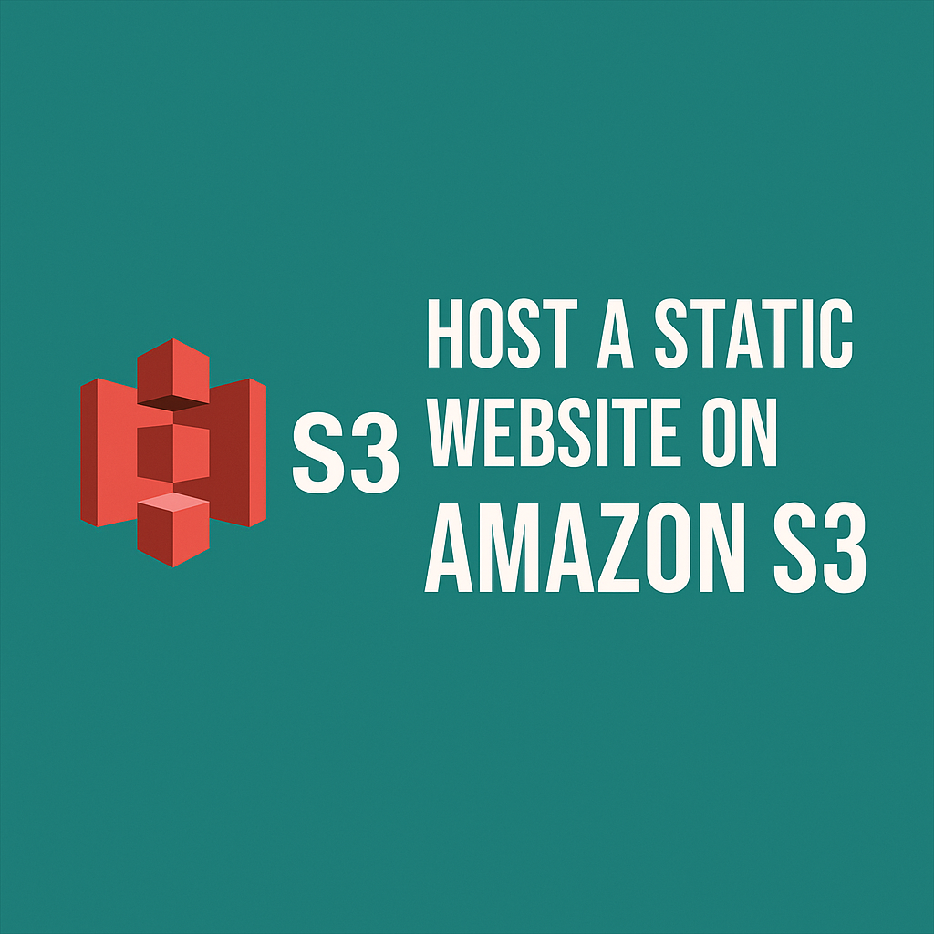
Amazon S3 Static Website Hosting
Unlock the power of scalable, cost-effective web hosting with Amazon S3.
VISHAL SUDHA ARUL 12306232

Slide 2
OVERVIEW
What is Amazon S3 Static Website Hosting?
Cloud Storage Power
Static Content Delivery
Serverless Simplicity
Amazon S3 (Simple Storage Service) is a robust cloud storage solution designed for storing and retrieving any amount of data, anywhere in the world.
Static website hosting on S3 means serving web pages with fixed content, such as HTML, CSS, JavaScript, and images, without requiring server-side processing.
With S3, there are no servers to manage. It acts as a highly scalable and durable web server for your static files, simplifying infrastructure.

Slide 3
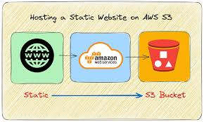




Why Use S3 for Static Websites?
Cost-Effective
Pay only for storage and bandwidth — usually very cheap.
Highly Durable
99.999999999% durability keeps files safe.
Scalable & Available
Handles heavy traffic automatically with high uptime.
Simple Setup
No servers to manage — just upload files and host..

Slide 4
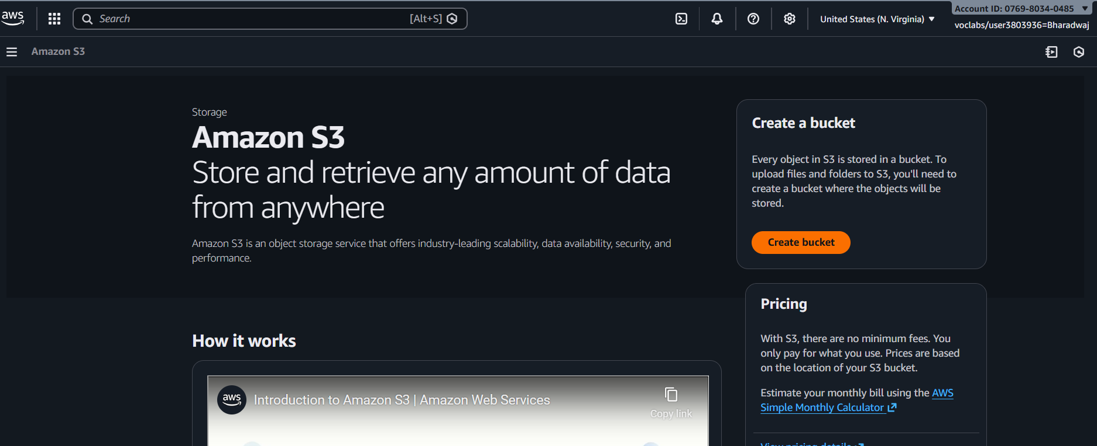
HOW IT WORKS
Step 1: Create an S3 Bucket
The first step involves setting up your storage container on AWS. This bucket will hold all your website's files.
Log in to the AWS Management Console and navigate to the S3 service.
Create a new bucket and ensure its name is globally unique (e.g., yoursite-2026).
Select an AWS region that is geographically closest to your primary audience to optimise loading speeds for your visitors.

Slide 5
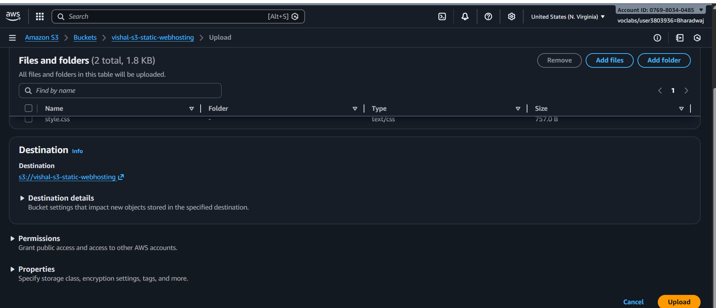
Step 2: Upload Your Website Files
Once your bucket is ready, it's time to populate it with your website's content.
Upload all your static files, including your HTML, CSS, JavaScript, and images.
Crucially, name your main page index.html; this file will be loaded by default when users visit your site.
Consider uploading an error.html page to provide custom messages for any access issues.

Slide 6
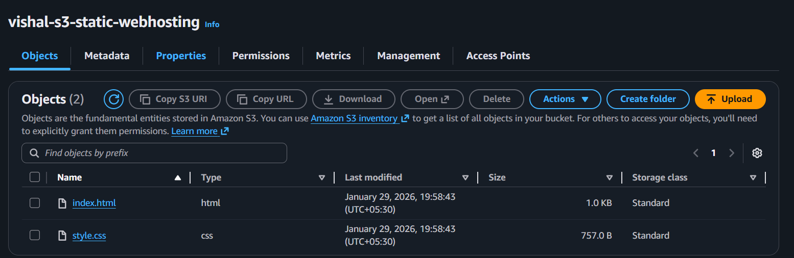
Step 3: Enable Static Website Hosting
This critical step configures your S3 bucket to function as a web server.
Within the bucket's "Properties" tab, locate and enable the "Static website hosting" option.
Specify index.html as your index document and, if provided, error.html as your error document.
Make a note of the website endpoint URL provided by S3, as this will be your website's address.

Slide 7
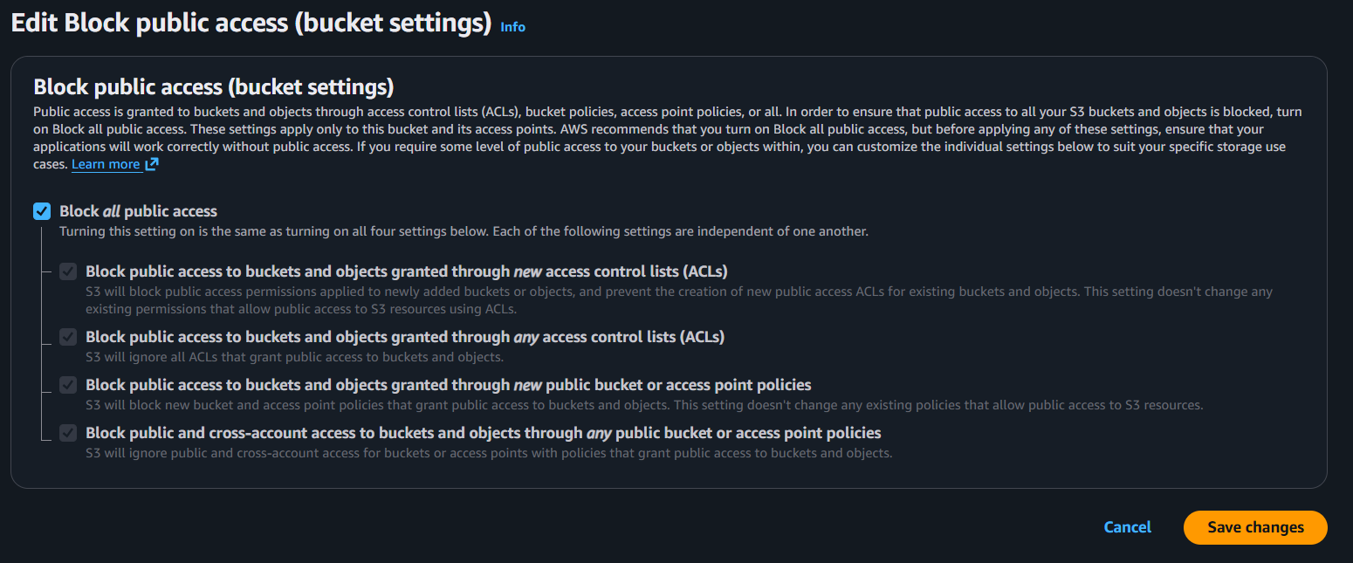
Step 4: Configure Public Access
By default, S3 buckets are private. You need to explicitly grant public read access for your website to be viewable.
To allow public reads, you must first disable the "Block Public Access" settings for your bucket.
Subsequently, apply a bucket policy that explicitly grants public read permissions to the files within your website.

Slide 8
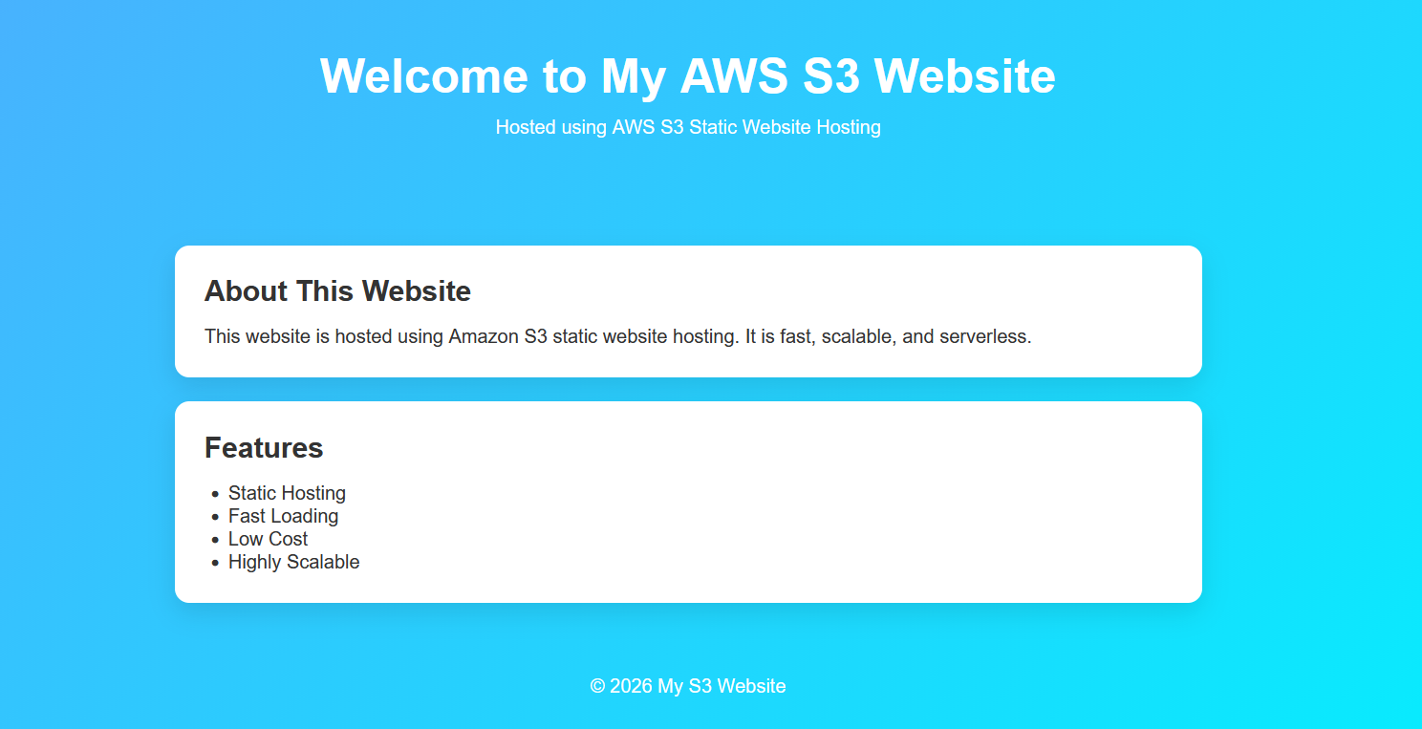
Step 5: Hosted Web Page
This is the Hosted Site in AWS S3
Link: Vishal S3 Static Web Hosting

Slide 9
Advantages of S3 Static Website Hosting
Zero Server Management
Automatic Scaling
Low Cost
No need to install or maintain servers and any operating systems.
Handles many users automatically without any traffic.
Utilises a pay-as-you-go pricing model with generous free tier options, optimising your budget.
High Durability & Availability
Easy Integration
Our files are very safe and always available.
Easily connects with other AWS services (like domains, CDN).

Slide 10



Common Uses of S3 Static Hosting
Personal Portfolios & Blogs
Company Landing Pages
Single Page Applications (SPAs)
Ideal for showcasing personal work, résumés, or maintaining simple content-driven blogs.
Perfect for high-performance marketing sites, campaign landing pages, or company informational sites.
Excellent for hosting modern web applications built with frameworks like React, Angular, or Vue.
THANK YOU

