Slide 1
A Vision-based Geospatial Information System (GPS-free)
ADHIKARI Jyoti
THAPALIYA Bishal

Slide 2
OBJECTIVE
To develop a computer application that is useful to find the geographic location of a picture that is taken by a non-GPS devices such as; camera, webcam and mobile phone by comparing and matching properties with the photos (with GPS coordinates) that are stored in the dataset.
2
Notes:
OpenCV (Open Source Computer Vision) is a library of programming functions mainly aimed at real-time computer vision, originally developed by Intel's research center in Nizhny Novgorod (Russia), later supported by Willow Garage and now maintained by Itseez.^{[1]} The library is cross-platform and free for use under the open-source BSD license.
MinGW (Minimalist GNU for Windows), formerly mingw32, is a free and open source software development environment for creating Microsoft Windows applications.

Slide 3


TECHNOLOGIES USED
Open Source Computer Vision (OpenCV)
OpenCV is a library of programming funtions mainly
aimed at real-time computer vision.
Minimalist GNU for Windows (MinGW)
MinGW is a free and open source software development
environment for creating Microsoft Windows applications.
Notes:
OpenCV (Open Source Computer Vision) is a library of programming functions mainly aimed at real-time computer vision, originally developed by Intel's research center in Nizhny Novgorod (Russia), later supported by Willow Garage and now maintained by Itseez.^{[1]} The library is cross-platform and free for use under the open-source BSD license.
MinGW (Minimalist GNU for Windows), formerly mingw32, is a free and open source software development environment for creating Microsoft Windows applications.

Slide 4

TECHNOLOGIES USED cntd….
ECLIPSE (C++)
Eclipse is an integrated development
environment (IDE) used in computer programming.
It contains a base workspace and an extensible plug-in system for customizing the environment.

Slide 5
ALGORITHM
Using SURF (Speeded-Up Robust Features) algorithm
Keypoints Detection using
Calculate Descriptors
Matching Descriptors
Calculation of max and min distances between key points

Slide 6
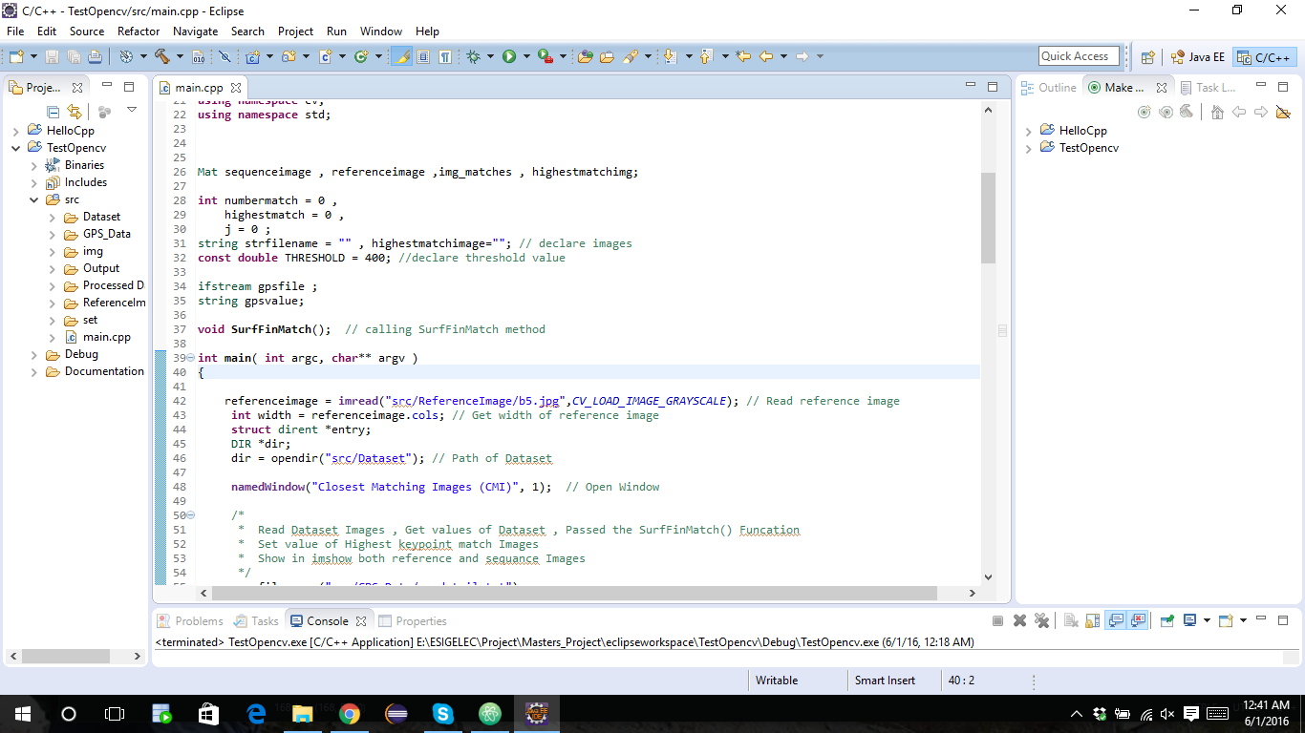
CODES

Slide 7
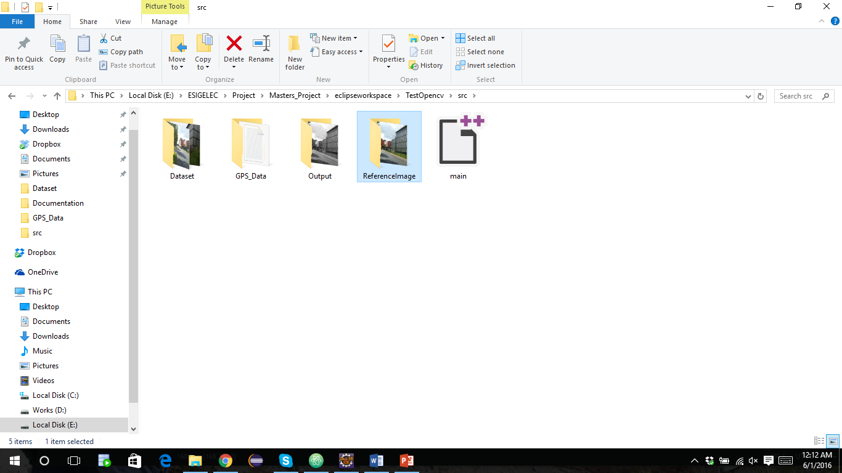
SAMPLE TEST
For instance: we have our reference image "b5.jpeg" in "ReferenceImage" folder. Now we have to extract its GPS latitude and longitude by detecting features from the set of images in "Dataset" folder.

Slide 8
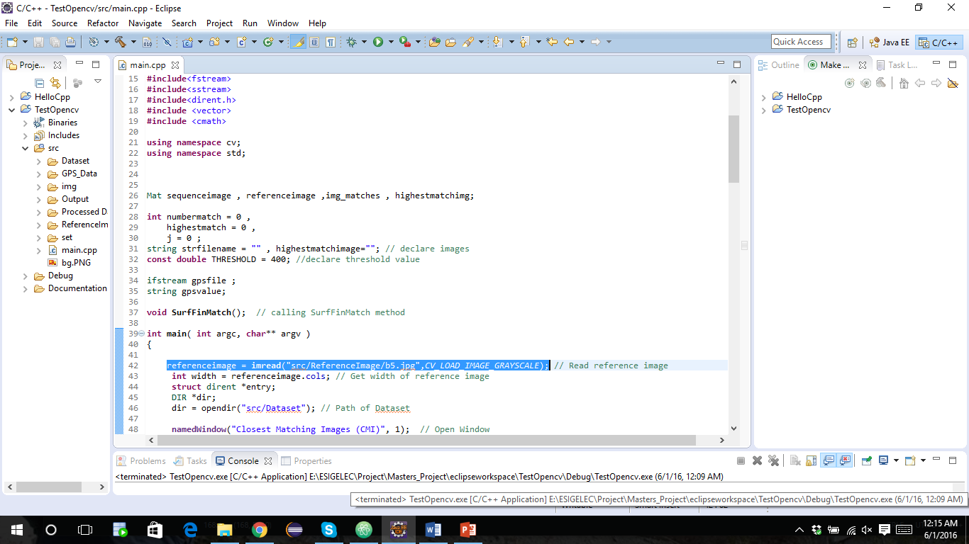
SAMPLE TEST…. contd.
Then we used the same image "b5.jpg" as referenceimage in source code.

Slide 9
SAMPLE TEST…. contd.
Click on Run button.

Slide 10
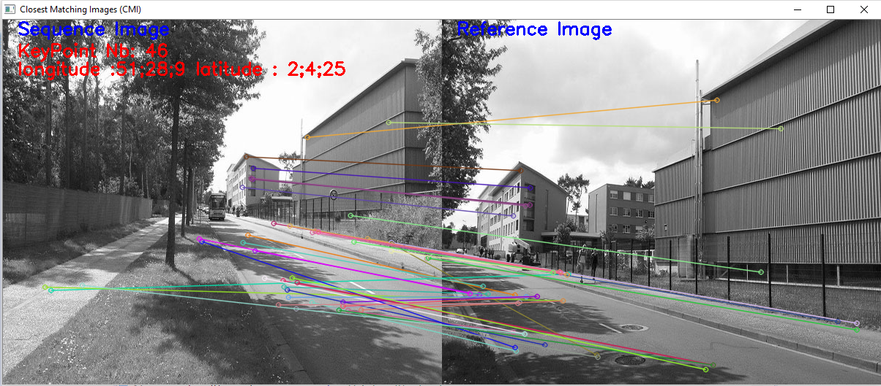
SAMPLE TEST…. contd.
An output of matching key points.

Slide 11
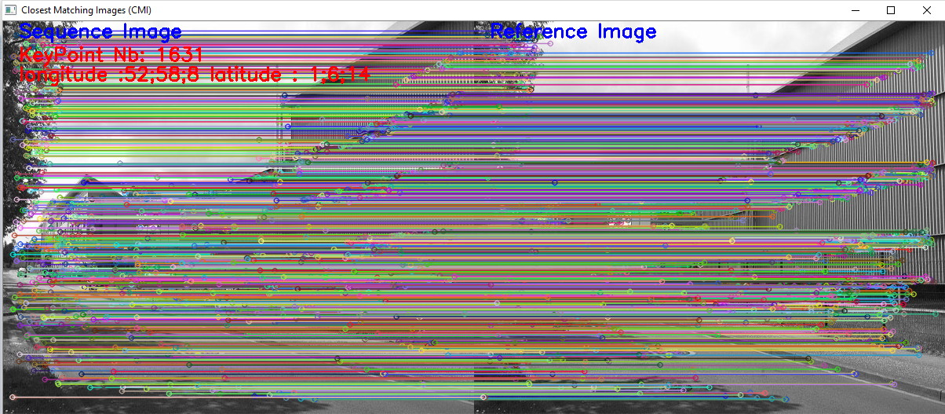
SAMPLE TEST…. contd.
An output of maximum key point matching image.

Slide 12
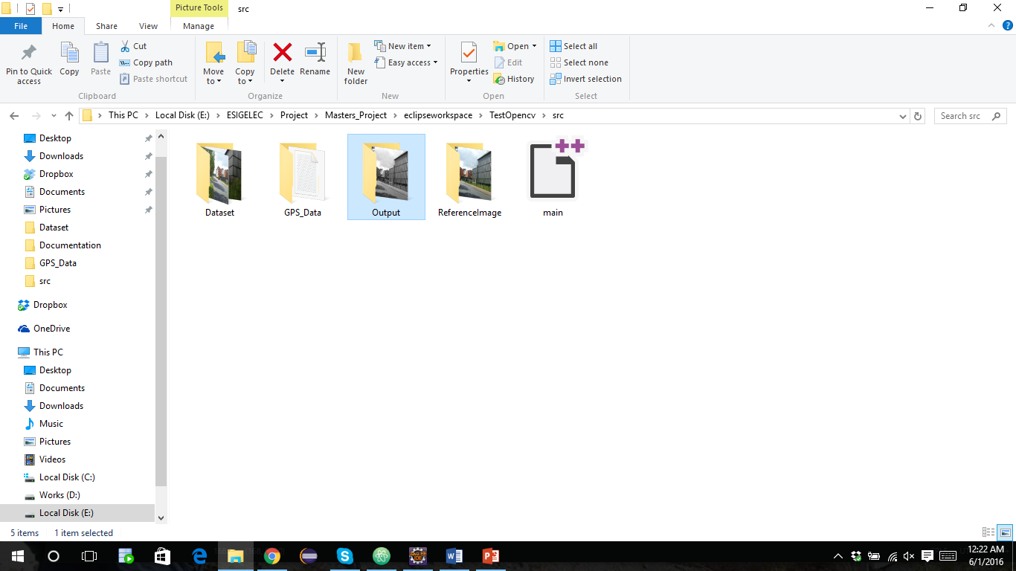
SAMPLE TEST…. contd.
An image with maximum matching key points will be saved as result in Output folder that gives longitude and latitude of an image.

Slide 13
LESSON LEARNED
When things go wrong, as they always will; excuses will not work. Find an alternative action or right suggestions instead. Allocating blame only causes conflict and aggression, searching for solutions will bring the team together. Together with leadership skills will definitely help you towards achieving your goal.

Slide 14
THANK YOU!!!

