Slide 1



Investors & Investments

Slide 2

Team Members
Vishal Tomar
Eshwar Konda

Slide 3

Insights
Top Investors in terms of Country, State, Region and City.
Distribution of investors between Organization and individual person
Fund raised by each and every Country.
How many investor has investment partner while investing.
In which types of investment, Investor had invested
Investor active in which social media
Who is a lead Investor while doing an investment
Investment taken place in terms of years and Quarter

Slide 4

Introduction
In this Project we had analyze the data and find some useful insights from it.
We had also analyzed some data and presented it in the form of Dashboard.
We will give some overview of our some insights.

Slide 5
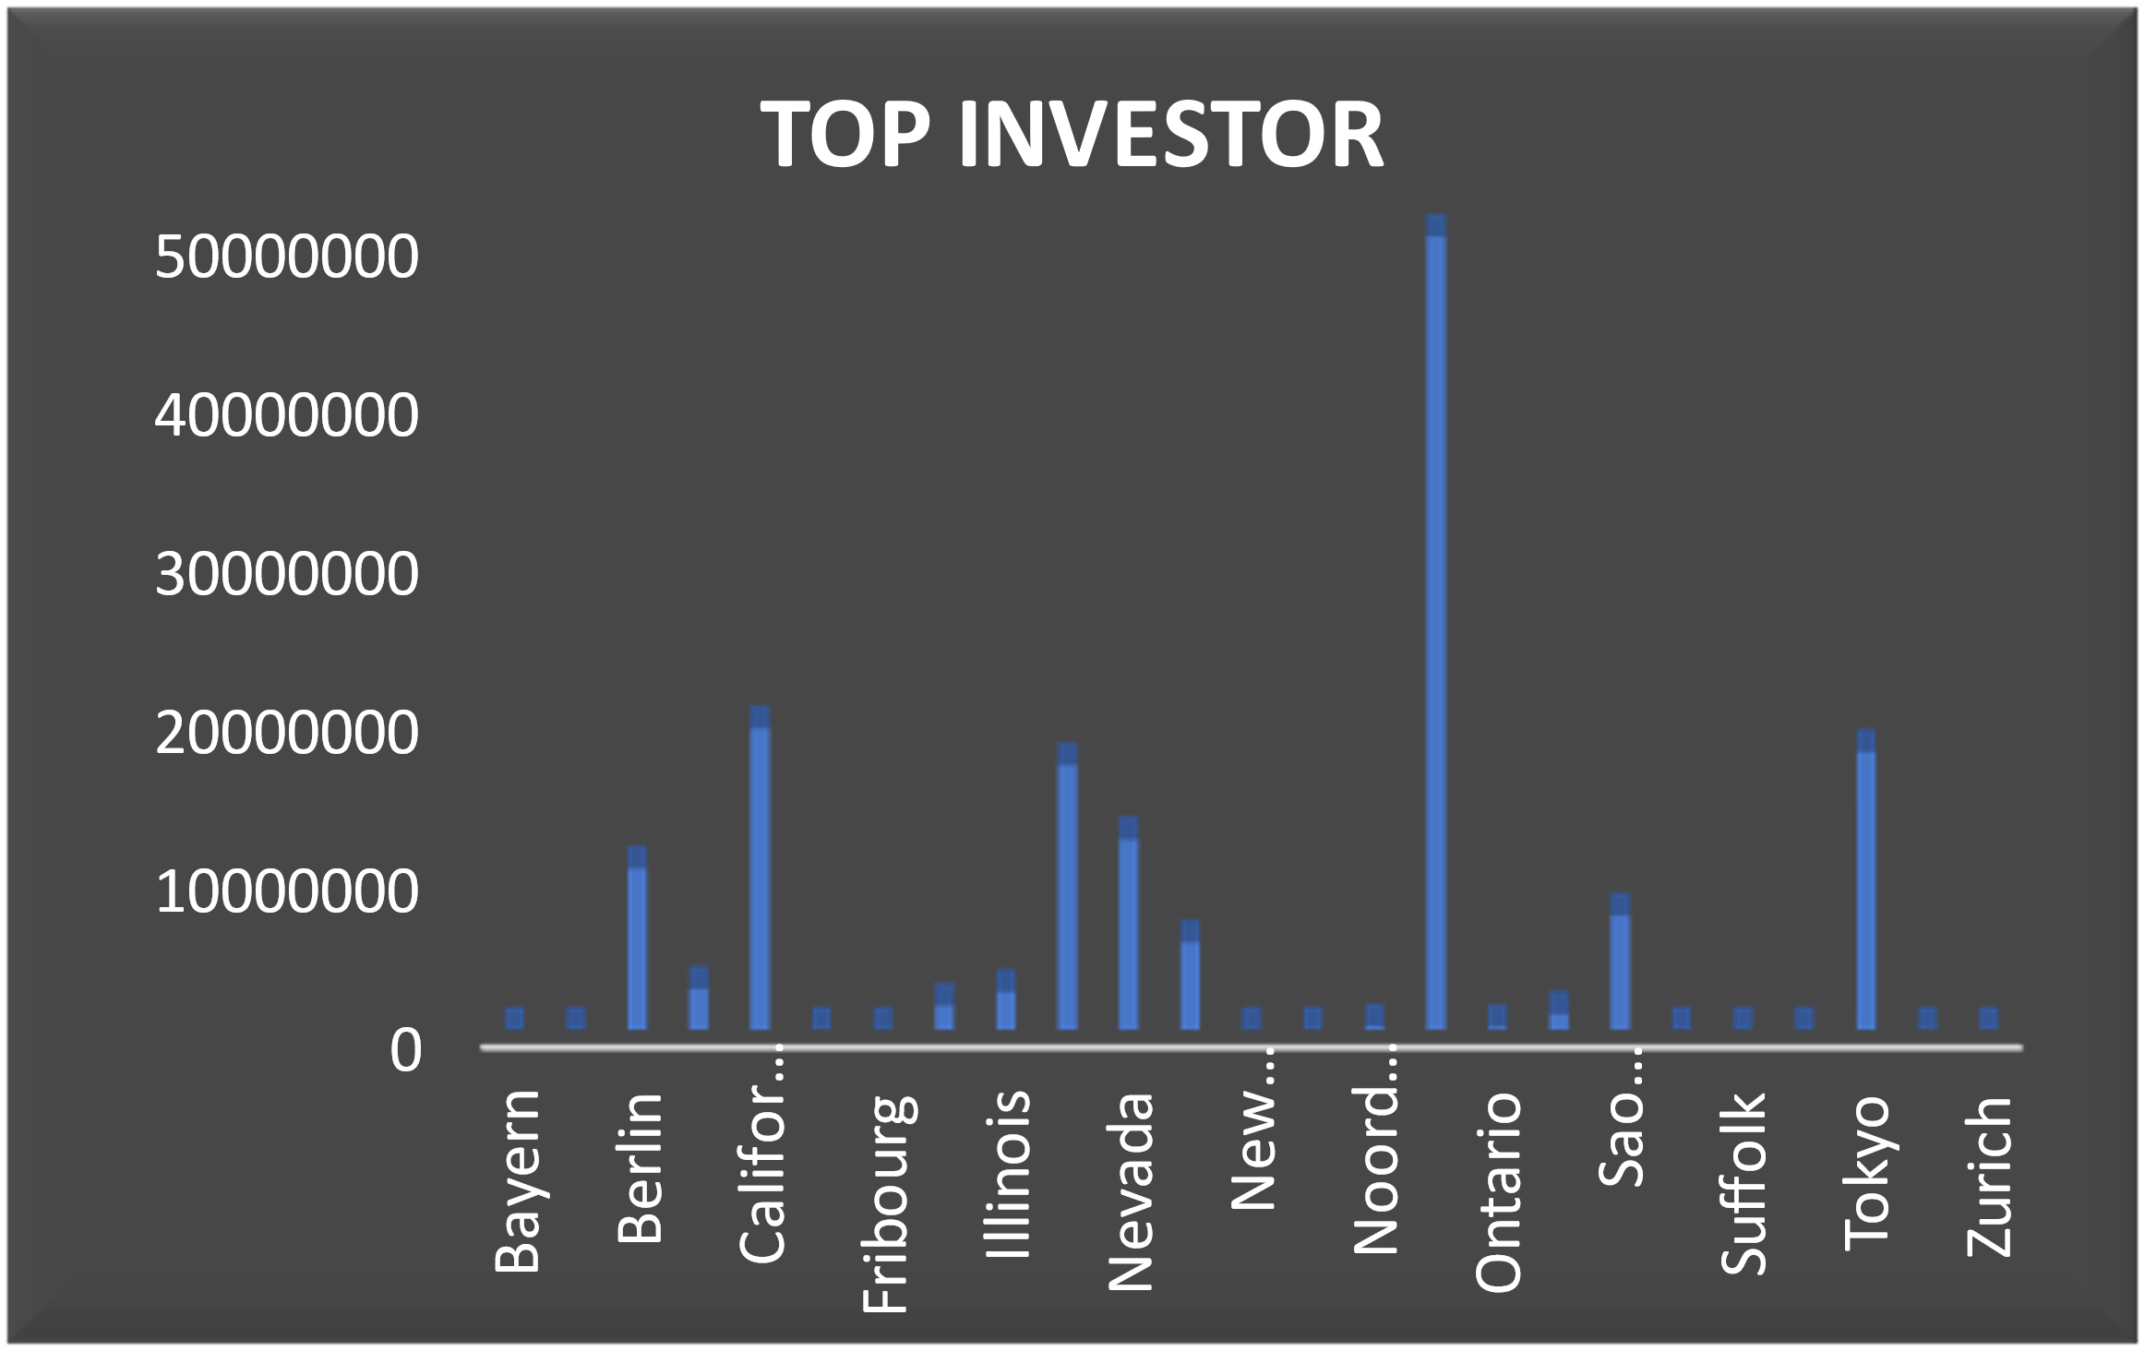
Top Investors

Slide 6
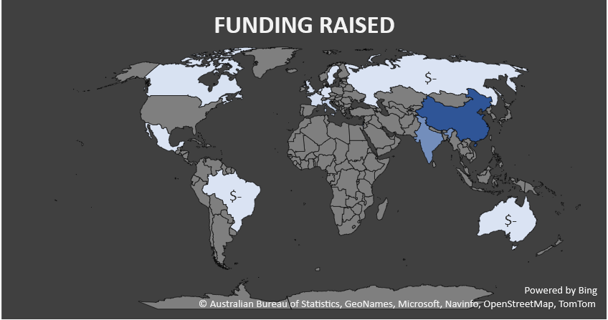

Slide 7
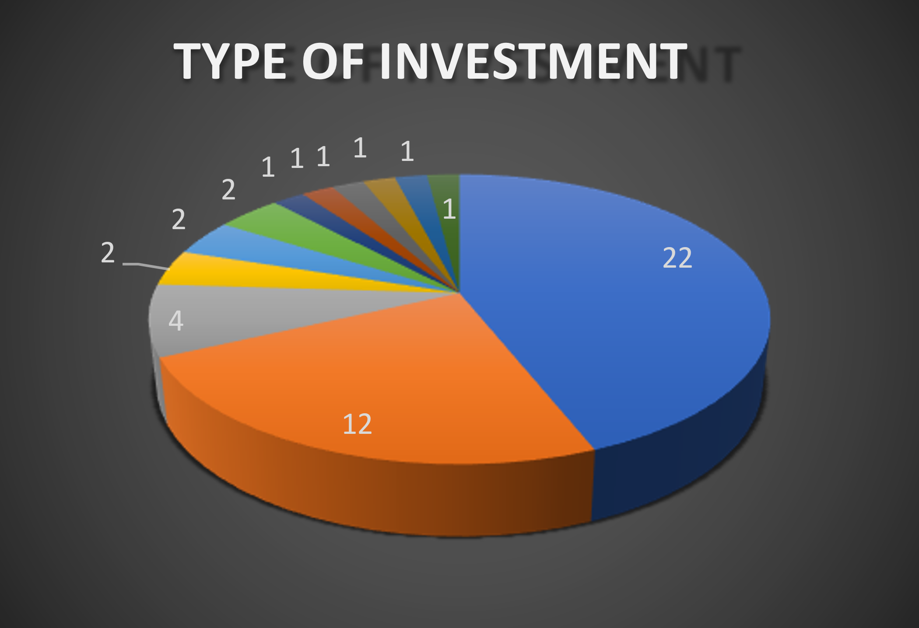

Slide 8
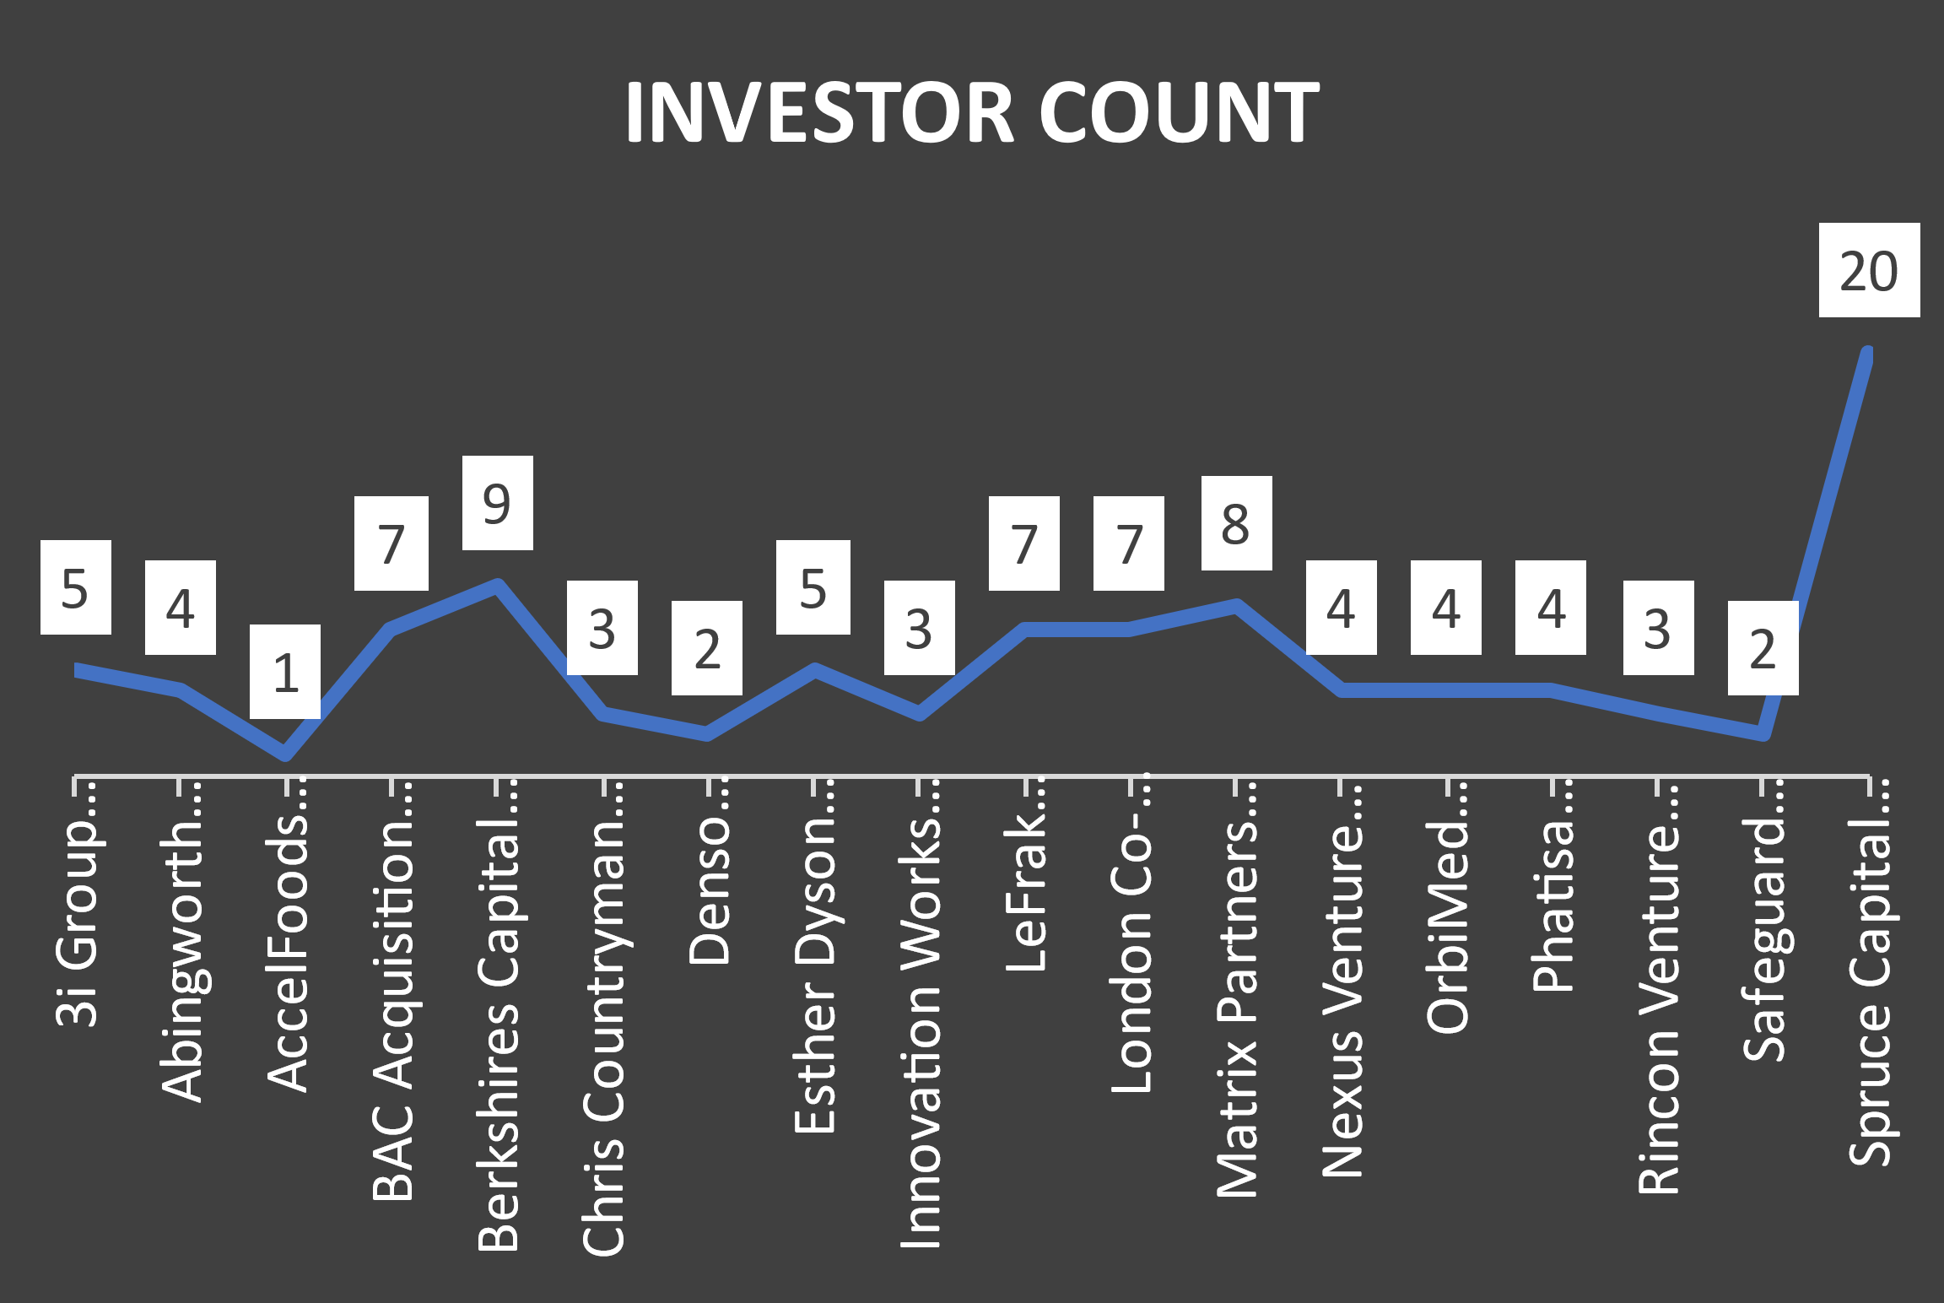

Slide 9
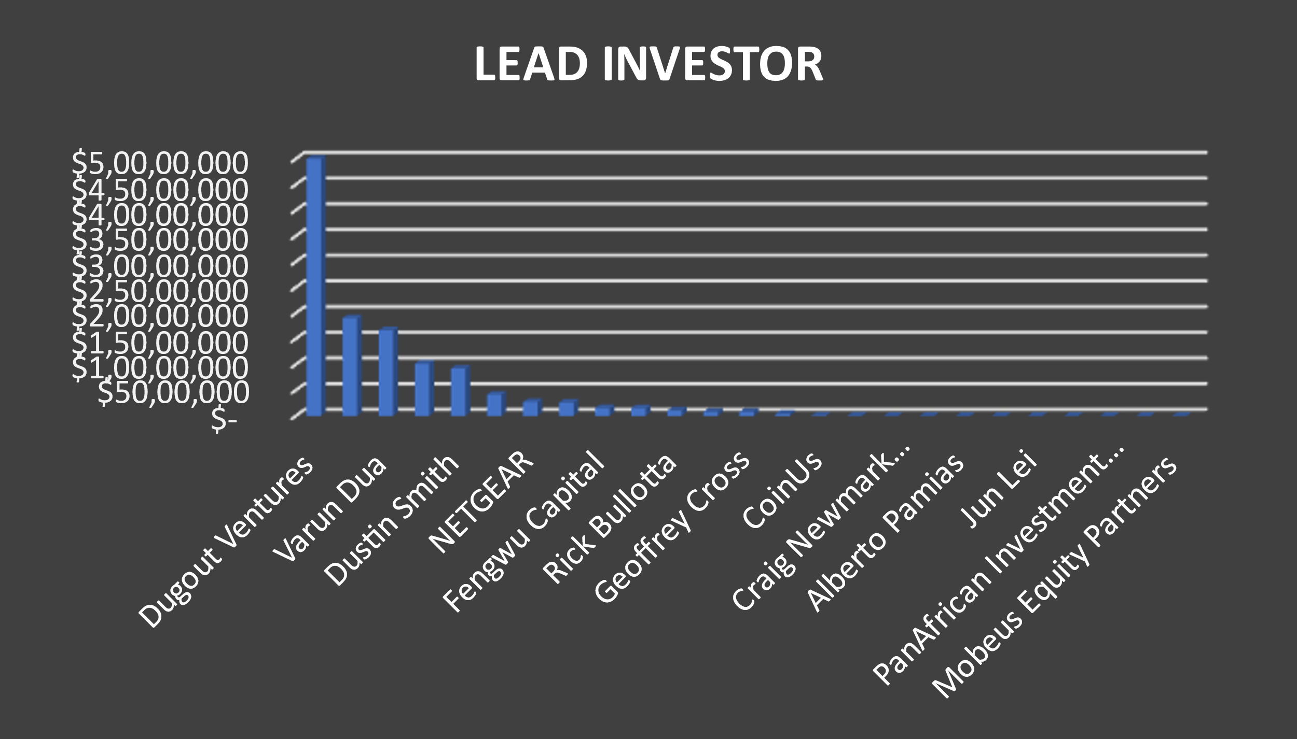

Slide 10
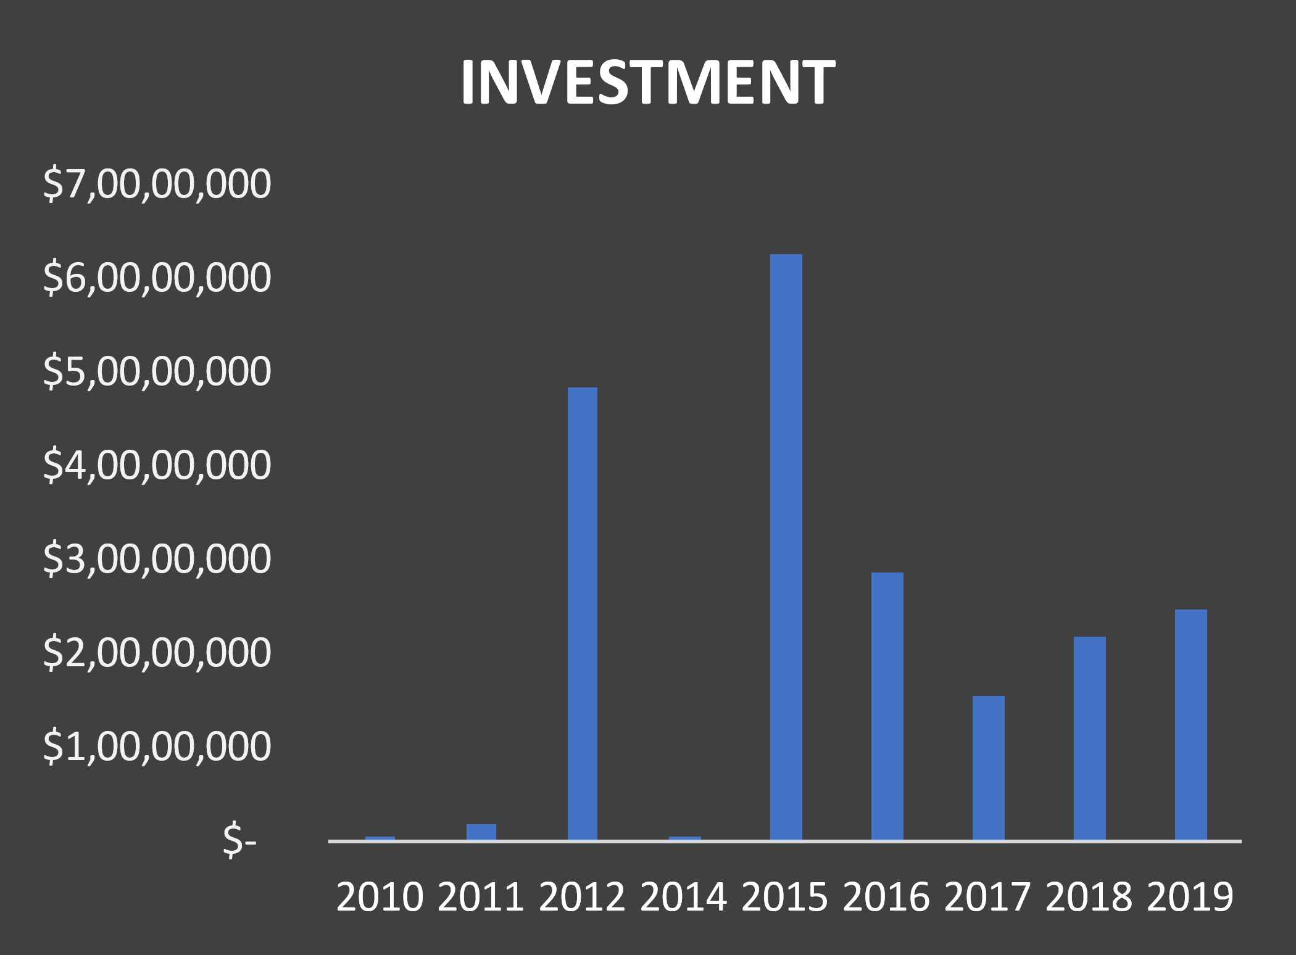

Slide 11
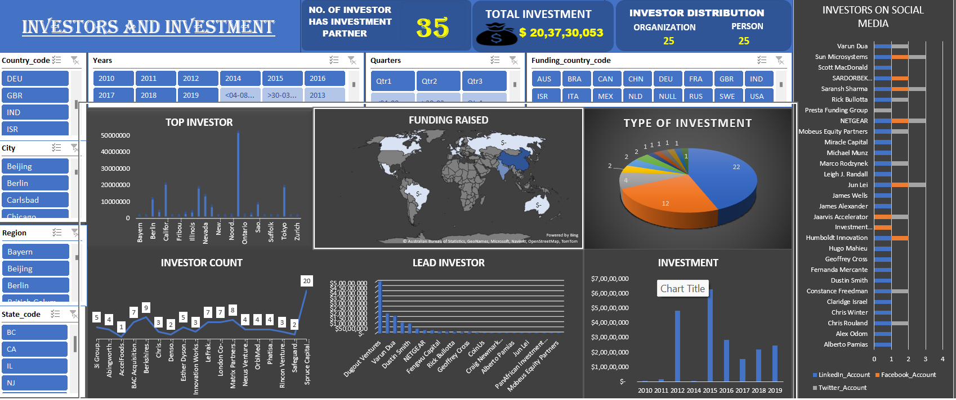

Slide 12
Thanks

