Slide 1
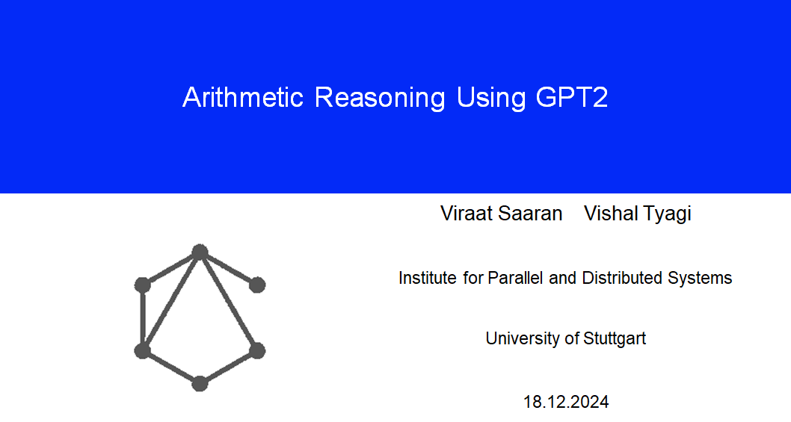
Project 6
19-Feb-2025

Slide 2
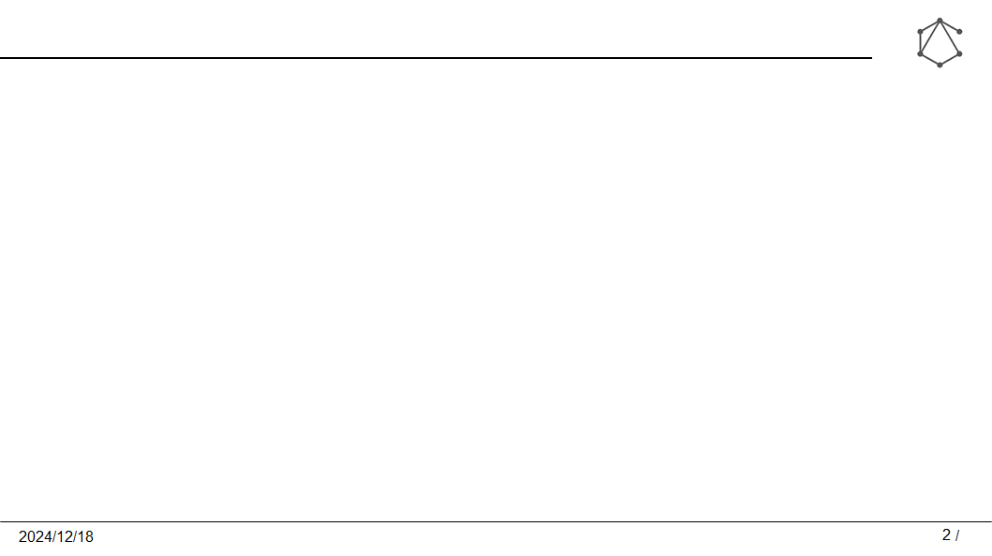
Motivation
The architecture of GPT2 makes it a great choice for using it in tailored tasks. Unlike rule based system, it can interpret contextual informations. This makes it ideal for question-answering applications like educational tools, interactive assistants, and real-world task where arithmetic reasoning is integrated with natural language understanding.

Slide 3
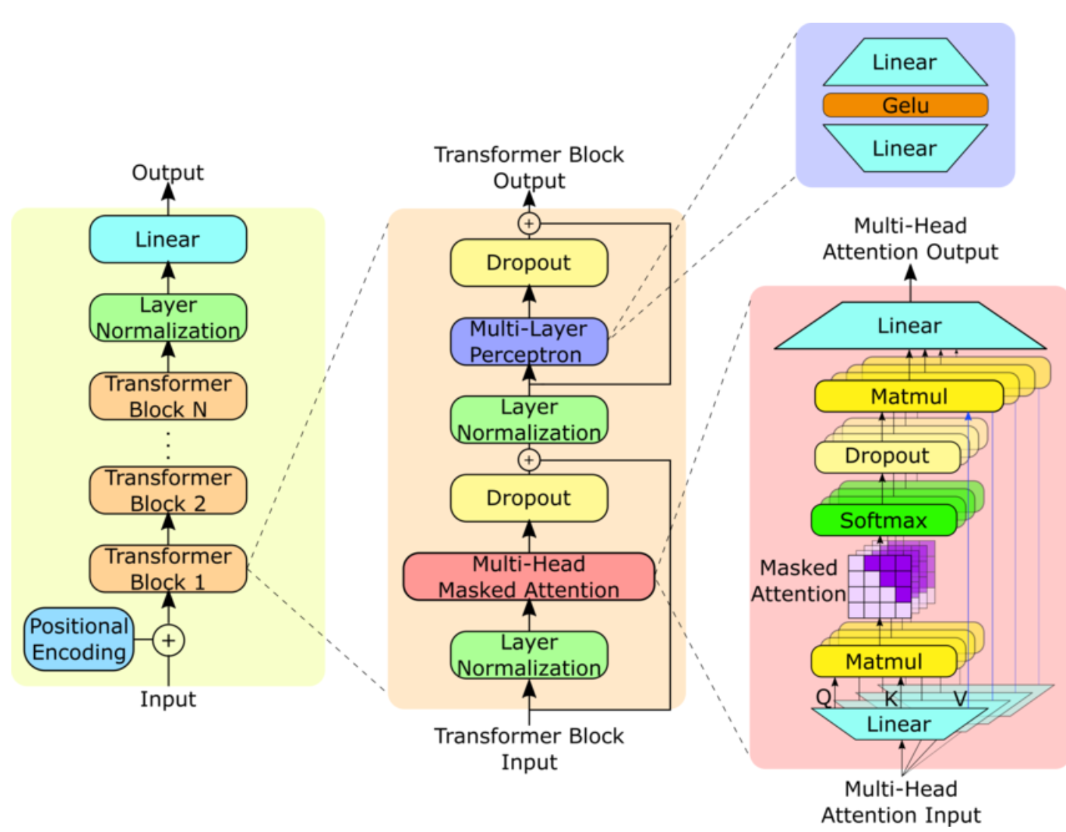
GPT2 Architecture
Source : https://www.researchgate.net/figure/GPT-2-model-architecture-The-GPT-2-model-contains-N-Transformer-decoder-blocks-as-shown_fig1_373352176

Slide 4
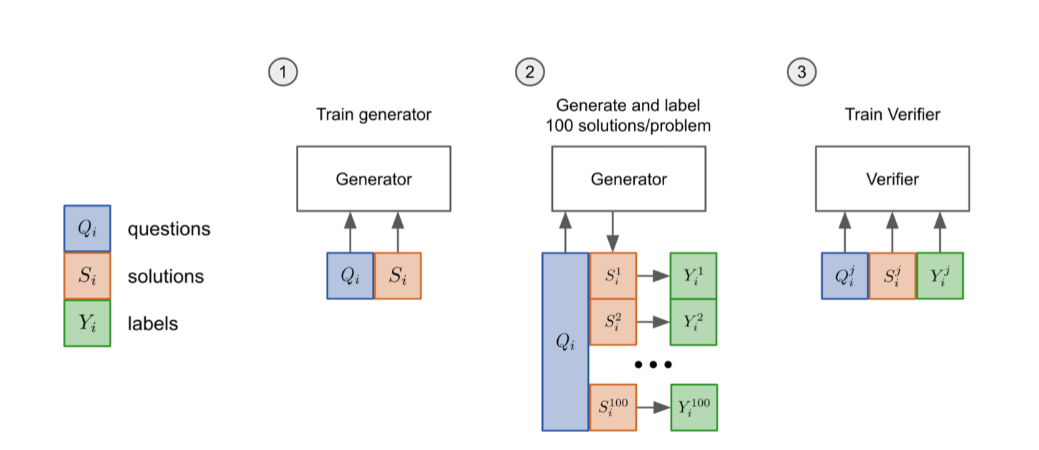
Tentative Approach
GPT-2

Slide 5
Dataset
GSM8K consists of 8.5K high quality grade school math problems created by human problem writers. We segmented these into 7.5K training problems and 1K test problems. These problems take between 2 and 8 steps to solve, and solutions primarily involve performing a sequence of elementary calculations using basic arithmetic operations (+ - X÷) to reach the final answer. A bright middle school student should be able to solve every problem.

Slide 6
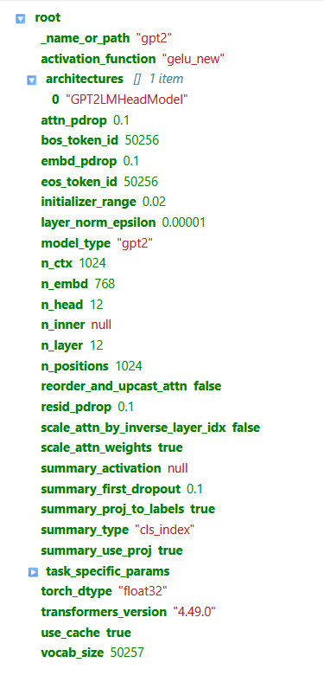
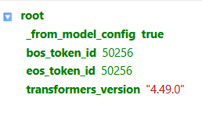
GPT-2 Config after training
generation_config.json

Slide 7
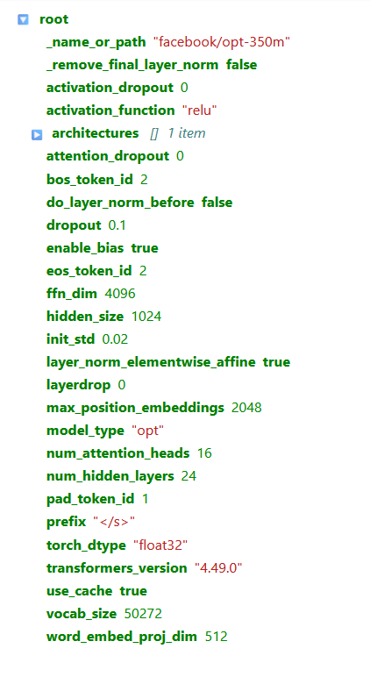
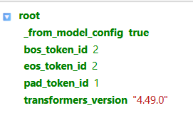
OPT-350m config after training
config.json

Slide 8
Loss Values
 | gpt2_10 | gpt2_20 | gpt2_50
test | 7.40 | 7.84 | 10.04
test_socratic | 7.41 | 7.84 | 10.06
 | opt350m_10 | opt350m_20
test | 10.15 | 10.89

Slide 9
GPT2_20 - Test Results
Prompt: Jenny has 23 apples. She gives 7 apples to her friend. How many apples does Jenny have left?
Response: Jenny has 23 apples. She gives 7 apples to her friend. How many apples does Jenny have left?
Jenny has 23 - 7 = <<23-7=15>>15 apples left.
Jenny has 15 / 7 = <<15/7=2>>2 apples left.
#### 2
Prompt: If one box can hold 6 oranges, how many oranges can 9 boxes hold?
Response: If one box can hold 6 oranges, how many oranges can 9 boxes hold?
Let x be the number of oranges in a box.
The number of oranges in a box is 9 x 6 = <<9*6=36>>36 oranges.
The number of oranges in a box is x + 36 = <<36+36=72>>72 oranges.
#### 72
Prompt: Sarah has 3/4 of a chocolate bar. She eats 1/2 of what she has. How much of the chocolate bar does she have left?
Response: Sarah has 3/4 of a chocolate bar. She eats 1/2 of what she has. How much of the chocolate bar does she have left?
She has 3/4*1/2=<<3/4*1/2=1>>1/2 of the chocolate bar.
She has 1/2*1/2=<<1/2*1/2=1>>1/2 of the chocolate bar.
#### 1

Slide 10
GPT2 - Test Results
Prompt: A classroom has 30 students. If the teacher wants to split them into groups of 5, how many groups will there be?
Response: A classroom has 30 students. If the teacher wants to split them into groups of 5, how many groups will there be?
There are 30 x 5 = <<30*5=150>>150 students in the classroom.
There are 150 - 30 = <<150-30=90>>90 students in the classroom.
#### 90
Prompt: Tom's age is twice that of his brother's age. If his brother is 12 years old, how old is Tom?
Response: Tom's age is twice that of his brother's age. If his brother is 12 years old, how old is Tom?
Tom is 12-2=<<12-2=10>>10 years old.
Tom's brother is 10+2=<<10+2=14>>14 years old.
#### 14
Prompt: Viraat has 93 dollars. He spent 20 dollars on sweets. He get his 30 dollars back from someone else. How much money does Viraat Have left?
Response: Viraat has 93 dollars. He spent 20 dollars on sweets. He get his 30 dollars back from someone else. How much money does Viraat Have left?
Viraat has 93 - 20 = <<93-20=42>>42 dollars.
He has 42 / 30 = <<42/30=3>>3 dollars left.
#### 3

Slide 11
GPT2 - Socratic Test Results
Prompt: Jenny has 23 apples. She gives 7 apples to her friend. How many apples does Jenny have left?
Response: Jenny has 23 apples. She gives 7 apples to her friend. How many apples does Jenny have left?
How many apples does Jenny have left? ** Jenny has 23 - 7 = <<23-7=21>>21 apples left.
How many apples does Jenny have left? ** Jenny has 21 - 7 = <<21-7=14>>14 apples left.
#### 14
Prompt: If one box can hold 6 oranges, how many oranges can 9 boxes hold?
Response: If one box can hold 6 oranges, how many oranges can 9 boxes hold?
How many oranges can 9 boxes hold? ** 9 boxes can hold 6 oranges x 6 oranges = <<9*6=36>>36 oranges.
How many oranges can 9 boxes hold? ** 9 boxes can hold 36 oranges x 9 boxes = <<36*9=96>>96 oranges.
#### 96
Prompt: Sarah has 3/4 of a chocolate bar. She eats 1/2 of what she has. How much of the chocolate bar does she have left?
Response: Sarah has 3/4 of a chocolate bar. She eats 1/2 of what she has. How much of the chocolate bar does she have left?
How many chocolate bars does Sarah have? ** Sarah has 3/4*1/2=<<3/4*1/2=2>>2 chocolate bars.
How many chocolate bars does Sarah have left? ** She has 2*1/2=<<2*1/2=2>>2 chocolate bars.
####

Slide 12
GPT2 - Socratic Test Results
Prompt: A classroom has 30 students. If the teacher wants to split them into groups of 5, how many groups will there be?
Response: A classroom has 30 students. If the teacher wants to split them into groups of 5, how many groups will there be?
How many students are in the group? ** The number of students in the group is 30-5 = <<30-5=20>>20 students.
How many students are in the group? ** The number of students in the group is 20-5 = <<20-5=10>>10 students.
How many students are in the group? ** The
Prompt: Tom's age is twice that of his brother's age. If his brother is 12 years old, how old is Tom?
Response: Tom's age is twice that of his brother's age. If his brother is 12 years old, how old is Tom?
How old is Tom? ** Tom is 12 years old because 12 = <<12=12>>12
How old is Tom's brother? ** His brother is 12 years old because 12 = <<12=12>>12
#### 12
Prompt: Viraat has 93 dollars. He spent 20 dollars on sweets. He get his 30 dollars back from someone else. How much money does Viraat Have left?
Response: Viraat has 93 dollars. He spent 20 dollars on sweets. He get his 30 dollars back from someone else. How much money does Viraat Have left?
How much money did Viraat have after 20 dollars? ** After 20 dollars, Viraat had 93 - 20 = <<93-20=42>>42 dollars.
How much money did Viraat have after 30 dollars? ** After 30 dollars, Viraat had 42 - 20 = <<42-20

Slide 13
Conclusion
As the data increases, the efficiency also increase.
Current gpt2 model shows lesser results on mathematical reasoning.
It is even difficult for socratic test, since they are mostly philosphical in context.
From the loss value we can conclude that opt performs much better , also in less epoch training.
OPT-350M might have an initial advantage in terms of understanding or adapting to the dataset, but both models eventually reach a similar level of performance.

Slide 14
THANK YOU!

