Slide 1
American Airlines BHS
Presented by
Vamsi Krishna Bellam - 11593718
Naga Satya Sai Parvathaneni - 11599516
Aakanksha Poreddy -
Vishal Vallapu - 11618660

Slide 2
Content steps
Problem statement
Dataset analysis
Data wrangling
Exploratory data analysis
Modelling
Results
Conclusion

Slide 3

Problem statement
Predict the number of bags that will arrive into the baggage handling system for any given outbound flight.
Explore patterns and trends which can lead to better operational measures.

Slide 4

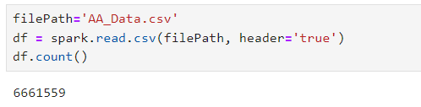
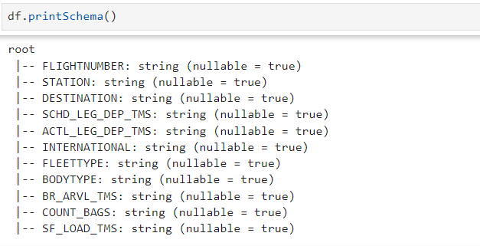
Dataset analysis
Dataset length
Schema

Slide 5
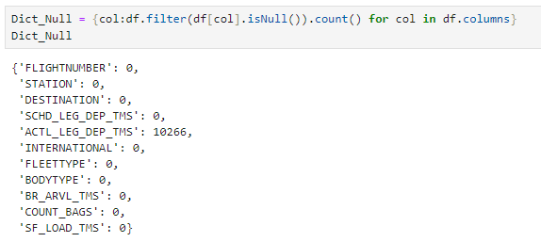
Dataset analysis
Row definition
Number of bags arrived in the bag room per flight per minute.
Null values
Time series range
May 25th, 2023 – September 5th, 2023

Slide 6
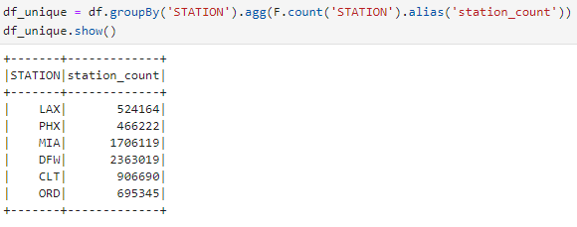

Dataset analysis
Source stations
Destination stations

Slide 7

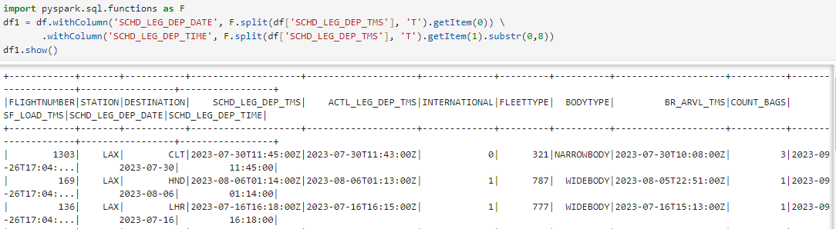
Data wrangling
Splitting the schedule leg timestamp to date and time.

Slide 8
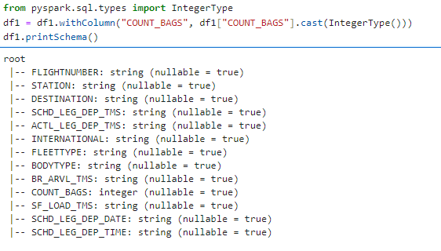
Data wrangling
Converting the bags count variable into integer.

Slide 9
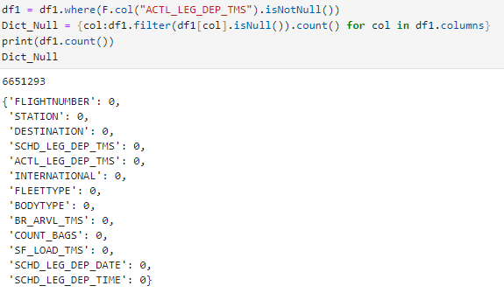
Data wrangling
Removing null values in the dataset

Slide 10
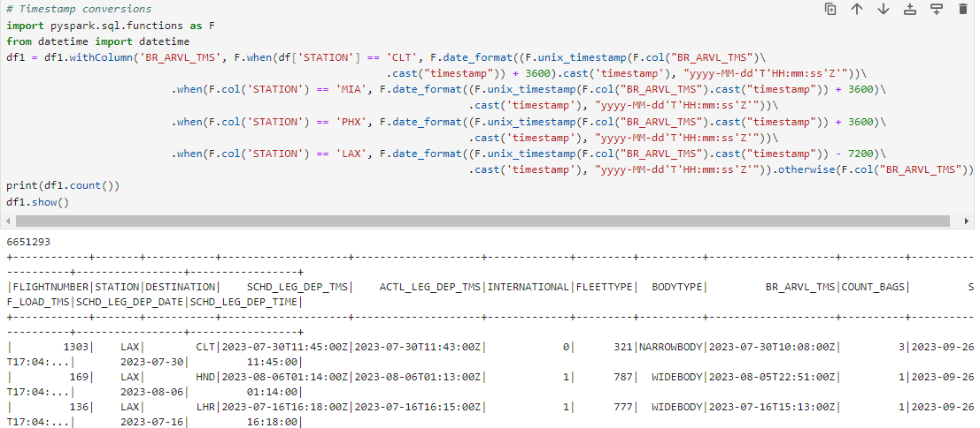
Data wrangling
Timestamp conversions

Slide 11
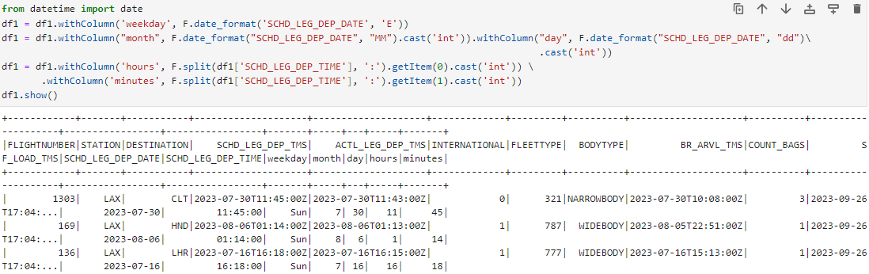
Data wrangling
Feature creation

Slide 12
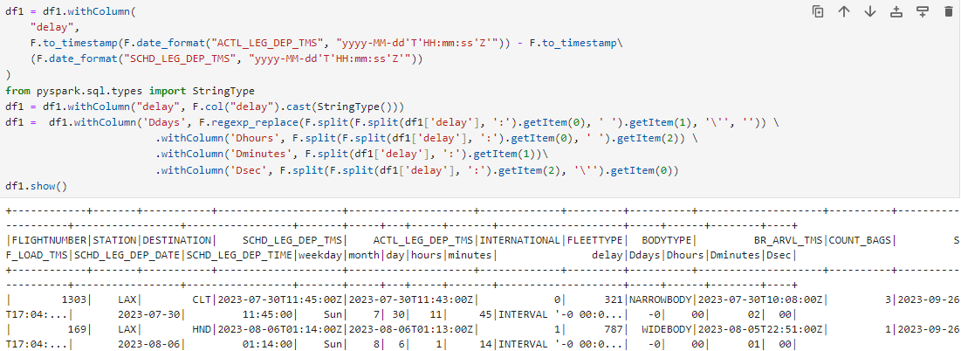
Data wrangling
Feature creation

Slide 13
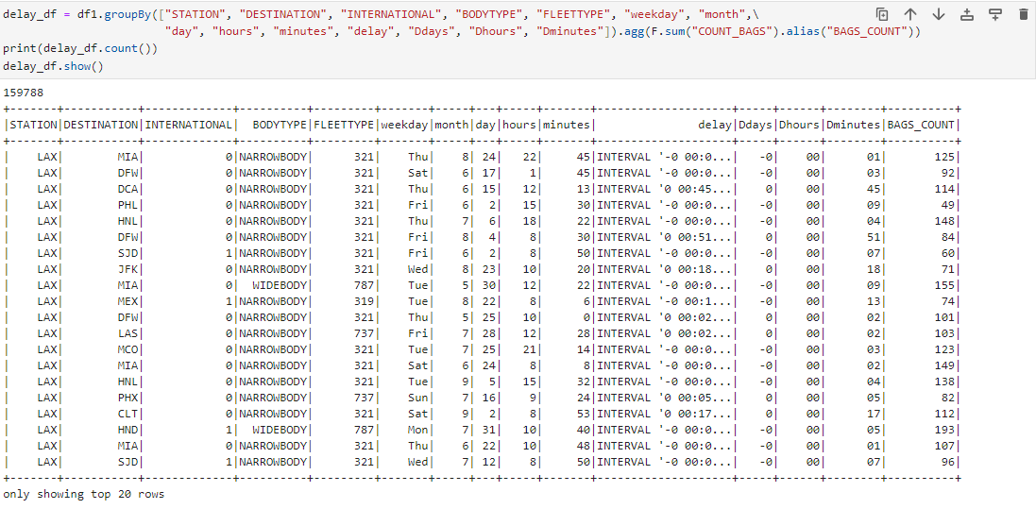
Data wrangling
Dataset Aggregation

Slide 14
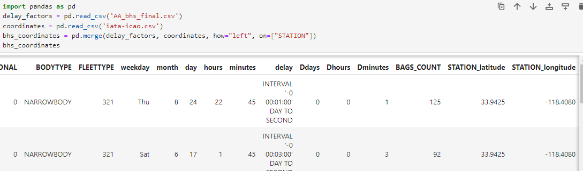
Data wrangling
Feature creation

Slide 15
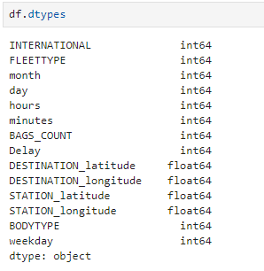
Data wrangling
Data handling
Body type
Narrowbody - 1
Widebody - 0
Weekday
Sunday - 0
Monday - 1
Tuesday - 2
Wednesday - 3
Thursday - 4
Friday - 5
Saturday - 6
Calculated delay

Slide 16

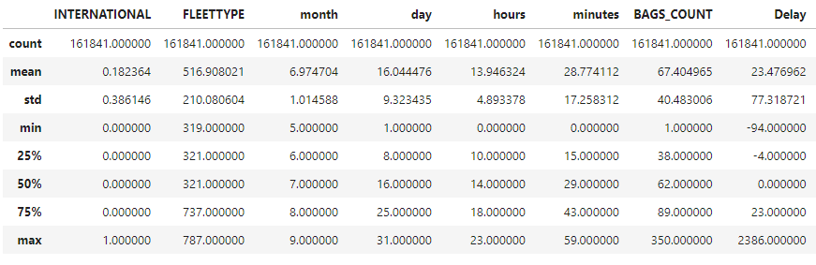
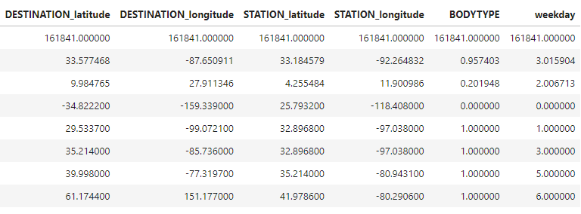
Exploratory data analysis
Descriptive statistics

Slide 17
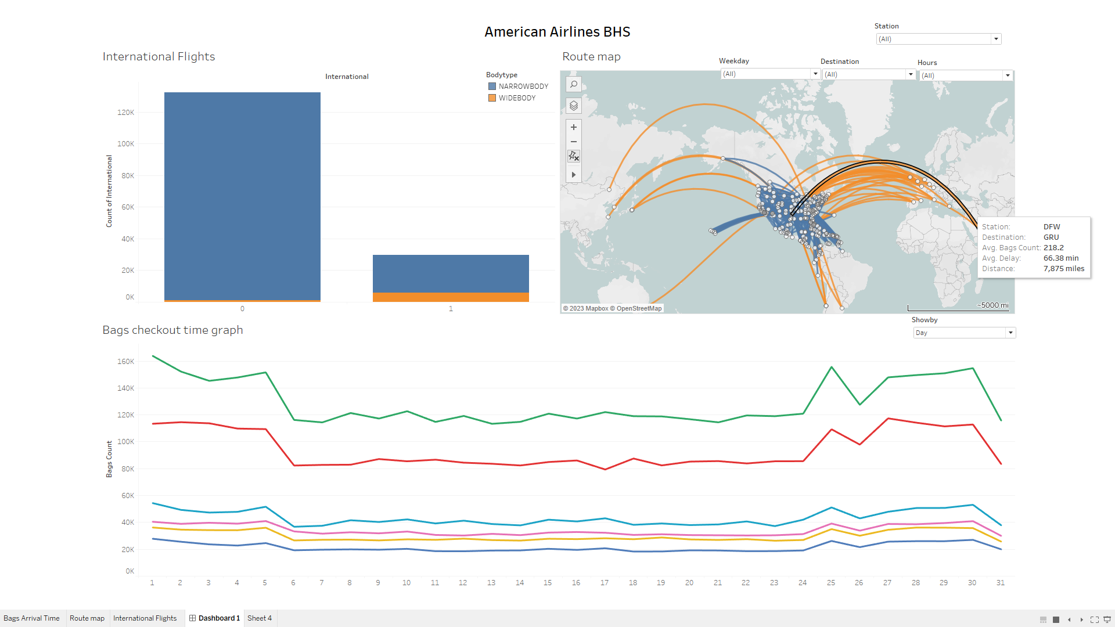
Exploratory data analysis

Slide 18
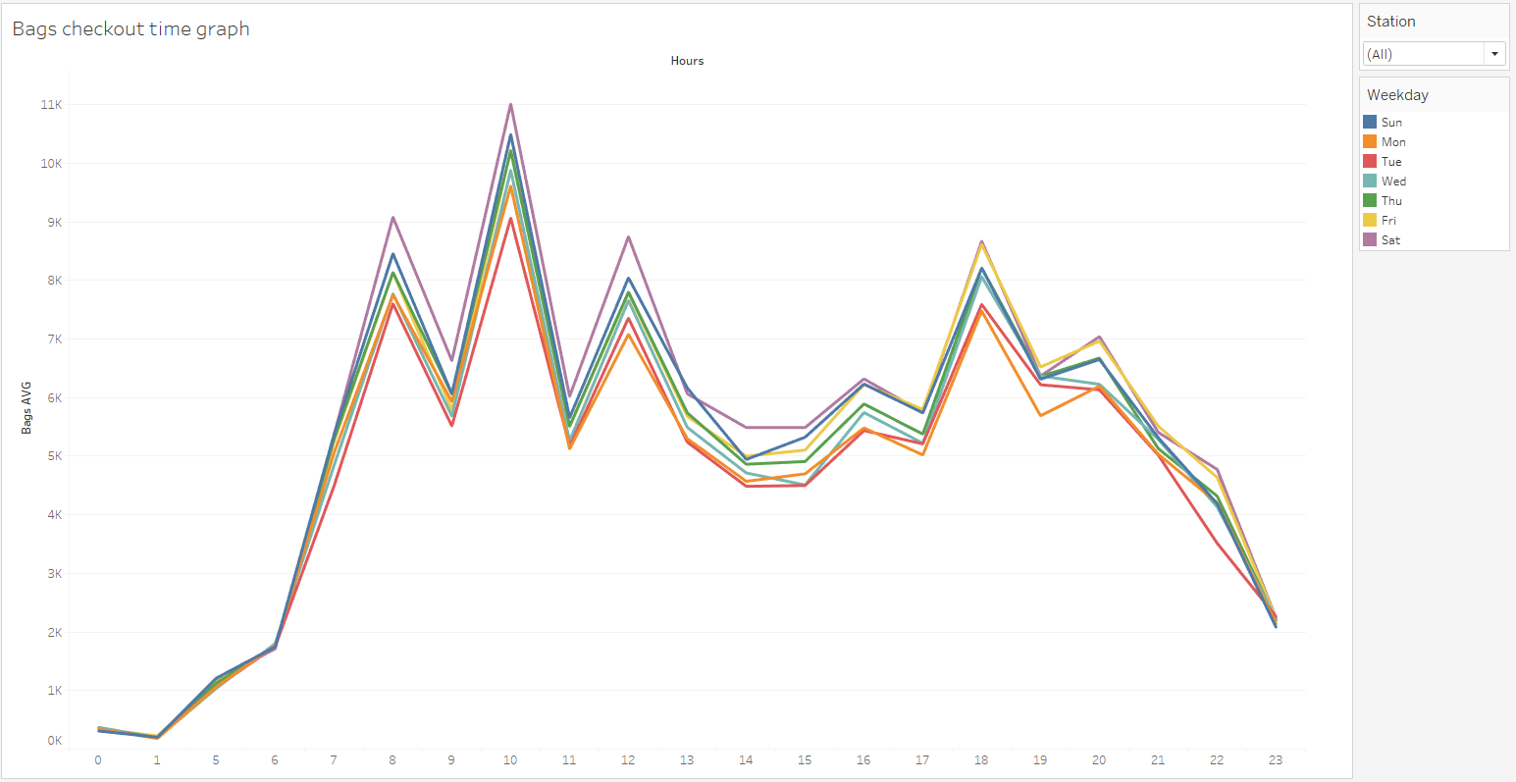
Exploratory data analysis

Slide 19
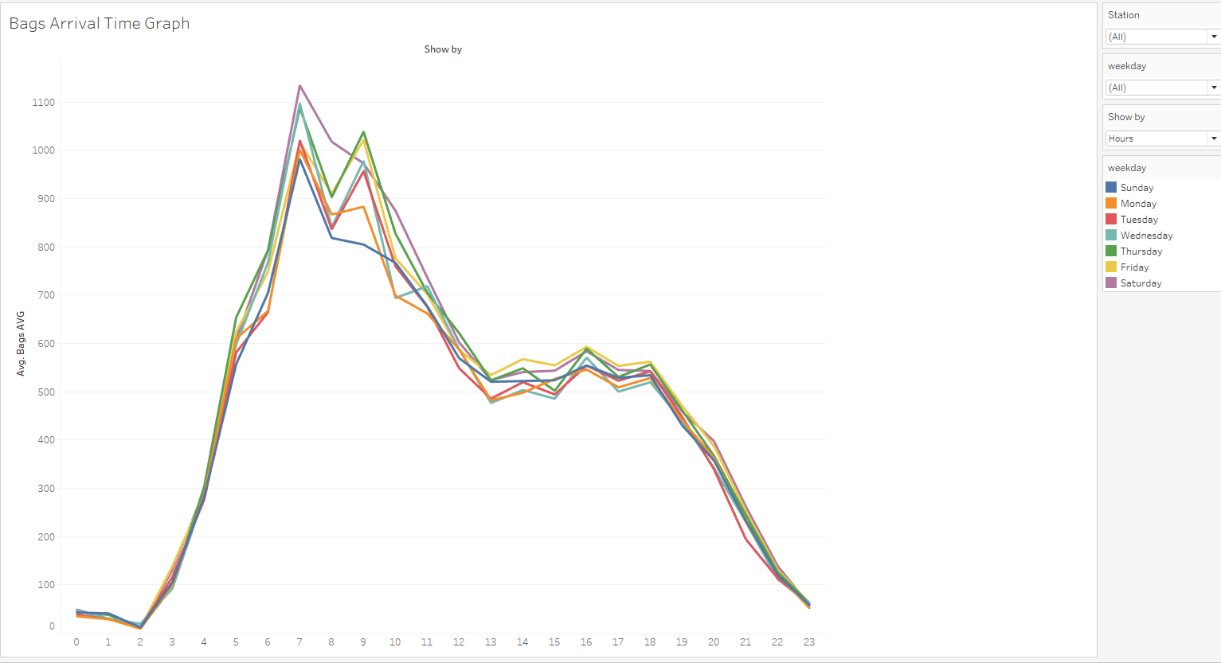
Exploratory data analysis

Slide 20

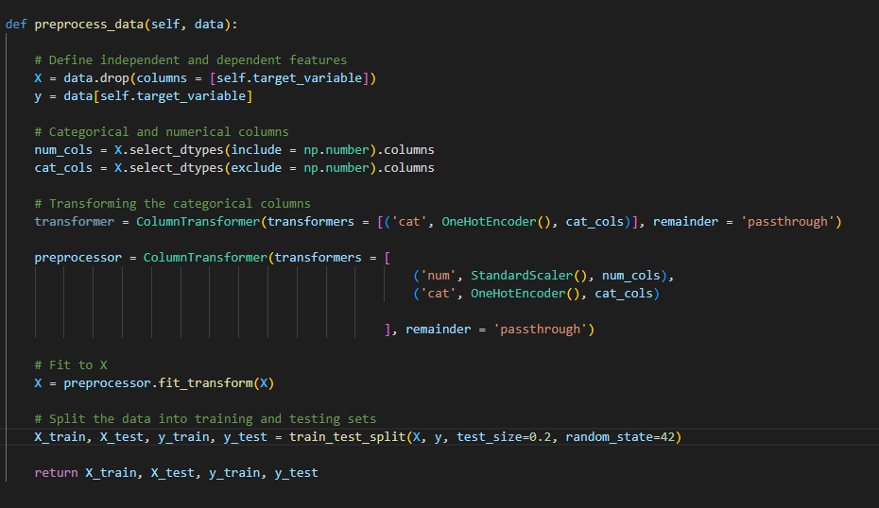
Modelling
Preprocessing

Slide 21
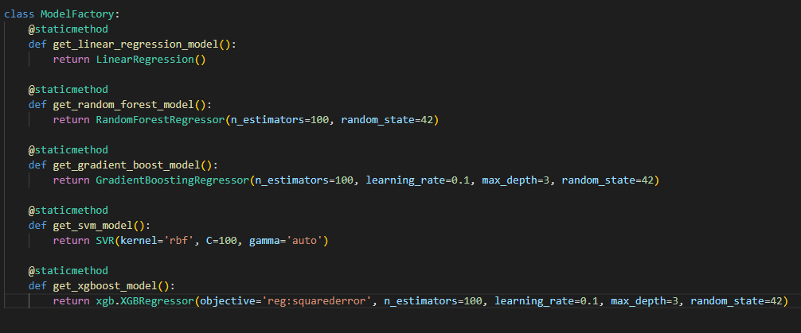
Modelling
Models

Slide 22
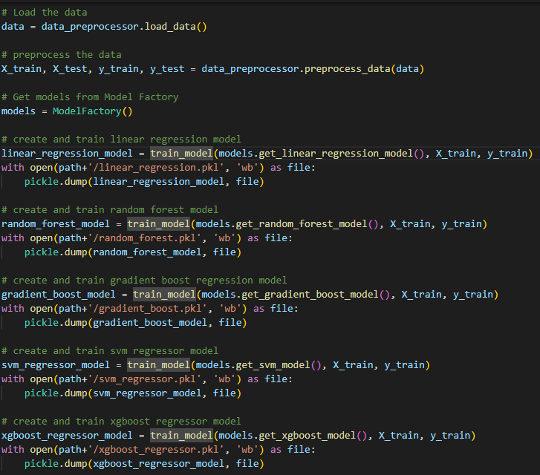
Modelling
Model training

Slide 23


results
Model comparison

Slide 24

Conclusion
Challenges overcome
Model performance
Pattern analysis
Further refinement

