Slide 1

ALPIQ – Modeling Tomorrow‘s Energy Needs
Vishal Varwani, Florian Zogaj, Jakob Hütteneder, Jadhav Gourav

Slide 2
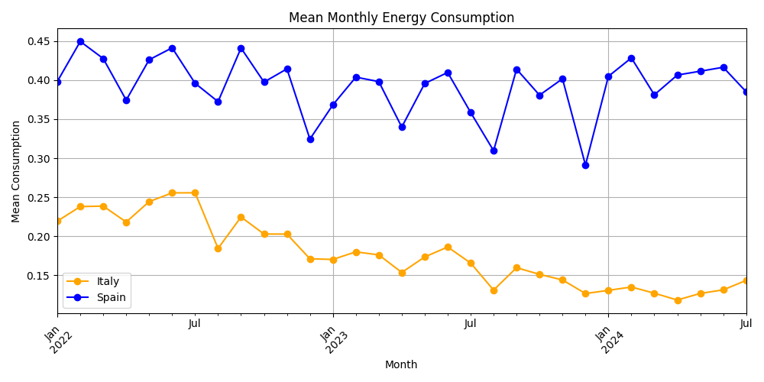
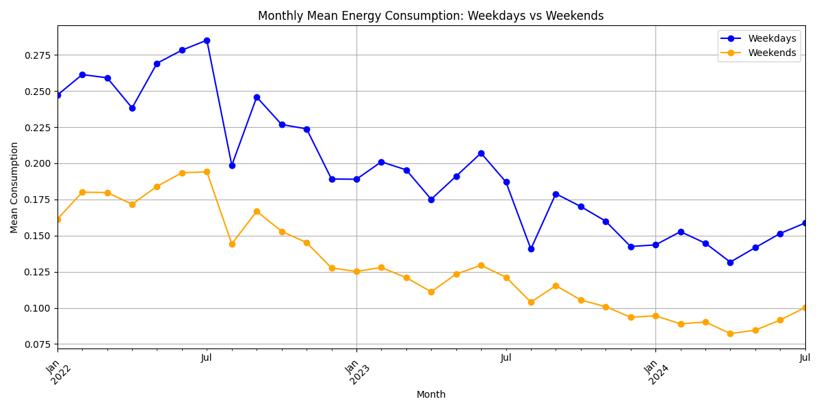
Understanding the data

Slide 3
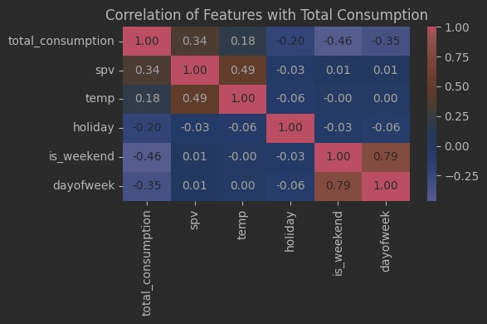
Understanding the data

Slide 4
Feature Engineering
Months
Days
Is_weekend (0 – weekdays, 1 – weekends)
Hours
Holidays (0 – no holiday, 1 – holiday)
Spv
Temperature
Lag (1h, 24h, 48h)

Slide 5
LSTM (Long short-term memory)

Slide 6
XGBoost (eXtreme Gradient Boosting)

