Slide 1
DBMS
Blood Bank Management System
By :
Vishal Vasoya 202118013
Bhavin Soneji - 202118024
Parth Surydhwaj - 202118032
Bhumi Bosamia -- 202118040

Slide 2
About
Blood bank stores employee details, patient details, donor details, and blood stored in the Inventory. For patients and donors, their medical information is stored.
Blood details help in managing blood requirements, which is our primary goal.

Slide 3

Description
Blood bank requires very meticulous storage of data. This storage needs to be maintained properly. Blood
availability is essential for medical emergencies. Thus we need a good database that correctly describes the
stored blood. Many people with blood conditions require a blood transfusion at a specific time interval. Such
people can register at a blood bank so that the bank can provide blood for regular transfusion. Details of the
patient need to be maintained. This is because the donor must be healthy for his/her blood to be used by a
patient.

Slide 4
There are departments like inventory, camps, etc. Inventory is where the blood is been stored, and we have all the details such as available bloodstock for any blood group. We have camps that handle the camping for the blood collection by the donors. Camps are held at certain time intervals, and we have many donors coming to the camps for donations. A donor can have multiple instances over a period of time, and the details of each donation and donor need to be adequately maintained.
Blood Bank manages the blood request by patients and hospitals. Patients and Hospitals can seek the branch where the blood requested by them is available and also, the available amount of blood. The employee details include name, age, gender, and also the department of each of them where they are working. Data of all these need to be maintained for the proper functioning of the bank.

Slide 5
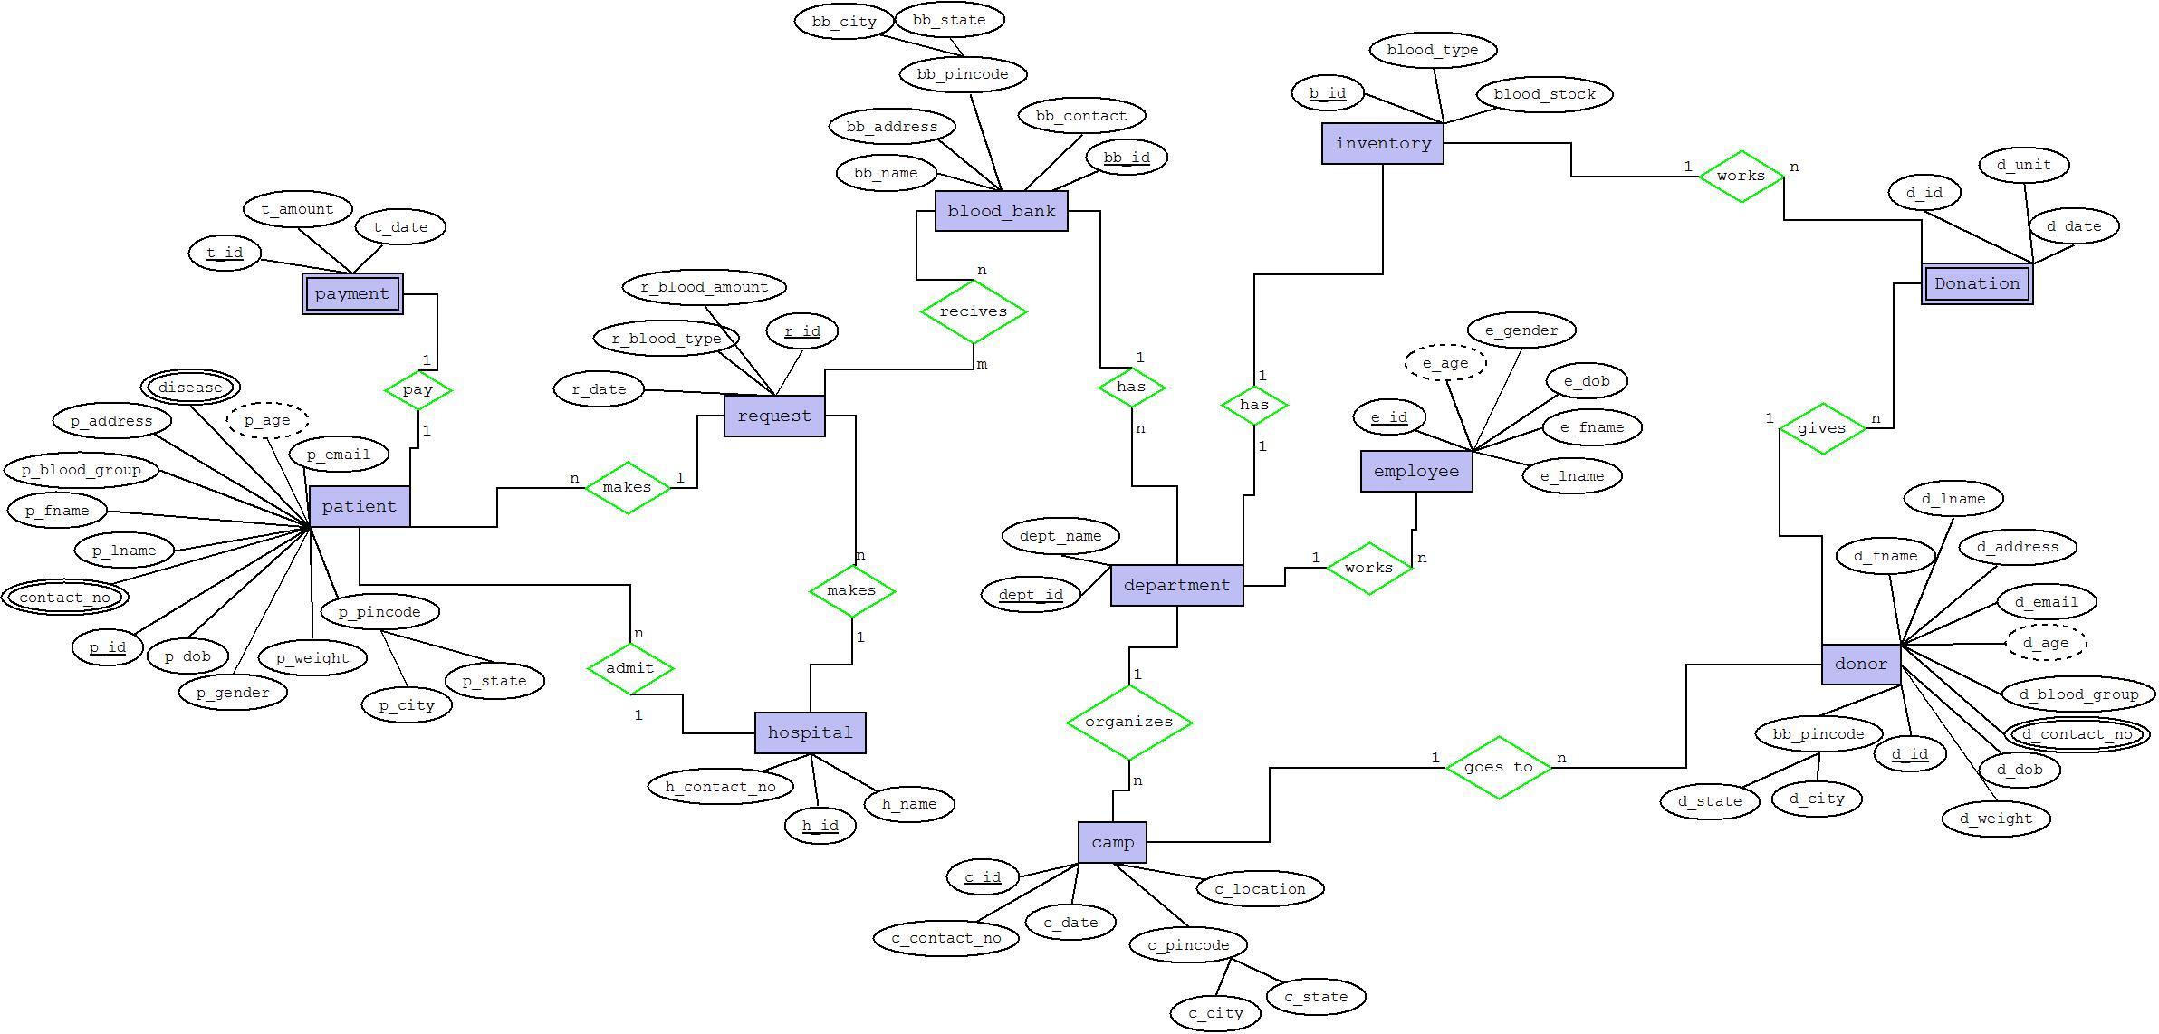
ERD : Entity Relationship Diagram

Slide 6
Entities
Blood Bank
Patients
Donor
Employee
Blood bank which manages the whole system.
One who require the blood.
One who donates the blood.
One who manages all the departments.

Slide 7
Entities
Inventory
Camp
Request
Hospital
Where the blood is stored.
Organized for blood Collections.
To connect the blood request from patient and hospital to the blood bank.
One who makes request for blood.

Slide 8
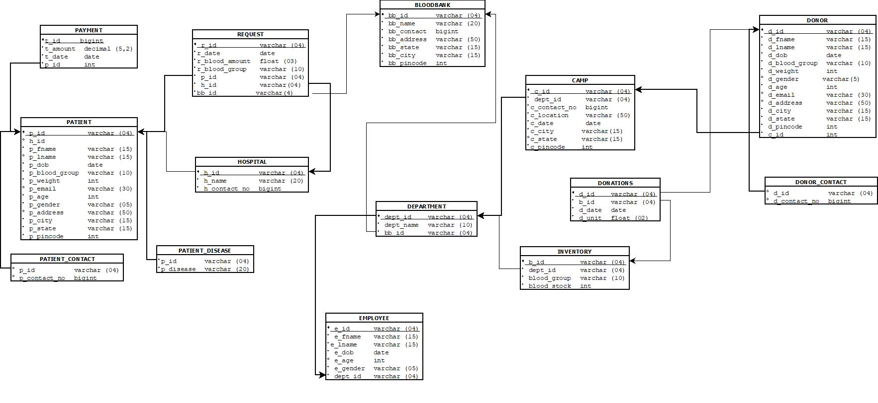
Relational Schema

Slide 9
FUNCTIONAL DEPENDENCIES :
BLOODBANK
(bb_id, bb_name, bb_contact, bb_address, bb_state, bb_city, bb_pincode)
{ bb_id } -> bb_name
{ bb_id } -> bb_contact
{ bb_id } -> bb_address
{ bb_pincode } -> bb_state
{ bb_pincode } -> bb_city
Candidate Key:- { bb_id, bb_pincode }
Prime Attribute:- bb_id, pincode
Non-Prime Attribute:- bb_name, bb_contact, bb_address,bb_state, bb_city

Slide 10
FUNCTIONAL DEPENDENCIES :
Normalization to 3NF and BCNF form.
Reason: It is in 2NF but bb_pincode is not unique. Thus it cannot be a prime attribute. So bb_id and bb_pincode together can be declared as super key, thus uniquely identifying bb_city and bb_state.
{ bb_id } -> bb_name
{ bb_id } -> bb_contact
{ bb_id } -> bb_address
{ bb_id, bb_pincode } -> bb_state
{ bb_id, bb_pincode } -> bb_city

Slide 11
FUNCTIONAL DEPENDENCIES :
Request
(r_id, p_id, h_id, bb_id, r_date, r_blood_amount, r_blood_group)
{ r_id } -> r_date
{ r_id } -> h_id
{ r_id } -> p_id
{ r_id } -> bb_id
{ r_id } -> r_blood_amount
{ r_id } -> r_blood_group
Candidate Key:- { r_id }
Prime Attribute:- r_id
Non-Prime Attribute:- p_id, h_id, bb_id, r_date, r_blood_amount, r_blood_group
Table is in 3NF and BCNF form.
Reason: It is in 2NF and there is no transitive dependency for non-prime attributes.

Slide 12
FUNCTIONAL DEPENDENCIES :
DONATIONS
(d_id, b_id, d_date, d_unit)
{ d_id, b_id } -> d_date
{ d_id, b_id } -> d_unit
Candidate Key:- { d_id, b_id }
Prime Attribute:- d_id, b_id
Non-Prime Attribute:- d_date, d_unit
Table is in 3NF and BCNF form.
Reason: It is in 2NF and there is no transitive dependency for non-prime attributes.

Slide 13
FUNCTIONAL DEPENDENCIES :
PATIENT_DISEASE
(p_id, p_disease)
{ p_id } -> p_disease
Candidate Key:- { p_id }
Prime Attribute:- p_id
Non-Prime Attribute:- p_disease
Table is in 3NF and BCNF form.
Reason: It is in 2NF and there is no transitive dependency for non-prime attributes.

Slide 14
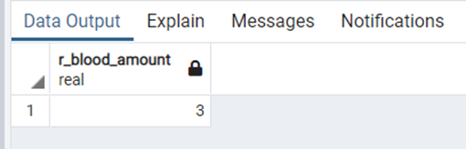
Queries
Display the total no. of units requested for B-ve blood type on date='2021-11-18'.
select r_blood_amount from request where r_blood_group='B Negative' and r_date='2021-11-18’

Slide 15
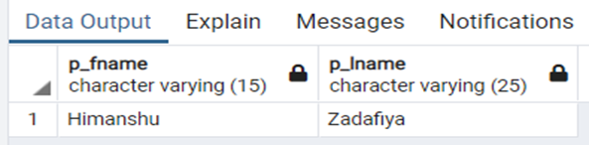
Queries
Display name of the patient who has requested A+ve Blood group.
select p_fname,p_lname from patient p join request r on p.p_id=r.p_id where r_blood_group='A Positive';

Slide 16
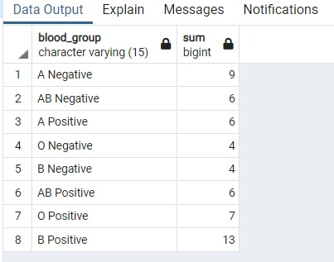
Queries
Display blood stock of every available blood group.
select blood_group,sum(blood_stock) from inventory group by blood_group;

Slide 17
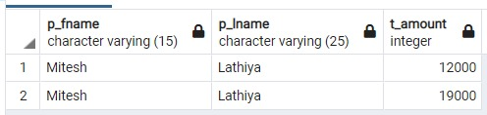
Queries
Display the patient details and amount who pay more than one time.
select p_fname,p_lname,p1.t_amount from patient p join payment p1 on p.p_id=p1.p_id where p.p_id in (select p_id from payment group by p_id having count(p_id)>1);

Slide 18
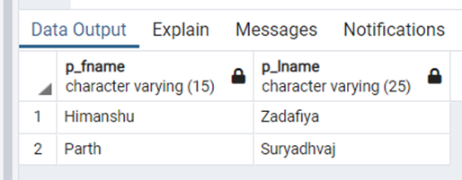
Queries
Display the number of patient having disease='Diabetes'.
select p_fname,p_lname from patient natural join patient_disease where p_disease='Diabetes'

Slide 19
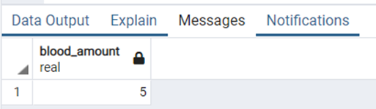
Queries
Display the number of blood request in a given month(Octomber'2021).
select sum(r_blood_amount) as blood_amount from request where EXTRACT(MONTH FROM r_date)=10;

Slide 20
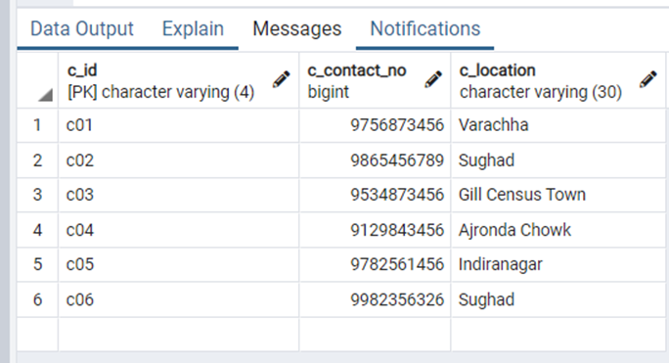
Queries
Display all the camp organize in year=2021.
select c_id,c_contact_no,c_location from camp where EXTRACT(YEAR FROM c_date)=2021;

Slide 21
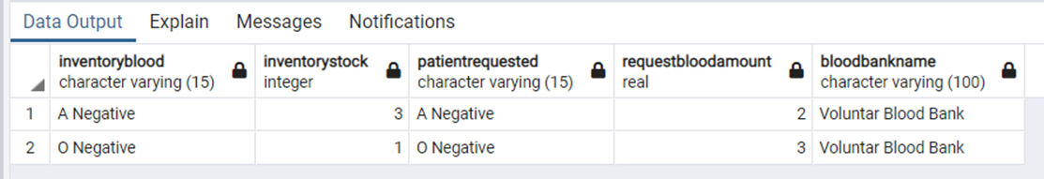
Queries
Check the blood which is requested by patient is available or not in the inventory of the blood bank ='Voluntar Blood Bank'.
select i.blood_group as InventoryBlood,i.blood_stock as InventoryStock,r.r_blood_group as PatientRequested,r.r_blood_amount as RequestBloodAmount,bb.bb_name as BloodBankName from inventory i join department d on i.dept_id=d.dept_id join blood_bank bb on d.bb_id=bb.bb_id join request r on bb.bb_id=r.bb_id join patient p on r.p_id=p.p_id where i.blood_group=r.r_blood_group and bb.bb_name='Voluntar Blood Bank';

Slide 22
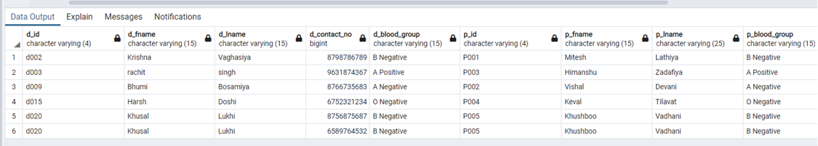
Queries
Display the name and contact of the donor whose blood group match with patient requested blood group.
select d.d_id , d_fname , d_lname , d1.d_contact_no , d.d_blood_group , p.p_id , p.p_fname , p.p_lname , p.p_blood_group from donor_contact d1 join donor d on d1.d_id=d.d_id join camp c on d.c_id=c.c_id join department dep on c.dept_id = dep.dept_id join blood_bank bb on dep.bb_id=bb.bb_id join request r on bb.bb_id=r.bb_id join patient p on r.p_id=p.p_id where d.d_blood_group=p.p_blood_group;

Slide 23
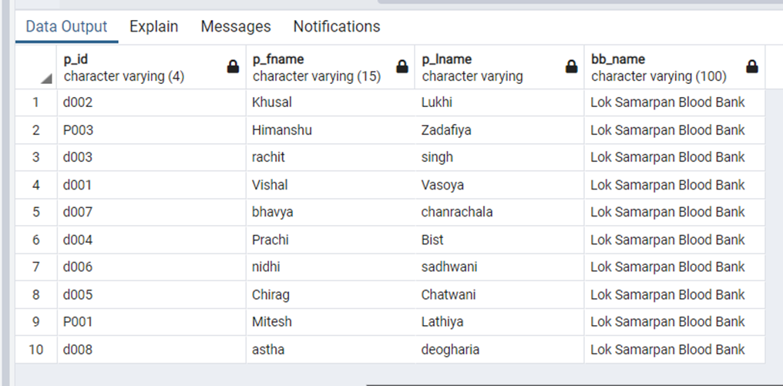
Queries
List all the patients and donors associated with the any particular blood bank.
(select p.p_id,p_fname,p_lname,bb_name from patient p join request r on p.p_id=r.p_id join blood_bank bb on r.bb_id=bb.bb_id where bb_name='Lok Samarpan Blood Bank')
union
(select d.d_id,d_fname,d_lname,bb_name from donor d join camp c on d.c_id=c.c_id join department d1 on c.dept_id=d1.dept_id join blood_bank bb on d1.bb_id=bb.bb_id where bb_name='Lok Samarpan Blood Bank')

Slide 24
Conclusion :
The above-described system is an attempt to solve the user queries on blood banks and data related to it. It is a logically designed and relationally connected system that makes it user-friendly enough to eliminated the issues like redundancy & inconsistency and provides access, security and concurrency to the users.
Through this project we came across many new concepts on database management, its storage and abstraction. Also, we developed an insight of the domain on how an organisation (e.g.- Blood Banks, Hospitals, Banks, Employee Management etc.) works. Primarily, to our topic, we get to know how to relate the entities and how to ease the working in the system. How to provide the patient the required information to get an easy reach to the hospital or the blood bank, vis-à-vis to keep a record of the blood available/deposited in an inventory which may be collected by the donors at blood camps.
It has been a great opportunity working on the project and inculcate the use of IT in health sector, hence maintaining an efficient and structured record of Blood Banks, its locations, availability, donors, patients, past records, hospitals etc.

Slide 25
Thank You

