Slide 1

FACE MASK DETECTION
GROUP
VISHAL VASOYA (202118013) VASHISHTH RAVAL(202118026)

Slide 2

INTRODUCTION
I N C U R R E N T T I M E S , M A S K I S A N E C E S S I T Y W H I L E G O I N G O U T S I D E .
A I M I S T O P R E P A R E A M O D E L T H A T W O U L D H E L P D E T E C T I N G W H E T H E R O R N O T A MA S K I S WE A R NING C O R R E C T L Y .
U S E R S C A N B E S E G R E G A T E D I N T O 3 D I F F E R E N T C A T E G O R I E S :
W E A R I N G A M A S K
W E A R I N G A M A S K C O R R E C T L Y N O T A T A L L W E A R I N G A M A S K

Slide 3
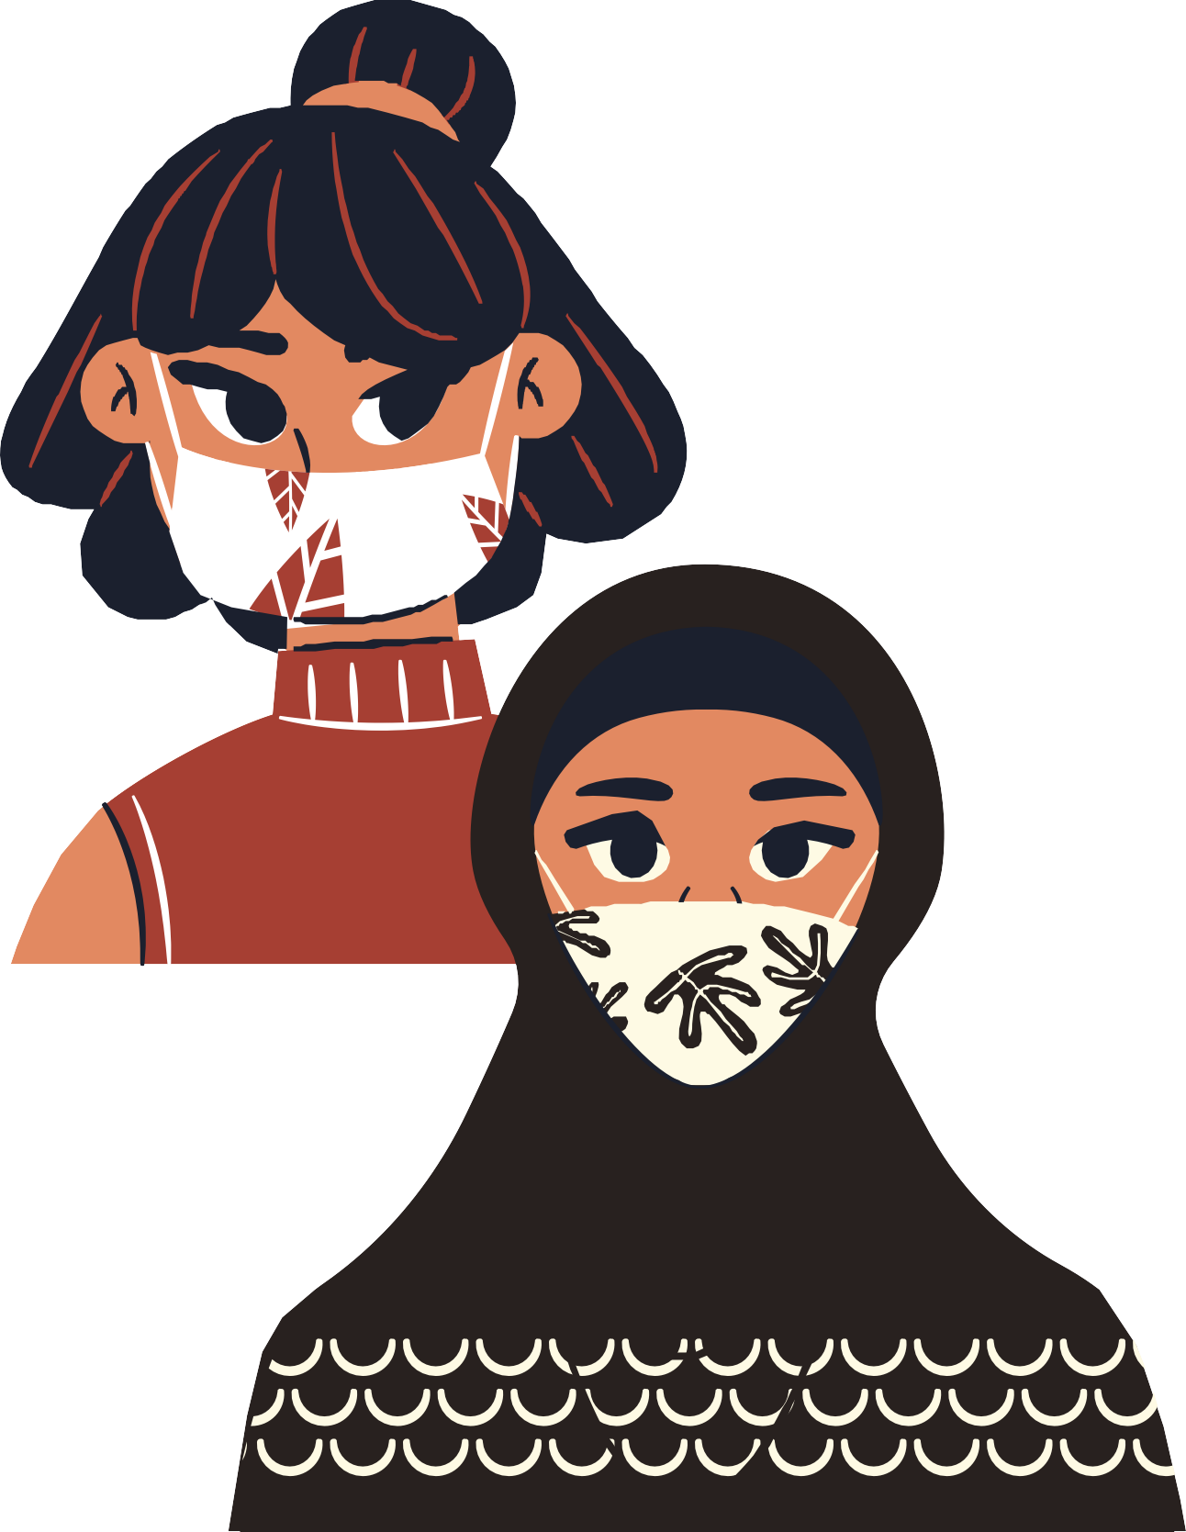
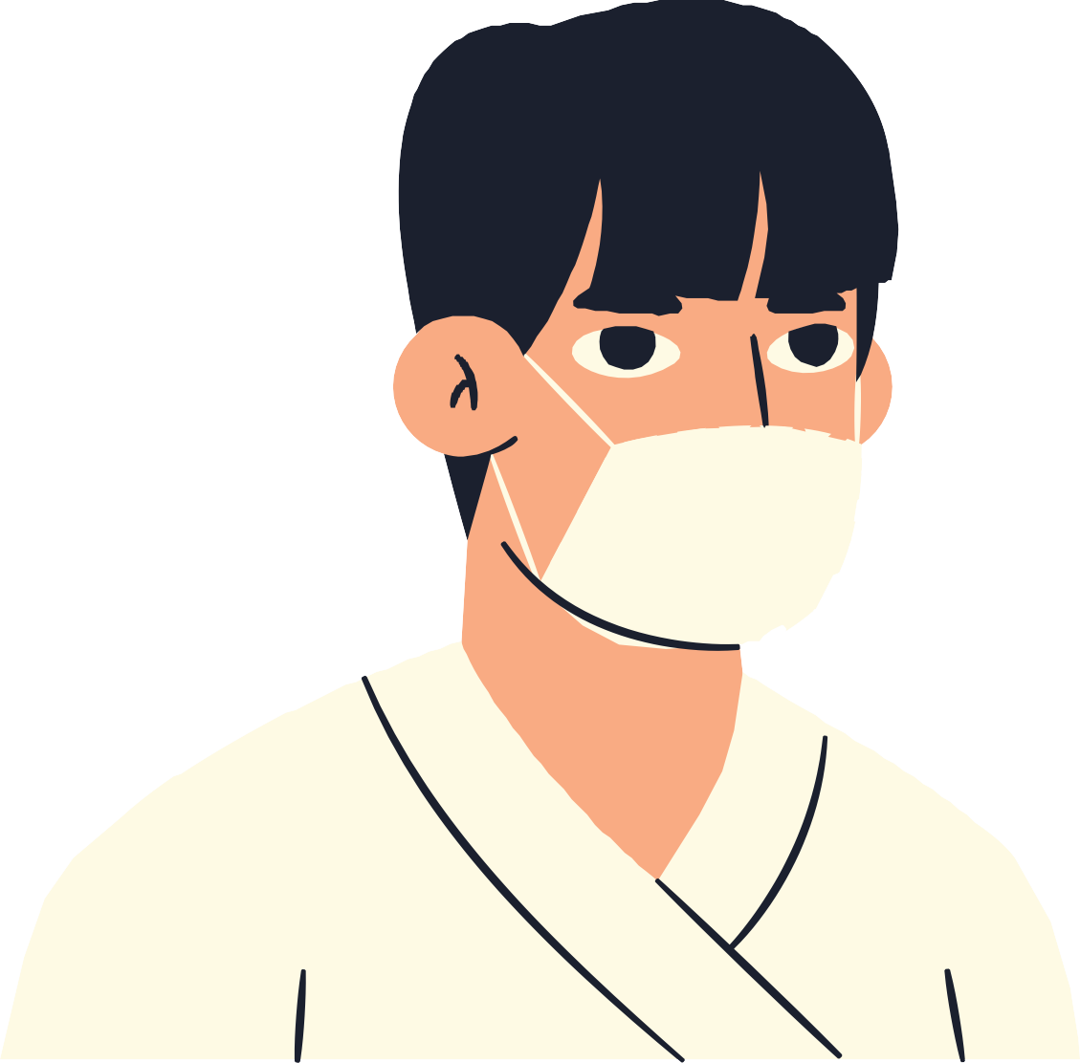
PROBLEM STATEMENT
Will deliver a model to tackle a situation as improper position of masks on face, and to help authorities segregate them from the ones wearing them properly.
In this we will take an image as an input.
Through this model users can identify and segregate the different types of people on the three basis(output) as mentioned in previous slide, by simply testing the image through the model.

Slide 4
DATASET DETAILS
We will be using Kaggle's Face Mask Detection Dataset
Dataset contains 853 images belonging to follwing 3 different classes:
With Mask
Without Mask
Mask worn incorrectly
Dataset also contains information of bounding boxes in the PASCAL VOC format
In total there are 4072 faces in the given 853 images.
With Mask
Without Mask
Incorrect Mask
0
1,000
2,000
3,000
4,000

Slide 5
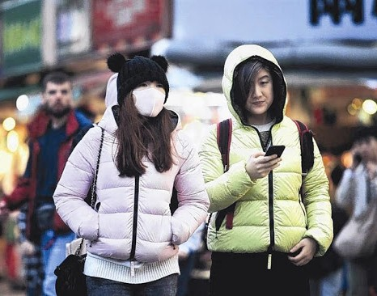
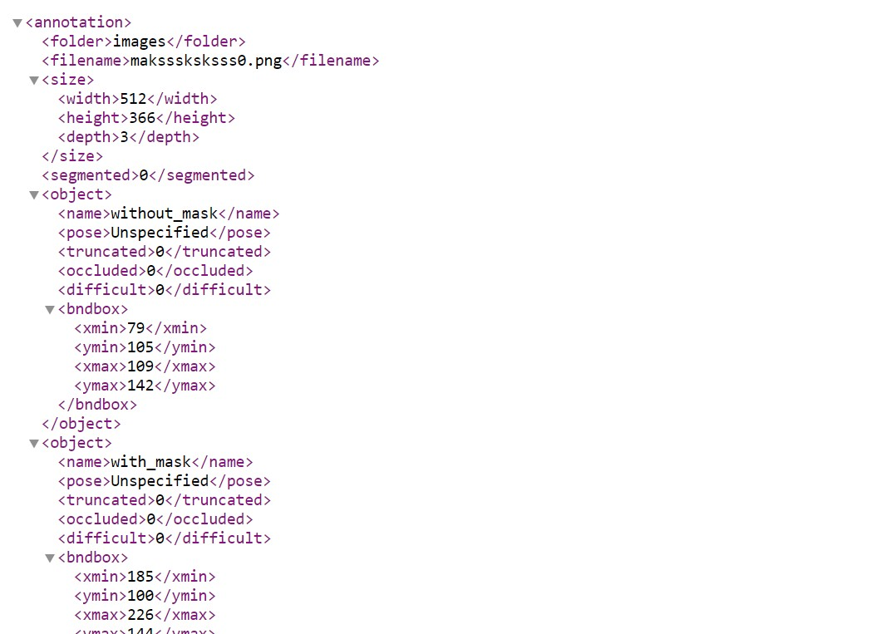
example of image from dataset along with the corresponding xml file

Slide 6

METHODOLOGY

Slide 7
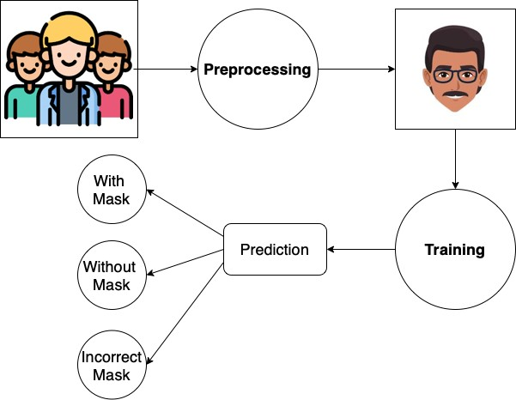
SCHEMATIC

Slide 8
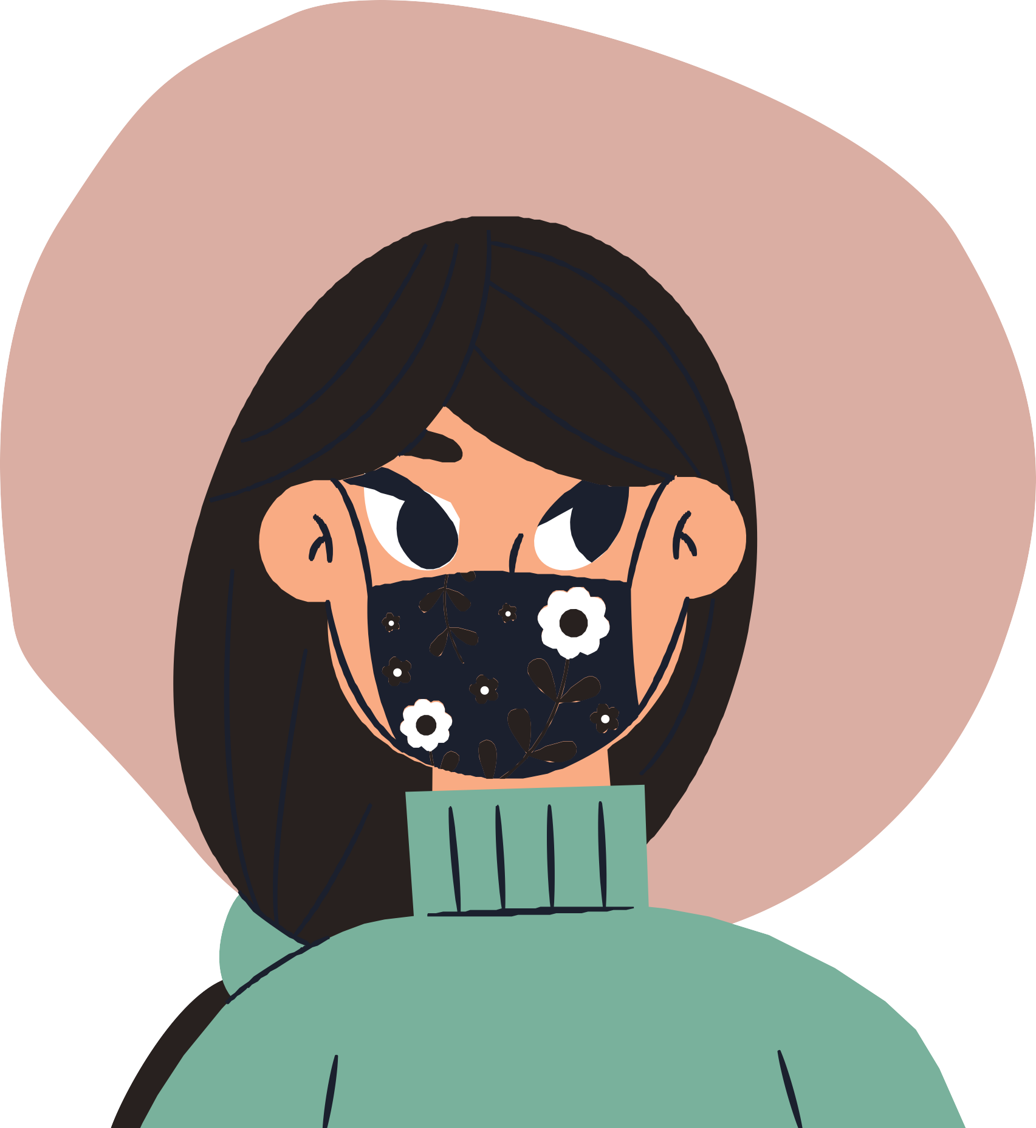





Preprocessing
finding coordinates of the faces and number of faces in each image extracting faces from the image and their corresponding label.
crop the image and storing faces and labels resizing and making image array
encoding labels in one hot encode form
performing data augmentation using Image DataGenerator
splitting thhe data into training and testing
set

Slide 9
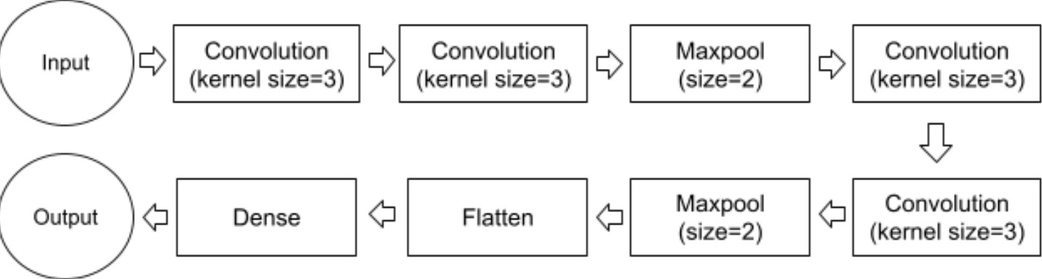
IMPLEMENTATION
We have used Keras' Sequential model, in this we have added 8 layers which are represented in the following figure:

Slide 10

IMPLEMENTATION
After preparing the sequential model we
compile the model to make it useful for our prediction. For compilation we use ADAM optimizer along with accuracy and recall as the metrics.
Post compilation we run our model for 15 epochs, with the augmented data by ImageData Generator. The result of each epoch are as follows:

Slide 11
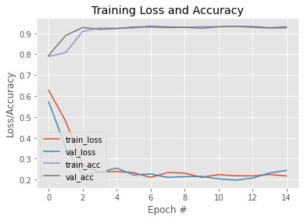
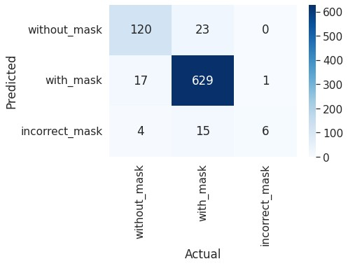
RESULTS
Below are the results of our model, after training it. First figure represent Loss/Accuracy after each epoche
Second figure shows confusion matrix of model after evaluating it on testing data

Slide 12
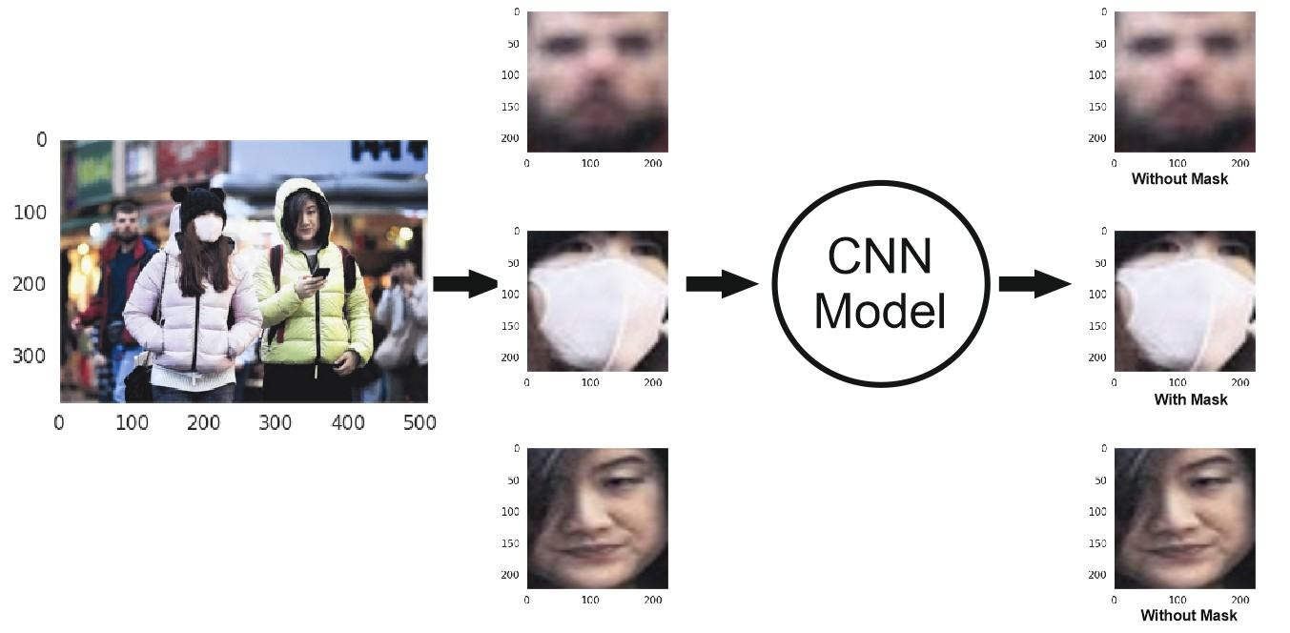
RESULTS
Predicting image when face annotation is given in XML file

Slide 13
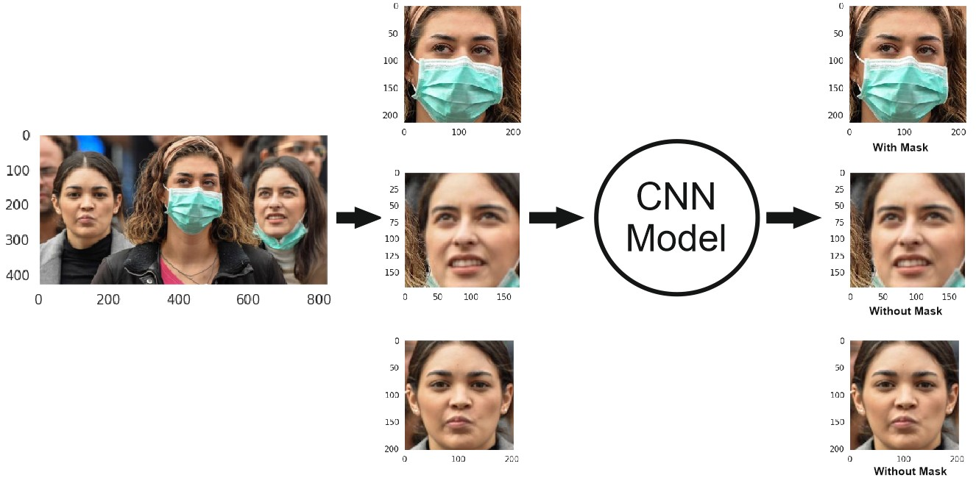
RESULTS
Predicting image after extracting faces using Cascade classifier

Slide 14

CONCLUSION
Our very well in prediction “With Mask” and “Without Mask” faces but
sometimes in the case of “Incorrect Mask”, it gives predictions as “With Mask”.
This is mainly because of the imbalance in the dataset.
This prediction can be improved by adding more images of faces with an Incorrect mask.

Slide 15

REFRENCES
A. Das, M. Wasif Ansari and R. Basak, "Covid-19 Face Mask Detection Using TensorFlow, Keras and OpenCV," 2020 IEEE 17th India Council International Conference (INDICON), 2020, pp. 1-5, doi: 10.1109/INDICON49873.2020.9342585.
Andrewmvd, 2020-05-22, Face Mask Detection, version 1, from https://www.kaggle.com/andrewmvd/face- mask-detection
https://www.superdatascience.com/blogs/the- ultimate-guide-to-convolutional-neural- networks-cnn

Slide 16
THANK YOU

