Slide 1
Automatic segmentation of clothing for the identification of fashion trends using k-means clustering
Prepare by –
VISHAL VASOYA - 202118013 VASHISHTH RAVAL - 202118026
BHUMI BOSAMIA - 20118040 DEVANSHI SHAH - 202118042

Slide 2
Roadmap
Intoduction
Results
1
3
2
4
Methodology
Conclusion

Slide 3
INTRODUCTION
Fashion is a fast-growing industry, Where trends are changing day by day. This project proposes an automatic segmentation method for the clothing identification.
We are using K-means clustering algorithm to identification for image, were identified based on color, texture and shape.

Slide 4
Methodology
1. Importing and describing the data
2. Applying PCA
3. Model Implementation
4. Prediction

Slide 5
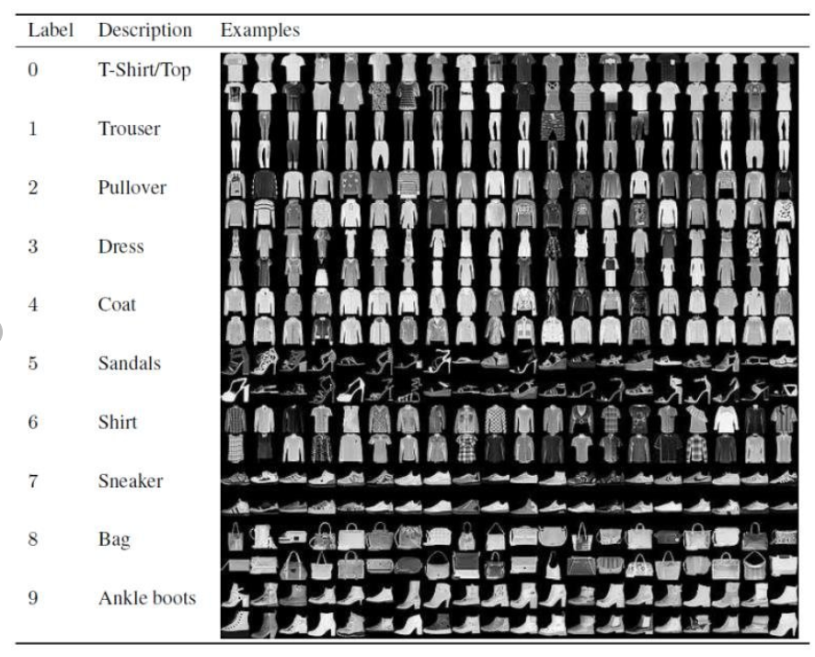
1. Importing and describing the data
We are using fashion mnist dataset. The data set consists of a training set of 60,000 observations and a test set of 10,000 observations.

Slide 6

2. Applying PCA
Principal component analysis is a method used to reduce the number of dimensions in a dataset without losing much information.

Slide 7
3. MODEL IMPLIMENTATION
Elbow method
We use elbow method to find the optimum value of K.

Slide 8
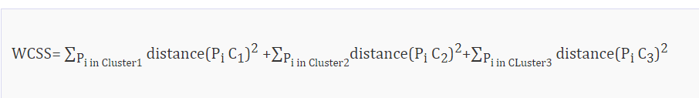
Elbow method
This method uses the concept of WCSS value. WCSS stands for Within Cluster Sum of Squares, which defines the total variations within a cluster. The formula to calculate the value of WCSS (for 3 clusters) is given below:

Slide 9
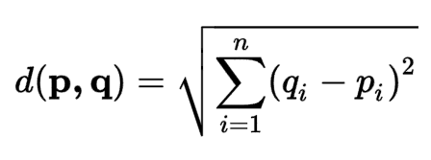
K means clustering
The K-means clustering algorithm basically does two things:
Use an iterative process to determine the best value for the K centroid or centroid by Euclidean distance.
Assign the closest k - center to each data point. Data points near a particular k - center create clusters.

Slide 10
Before and after applying k-means

Slide 11
Results
Models | Accuracy | Precision | Recall | F1 score
K - Means | 0.68 | 0.55 | 0.64 | 0.66
Decision Tree | 0.75 | 0.71 | 0.70 | 0.71
Random Forest | 0.83 | 0.78 | 0.82 | 0.74
CNN | 0.91 | 0.97 | 0.89 | 0.89

Slide 12
Conclusion
Here we can conclude that the K-means model is performing classification based on the image values irrespective from the shape, size or color of the image, which is used in CNN. So we can say that the K-means is not that adequate in image compare to others.

Slide 13
THANKS!

