Slide 1
CI/CD USING GITHUB
Vishala Singa

Slide 2
What is CI/CD
Continuous Integration (CI): The practice of merging all developer working copies to a shared mainline several times a day.
Continuous Deployment (CD): The practice of automatically deploying all code changes to a production environment after passing automated tests.

Slide 3
CI/CD Pipeline Overview
Stages:
Source: Code is pushed to the repository.
Build: Code is compiled and built.
Test: Automated tests are run.
Deploy: Code is deployed to staging or production environments.

Slide 4
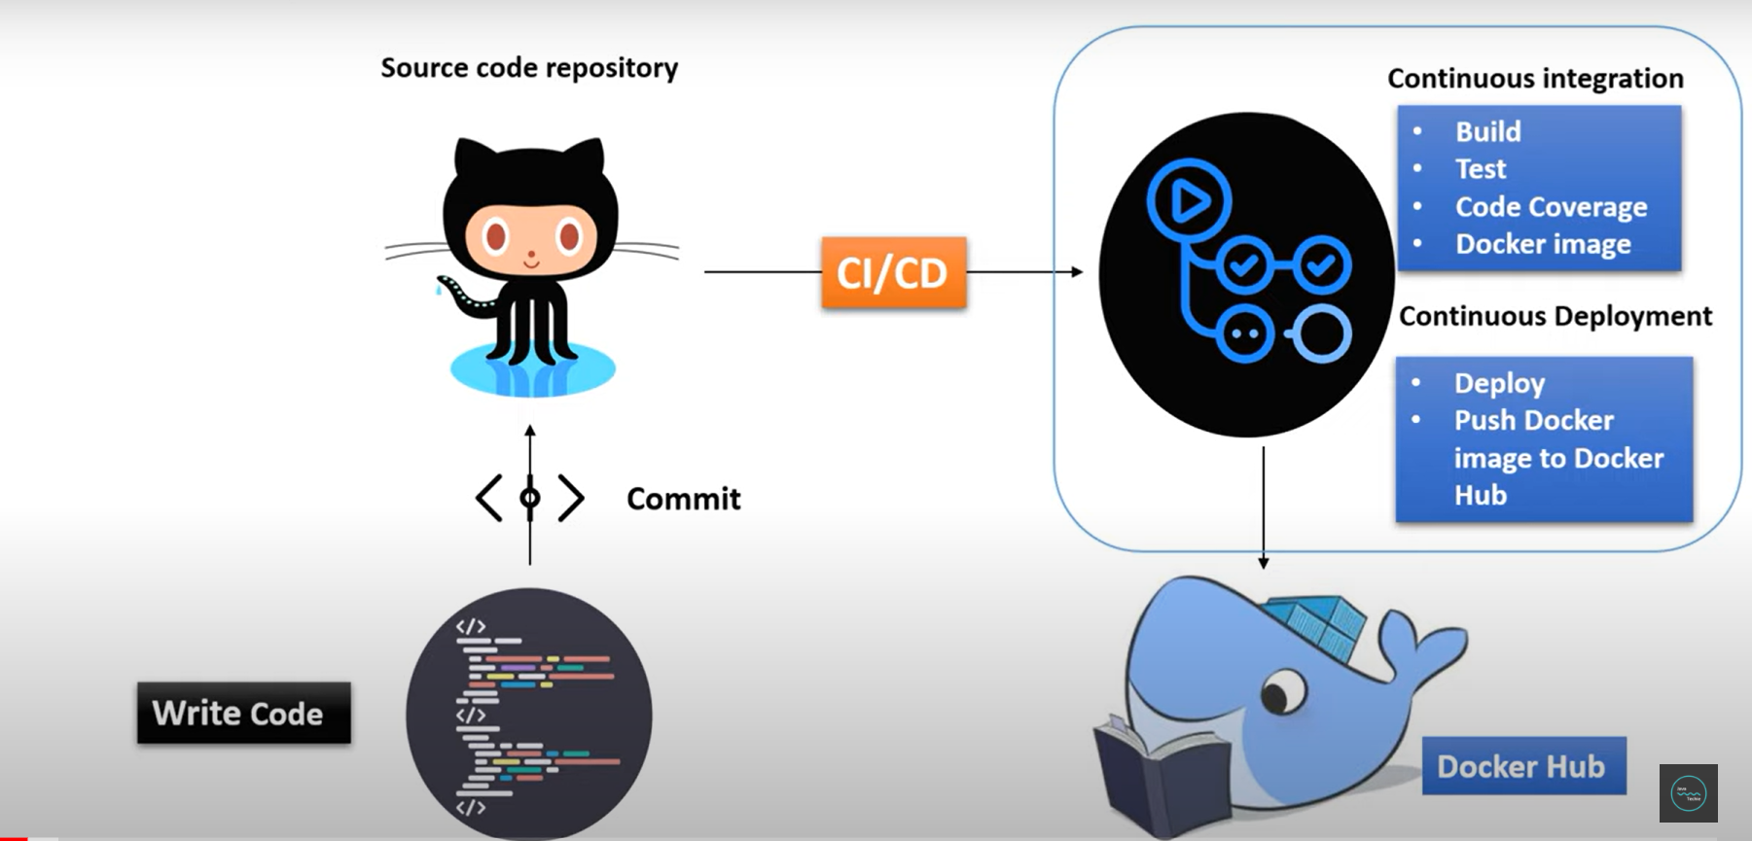

Slide 5

GITHUB ACTIONS
Definition: GitHub Actions is an integrated CI/CD and automation tool within GitHub that enables you to automate workflows directly from your GitHub repository.
Purpose: Automates tasks such as testing, building, and deploying code, and can also handle other tasks like notifications and issue management.

Slide 6
FEATURES OF GITHUB ACTIONS
Integrated Workflows: Seamlessly integrates with GitHub repositories.
Customizable: Define workflows in YAML files (. github/workflows)
Pre-Built Actions: Use or create reusable actions from the GitHub Marketplace.
Event-Driven: Triggers workflows based on GitHub events (e.g., push, pull _ request, schedule)

Slide 7
THANK YOU

