Slide 1
Bank Analysis
MySQL

Slide 2
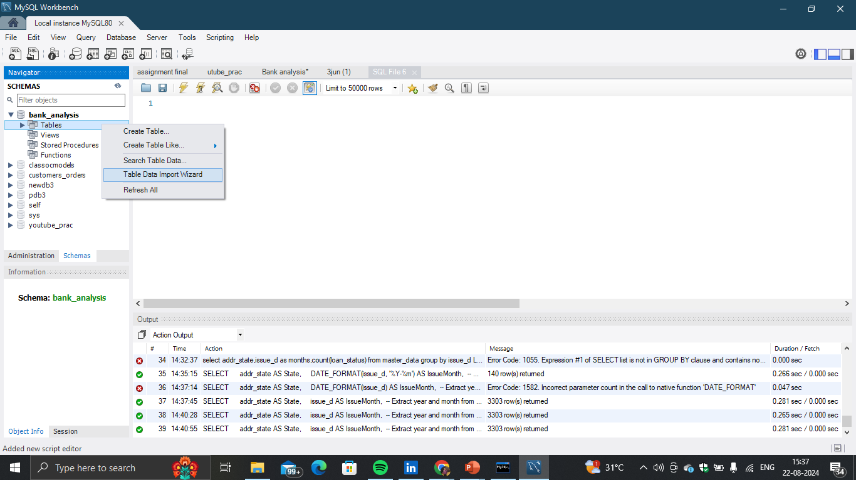
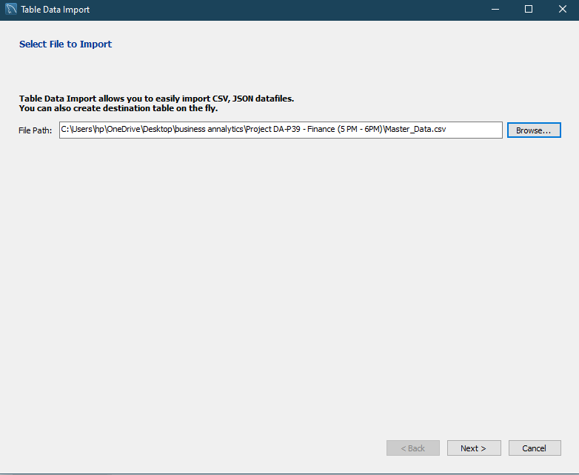
Data Import (csv to MySQL)

Slide 3
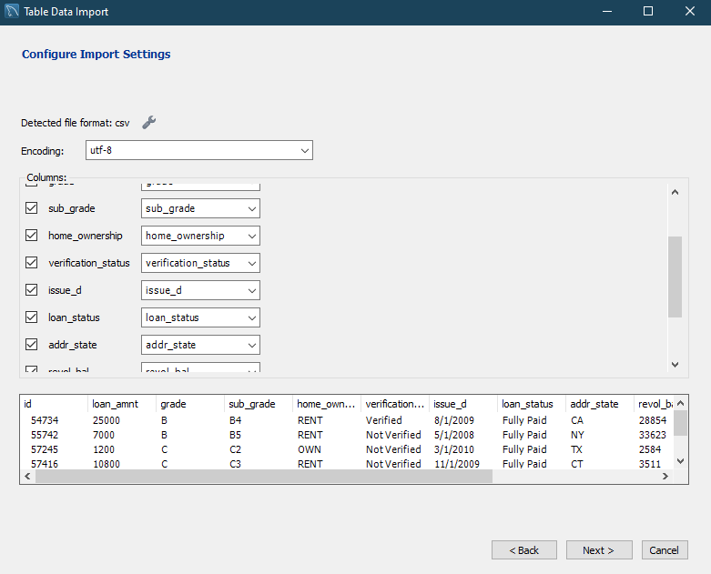
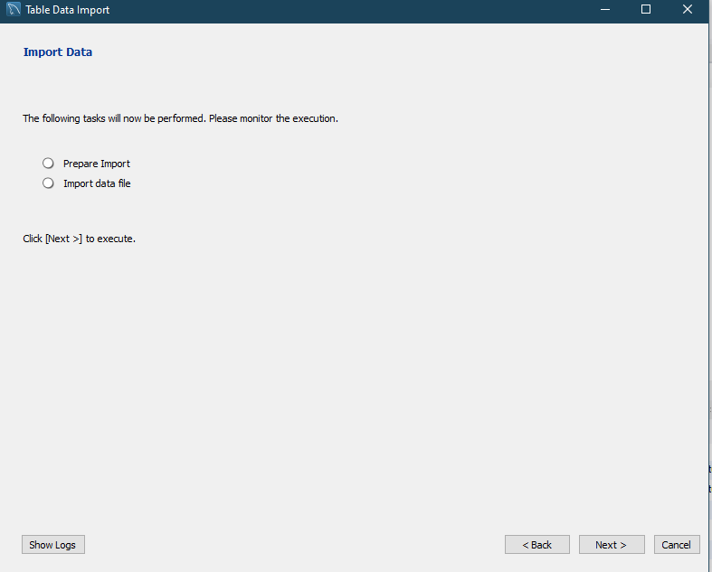

Slide 4
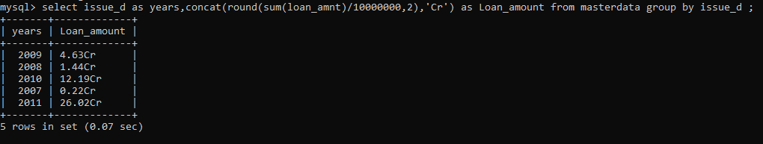
KPI 1:-Year wise loan amount Stats
SYNTAX :- select issue_d as years, concat(round(sum(loan_amnt)/10000000,2),'Cr') as Loan_amount from masterdata group by issue_d ;

Slide 5
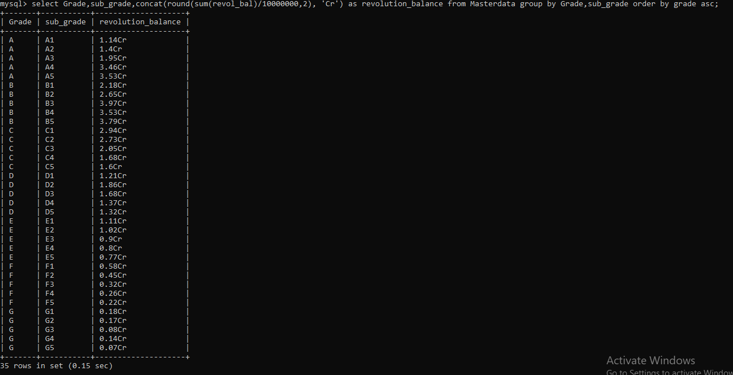
KPI 2 :- Grade and sub grade wise revol_bal
SYNTAX :- select Grade, sub_grade, concat(round(sum(revol_bal)/10000000,2), 'Cr') as revolution_balance from Masterdata group by Grade, sub_grade order by grade asc;

Slide 6
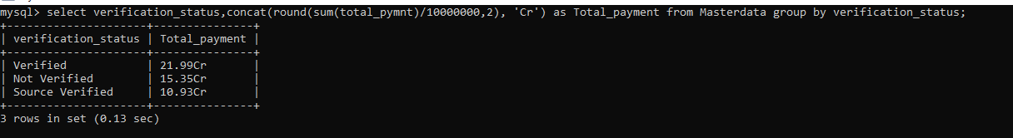
KPI 3 :-Total Payment for Verified Status Vs Total Payment for Non Verified Status
SYNTAX :- select verification_status,round(sum(total_pymnt),2) as Total_payment from Master_data group by verification_status;

Slide 7
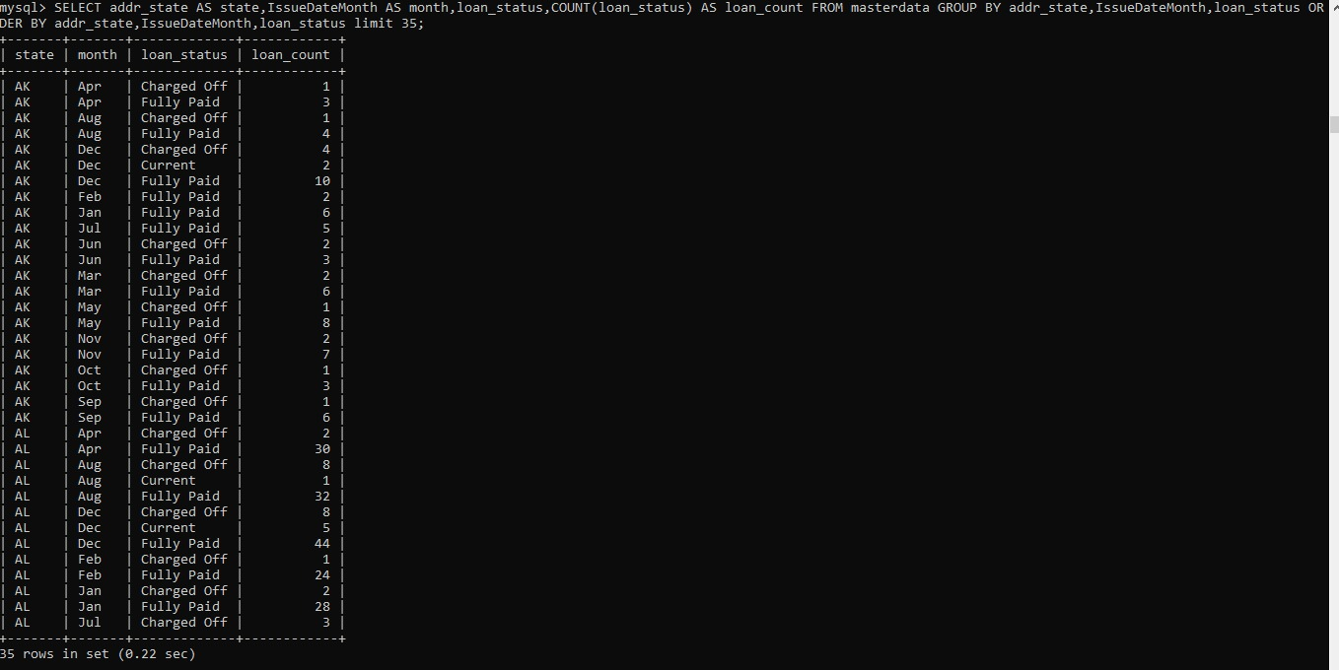
KPI 4 :-State wise and month wise loan status
SYNTAX :- SELECT addr_state AS state,IssueDateMonth AS month,loan_status,COUNT(loan_status) AS loan_count FROM masterdata GROUP BY addr_state,IssueDateMonth,loan_status ORDER BY addr_state,IssueDateMonth,loan_status limit 35;

Slide 8
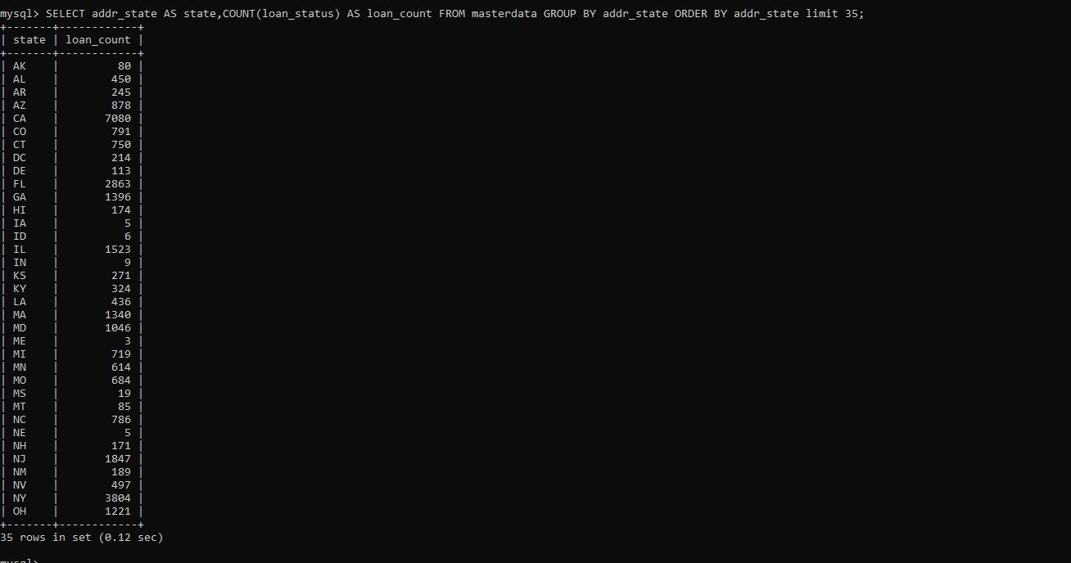
SYNTAX :- SELECT addr_state AS state,COUNT(loan_status) AS loan_count FROM masterdata GROUP BY addr_state ORDER BY addr_state limit 35;

Slide 9
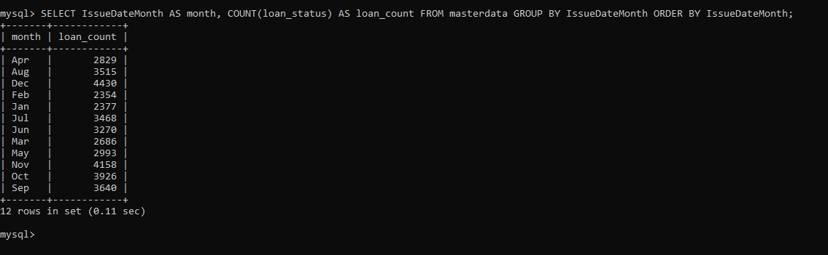
SYNTAX :- SELECT IssueDateMonth AS month, COUNT(loan_status) AS loan_count FROM masterdata GROUP BY IssueDateMonth ORDER BY IssueDateMonth;

Slide 10
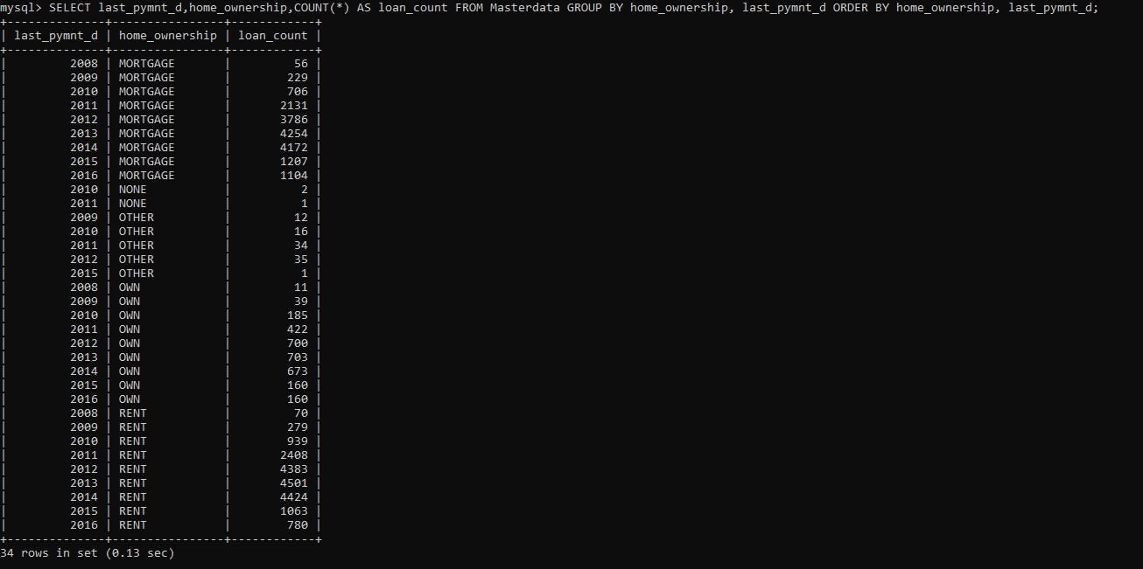
KPI 5 :- Home ownership Vs last payment date stats
SYNTAX :- SELECT last_pymnt_d,home_ownership,COUNT(*) AS loan_count FROM Masterdata GROUP BY home_ownership, last_pymnt_d ORDER BY home_ownership, last_pymnt_d;

Slide 11
THANK YOU

